Slide 1
2013 CPS Energy Workshop
Mladen Kezunovic
Anuradha Annaswamy
Ian Dobson
Santiago Grijalva
Daniel Kirschen
Joydeep Mitra
Le Xie
CPS-PI meeting, Crystal Gateway Marriott, Arlington, November 7-8, 2014

Slide 2
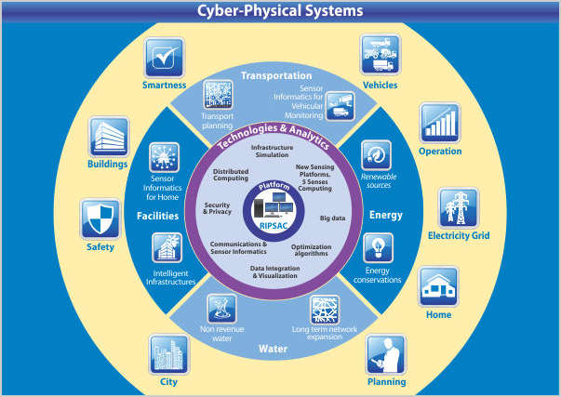
Cyber Physical Systems
CPS Science
A Nexus of the digital and physical worlds
(From www.tcs.com)

Slide 3

Overview
Workshop on Energy Cyber Physical Systems
Dec 16-17, 2013
Goals: Research challenges and opportunities related to Energy Cyber Physical Systems
Over a hundred participants and written contributions
A report prepared by Kezunovic et al.
Waterview Conference Center, Arlington, VA

Slide 4
Overview of the report

Slide 5

The Electricity Grid
Electricity corresponds to 40% of the total energy consumption in the US at present.
(primary focus of the report)
An apt example of an Energy-Cyber Physical System!

Slide 6
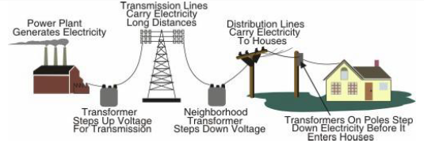
Traditional Electricity Grid
Bulk conventional generation to achieve economies of scale
A model involving generation, transmission, distribution, and the consumer
A “load-following” control paradigm, in which the consumer uses energy at will and the system responds to the consumer demand by producing matching resources.
Just in time operation, with virtually no energy storage
Control and stability established by inertia of large synchronous generators
Centralized investment, planning, operation and control by electric utilities
Electricity markets engage energy producers and providers – not consumers
Utility business model based on revenue according to sales volume
Figure source: Joe Hughes presentation at the NIST Standards Workshop 2006

Slide 7
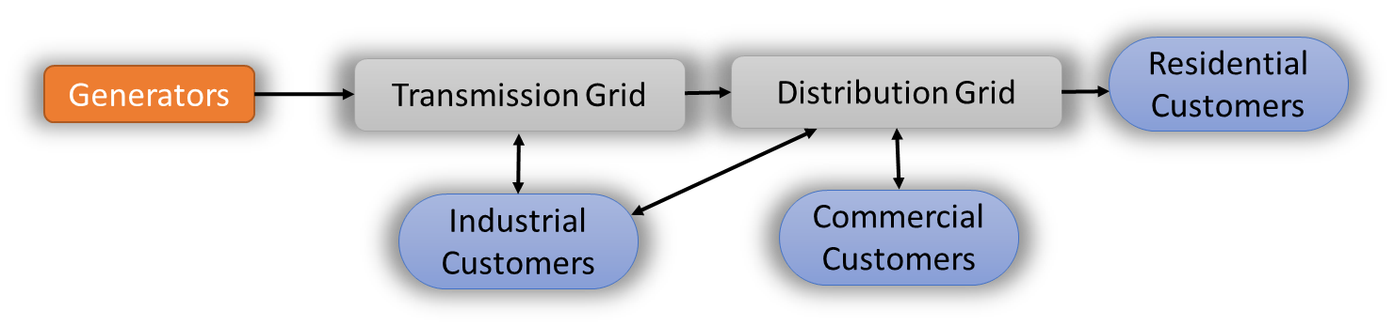


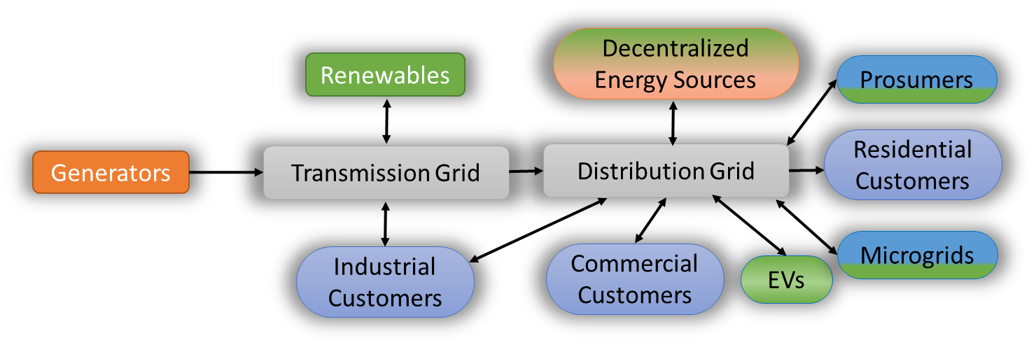
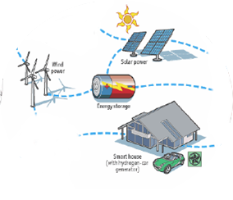
Paradigm Shift: From Current to Smart Grids
Environmental Sustainability
Advanced
Technologies
Fundamental transformation of the planning, control & management of the Energy Cyber Physical System

Slide 8











Implications on Information and Decision-making
Network
Operations
Hierarchical human-administrated design
Generation
Transmission
Industrial
Consumers
Demand Response
Distribution
Smart Meters
Smart Devices
Industrial Consumers
Energy Efficiency
Distribution Consumers
Distribution Consumers
Conventional Grid
Utilities
Network
Operations
Communication links
Generation Facilities
Multi-scale integrative view
Expandable and flexible architecture
Energy providers
DERs
Distributed Community Storage
Microgrid
Distribution
Transmission

Slide 9
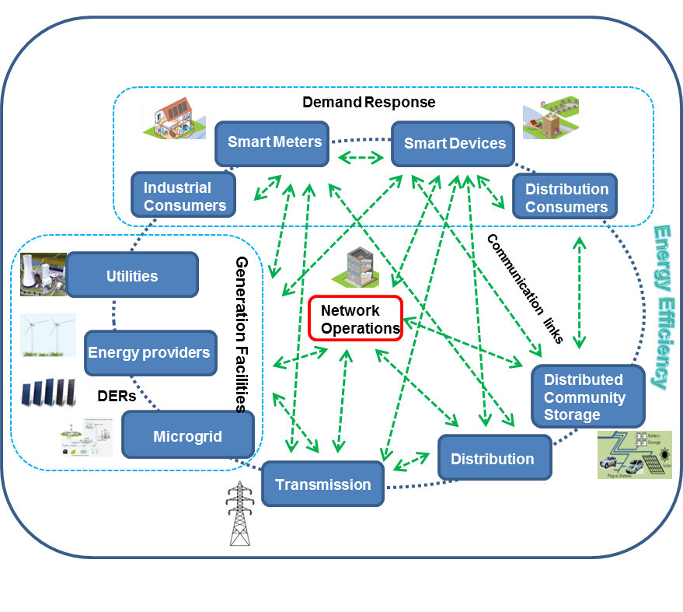
Key Questions
How do we provide incentives for active participation by customers?
How do we integrate flexible markets with cyber-physical energy systems, from retail to wholesale?
How do we design market mechanisms and policies for cyber-secure energy systems?
How do we schedule and control energy exchanges across multiple layers with quantifiable performances?
How do we ensure that the security and privacy of grid operation as complex cyber systems
are introduced at all levels?
How do we standardize the design process to enable plug-and-play in ways that are compatible with the long lifecycles of energy system components?
How do we enhance the operation of the grid
so that it can be operated closer to its stability
margin without compromising reliability?
How do we educate diverse stakeholders
  from technical, policy, economic, business, and public sectors?

Slide 10
E-CPS Architecture: Needs and Requirements
Domain | Trend or Paradigm Change
Sources | From fossil fuel to renewable From bulk centralized to partially distributed Highly variable & cost effective
Information | Can control entire system through software Increased digital control Cyber-security issues Personal information, privacy concerns Available sensing and data
Actors | Consumers can also produce and store Consumers seek their own objectives Massive number of actors and devices Traditional actors have to interact with new actors
Future requirements
Scalability
Reliability and Availability
Robustness
Carbon footprint
Energy Efficiency
Affordable cost
Sustainability
Market flexibility
Resilience
Energy security
Public acceptance
Consumer empowerment

Slide 11
Broad Research Topics
Control and Protection
Resilience
Testbeds
Education

Slide 12
1. Control & Protection
Multi-temporal cross-layer control architecture which includes all decision makers is much needed.

Slide 13
Challenges for Control
Markets:
Improve currently suboptimal DAM and RTM
Redesign reserve scheduling market to better handle high renewable penetration
Better renewable predictions
Introduce dynamic market mechanisms to integrate demand response
Explore retail market mechanisms
Coordination of heterogeneous assets:
Develop modeling framework for various demand profiles
Coordination across legal entities with minimal information exchange
Adaptive solutions for EVs and optimal solutions for distributed generation
Fundamental scientific challenges:
Cross-layer design and analysis
Hierarchical coordination of heterogeneous distributed agents
Interplay between communication and control

Slide 14
2. Challenges for Resilience
Complexity - There are already a gigantic number of cyber-physical failure paths
Methods for Contingency analysis - There is a challenge to integrate measurements, information, algorithms communications and models
Modeling for resilience - Cyber-physical modeling appropriate to study resilience even in the present grid with its physics, controls, protection, information and computing systems is a challenge.
Uncertainties - There are statistical and related challenges in dealing with the uncertainty of attacks, failures, and the subsequent events.
Implementation of resiliency strategies - Feasibility of implementation is a major challenge and constraint. Cost and benefits must be estimated and who pays must be determined.
Broader interdependencies - Resilience strategies must also take into consideration the interdependencies between the ECPS and other infrastructures, such as first-responder (emergency response) systems and mass-communication media (for broadcasting emergency information to the population).

Slide 15
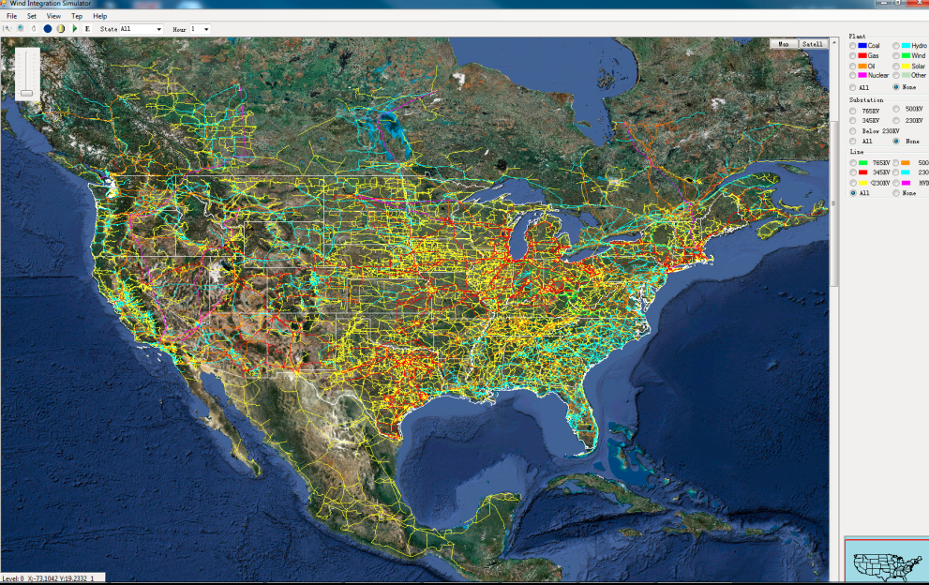
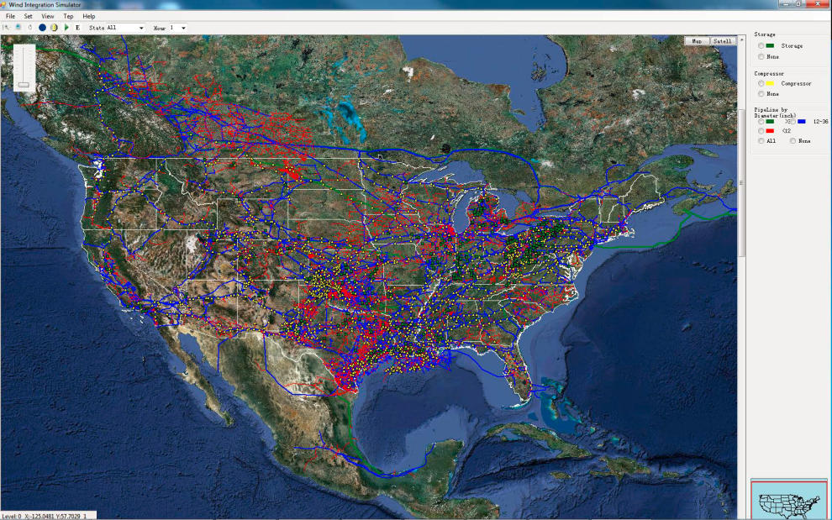
Resilience in E-CPS
Electricity and gas infrastructure example
Electricity Network
Gas Network
Coordination
Necessary actions to improve resiliency:
Develop computational models
Gain analytical insight
Increase coordination
Propose guidelines
Figure source: M. Shahidehpour, Z. Li, “Long‐term Electric and Natural Gas Infrastructure Planning Requirements”, Presentation of the white paper submitted to NARUC, October 2014

Slide 16
3. Performance Validation: Testbeds
Key questions:
What criteria should be used to assess the performance of energy CPS?
What resources do we need to develop to assess the performance of energy CPS before deployment?
Technical
Risk
Cost
Interrelated performance criteria
Key actions:
Modeling and simulation for performance assessment
Test cases and validation with real-world data
Large scale testbeds to set the realistic performance criteria for fundamental research, as well as for practical implications

Slide 17
Challenges
Models and simulations:
Ensure the scalability of the simulations
Develop tools that can model simultaneously the cyber and physical domains
Determine the model detail needed for the purpose of each tool
Enhance the ability of simulation tools to model and operate at multiple timescales
Enhance simulation and optimization techniques that model the stochastic nature of physical systems, computing systems, and communication systems
Develop techniques for optimizing the balance between the technical, risk and cost criteria
Testbeds:
Should be designed to capture
temporal multi-scale in control and operations
synchronization
data management and information architectures for Energy CPS
aspects of system composability given CPS heterogeneity
aspects of “openness” and future-proof features of energy CPS designs
rare events in the CPS system
relevance and application of open architectures and open source systems
Large scale testbeds may be the only way to deal with E-CPS challenges

Slide 18
4. Energy CPS: Education
ECPS education needs to be boosted to allow future generation of scientists, engineers and other related professions to develop
Communication technology:
  Components need to be connected, both talk and listen
Sensing and actuation:
  Support faster and accurate response for monitoring, demand-side management (ex. TOU pricing)
Control
  Monitor, diagnose, and implement solutions/decisions at the right time-scales and locations
Enabling technologies
  Storage, power-electronics, superconductivity, etc.
Human/operator interface

Slide 19
Energy CPS: Training and Dissemination
Academia, industry, government, and consumers – all need to be educated
Development and deployment of E-CPS require technical education (of engineers and students) and awareness building (for policy makers and consumers)
Curriculum Development
Power system concepts (circuit theory, energy conversion, control, protection)
Sensors, communication, computing, networks, cyber-security, markets
Training and certification in both traditional power systems and emerging topics such as cyber-security are essential
Role of testbeds is a highly compelling one in education and training as well.

Slide 20
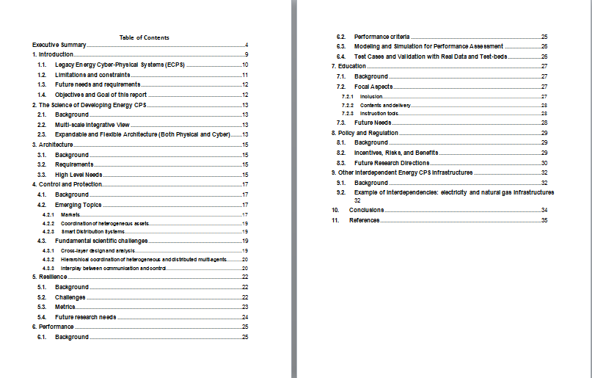
A Snapshot of the Report

