Slide 1


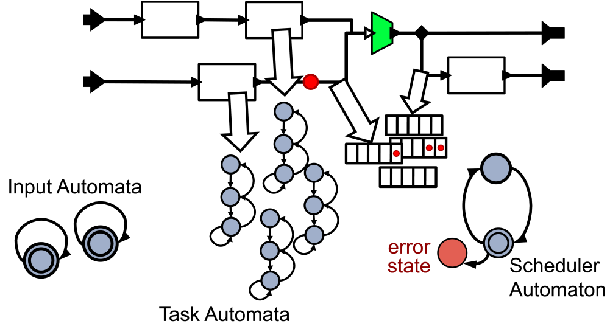
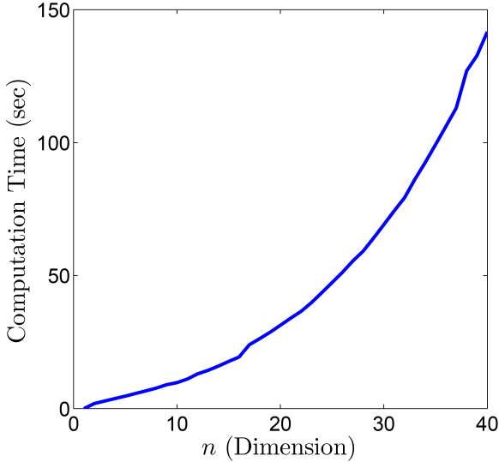
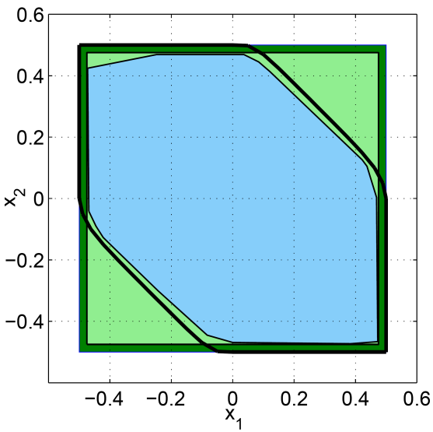
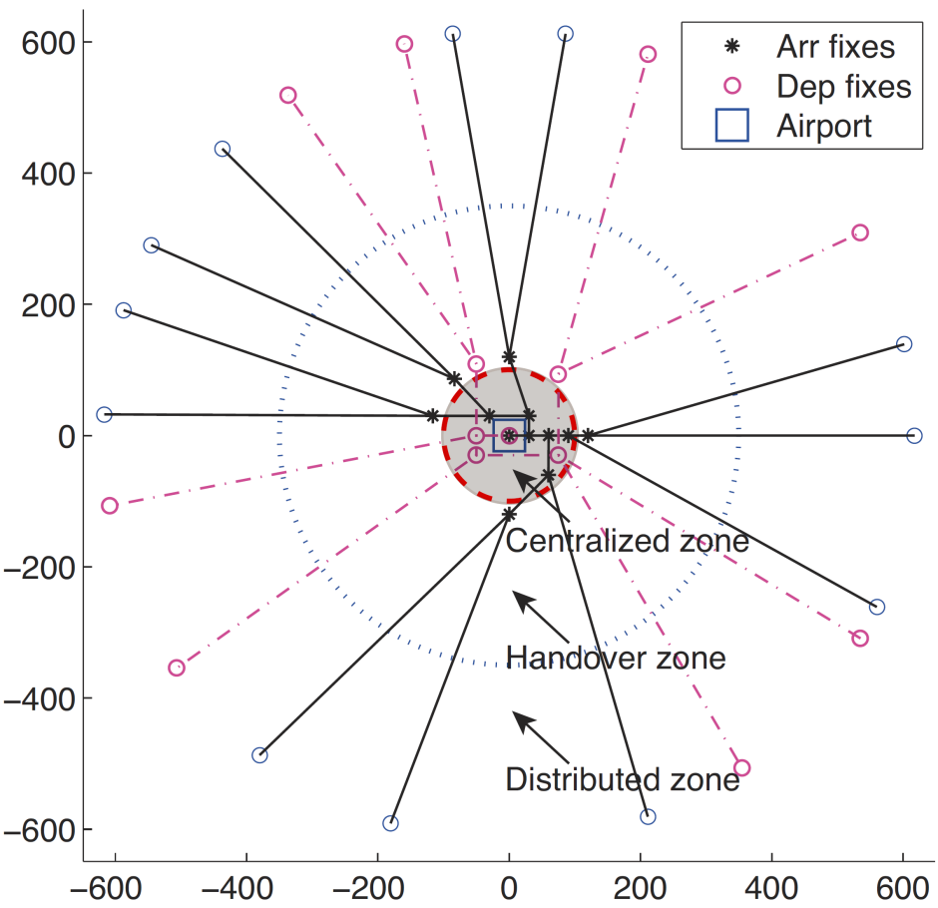
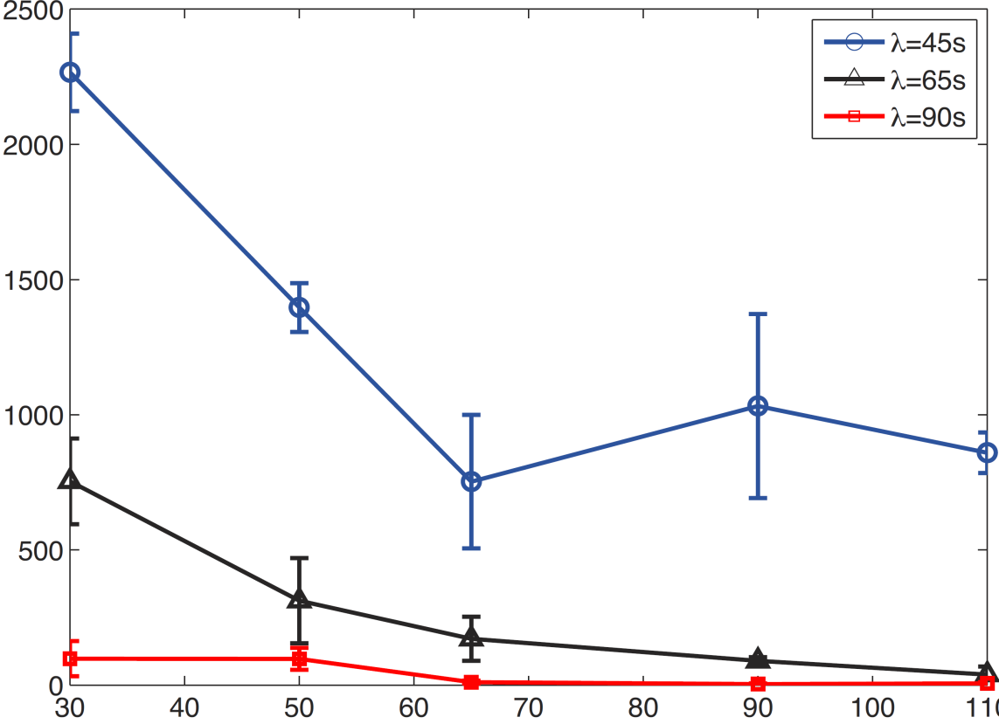
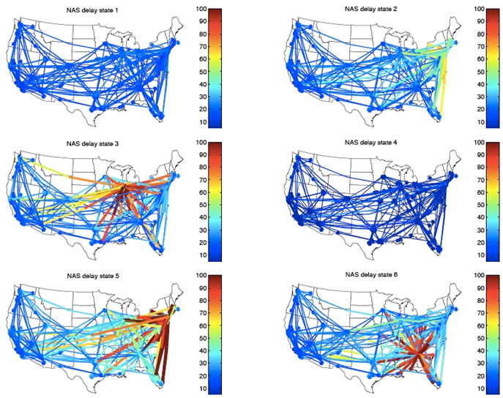
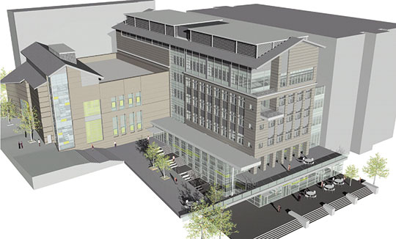
#CNS-0931843
Hybrid and Embedded Systems
Blending physics-based models with data
Model of computation for distributed heterogeneous services
Programming temporally integrated distributed systems
Timed automata analysis proves schedulability is decidable [1] (left)
Scalable computation of safety certificates for constrained sampled-data cyber-physical systems (right)
Tasking Sensors
Energy Efficient Air Transportation Systems
Development of Simple Monitoring and Action Protocol (sMAP)
Reachability-based method for tasking sensors
Estimating time-varying sensor reception
Sensor scheduling and placement
NextGen Air Transportation as Sensing and ActionWeb of Aircraft [4]
Novel framework for managing arrivals using a hybrid centralized-distributed algorithm for communication and control
Significantly improves performance under various operating conditions
Closing the Loop
Robust model predictive control (MPC) with learning in the loop [2]
Stochastic hybrid systems beyond certainty equivalence
Optimization of hybrid systems
Timing and event-driven computation
Terminal Radar Approach and Control (TRACON) modeled upon LAX
arrivals and departures, along with the comm./control protocols in each “zone”.
Average rate of generation of holding patterns in the TRACON vs. radius of centralized control and incoming traffic arrival rate.
ATS
Building Control
Contract Design for Frequency Regulation by Building Aggregations
Airport Surface Congestion Modeling and Control [5]
Renewable energy sources increase supply uncertainty
Flexibility in buildings can be pooled by aggregator to provide Ancillary Services to the electricity grid
Contract theory:
Incentives necessary for buildings to participate
Optimal contract obtained from solution of a bi-level optimization problem
New queuing network model learned from operational data
Based on the transient analysis of D(t)/E_{k}(t)/1 queues
Model validated for several airports (Boston, Newark, Philadelphia, LaGuardia,…)
Dynamic programming formulation with runway throughput and congestion level as objectives
Account for variability in taxi travel times and departure runway throughput
Optimal control policy designed, field-tested and evaluated at BOS
Predictions of departure throughput, avg. taxi-out times and departure queue lengths over a 13-hour period in December 2010
Air Traffic Network Delay Prediction [6]
Implementation on Sutardja Dai Hall
New model based on Random Forest algorithms incorporates temporal and network delay states
Identification of “typical delay states” for the National Airspace System using clustering (right)
Classification and regression performance evaluated using 2007-08 data for 100 most-delayed links
Avg. link delay prediction error 2-6 hours ahead: 20-24 min
Control of Heating, Ventilation, and Air Conditioning
Realistic testbed for providing frequency regulation while ensuring comfort
Grey-box model based on first principles and large data set collected through sMAP
Determination of the building’s flexibility and associated costs
E. Matsikoudis, C. Stergiou, E. A. Lee, "On the schedulability of real-time discrete-event systems," in Proc. 13th International Conference on Embedded Software (EMSOFT), September, 2013.
A. Aswani, H. Gonzalez, S. Sastry, and C. Tomlin, "Provably safe and robust learning-based model predictive control," Automatica, vol. 49, no. 5, 2013.
M. Balandat, F. Oldewurtel, M. Chen and C. Tomlin, “Contract Design for Frequency Regulation by Aggregations of Commercial Buildings,” in 52nd Annual Allerton Conference on Communication, Control, and Computing (Allerton), 2014.
P. Park, H. Khadilkar, H. Balakrishnan, and C. Tomlin, "Hybrid communication protocols and control algorithms for NextGen aircraft arrivals,” IEEE Transactions on Intelligent Transportation Systems, April 2014.
I. Simaiakis and H. Balakrishnan, ” Probabilistic Modeling of Runway Inter-departure Times,” AIAA Journal of Guidance, Control and Dynamics, December 2014.
J. J. Rebollo and H. Balakrishnan, “Characterization and Prediction of Air Traffic Delays,” Transportation Research Part C: Emerging Technologies, July 2014.
Claire Tomlin
David Culler
Edward A. Lee
S. Shankar Sastry
Hamsa Balakrishnan

