Slide 1
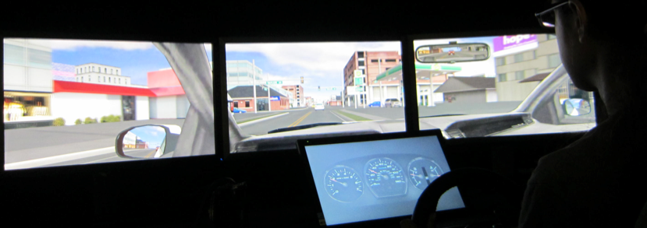
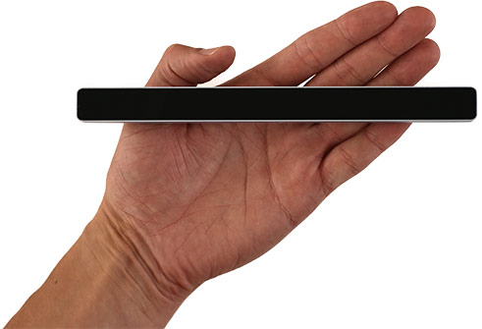
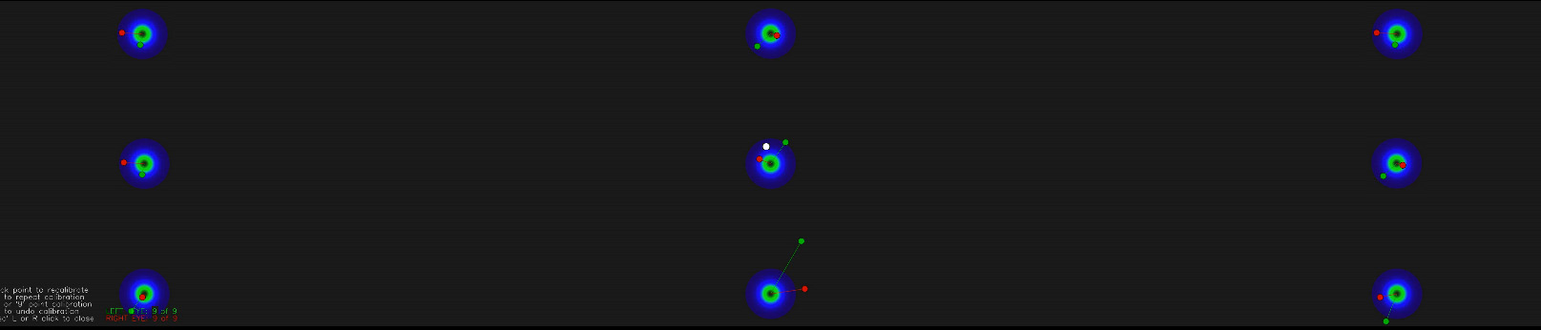
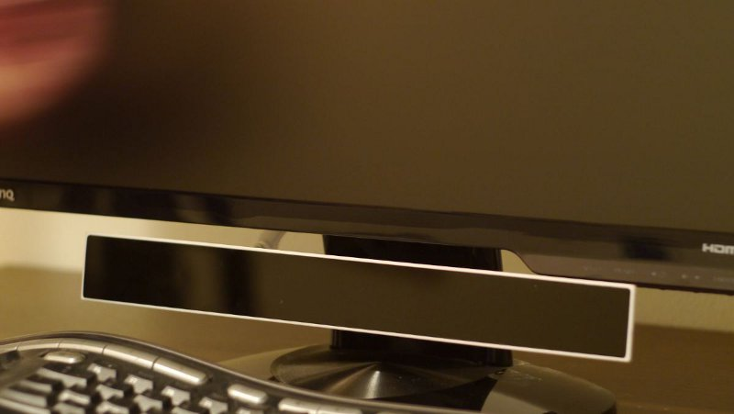
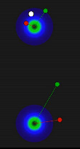
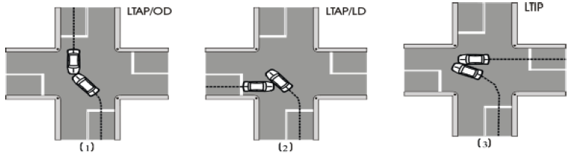
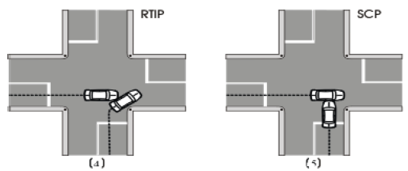
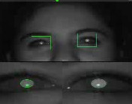
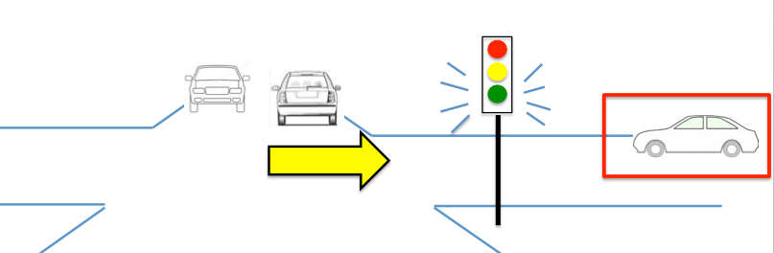
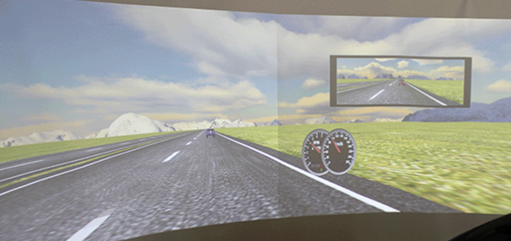
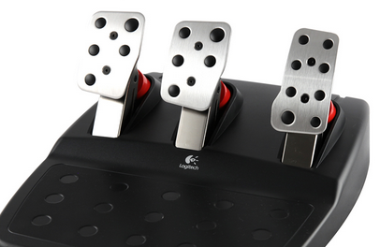
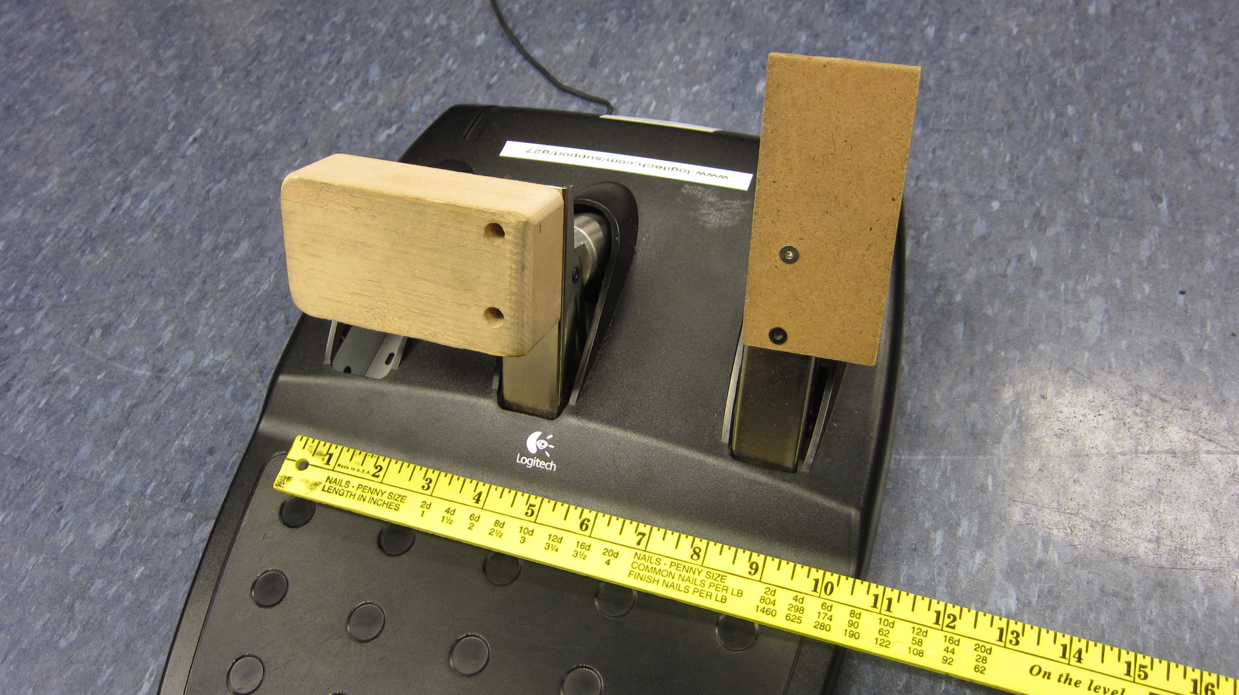
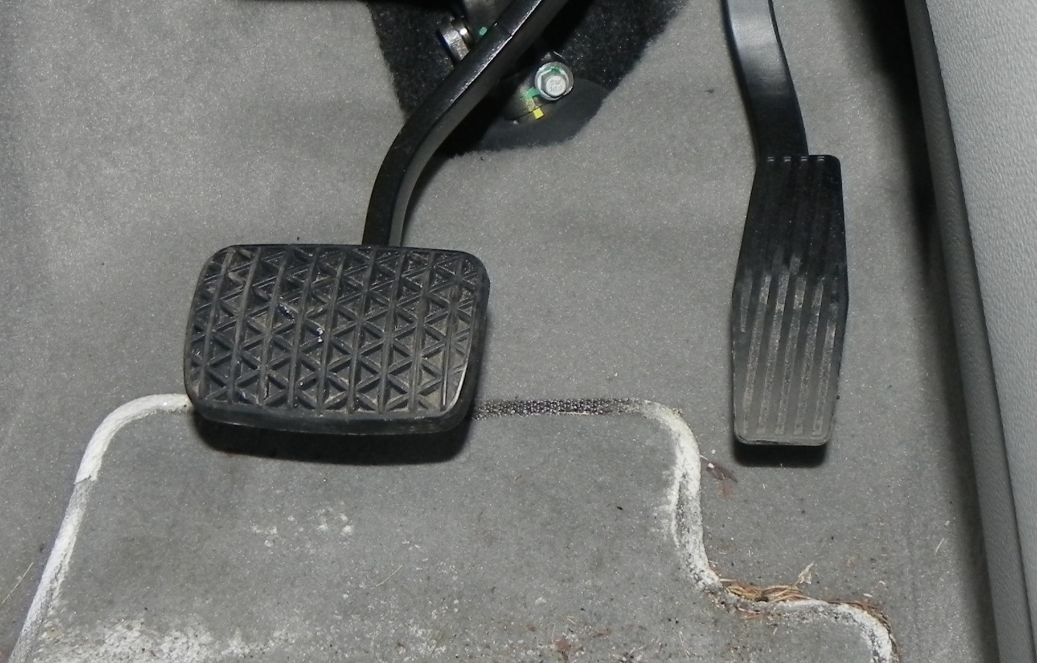
Advances in Driving Research: Models, Data, and New Methods
CPS Synergy: Collaborative Research:
Formal Design of Semi-autonomous
Cyber Physical Transportation Systems
PI: Domitilla Del Vecchio (MIT)
Co-PIs: Paul Green ( U. of Michigan),
Emilio Frazzoli (MIT)
NSF award 1239182
Paul Green, Heejin Jeong, Brian Lin, Te-Ping Kang – U. of Michigan (www.umich.edu/~driving)
Models and Data on Driving Through Intersections
New Methods
Until now, there were no agreed upon definitions for most driving performance measures and statistics, so studies were often not replicable. SAE Recommended Practice J2944, with which journals & conferences will require compliance,
(or papers will be rejected) defines them.
For most terms, there is a base concept (e.g., Time to Collision)
and multiple variations (Minumum, Adjusted Minimum, Inverse, etc.)
Some examples and the number of variations of the term include:
Response Time (15)
Time to Collision (2)
Lateral Lane Position (3)
Std Dev. of Lane Position (3)
Yes, there really are 11 ways to define a lane departure.
How should driver decision making at intersections be modeled?
How do the traffic signal phase (green, yellow, red), the time from
an intersection when the signal changes, what other vehicles are doing (turning), driver age and gender, and other factors affect driving through intersections?
-> Examine: speed, acceleration, jerk, and throttle histories
In 2 experiments so far (24 subjects/experiment), subjects drove through 2 sets
of 70 intersections following a lead vehicle (and being followed). At each intersection, the signal was either green, yellow (3 time options), or red. For
the yellow signals, vehicles at the intersection could be (1) stationary,
(2) intrude into the intersection, or (3) turn in front of them unexpectedly
as shown in the figure below. In experiment 2, augmented reality warnings
were provided.
Lane Departure (11)
Time to Line Crossing (3)
Lane Change (5)
Roadway Departure (3)
2. Very low-cost eye-fixation systems (1 - 10% price of lab system) can be good enough.
Gazepoint ($500 w/ SDK)
Accuracy: 1 deg claimed
(actually better than Eyetribe)
45 to 75 cm depth
real time visualization
preferred over Eyetribe
9 point,
3 screen
calibration
Eyetribe ($100 w/ SDK)
Accuracy: 1 deg claimed
+/- 15 cm depth
But doing good research also requires knowing how to use the equipment.
How can augmented reality
be used to present warnings?
3. For educational and demonstration purposes, a free, open source driving simulator (OpenDS) + specially modified (ask how) Logitech G27 driving game unit ($250)
can be used instead of research simulators.
3 systems @ AutoUI workshop
Keeping simulator hardware at the library
as “reserve books” students can borrow overcomes many problems and supports class use.
Cost is no longer a barrier for the “have nots” wanting to do simulator research
original
G27
Extensive data have been collected . See the Del Vecchio: MIT poster.
Teasers are below.
real vehicle:
2013 Buick
Encore
modified G27
4. Having the following vehicle honk when the subject drives too slowly leads to more realistic speeds.
For realistic behavior, one needs rules for starting, maintaining speed, and approaching intersections. What else would you suggest matters?
Notes:
9 pt
3 screen
calibration

