Slide 1


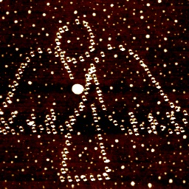
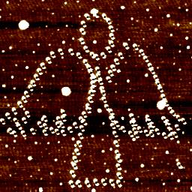
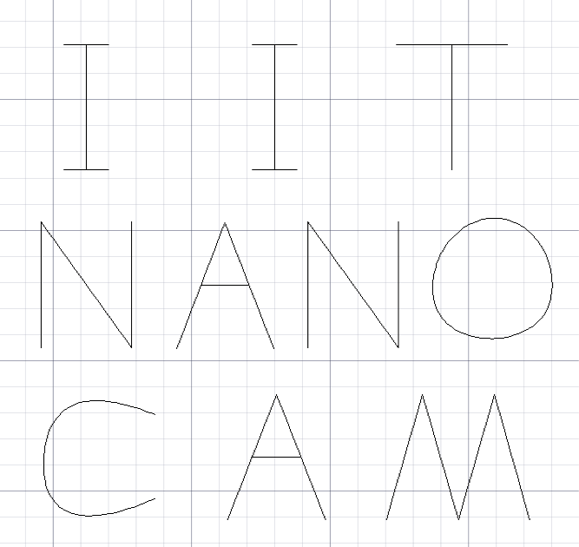
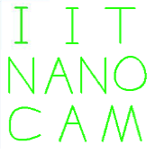
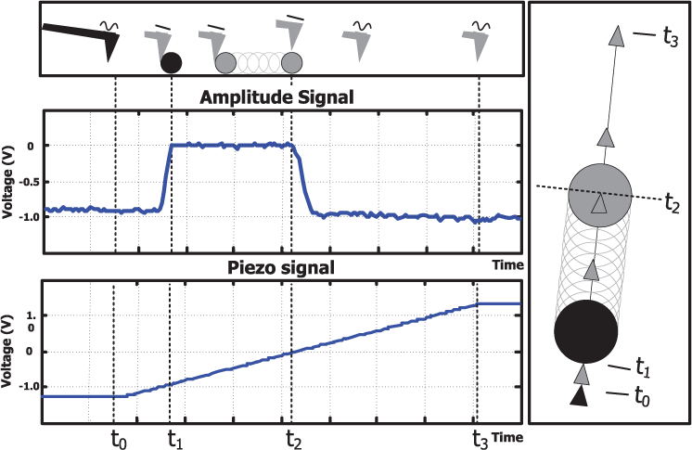
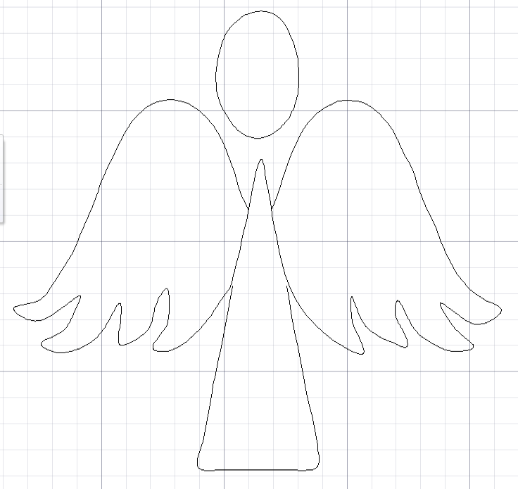

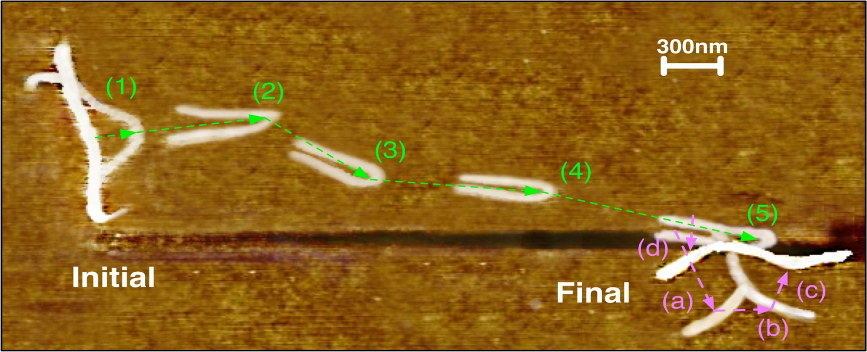
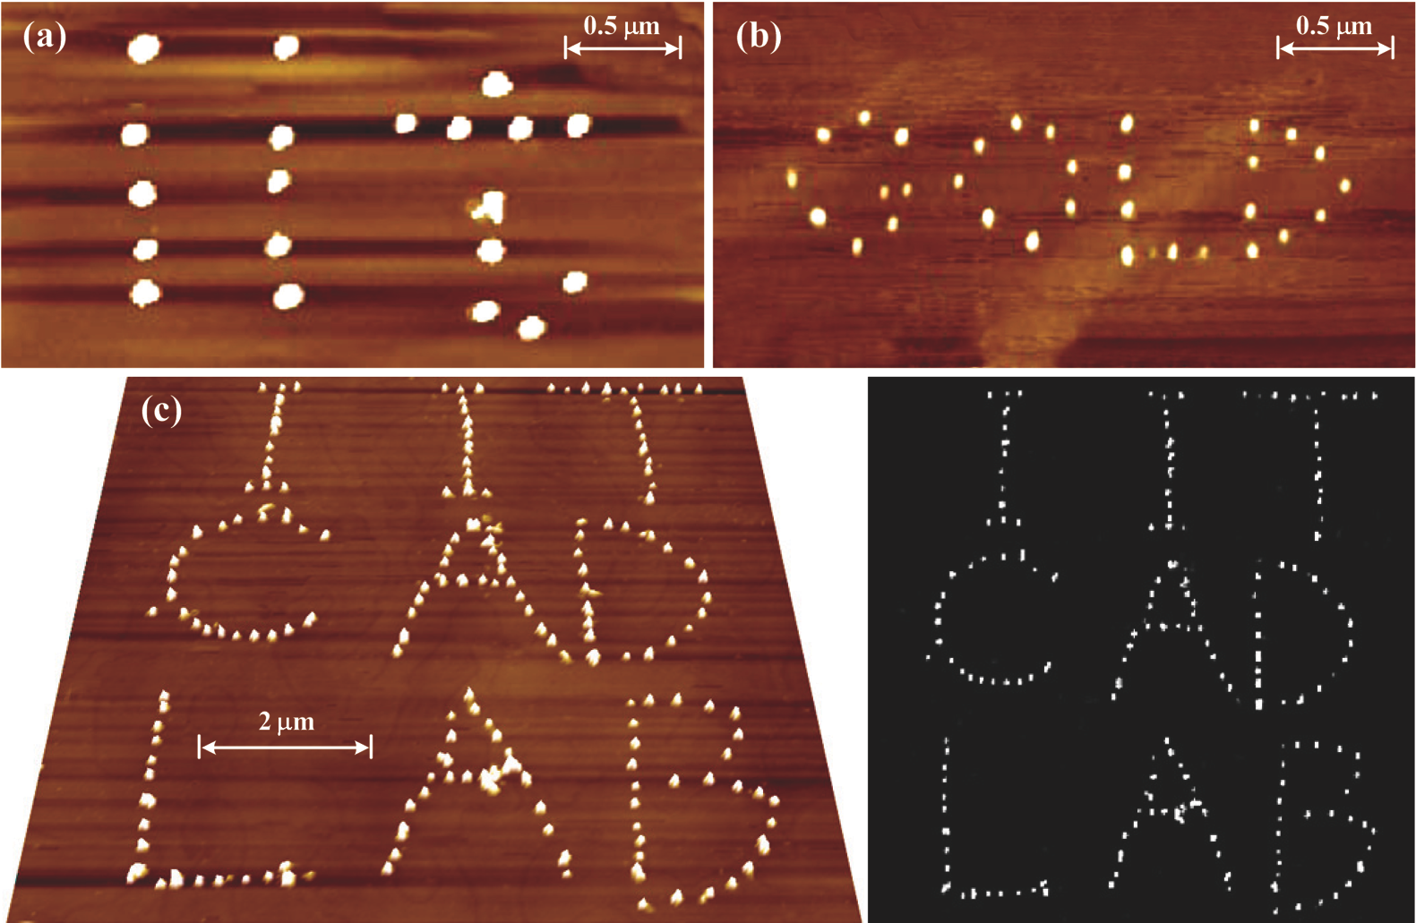
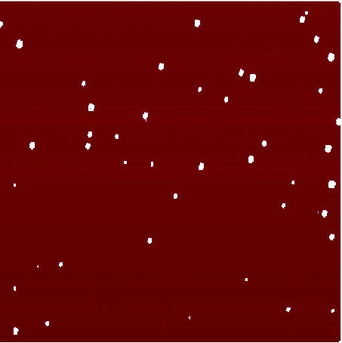
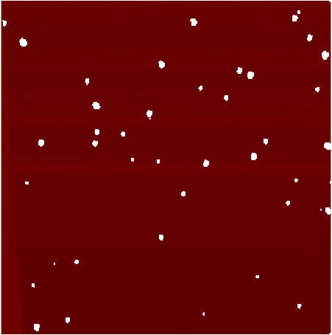

Automated and Robust Nano-Assembly with Atomic Force Microscopes
Xiaoping Qian¹ and Guangyong Li²
Kangmin Xu¹, Seung-Cheol Yang¹ Quan Tao²
¹ Department of Mechanical, Materials & Aerospace Engineering, Illinois Institute of Technology, Chicago, IL 60616
² Department of Electrical & Computer Engineering, University of Pittsburgh, Pittsburgh, PA 15261
Introduction
CAD Guided Nanolithography
Inverse modeling the dynamic behavior of piezoelectric actuator
Objective
The objective of this research is to develop an atomic force microscope (AFM) based cyber-physical system that can enable automated, robust and efficient assembly of nanoscale components such as nanoparticles, carbon nanotubes, nanowires and DNAs into nanodevices.
Goals
Developing an AFM based cyber-physical system through foundational theories and algorithmic infrastructures:
Automated particle manipulation algorithm - Efficient and automated nanoparticle manipulation using minimum local scan lines
Automated nanolithography system – Robust AFM based nanolithography that integrates nanoindentation with CAD geometry processing for fabricating complex patterns
Spatial uncertainty compensation – Compensating thermal drift using local scanning and dynamic behaviors of AFM piezoelectric scanner
Experimental/simulation studies for manipulation of the position and shape of nanowires
Point-based lithography
Compensating nonlinear dynamic behaviors of creep and hysteresis.
Infinite Impulse Response (IIR) model is designed with nano-indentation
Extending nanoindentation into a lithographic process for producing complex geometric features
Consistent removal rate without any directional restrictions during the process
(a) (b)
G(t)
Ĝ⁻¹(t)
System model by IIR filter
Inverse discrete state space
CAD integrated process planning
Before compensation
in 5 µm x 5 µm image
After compensation
in 5 µm x 5 µm image
Manipulation of the Position and Shape of Nanowires
Simulation Study on the Motion of Nanowires Assembled by Dielectricphoretic Force
Translational and Rotational Motion of Nanowires
- Dividing the nanowire to a series of small cylinders uniformly.
- Evaluating the drag force and drag torque with respect to the velocity and angular velocity
Automated Nanoparticle Manipulation
Nanoparticle assembly
Simulation on Trajectories of Nanowires
- A pair of sharp electrodes with a gap of 5 µm
- A single nanowire with 10 µm and radius 30 nm
Automatic formation of designed patterns of nanoscale objects is of fundamental importance in nanotechnology. The development of a robust manipulation method is a key step to achieve the goal.
Complex patterns fabrication
Pattern | “IITNANOCAM” | Angel
Workspace (μm x μm) | 5 x 5 | 5 x 5
Number of Indentation points | 1134 | 1058
Average Depth (nm) | 17.8 | 18.9
Interval (nm) | 27 | 27
Time spent (s) | 758 | 656
Sequential Parallel Pushing
Partial Localization
Experimental study for tip based CNT manipulation
AFM based mechanical manipulation of CNTs in the tapping mode
- The tip approaches the substrate until the deflection signal reaches the threshold value.
- During the manipulation process, AFM feedback system and the dither piezo that oscillates the cantilever are off.
2
Resolving Spatial Uncertainty
[(1) ~ (5)] Pushing a CNT at the center point and the center point
[(a) ~ (d)] unbending with a series of manipulation
Local scan to measure thermal drift
Representing the location of a nano-particle with its center and radius (R).
Updating the location with minimum of two scanning lines (Line L2 and V)
Conclusion
Strategic local scanning for drift compensation
- Dividing an AFM image into several parts along vertical direction.
- Performing a quick local scan in each part of the image to measure the drift value
- The drift value is calculated in a small local area instead of the global image
A new automated method for nanoparticle manipulation has been successfully developed through the tip based pushing.
An automated and robust nanolithography method has been developed with integration of CAD geometry processing and nano indentation.
A local scan method for thermal drift compensation has been developed to acquire drift free AFM image.
Mechanical/dielectrophoretic manipulation to align nanowires have been developed toward automated nanowire manipulation
Experimental Result
Pattern | “iit” | “GOLD” | “IIT CAD LAB”
Workspace (μm x μm) | 4 x 4 | 2.8 x 2.8 | 10 x 10
Particle type | Latex | Gold | Latex
Particle diameter(nm) | 50 | 10 | 50
Number of particles | 20 | 33 | 170
Time spent (hours) | 8 | 14 | 40
Acknowledgment
(a) before drift compensation
(b) After drift compensation
This research is sponsored by NSF CNS-1035844
and NSF CNS-1035563.
(Latex particles with a diameter of 50 nm in 20um×20um image)

