Slide 1

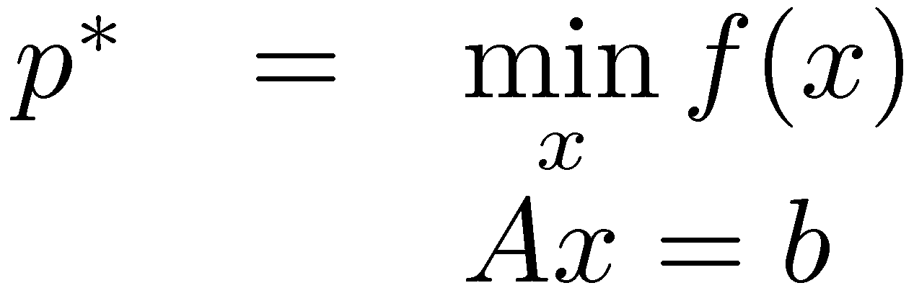
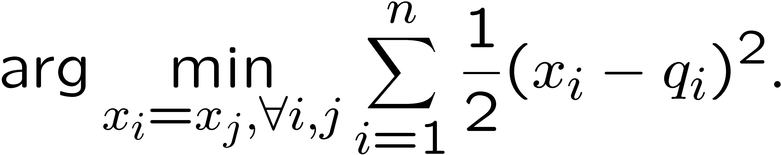
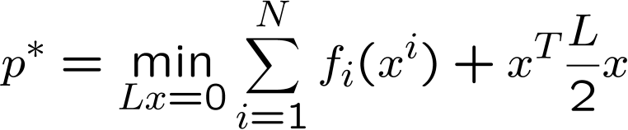
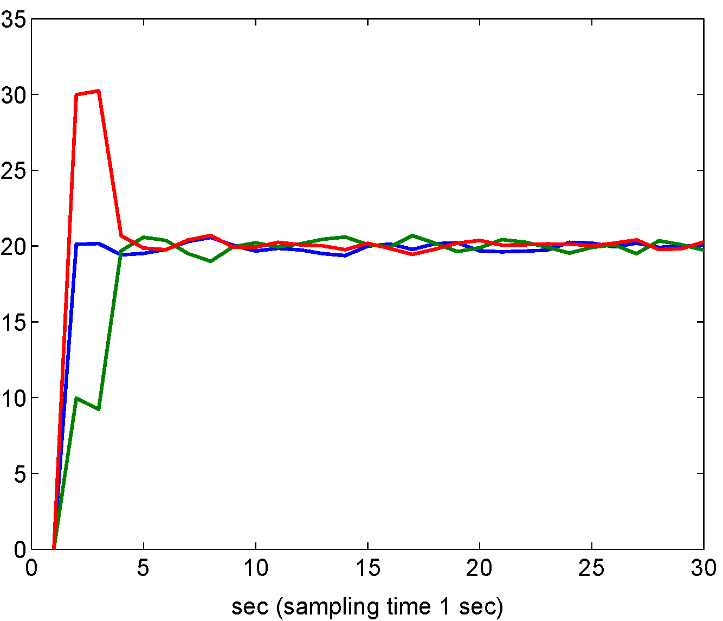
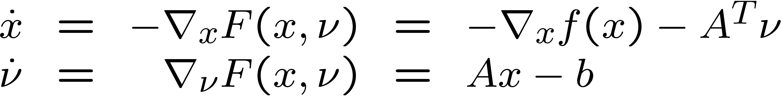
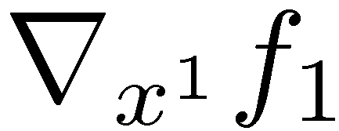
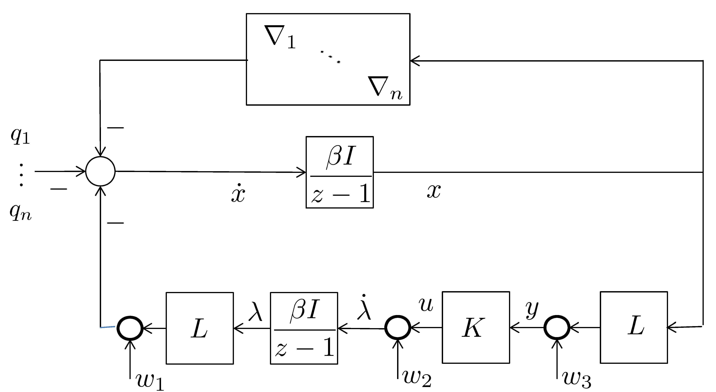
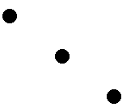
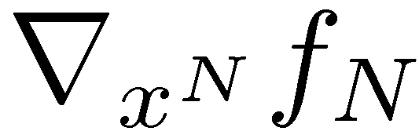
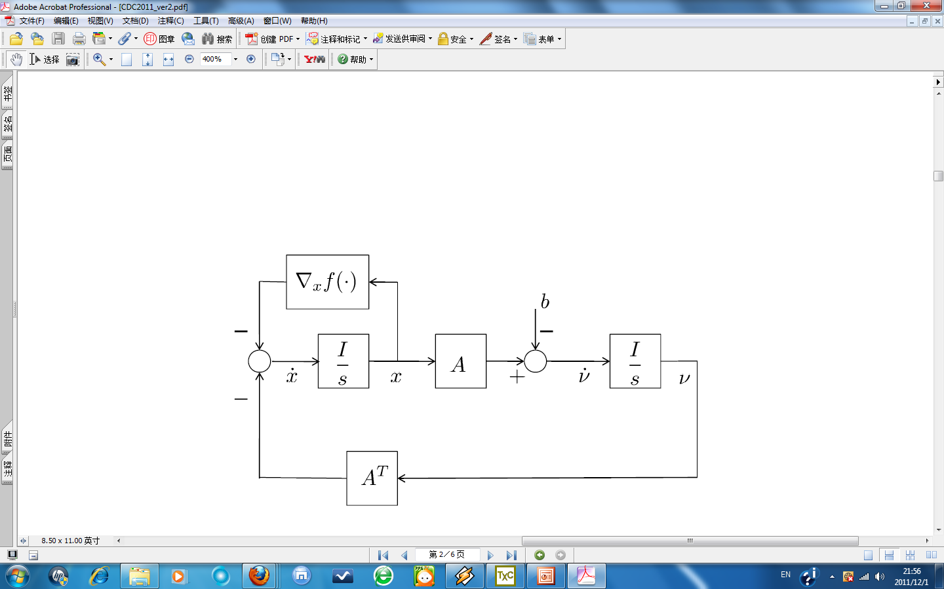
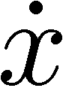


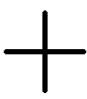



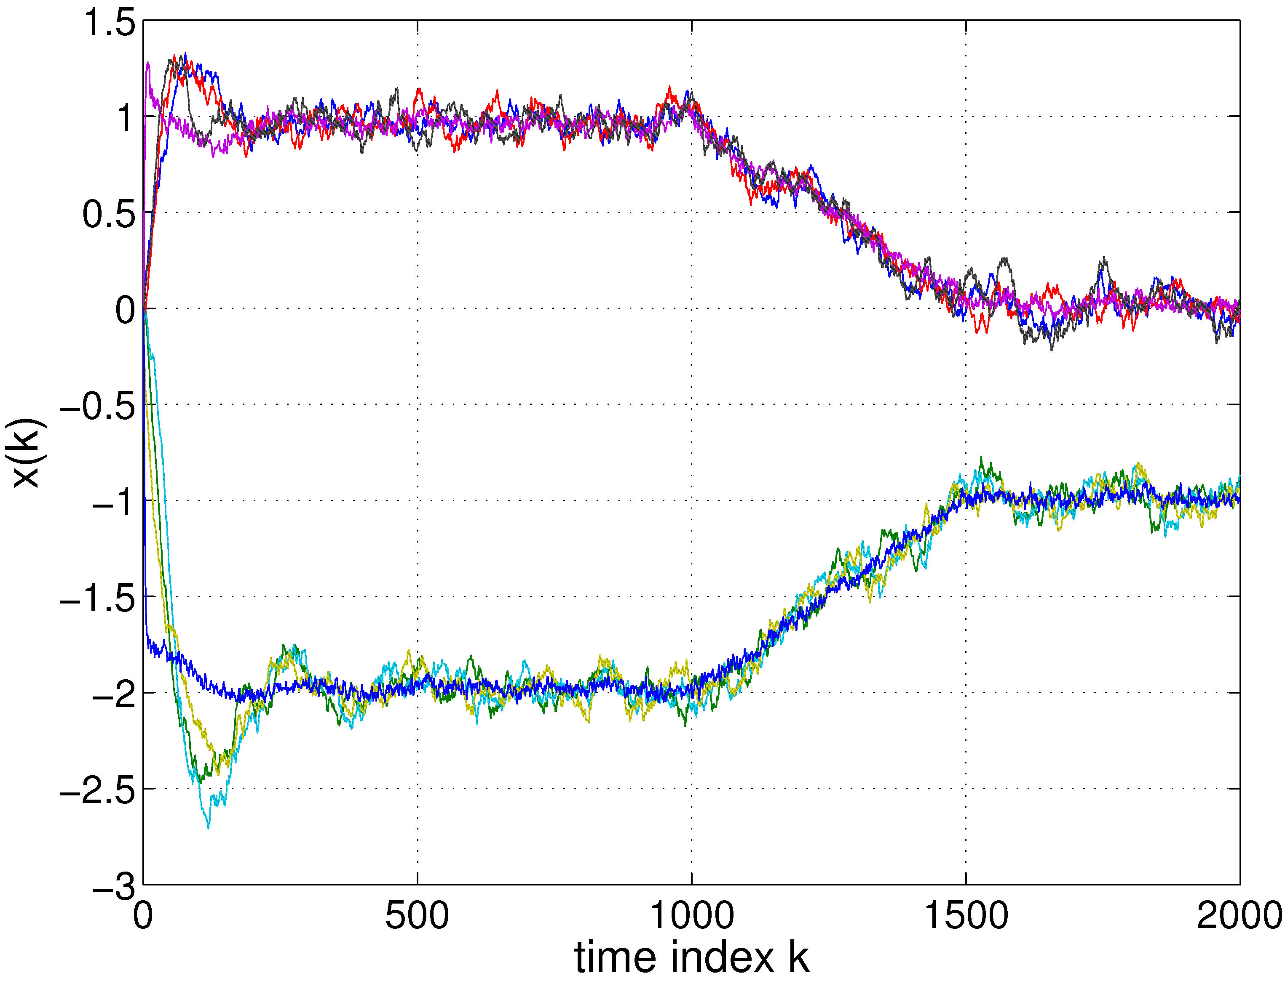
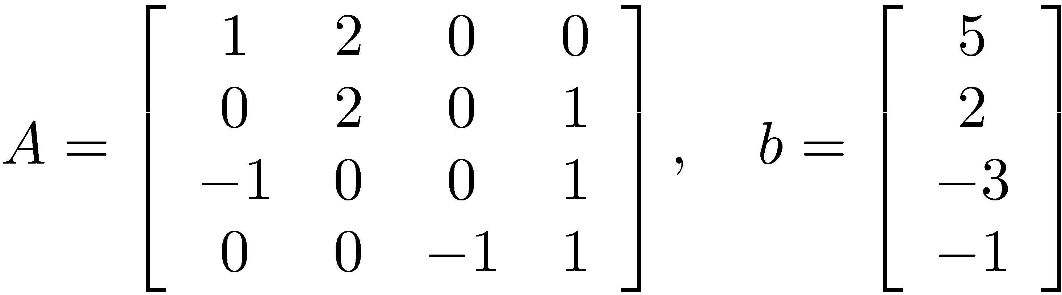
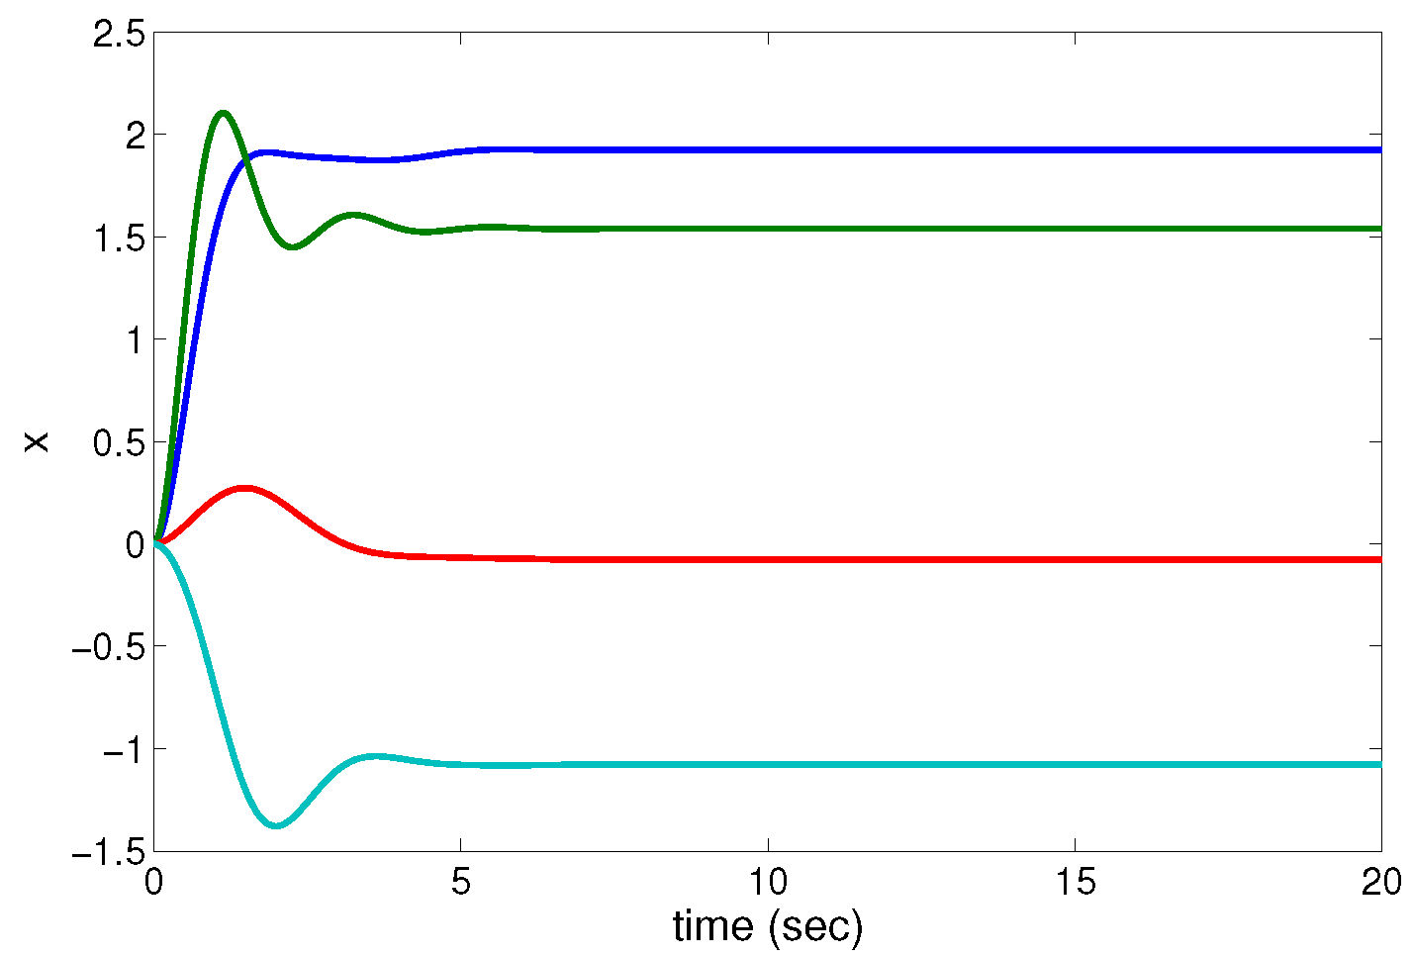
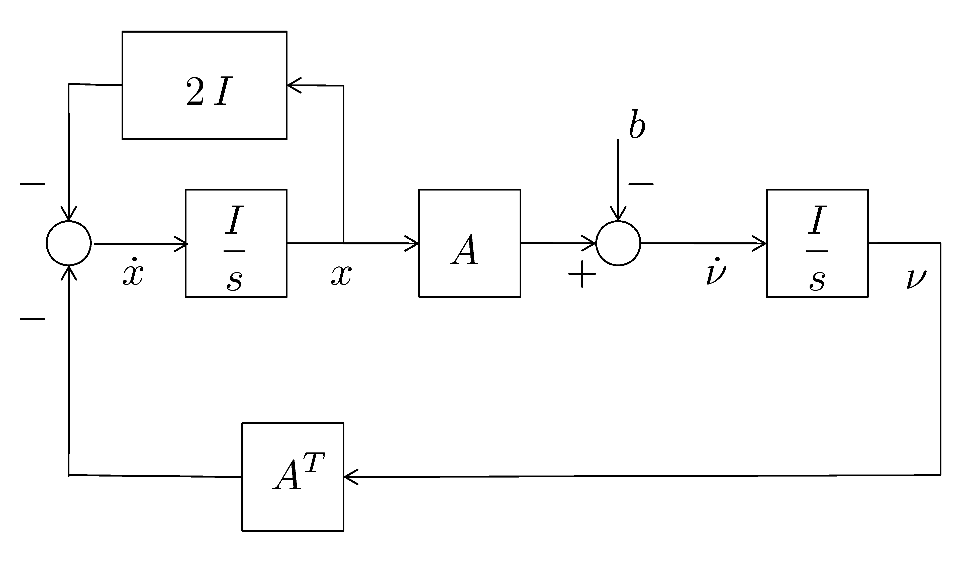
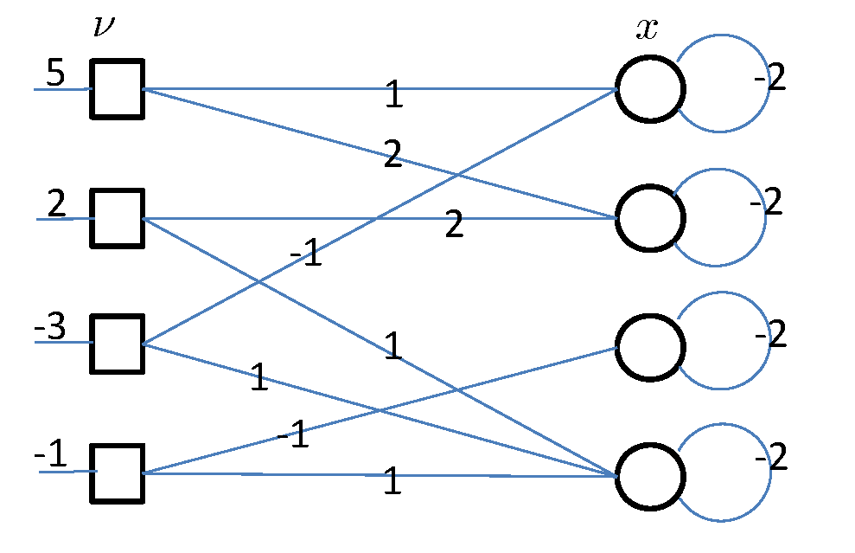
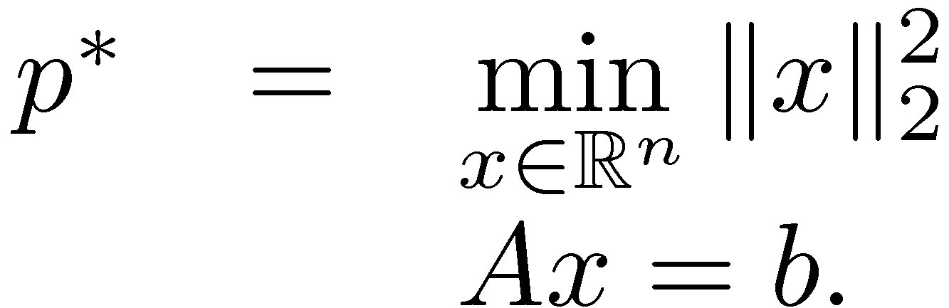
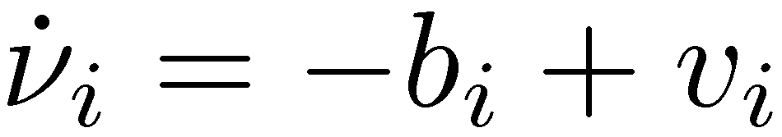
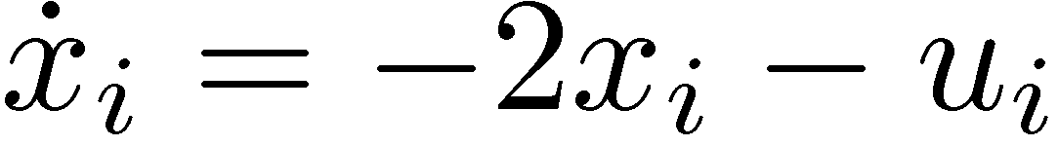
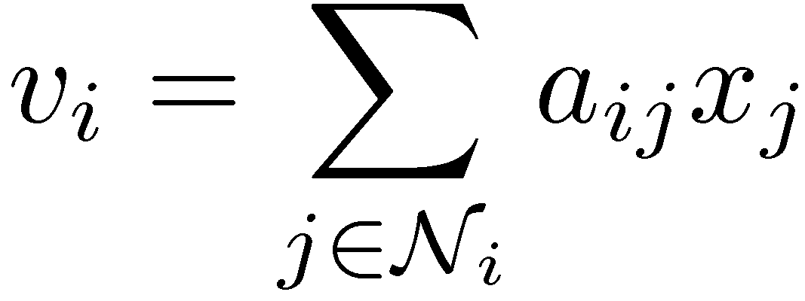
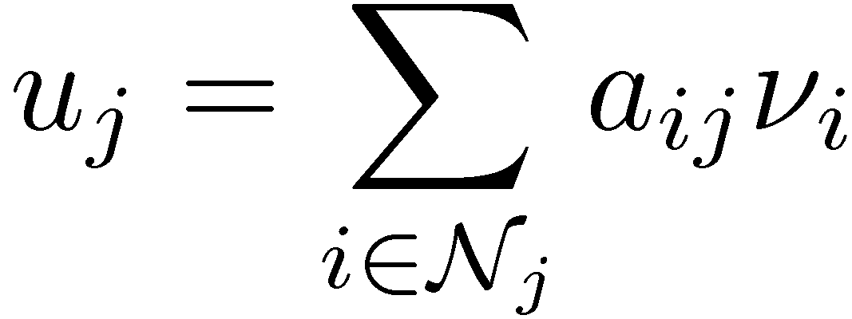
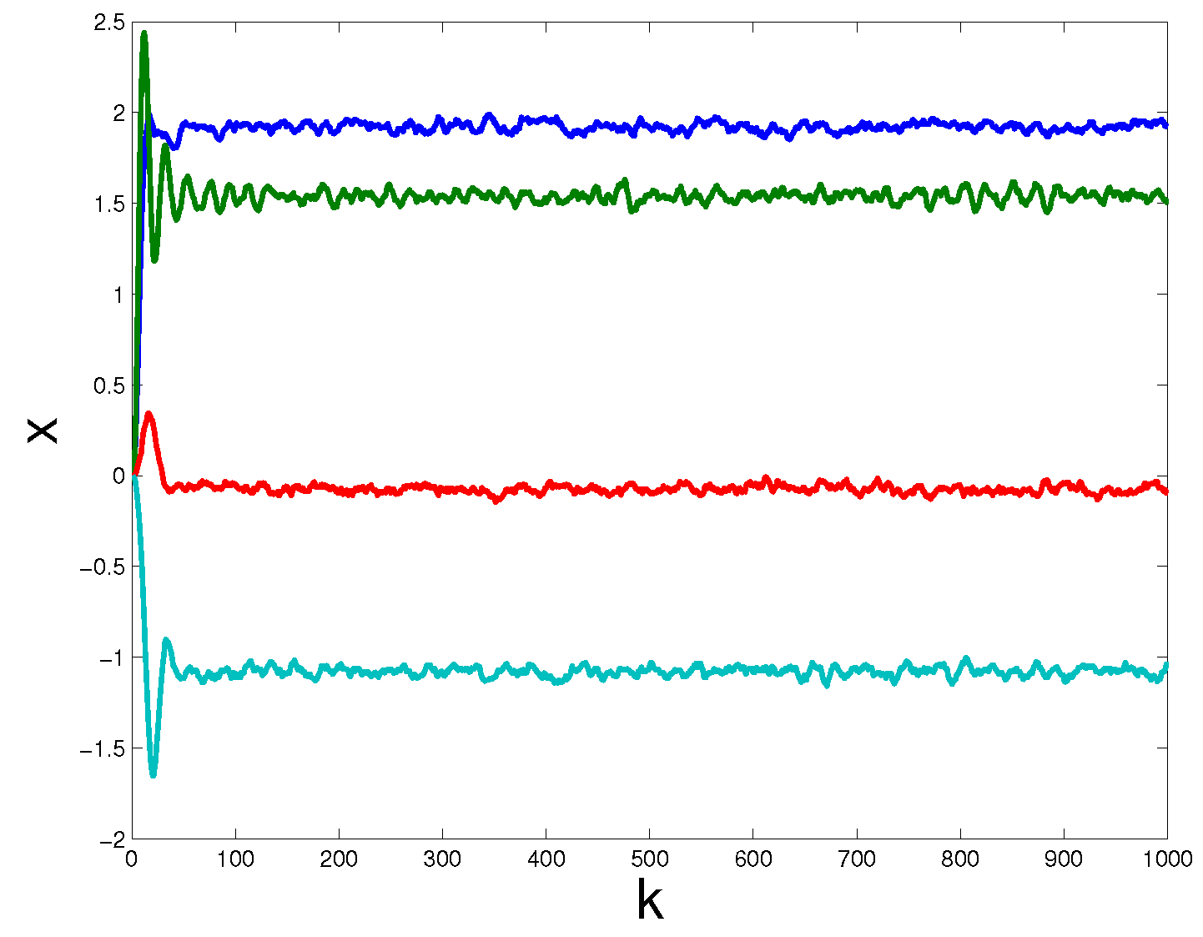
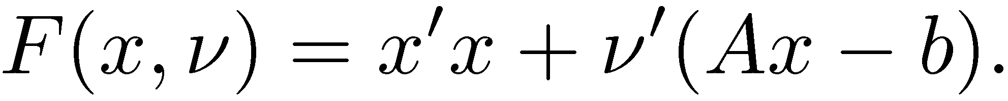
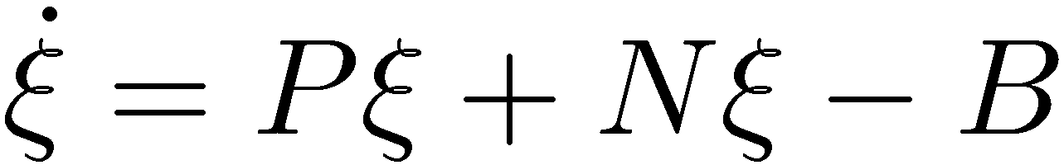
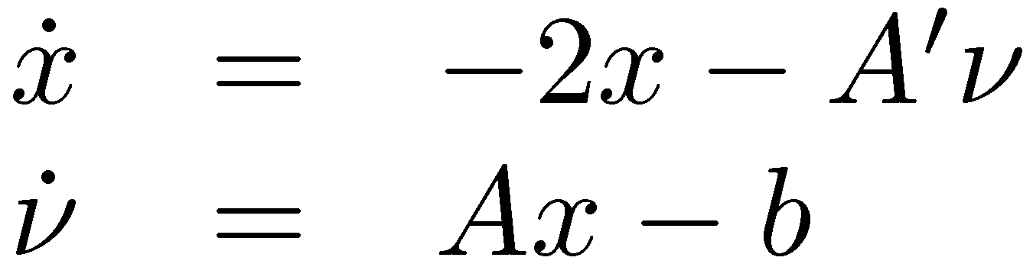
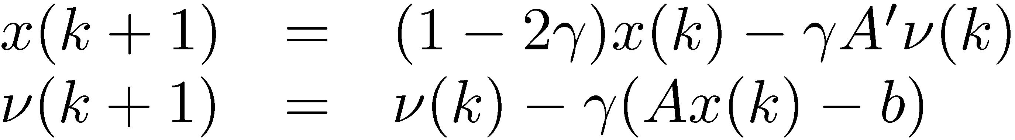
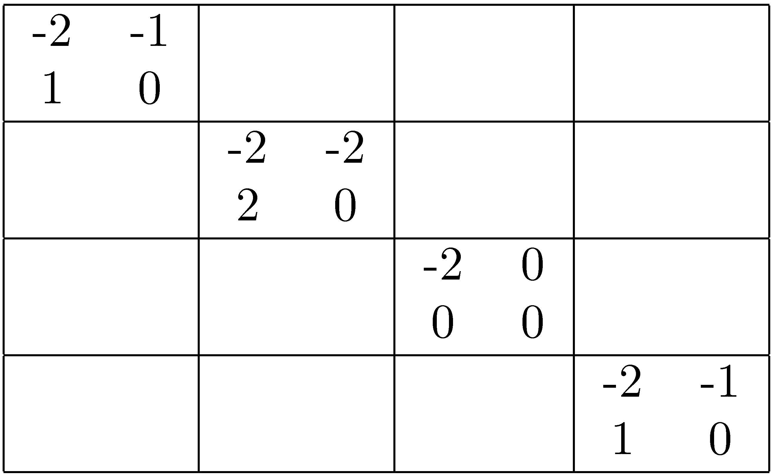
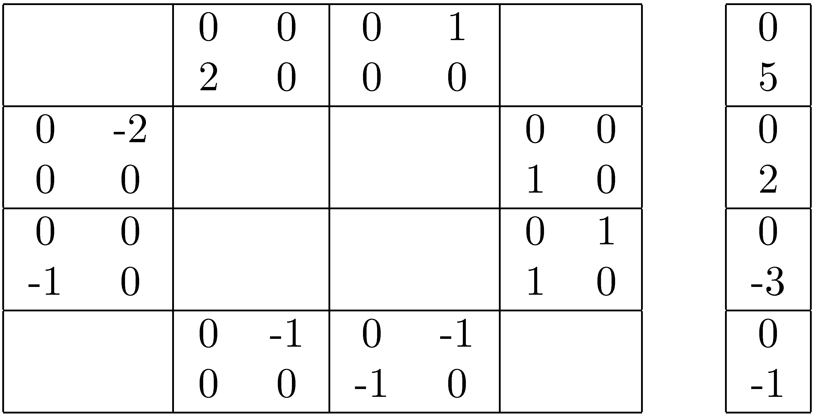
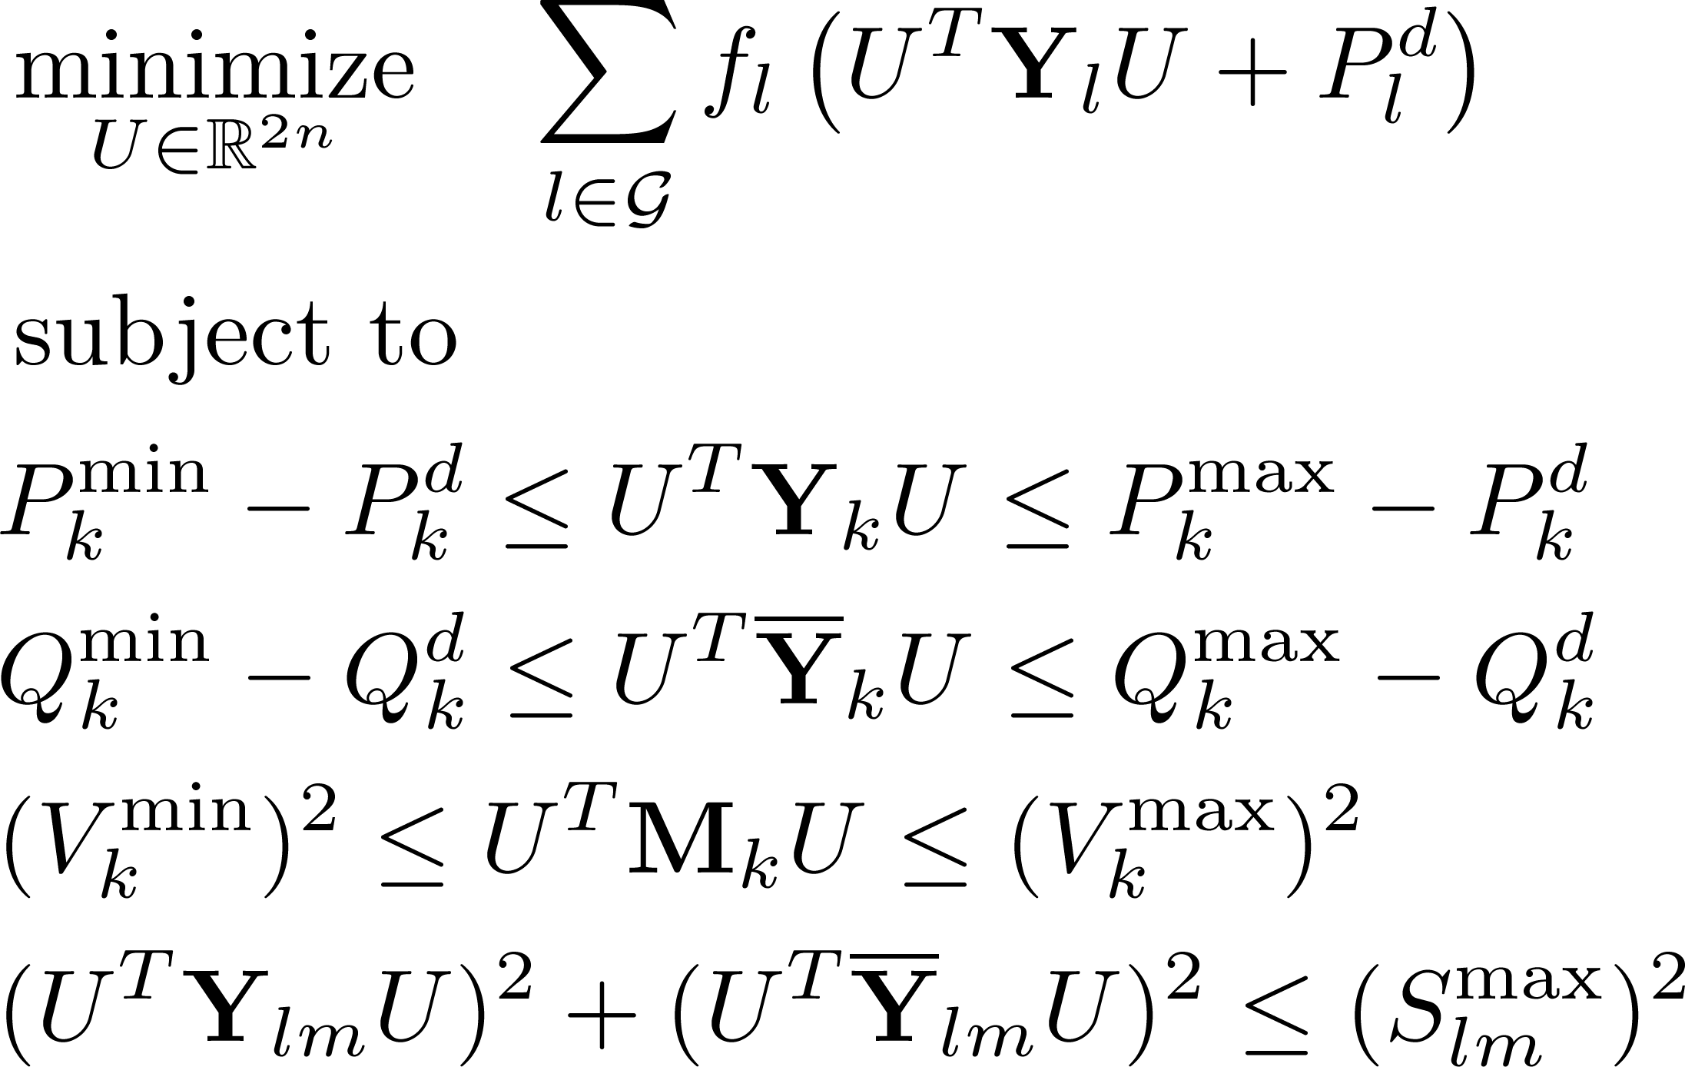
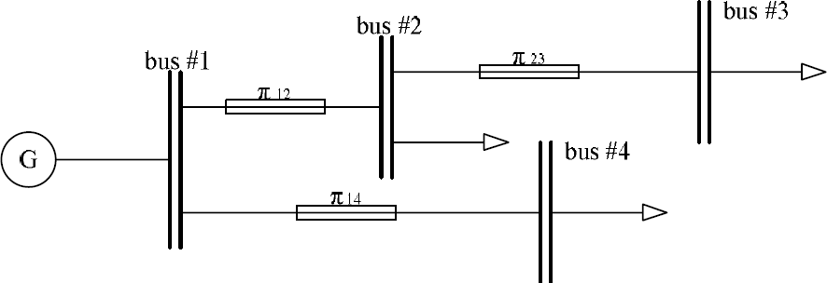


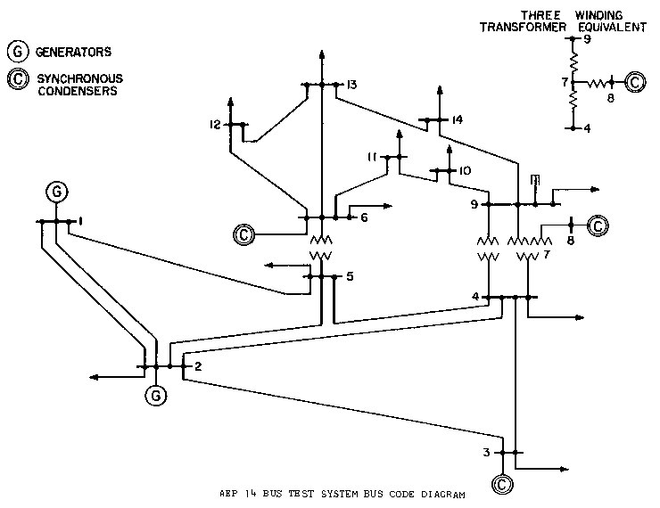
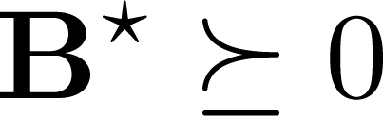
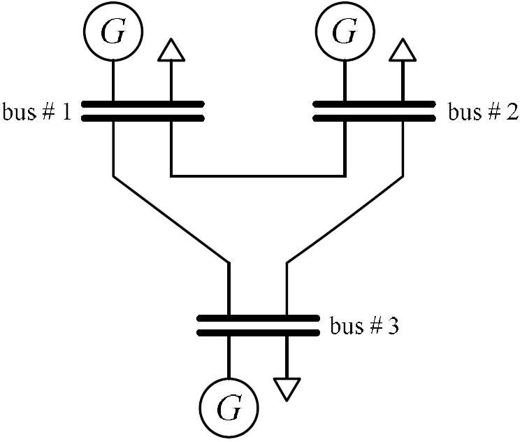
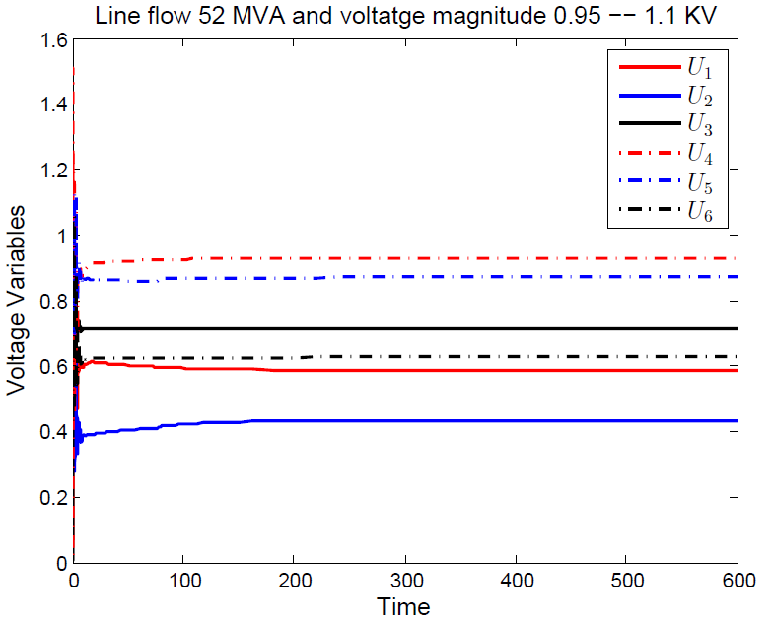
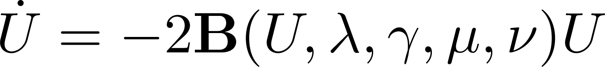
CPS: Breakthrough: Distributed computing under uncertainty: a new
paradigm for cooperative cyber-physical systems
  PI Nicola Elia Iowa State University, nelia@iastate.edu
Abstract. The main objective of this research is to develop the Science of CPS by proposing and developing new (dynamical) models of computation systems, integrated with the physical dynamics of cooperative multi-agent systems over communication networks. We intend to develop novel dynamical systems that solve distributed optimization and other computational problems and are resilient to noise and uncertainty. Toward this end, we have developed a new approach to distributed solution of systems of linear equations over networks. We have also unveiled the distributed nature and structure of Optimal Power Flow problems. Finally, we are continuing developing distributed control design methods to improve the performance of optimization systems.
Distributed Optimization Systems
Control perspective
Augmented Lagrangian: as PI controller
Real-time adaptive distributed optimization
Design of Distributed Ccontrollers
Lagrangian:
Optimization system
Converges to optimal solution under mild cond.
PI Networked controller
New distributed controller design method
provides network realizable controllers
Controller design methods
for networked distributed computing systems
Subject to fundamental limitations of feedback
Tracking? Adaptation? Disturbance rejection?
Multiplier dynamics as dynamic controller
Controller design for optimization systems?
Least Squares: LTI theory applies
Tracking resilient to noise and packet drops
Application to Distributed Solution of Linear Equations
Main idea:
Solve linear equations via constrained optimization
General approach
A need not to be symmetric
Solution need not to be unique
Solution assumed to exist
LTI Dynamics
Natural Distributed Implementation
Convergence
Wang and Elia IFAC 2014
Bipartite graph
Exponential convergence
Robustness to noise
Lagrangian:
Alternative Implementation
Optimization system
DT Optimization system
P
N
B
Application to Distributed Optimal Power Flows
Formulation of optimal power flows
The naturally distributed structure
Saddle point characterizations
Large-scale OPF simulations
SDP zero
Duality gap
The optimal
Saddle
points
Quadratic cost for power generation
Non-convex quadratic constraints
Can be solved by SDP dual relaxations
Define the primal-dual gradient dynamics
Flow between #2 & #3
60-MVA: SDP no gap
52-MVA: SDP has gap
By sum-of-squares (SOS) we prove that saddle point still exists
(the primal part)
Distributedness due to the sparsity of the network
Each bus involves as a computing agent
Implementation mimics the network topology
Large domain of attraction
Quick responses to demand changes
Any equilibrium point is a KKT point
Saddle point (primal-dual optima) ?
N. Elia, J. Wang and A.S.M. Vamsi, “Computing over Unreliable Networks” in Information and Control in Networks, G. Como,
B. Bernhardsson and A. Rantzer Editors, Springer, Volume 450, 2014, pp 241-275, 2014.
Ma and Elia Med14, CDC 2014
CPS PI Meeting
N. Elia, J. Wang and X. Ma, “Mean Square Limitations of Spatially Invariant Systems” in Control of Cyber-physical systems,
LNCNS, M. Thoma, F. Allgower, M. Morari Editors, Springer, Volume 449, 2013, pp 357-378, 2013.
Washington D.C. 6-7 November, 2014

