Slide 1
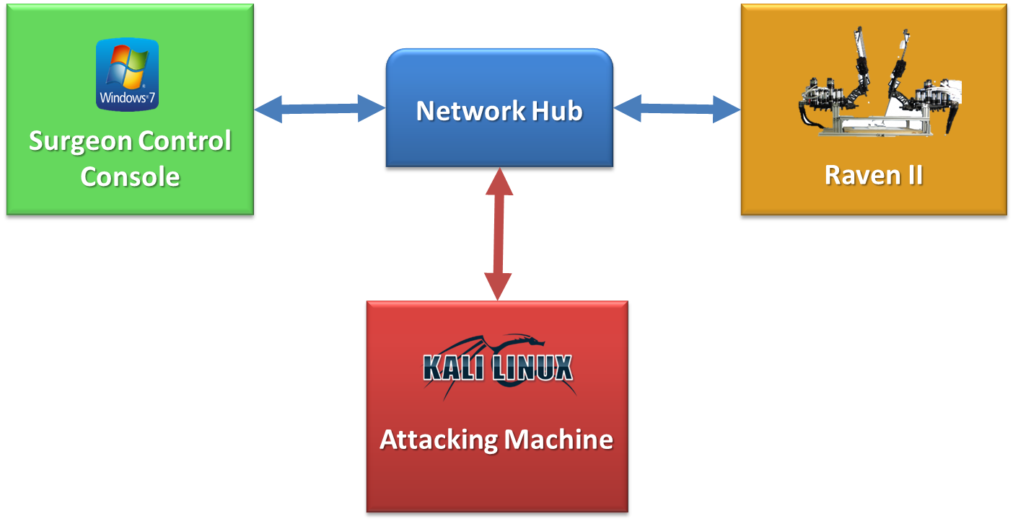
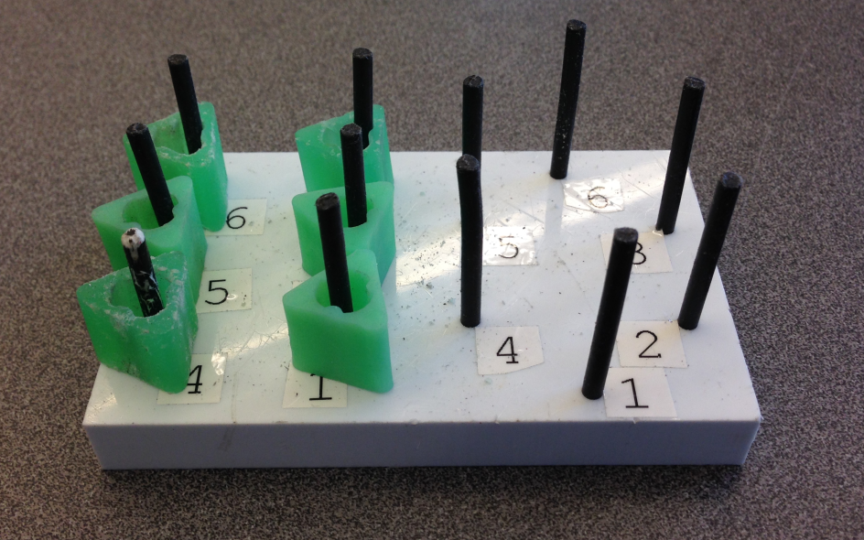
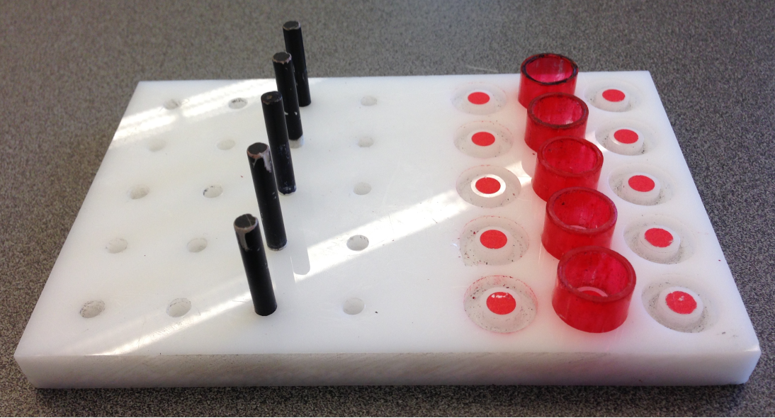
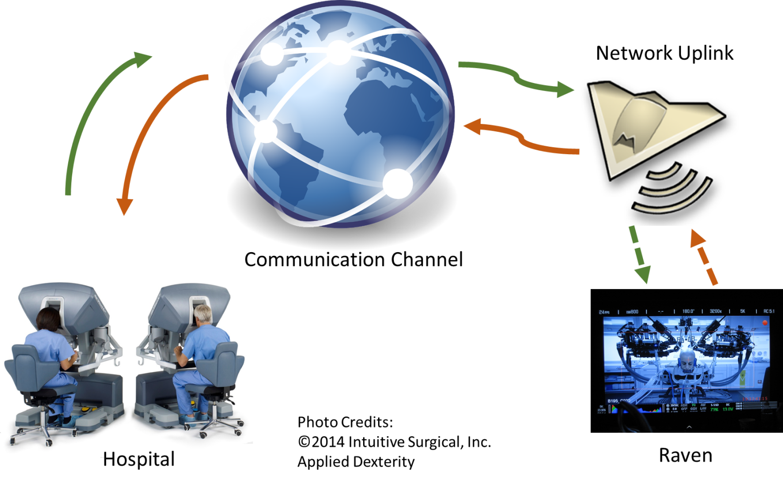
CPS: Breakthrough: Secure Telerobotics
Demonstration and Evaluation of Cyber-Security Attacks on Telerobotic Systems
Howard Jay Chizeck (PI) Tadayoshi Kohno (Co-PI) Tamara Bonaci (Grad. RA) Jeffery Herron (Grad. RA) Junjie Yan (Grad. RA)
chizeck@uw.edu yoshi@cs.washington.edu tbonaci@uw.edu jeffherr@uw.edu junjiey@uw.edu
Introduction
Approach: Threats Identification and Evaluation
Results: Threats Evaluation
This project – developing methods and tools to enhance security, privacy and safety of telerobotic systems
Expected results:
Mechanism to prevent security threats against telerobotic systems
Tools for monitoring and detection of unexpected and malicious activities
Methods to correct for errors caused by random failures and malicious actions
Attack classification, based on the impact on human operators:
Intention modification
Intention manipulation
Hijacking
Attacker’s position in the network:
Network observer
Network intermediary
Operator ‘s intent reordering:
Control messages delivered to the robot out-of-order
Result: jerky motion of robot’s arms – noticeable by operators
Operator’s intent loss:
Control messages randomly dropped
Single packet: acceptable packet dropping rate ≤ 55%
Groups of 100 consecutive packets: acceptable packet dropping rate ≤ 20%
Operator’s intent delay and Denial-of-service:
Both attacks increase the overall procedure time and the subjective assessment of difficulty
Different delay types tested – constant, uniformly distributed, normally distributed
Gaussian distributed delays have the worst impact
Denial-of-service attacks: learning effect observed → operators capable of adapting to unfavorable network conditions
Telerobotic Systems
Experimental Analysis
Systems where human operators interact with remote robots through communication networks
Application areas:
Robotic surgery
Military missions
Search and rescue robotics
Next generation telerobotic systems - expected to use the existing publicly available networks, combined with ad-hoc wireless and satellite networks
Impact of attacks evaluated through a series of experiments involving human subjects
System setup:
Conclusion and Next Steps
Problem
Telerobotic systems currently vulnerable to a variety of efficient attacks (single packet attacks!)
Some attacks easily preventable using well-established and readily available security mechanisms (encryption and authentication methods currently under evaluation)
Tensions between cyber security, safety and usability requirements of teleoperated systems render many existing security solutions infeasible → teleopration security a unique challenge!
Next step: the development of a monitoring mechanism for real-time identification of unique operator’s movement features.
Open and uncontrollable communication mediums → malicious entities (attackers) can disrupt or take over operator-robot communication
Challenges:
How easy would it be for an attacker to compromise a telerobotic system?
What would be the application and consequences of such cyber security attacks?
Considered telerobotic tasks:
Fundamentals of Laparoscopic Surgery task
Fitt’s law task
Denial-of-service
Operator’s intent reordering
Operator’s intent loss
Operator’s intent delay
Operator’s intent modification
Considered attacks:
Considered metrics:
Overall procedure time
Fitt’s index of difficulty
Subjective assessment of task difficulty
References
Acknowledgement:
This work was funded by the National Science Foundation
(NSF Grant 1329751 CPS: Breakthrough: Secure Telerobotics)).
[1] T. Yusuf, T. Bonaci, T. Kohno, H.J. Chizeck, “Dr. Hacker, I Presume? An Experimentally-based Discussion about Security of Teleoperated Surgical Systems”, 2014 USENIX Summit on Health Information Technologies, San Diego, CA, August 2014.
[2] T. Bonaci, J. Yan, J. Herron, T. Kohno, H. J. Chizeck, “Experimental Analysis of Denial-of-Service Attacks on Teleoperated Robotic Systems”, submitted to the 6th ACM/IEEE International Conference on Cyber-Physical Systems, Seattle, WA, April 2015.
[3] T. Bonaci, J. Herron, T. Yusuf, J. Yan. T. Kohno, H. J. Chizeck, “To Make a Robot Secure: An Experimental Analysis of Cyber Security Threats Against Teleoperated Surgical Robotics”, submitted to the 2015 IEEE International Conference on Robotics and Automation, Seattle, WA, May 2015.

