Slide 1
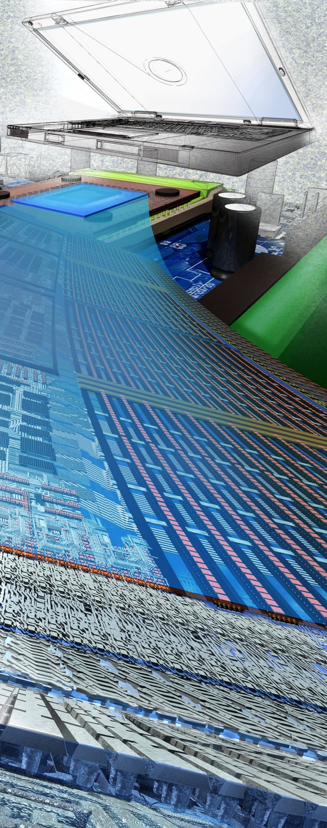
2013 CPS PI Meeting
Farnam Jahanian
National Science Foundation
October 17, 2013
Image Credit: Exploratorium.
Notes:
Good morning.
On behalf of my colleagues at the National Science Foundation, I am pleased to welcome you to the fourth annual Cyber Physical Systems, or CPS, Principal Investigators’ meeting.

Slide 2
A Shutdown Story …
From: ‪<reporting@research.gov>‬
Date: Mon, Oct 14, 2013 at 11:04 PM
Subject: Annual Project Report is OVERDUE for Award Number XXX
To: XXX
Award Number: XXX
Project Title:Collaborative Research: …
Report Type: Annual Project Report
PI: XXX
Awardee:University of XXX
Program Officer Name:Rudolf Eigenmann
Program Officer Email: XXX@nsf.gov
Program Officer Phone Number: XXX
The annual project report for the award referenced above is now OVERDUE. Please login to Research.gov to prepare and submit the annual project report as soon as possible (https://reporting.research.gov/fedAwardId/…)
As stipulated in the applicable award terms and conditions [NSF Agency Specific Requirements to the Research Terms and Conditions or other applicable terms named in the NSF award notice], the award referenced above requires the submission of an annual project report at least 90 days prior to the end of the current budget period.
Please note that interim reports do not qualify as annual reports and do not fulfill the annual report submission requirement.
Failure to submit timely reports will delay NSF review and processing of pending proposals for all identified PIs and coPIs on this award. It will also delay processing of administrative actions, including, but not limited to, no cost extensions. In the case of continuing grants, failure to submit timely reports may delay processing of funding increments.
Please DO NOT REPLY TO THIS MESSAGE. This e-mail was sent from an address that cannot accept incoming e-mail. If you have any questions about this project report, contact the Program Officer listed above.

Slide 3
Due to the lapse in government funding, National Science Foundation websites and business applications, including NSF.gov, FastLane, and Research.gov will be unavailable until further notice. We sincerely regret this inconvenience.
…

Slide 4
The melding of the cyber and physical worlds enables
smart systems all around us.
Credit: Theory Matters, SIGACT CATCS
Notes:
As automation and information technology pervade new platforms, cyber physical systems have become ubiquitous in our everyday lives and grow increasingly complex each year. They fly our planes, control our nuclear power plants, run our medical devices, and so much more.
The question we are asking today is, “How can we build and verify systems upon which people can – and will – bet their lives.?”

Slide 5
How can we design, build and verify reliable, predictable,
safe and secure cyber-physical systems upon which
people can - and will - bet their lives?
Image Credit: CCC and SIGACT CATCS
Notes:
The question we are asking today is,
How can we design, build and verify reliable, predictable,
safe and secure cyber-physical systems upon which
people can - and will - bet their lives?

Slide 6
CPS and National Priorities
Broadband & Universal Connectivity
Secure Cyberspace
Health & Wellbeing
Transportation & Energy
Education and Workforce Development
Environment & Sustainability
Manufacturing, Robotics, & Smart Systems
Emergency Response & Disaster Resiliency
Image Credit: MicroStrain, Inc.
Image Credit: Nicolle Rager Fuller, NSF
Image Credits: Texas A&M University
Image Credit: Cisco, Inc.
Image Credit: Nicolle Rager Fuller, NSF
Image Credit: ThinkStock
Image Credit: Georgia Computes! Georgia Tech
Notes:
Advances in cyber physical system hold the potential to reshape our world with more responsive, precise, reliable and efficient systems that:
Augment human capabilities;
Work in dangerous or inaccessible environments;
Contribute to a sustainable future;
Provide large-scale, distributed coordination; and
Enhance societal well-being.
These advances in CPS are closely intertwined with, and will have pervasive impact upon, many of our societal priorities,

Slide 7
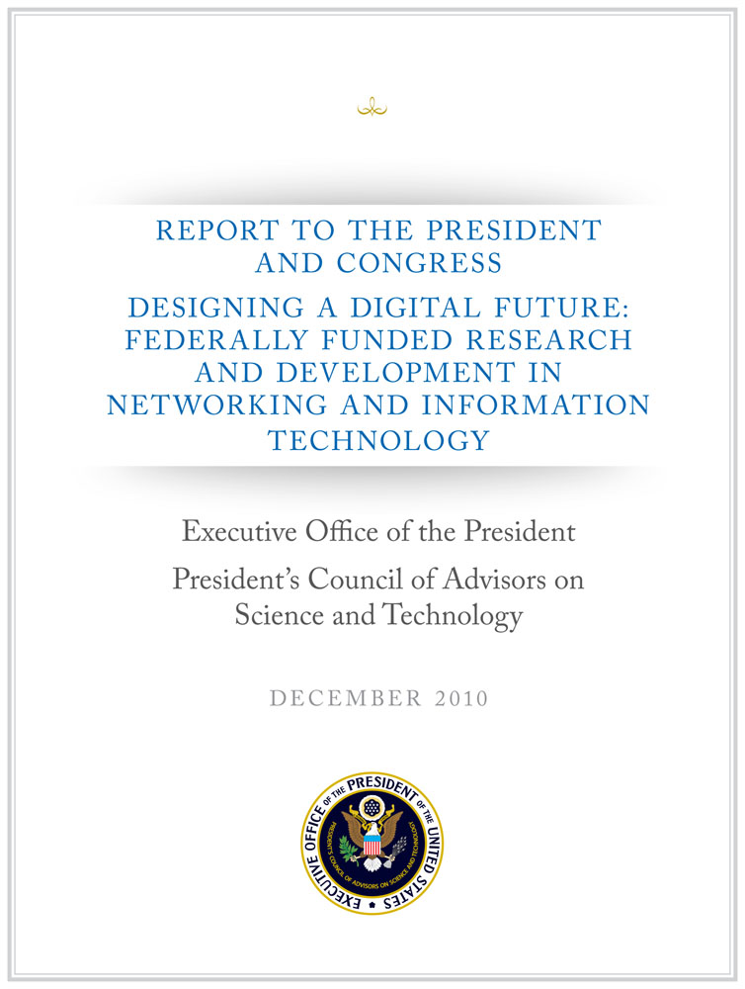
A National Imperative
2007 PCAST NITRD Report –Recommended cross-disciplinary programs to accelerate work in CPS by Federal R&D agencies
2010 PCAST NITRD Report – Expanded this recommendation to energy, transportation, health care, and homeland security
2011 PCAST Advanced Manufacturing Report – Recommended investments to strength US leadership in the areas of robotics, cyber-physical systems, and flexible manufacturing
Notes:
The need for investment in CPS as a national imperative is echoed in 3 recent reports by the President’s Council of Advisors on Science & Technology (PCAST).
--------
A PCAST 2007 report recommended that Federal R&D agencies strengthen existing programs or create new, cross-disciplinary ones programs to accelerate work in this area. The 2010 PCAST Networking and Information Technology (NIT) R&D report expanded on this recommendation, particularly as it applied to energy, transportation, health care, and homeland security. A PCAST 2011 report on Advanced Manufacturing has called for focused investments in advanced manufacturing to “strengthen U.S. leadership in the areas of robotics, cyber-physical systems, and flexible manufacturing” as a means to promote sustainable economic growth and job creation. These recommendations, consistent with President’s Innovation Strategy (2011), all arise from the accelerated demand and the increasing technical challenges they bring for new capabilities and services all deemed to be intelligent or “smart,” including transportation systems, medical technologies, buildings, and manufacturing.

Slide 8
The Future …
Top twelve economically
disruptive technologies (by 2025)
Notes:
And just recently, a McKinsey Global Institute report identified 12 disruptive technologies that will transform “life, business, and the global economy” by 2025 – and it’s worth noting that over half of these are in areas that are directly pertinent to CPS:
Consider top 6:
Mobile internet
Automation of knowledge work
The internet of things
Cloud technology
Advanced robotics
Autonomous and near-autonomous vehicles
And the others (renewable energy, 3-D printing, advanced oil and gas exploration …) rely upon or will be significantly enabled by the use of computing and information technologies.

Slide 9
Cyber-Physical Systems Program
Cyber-Physical Systems (CPS)
Deeply integrate computation, communication, and control into physical systems
Aspects of CPS include pervasive computation, sensing and control; networking at multi- and extreme scales; dynamically reorganizing/reconfiguring systems; and high degrees of automation
Dependable operation with high assurance of reliability, safety, security, and usability
Since CPS Launch in 2009:
Over $30M investment in FY13
350+ PIs and Co-PIs in 35 states
$170M total investment
250 awards
60 new awards in FY13 (35 projects)
Frontiers in CPS launched in FY13
Application sectors
Transportation
Energy and Industrial Automation
Health and Medical Care
Critical Infrastructure
Image Credit: MicroStrain, Inc.
Image Credit: Bristol Robotics Lab
Cross-Directorate Program: CISE, ENG, and SBE
Notes:
Cyber-physical systems aim to … Deeply integrate computation, communication, and control into physical systems
These are smart systems that have cyber technologies, both hardware and software, that are
deeply embedded in and interacting with physical components,
sensing AND changing the state of the real world
At the same time, we recognize that achieving next-generation cyber physical systems requires bringing together experts from many different sectors and disciplines.
New smart cyber-physical systems will drive innovation and competition in sectors such as the power grid, transportation, buildings, medical technologies, and industrial automation advanced manufacturing.

Slide 10
CPS Support across NSF
Cyber-Physical Systems
Smart Health & Wellbeing
Science, Engineering & Education for Sustainability (SEES)
National Robotics Initiative (NRI)
Secure and Trustworthy Computing (SaTC)
CISE and ENG Core Programs
Cyber-Physical Systems (CPS)
Expeditions
Notes:
The CPS program is only but one of many opportunities that address CPS and available to this community.
Within NSF, our investment in CPS has continued to build upon our Core programs in the CISE and Engineering Directorates, and complement several closely related cross-cutting programs, notably the National Robotics Initiative, or NRI, Smart and Connected Health, and Secure and Trustworthy Cyberspace.

Slide 11
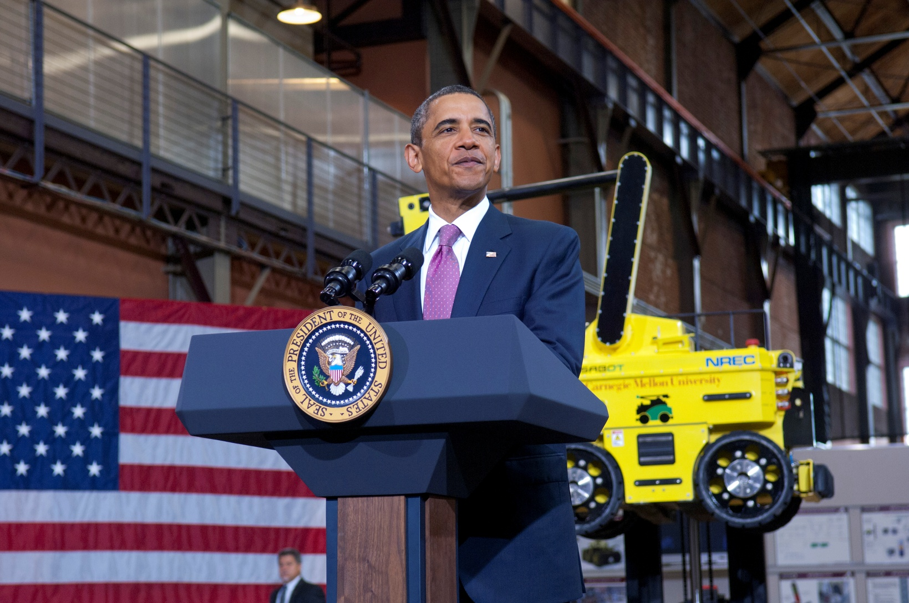
The National Robotics Initiative (NRI)
A nationally coordinated program across multiple government agencies to develop the next generation of robotics, to advance the capability and usability of such systems and artifacts, and to encourage existing and new communities to focus on innovative application areas.
Notes:
National Robotics Initiative
Develop the next generation of collaborative robots, or co-robots, that work beside and cooperatively with people
A nationally concerted cross-agency program to provide U.S. leadership in science and engineering research
Fundamental research in robotics science & engineering
Understanding the long term social, behavioral, and economic implications across all areas of human activity
Use of robotics to facilitate and motivate STEM learning across the K-16 continuum
Will enhance personal safety, health, and productivity
Cornerstone of this initiative is a joint solicitation among the four agencies represented on this slide.
President Obama Announced the Launch of NRI in June 2011
108 Researchers and 65 Institutions in 22 states funded

Slide 12
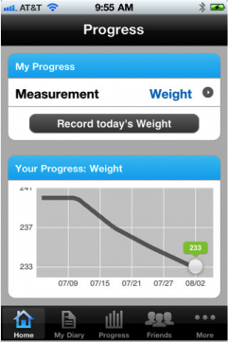
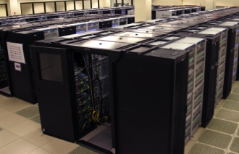
Smart and Connected Health
Transforming healthcare from reactive and hospital-centered to preventive, proactive, evidence-based, person-centered and focused on wellbeing rather than disease
Training
Coaching
GPS
EEG
Chronic Care
Decision Support
Population Statistics
Epidemiology
Evidence
Pulmonary Function
SpO₂
Social Networks
Health Information
Posture
ECG
Gait
Blood Pressure
Inference
Datamining
Balance
Step Height
Performance
Step Size
Prediction
Early Detection
Cross-Directorate Program: CISE, ENG, and SBE
Notes:
Information and communications technologies are poised to transform our access to and participation in our own health and well-being.
From Episodic, Reactive Focus on Disease
To Proactive and Preventive, evidence-based, focus on Wellbeing, Quality of Life
preventing the onset of diseases, improving diagnoses and treatments, enhancing the quality of health care delivery,
and empowering us to participate in our own health and well-being
Cross-Directorate Program: CISE, ENG, SBE

Slide 13
NITRD Senior Steering Group
Federal SSG for CPS Launched in fall 2012
Build partnership to advance US leadership in CPS across federal agencies
NIST, USDA, DHS, DOT, DOD, DOE, NASA, NIH, …
Notes:
As part of a Federal Senior Steering Group for Cyber Physical Systems that was established last fall, we have had the pleasure of working across the NSF and across the government, including the USDA, DHS S&T, DOT FHWA, DOD, DOE, NASA, NIH, and NIST, to build a partnership to advance U.S. leadership in cyber physical systems.
Our partnership will allow us to grow the CPS program in the coming year – and to ensure the initiative plays a catalytic role in the development of smart technologies that advance societal grand challenges and enhance our nation’s productivity.
As a PCAST report on Networking and Information Technology R&D earlier this year concluded, Federal agencies “are continuing to create a coordinated response while also establishing new programs to fund advances in cyber physical systems.”

Slide 14
Notes:
And recognizing the unique nature of CPS – including core and domain-specific knowledge, as well as the inherent multidisciplinarity of CPS – we have worked with our colleagues at the National Academies ---Science Computer Science and Telecommunications Board (CSTB) to launch a study on the current and future needs in education for CPS. The goal is to foster community-wide dialogue and articulate a vision for a 21st century CPS-capable U.S. workforce.
This study will emphasize the skills needed for the CPS scientific, engineering, and technical workforce but would

Slide 15
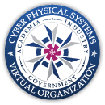
CPS Virtual Organization
Community Building
promoting collaboration and close interaction between academia, industry & government
facilitating interactions across technical disciplines & across applications areas
cross-fertilization of research in CPS core sciences and applied research in domain- and mission-oriented problems in a multi-agency setting
Collaboration Support via Portal
information flow and awareness of CPS activities
collaboration and professional networking
knowledge repository to facilitate the open exchange of challenge problems, research results, tools, and educational materials
http://cps-vo.org
~1500+ users increasing interest by other federal agencies to provide open source results and to increase interactions among research communities
* Supporting CPS/NITRD community activities
Notes:
And, of course, realizing the promise of CPS requires the collective intellect and efforts across this community. The VO has provided a framework to build on your shared interest, expertise, and partnerships, engaging nearly 1500 users for closer collaborations, relationships, and knowledge sharing.
Several of our partner agencies have joined this effort.
We are seeing important and emerging areas of exploration for CPS, including agricultural CPS and security of CPS. You will hear much more about these topics during the course of this meeting.

Slide 16
Enabling Smart Systems for the Future
Many of tomorrow’s breakthroughs will occur at the intersections of diverse disciplines.
We need to invest in a research pipeline comprising of long-term foundational research for cyber-physical systems, experimental prototypes, and early deployments to spur innovative applications.
The CPS R&D community will continue to have a transformative and durable impact on our national priorities.
We, working with other federal agencies, are committed to foster this emerging, consolidating research community and to reinforce its sustained role in advancing frontiers of science and engineering innovation.
A vibrant discovery and innovation ecosystem is critical to success.
Notes:
I am looking forward to an outstanding meeting over the next two days, comprising several invited keynotes, a technology transition panel, and the research talks, technology demonstrations, and posters that many of you will be presenting.
Let me acknowledge all those who helped pull together this program, particularly David Corman, Ted Baker, and Helen Gill at NSF, and our colleagues at the CPS VO, Janos Sztipanovits and Frankie King.

Slide 17
We need your help!
Nurture and Support a Culture of Engagement and Service
Embrace a Collaborative Culture Enabled by Foundational Research
Educate and Empower the Next Generation
Help shape the future directions of the field, priorities for the nation, and formulate a research and education agenda to address societal challenges.
Advances in CPS are pushed by long-term investment in foundational research and cross- and inter-disciplinary research and pulled by expanding complexity, scope, and scale of global priorities.
Lead a cyber- and technology-enabled transformation in education and learning to develop the next generation IT workforce and contribute to universal, transparent, and affordable participation in a knowledge-based society.
Notes:
(1) As a community, we need to nurture and support a culture of engagement and service.
As a community, we have the opportunity to…
to shape the future directions of the field and priorities for the nation
to formulate research and education agenda to address societal challenges
Community engagement can happen at many level at many levels
And as leaders of our community … encourage and reward national service
(2) Long-term investment in foundational research is imperative
Interactions of research ideas multiply their impact and seed new ideas with the potential to lead to unanticipated advances.
There is often a long, unpredictable incubation period – requiring sustained investment – between initial exploration and impact.
Unanticipated outcomes are often as important as the anticipated ones.
Advanced cyberinfrastructure will accelerate the pace of discovery and innovation in all areas of inquiry and enables a platform on which cross- and inter-disciplinary research thrives.
Cross- and inter-disciplinary research is pushed by advances in IT and pulled by the expanding complexity, scope, and scale of global priorities.
Tremendous opportunity exists for the CISE community to work with other disciplines in true collaborations and to address challenges facing humanity.
(3) Computing and communications discipline forms a pervasive intellectual fabric that connects all other disciplines:
Develop the next generation of the computing, communication, and information technology workforce.
Empower citizens by promoting understanding of the principles and uses of computation- and data-intensive techniques.
Lead a cyber- and technology-enabled transformation in education and learning.
Contribute to universal, transparent, and affordable participation in a knowledge-based society.

Slide 18
Thanks!
fjahania@nsf.gov
Notes:
In conclusion:
The work you do today will lay the groundwork for new enterprises, promote economic growth, improve our citizens’ quality of life, and fortify the foundations for U.S. competitiveness for decades to come.
Best wishes for a successful meeting.

