Slide 1

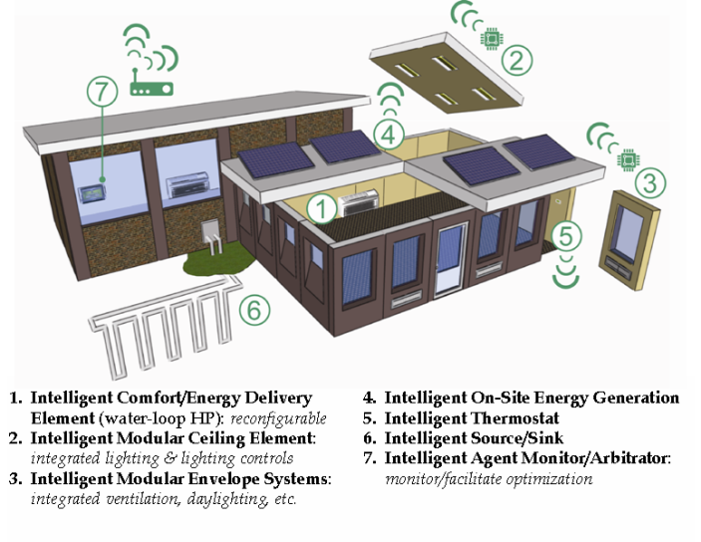
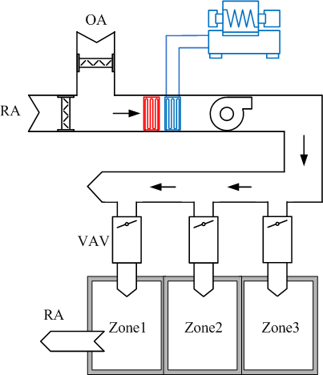
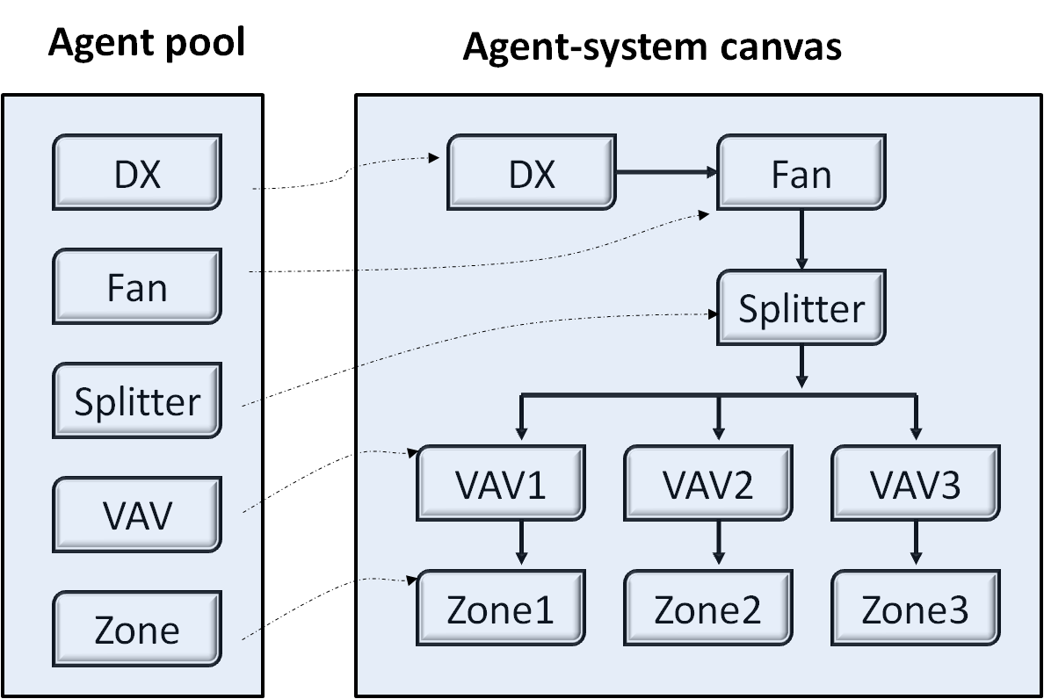
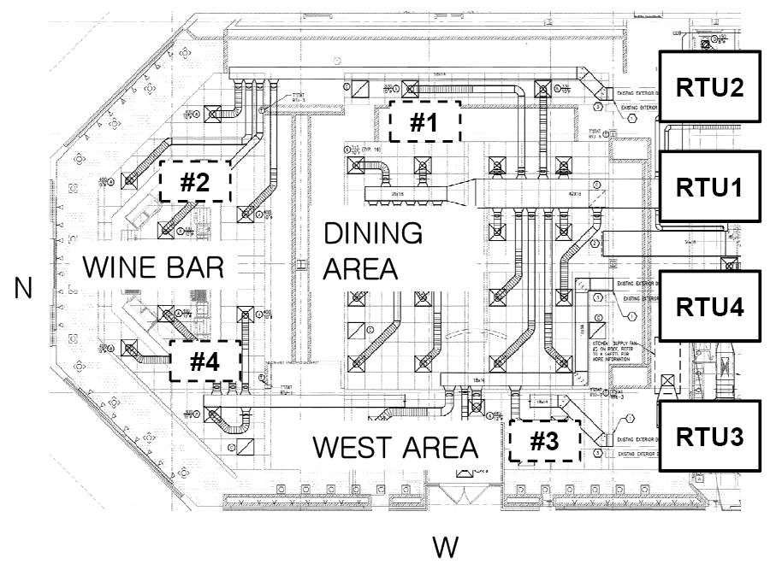
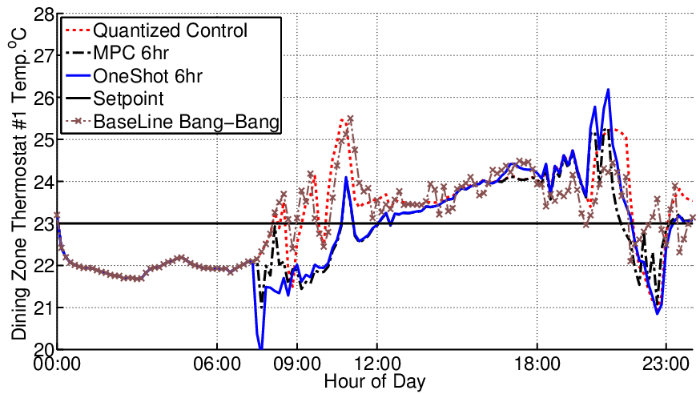
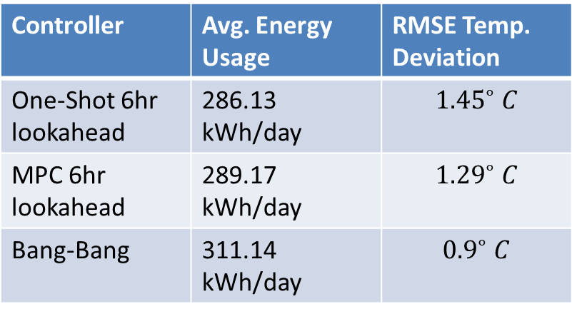
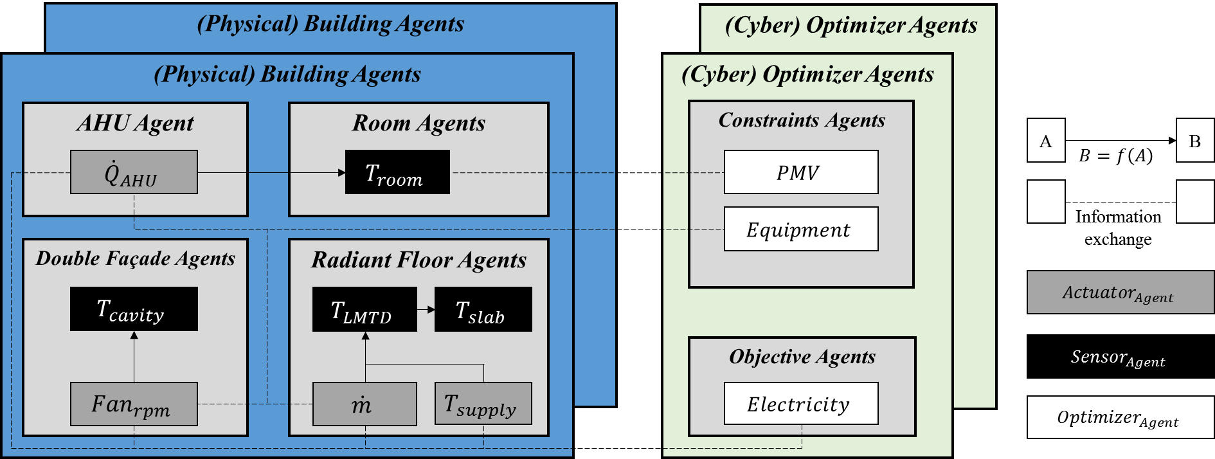
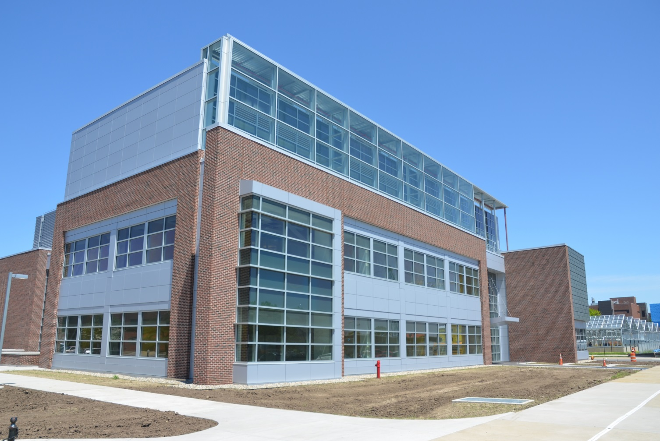
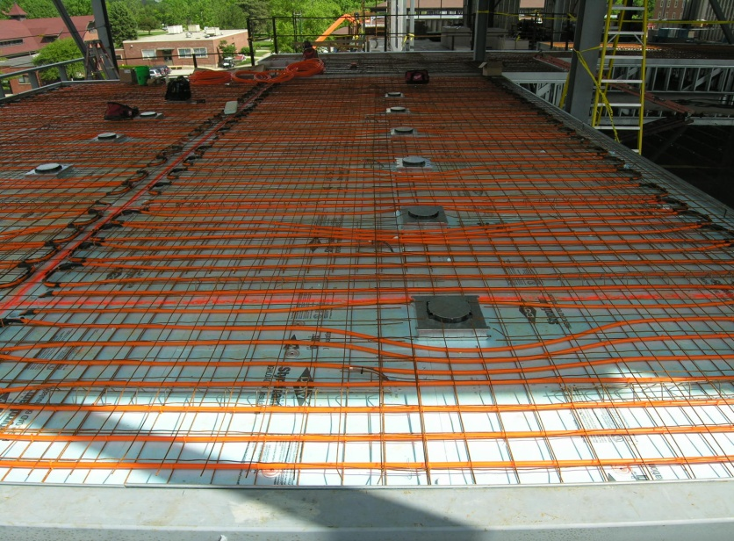
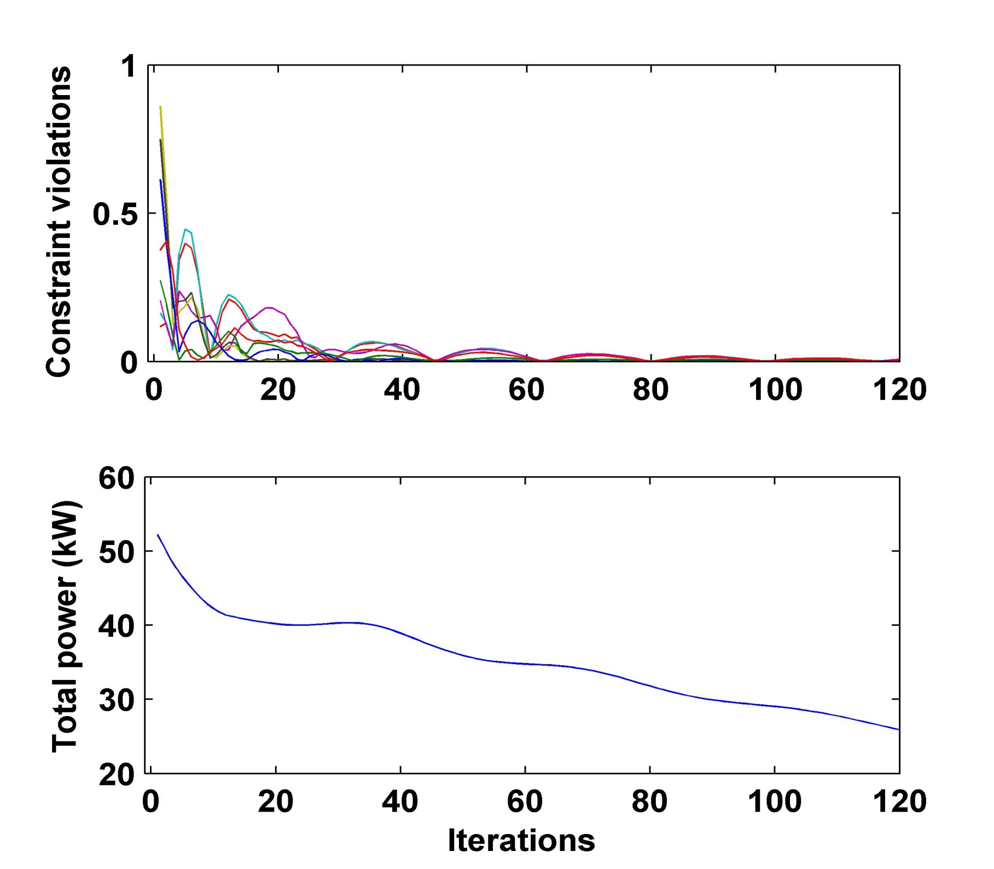
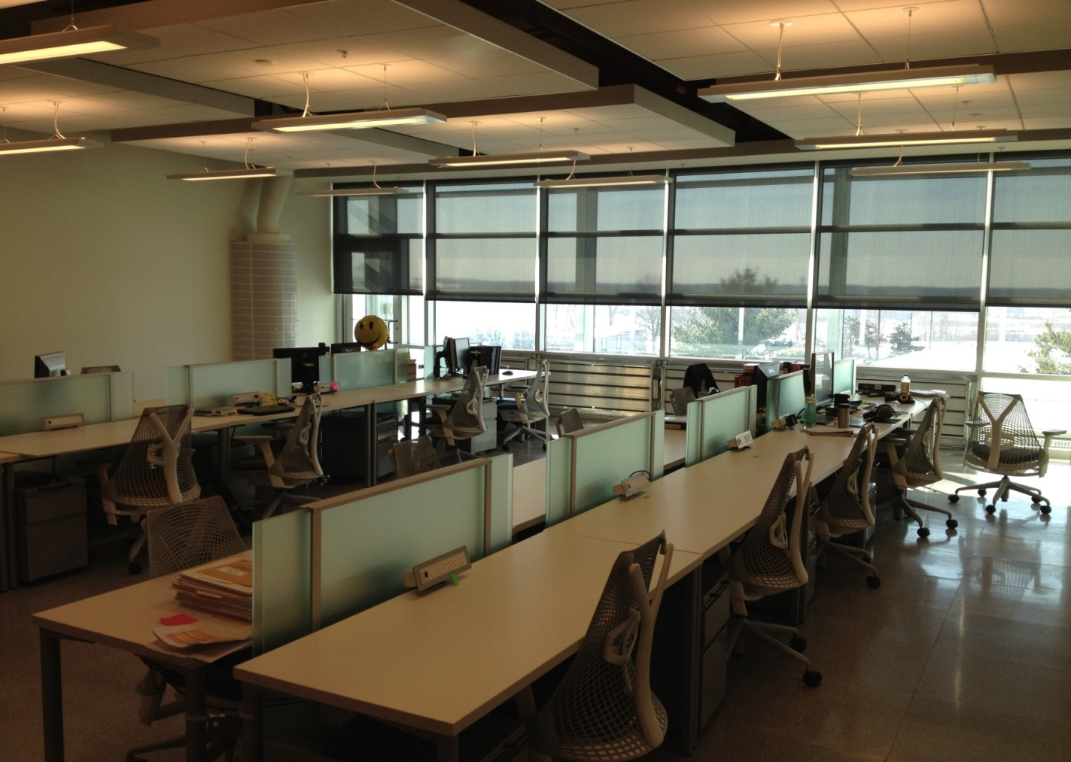
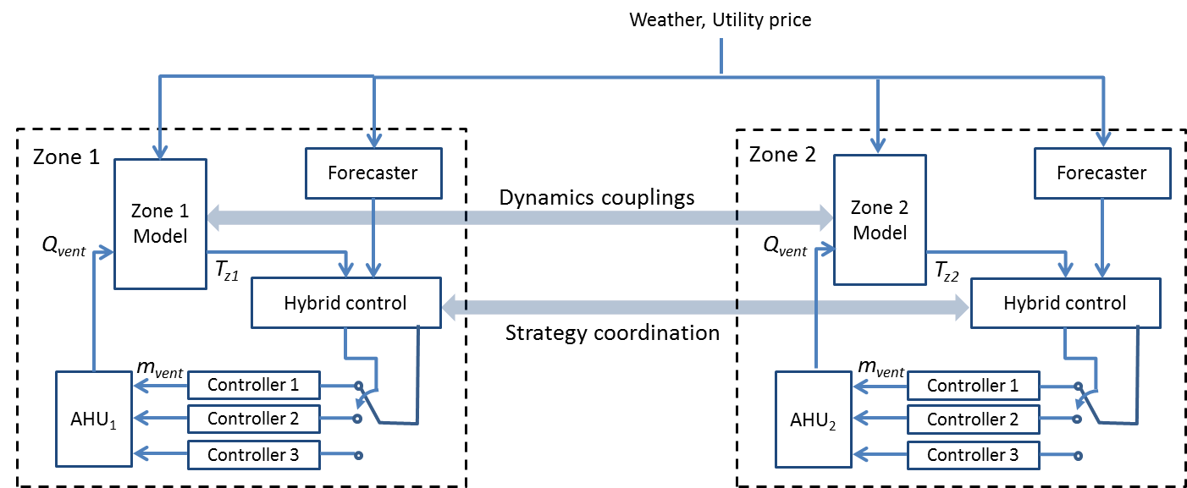
CPS: Synergy: Plug-and-Play Cyber-Physical Systems to Enable Intelligent Buildings
PI: Jianghai Hu, Co-PI: Panagiota Karava, Thanos Tzempelikos, James Braun, Purdue University
CPS Award 1329875, 1/1/2014-12/31/2016
Vision
Case Study I
Case Study II
Modular Plug-and-Play Buildings Control
Centralized AC System of 3-Zone Building
Rooftop Units (RTU) Coordination
A set of pre-engineered intelligent modules
Commissioned on site in a plug-and-play (LEGO) way
Flexibility to meet individual design objectives
Reconfigurability in building retrofit
Direct-expansion (DX) cooling unit with capacity modulation
Variable speed fan and VAV boxes for local temperature control
Objective: Minimize power consumption at each time instant
Harvest Grill Restaurant, PHL, with multiple zones
Four RTUs with different efficiencies and capacities
Objective: find the optimal RTU on/off schedule
HVAC System
Multi-Agent Framework
Harvest Grill Restaurant
Simulation Results
Proposed solution algorithms
DP-based hybrid opt. control
MPC implementation
Baseline bang-bang control
Agent-based control in study
Comparison of Performances
Approach
Agent-Based Distributed Optimization:
Optimization decomposed into sub-problems solved by optimizer agents
Coupling constraints enforced by coordinator agents
An Agent-Based Modeling and Control Framework
Sub-problem for agent i:
Subsystems of multi-zone buildings modeled by physical agents (sensors, actuators, HVAC equipment, etc.)
Decision making by cyber agents (constraint enforcement, prediction, cost optimization, inter-agent communication, etc.)
Intra-agent optimization:
Experimental Testbed
Purdue Living Laboratories
Inter-agent coordination:
Results:
What we learned:
For non-convex problems, convergence is not guaranteed for the proposed algorithm; multi-start scheme is needed
Testing results show that more than 60% of randomly generated initial points led to near-optimal solutions recovering more than 90% of the energy savings.
High-performing glazing/framing
Reconfigurable air-based system
Reconfigurable facades
Floor heating
Automated lighting/shading
Modular ceiling clouds

