Slide 1


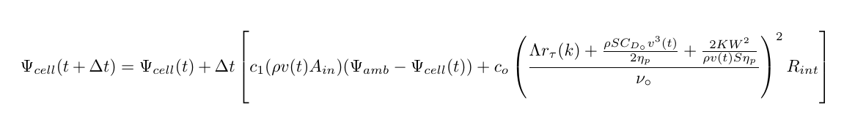
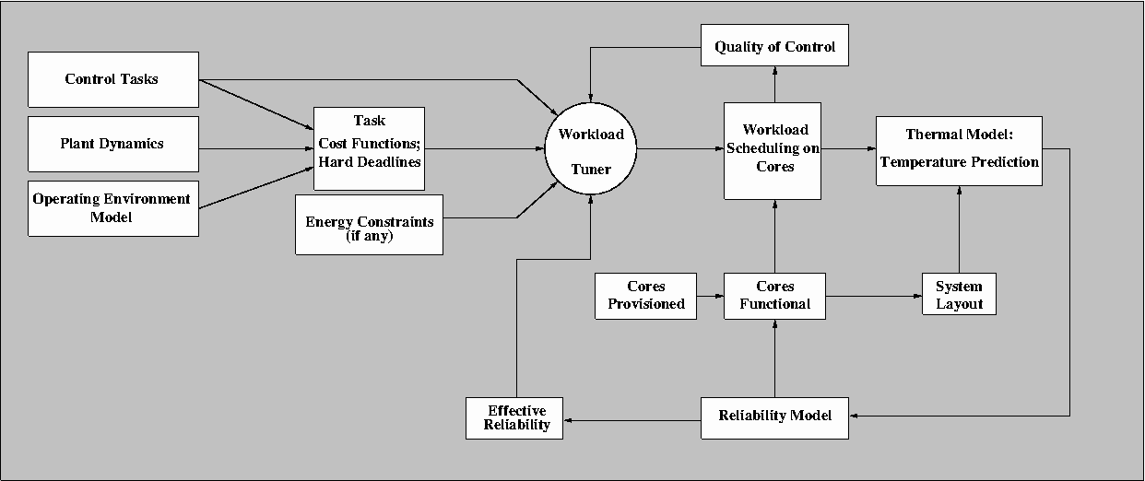
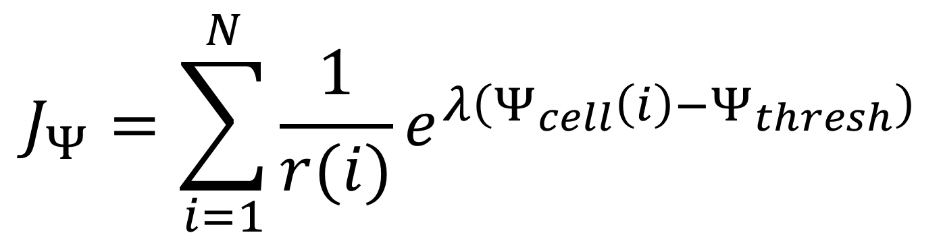
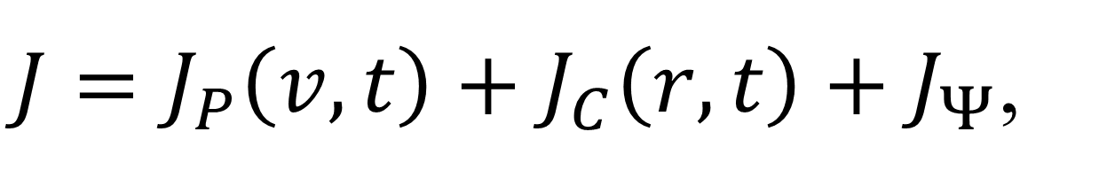
CPS: Synergy: Thermal-Aware Management of Cyber-Physical Systems
K.G. Shin; E.M. Atkins
University of Michigan
C.M. Krishna; I. Koren
University of Massachusetts
S. Wang
General Motors
Motivation
Online Thermal Management
Optimization & Validation
Cyber-physical processors work
in harsh environments and often suffer very high operating temperatures.
High temperature can accelerate processor aging and increase
failure rate.
Effective thermal-aware management is required to meet
the computational demands of
the application while reducing processor thermal stress.
Unmanned Aerial Vehicles (UAVs)
System-Wide Manager
Periodically sample core subunit temps; estimate core reliability
If est. core reliability differential exceeds a given threshold, migrate tasks away from the less reliable core.
Optimize UAV mission cost J over time, energy use, information (entropy), & temperature (ψ)
  Design variables: physical (p) UAV speed v(t) and onboard core (c) use r(t)
Lab & wind tunnel experiments: validate temperature dynamics models
Core-Level Manager
Adjust core speeds
Power gating
Architecture adaptation
Failure Sources
Electromigration
Dielectric breakdown
Negative bias temperature instability
$$J_{Ψ}=\sum_{i=1}^{N}{\frac{1}{r(i)}e^{λ\left(Ψ_{cell}\left(i\right)−Ψ_{thresh}\right)}}$$
$J=J_{P}\left(v,t\right)+J_{C}\left(r,t\right)+J_{Ψ}$,
All strongly dependent on temperature
Our Approach
Controlled Plant:
Current state
Dynamics
Desired trajectory
Safety envelope
Steady State Temperature
over UAV Engine (Airspeed)
& Core (Cyber) Controls
System Provisioning
Pareto Fronts over Temperature, Energy,
Entropy (Info.), & Time
Dynamic computational workload and core assignment
Core reconfiguration
Balance quality of control against
thermal stress

