Slide 1
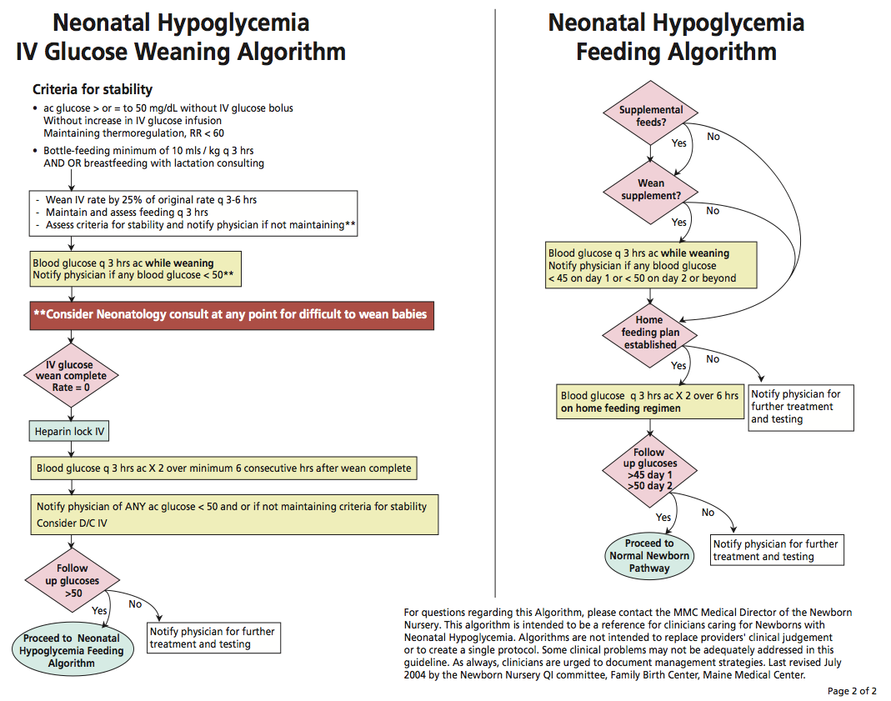
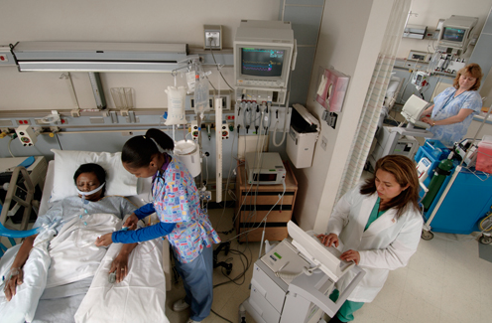
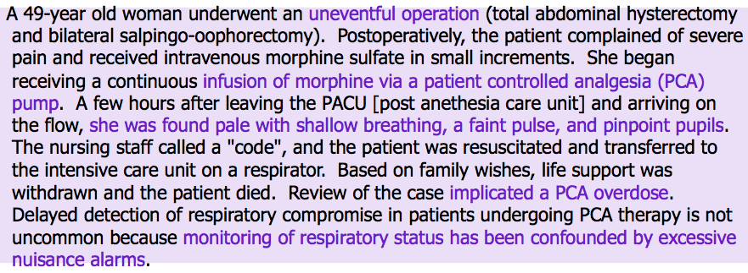
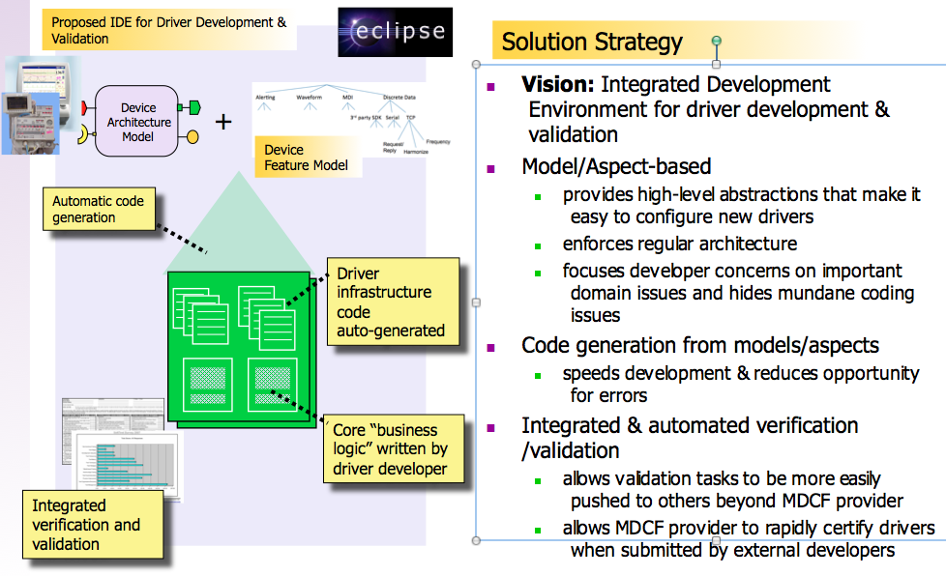
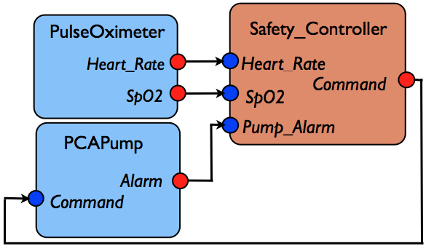
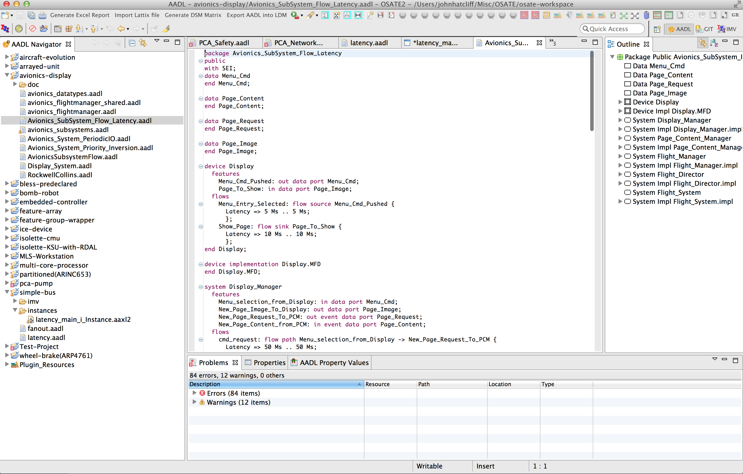
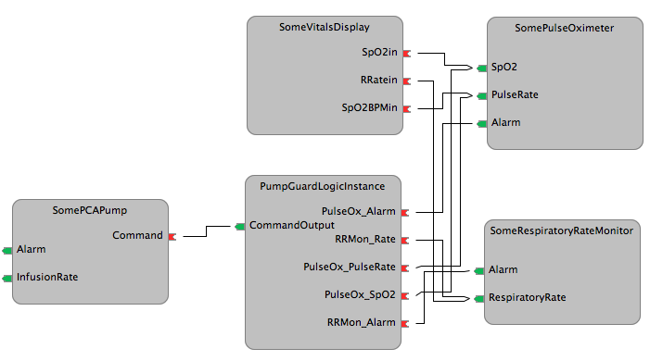
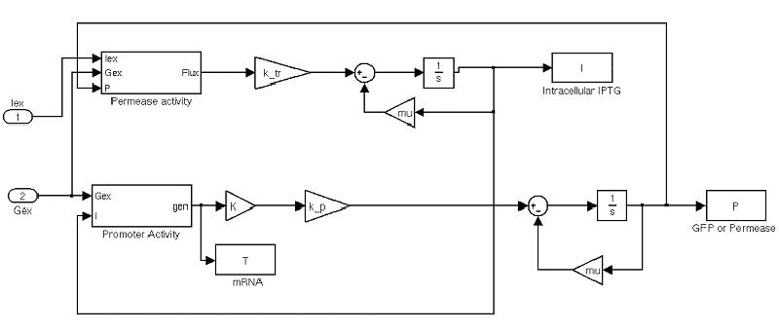
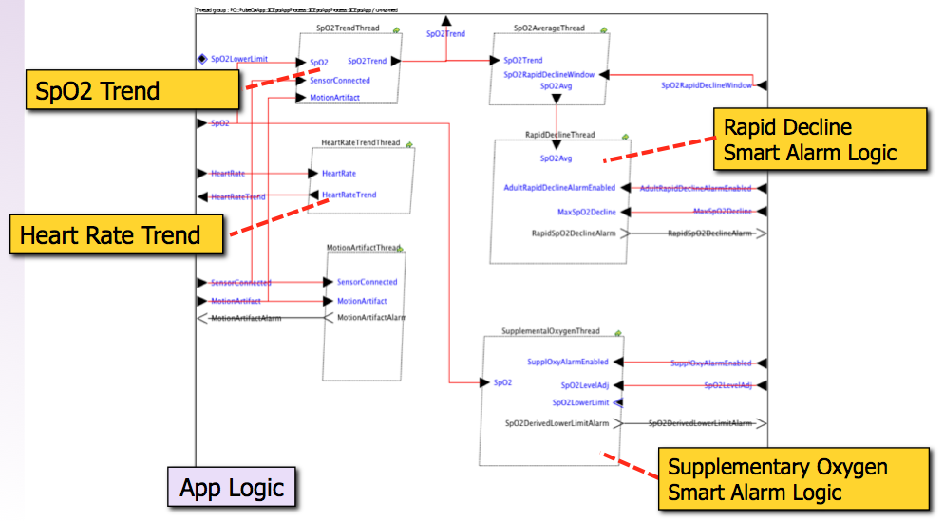
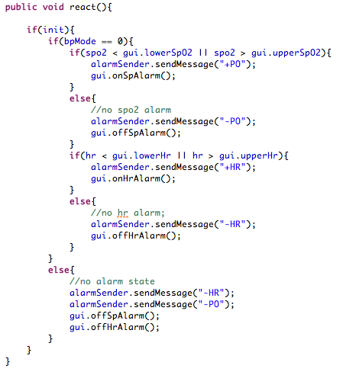
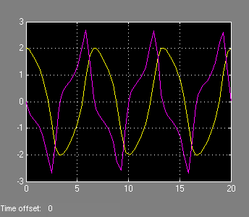
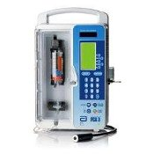
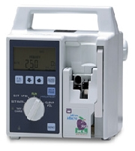
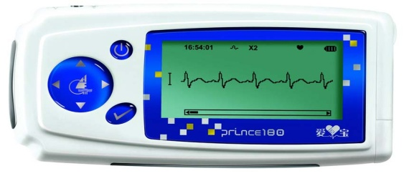
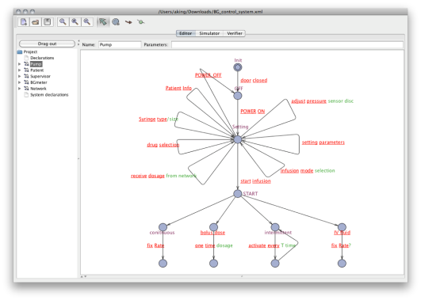
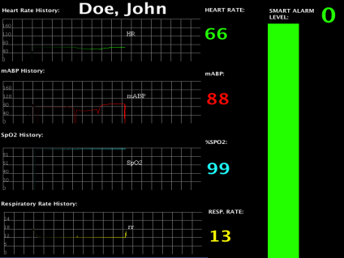
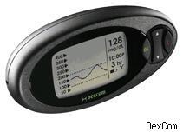
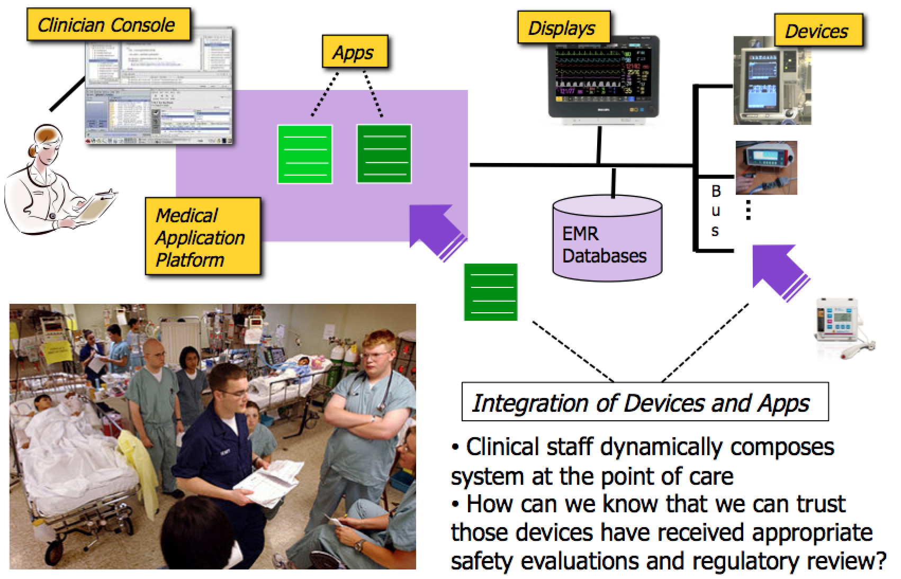
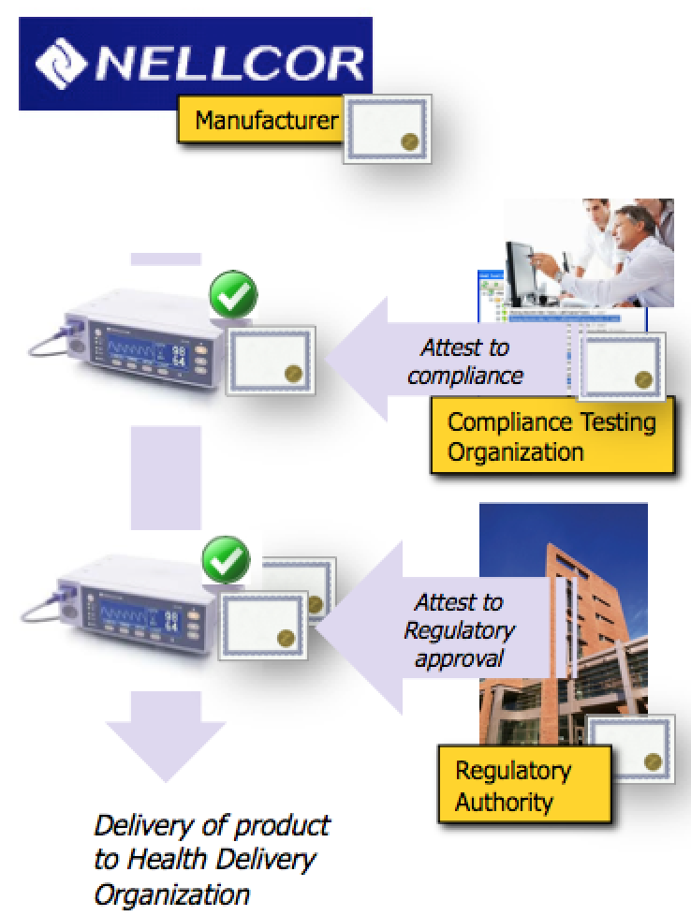
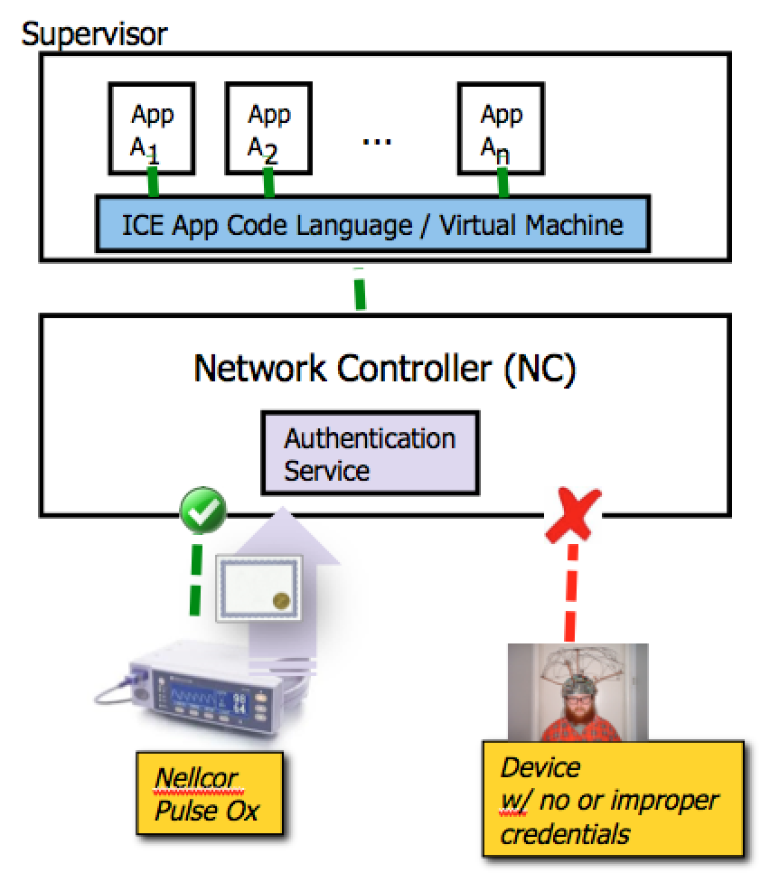
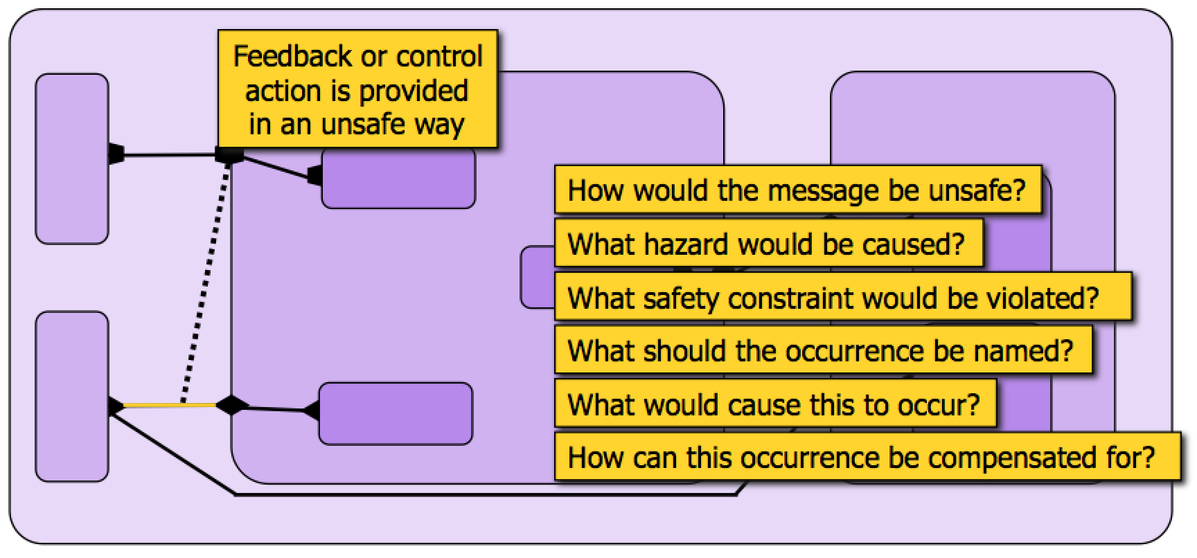
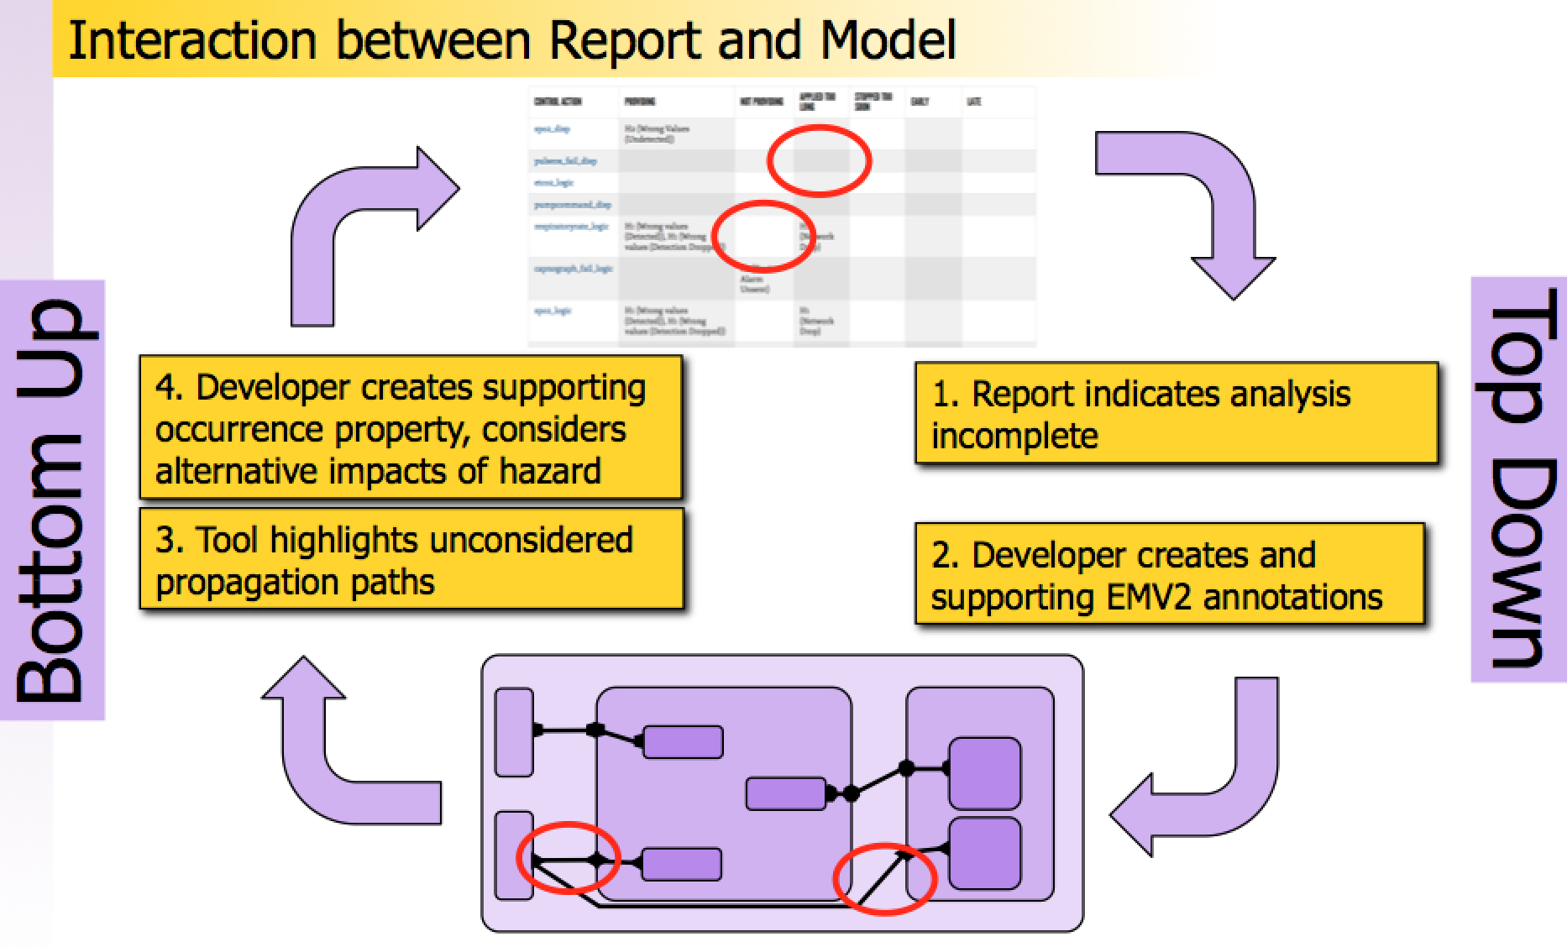
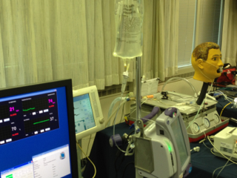
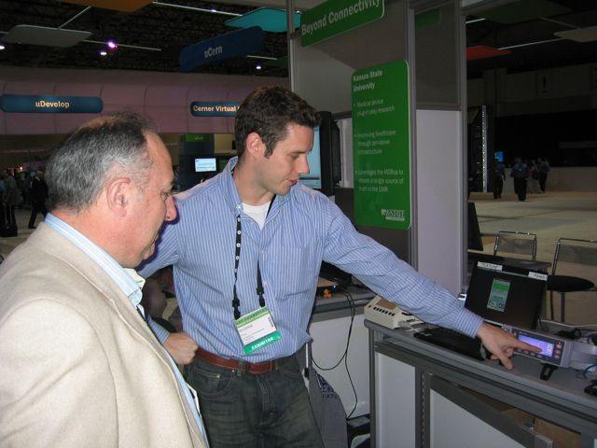
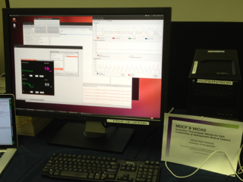
CPS: Synergy: Collaborative Research: Trustworthy Composition of Dynamic App-Centric Architectures for Medical Application Platforms (NSF CNS-1239543/1239324)
CPS PRINCIPAL INVESTIGATOR MEETING
Lead PI: John Hatcliff (KSU – hatcliff@ksu.edu), PI: Insup Lee (U Penn)
Lack of “System of Systems” Support
What Could be Achieved if Devices formed a System of Systems (SoS)?
Delivering modern medical care involves complex cyber-physical systems…
many medical devices, electronic medical records, clinicians/care-givers …all working together to achieve a goal
Although most modern medical devices have some form of connectivity, they are not integrated so that they can work together as a system
devices are “unaware of their context”, e.g., details of patient parameters, history, current procedures they may impact/distort readings
data from multiple devices is not combined to produce more meaningful information to clinicians
actions of multiple devices cannot be automatically coordinated to achieve greater safety and efficiency
Problems / Challenges
Sensor Data Displays
Safety
Clinical Protocols
Clinicians
Actuators
Security
Information Systems
Patient !
Sensors
There is no means to integrate devices and information systems and coordinate their actions as a cyber-physical system of systems
Medical Application Platforms (MAPs)
Component-based Development for Coordination Apps
The Medical Device Coordination Framework (MDCF)
Real-time support
Via MIDAS Middleware
Research Issues
Apps are developed in a model-based development environment based on the industry standard Architecture and Analysis Definition Language (AADL)
Our project is developing an open source Medical Device Coordination Framework – a medical application platform (MAP) for integrating medical devices into systems
The MDCF provides…
Publish-subscribe real-time middleware for integrating devices
A component-based application (app) environment for developing and running algorithms that coordinate the device data flows and actions
Together the platform, app, and connected devices form a Virtual Medical Device – a composite system device composed of individual devices
VMD App
Validation & Verification
MDCF Platform
Verification
Components are composed to form coordination apps
Hard real-time communication infrastructure
Light-weight
Pub/sub programming model
Support for programming clinical-algorithms with real-time constraints
Event driven
Time triggered
Admission control
Guarantee performance specified by VMD App or prevent clinician from instantiating VMD
Device connection protocols
Device configuration protocols
VMD setup/tear-down algorithm
Verify that platform:
Correctly implements admission control
Correctly implements protocols
Technology Solutions
+
=
Generate simulation models
directly from executable
VMD App specification
(for validation)
Device Coordination Algorithm
Medical Device Types
Virtual Medical Device
(VMD)
Export specification to
model-checker for
verification
Clinician selects appropriate VMD
MDCF binds appropriate devices into VMD instance
MDCF
MDCF displays VMD GUI for clinician
OSATE Eclipse-based Development Environment
The MDCF aligns with the ASTM standard for an Interoperable Clinical Environment (ICE) developed by the CIMIT MDPnP project.
Authentication Framework for Trusted Composition
Component-wise Hazard Analysis and Risk Management
Solution (Part 1): At critical steps in development/certification, components are given digital certificates that attest to their safety and compliance with platform architecture
Solution (Part 2): When components are integrated, platform automatically checks that components have the appropriate digital credentials
Our novel approach involves integrating Leveson’s STPA Hazard Analysis with formal architecture models in AADL. Due to our auto code generational from models, hazard analysis is directly traceable to source code and architecture infrastructure components.
Controlled Process: Patient
Controlled Process: Patient
Sensor: Pulse Oximeter
Inadequate Operation: SpO₂ value incorrect
Actuator: PCA Pump
Inadequate Operation: Pumps Normally
Sensor: Pulse Oximeter
Inadequate Operation: SpO₂ value incorrect
Actuator: PCA Pump
Inadequate Operation: Pumps Normally
Applications
Controller: App Logic
Process Model Incorrect: Wrongly believes patient to be healthy
Controller: App Logic
Process Model Incorrect: Wrongly believes patient to be healthy
Control Action: PulseOx –> App
Incorrect Info Provided: Sends bad SpO₂
Control Action: App –> PCA Pump
Inappropriate Control Action: Inadvertent “Pump Normally” command
Feedback: PulseOx –> App
Incorrect Info Provided: Sends bad SpO₂
Control Action: App –> PCA Pump
Inappropriate Control Action: Inadvertent “Pump Normally” command
Industry Collaboration
Standards & Regulatory Policy
Educational Material
Team
PIs are members of the AAMI / UL 2800 standard committee tasked with writing a family of standards for safety/security of medical device interoperability
We are actively engaged with FDA engineers to develop science-based inputs for forming regulatory policy for interoperable medical systems
The MDCF is open source and is designed to support a variety of interesting class projects and graduate research projects
Kansas State University
University of Pennsylvania
A collection of mock (software simulated) medical devices including blood pressure monitor, pulse oximeter, infusion pump, electrocardio-gram (ECG)
A collection of example apps illustrating how to use the MDCF app development environment
Illustrations of how to interface with real medical devices
Suggested student projects
Detailed requirements and development artifacts for Patient-Controlled Analgesic (PCA) Pump
Lectures on safety-critical system development – requirements, hazard analysis, assurance cases, etc.
John Hatcliff
Robby
Eugene Vasserman
Steve Warren
Venkatesh Ranganath
Yu Jin Kim
Brian Larson
Sam Procter
Kim Fowler
Insup Lee
Oleg Sokolsky
Andrew King
Outreach/Impact
Safety/security requirements of architectures for Medical Application Platforms (MAPs)
Framework for compositional certifications of MAPs
Guidelines for evaluating compliance to requirements
Safety evaluation eco-system for medical device interoperability platforms
Example hazard analyses, mock 510(k) regulatory submissions for apps and other MDCF components
Guidelines for development of third-party certification regime
Collaborators
Center for Integration of Medicine and Innovative Technology (CIMIT)
FDA & Underwriters Lab
Demo for NIH with CIMIT, Anakena Solutions, DocBox
U Penn Ph.D. student Andrew King explains demo scenario to FDA engineer Paul Jones
Dr. Julian Goldman
David Arney, Jeff Plourde
Paul L. Jones (FDA)
Sandy Weininger (FDA)
Anura Fernando (UL)

