Slide 1
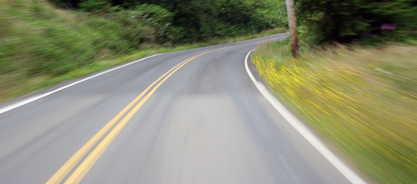
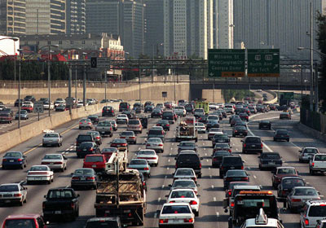
CPS and the Mobile Tsunami
Hari Balakrishnan
M.I.T.
cartel.csail.mit.edu

Slide 2
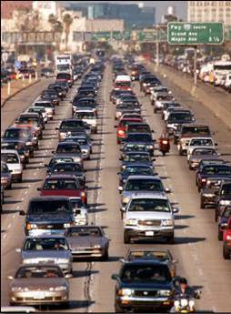
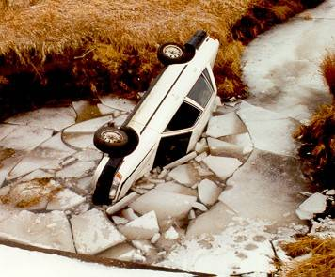
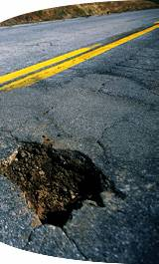
Road Transportation Challenges
Accidents & hazards Congestion
Degrading roads Pollution
80% of world’s population is in places where automobile
growth is occurring at >20% per year

Slide 3
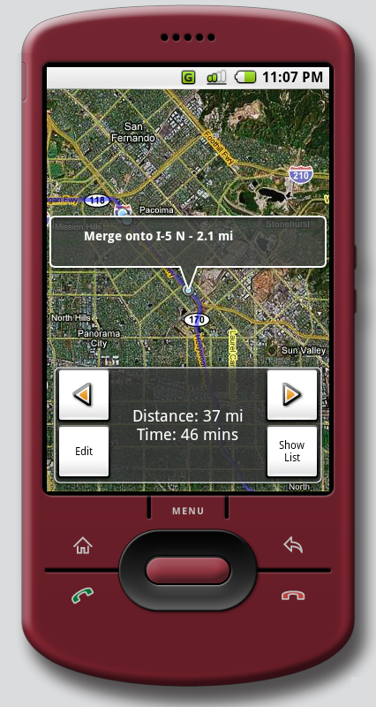

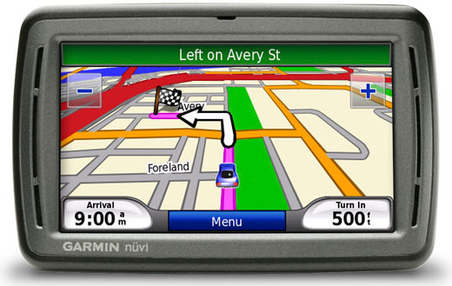
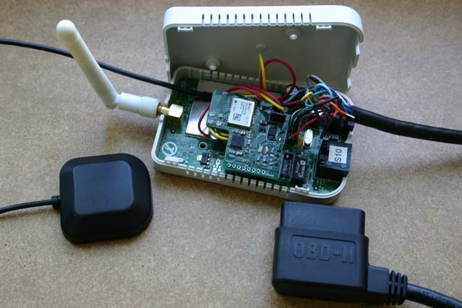
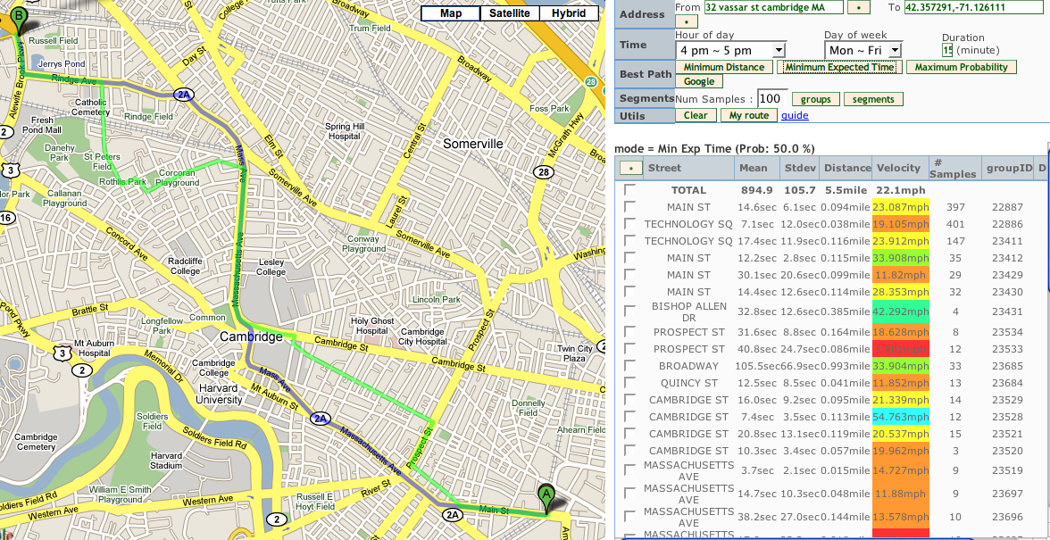
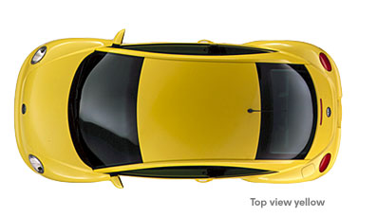
CarTel: Vehicular CPS with Mobile Sensing
Servers
Modeling, prediction, analysis
Location-based vehicular apps
Protect user location privacy
CITA distrib. prog. framework
Trajectory & delay estimation (VTrack, CTrack)
Traffic-aware stochastic routing
Usage-based tolling
Road surface & hazard monitoring (Pothole Patrol)
Driver safety scoring & insurance
Highly granular raw data collection
Aggregation provides environmental info
Details enable personalized service
V2I
Smartphones or embedded device
in vehicles
V2V mobile mesh
Partners: PlanetTran, Ford, Insurance Co.
Notes:
V2I == Vehicle-to-Infrastructure
V2V = Vehicle-to-Vehicle

Slide 4
Why Smartphones for CPS?
Smartphones
Truly ubiquitous!
Births
Births-deaths
Per day, in Q2 2012

Slide 5
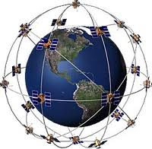
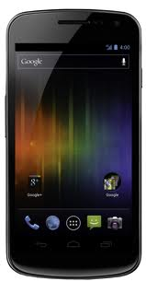
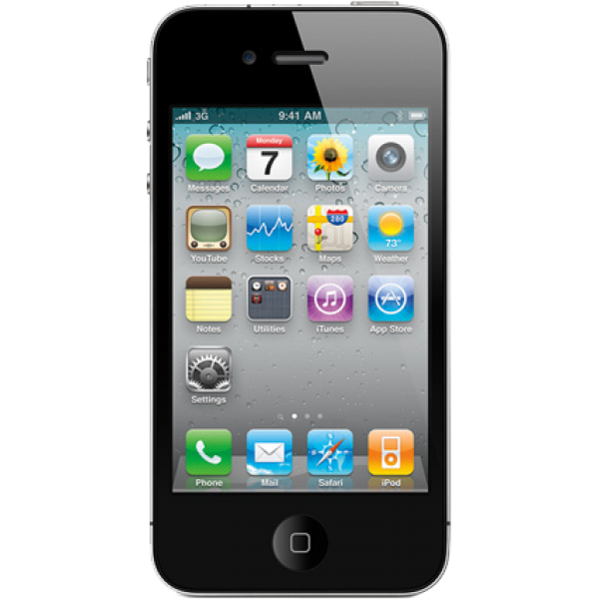


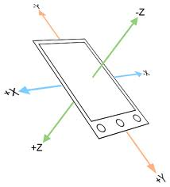
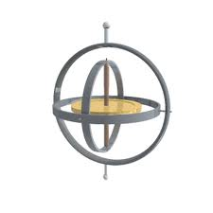

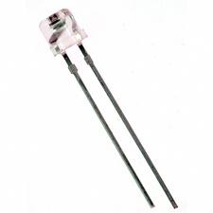
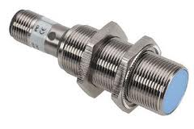
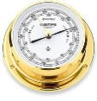

Why Smartphones for CPS?
GPS
WiFi
Detailed driving activity
Mileage
Road types
Hours
Delays & congestion
Speed profiles
Accel events
Hazards
Cell
Accl
Gyro
Compass
Mic
Light
Proximity
Barometer

Slide 6
Smartphones
Key to Mass Adoption
Telematics Update says (2012):
  Smartphones may emerge as a way to incentivize the insurance telematics model.
  Connecting insurance telematics solutions to smartphones can provide transparency to drivers and a degree of control.

Slide 7
Challenges
Clean models from noisy data
Distributed programming framework
Privacy and security protocols
Actuation & feedback

Slide 8
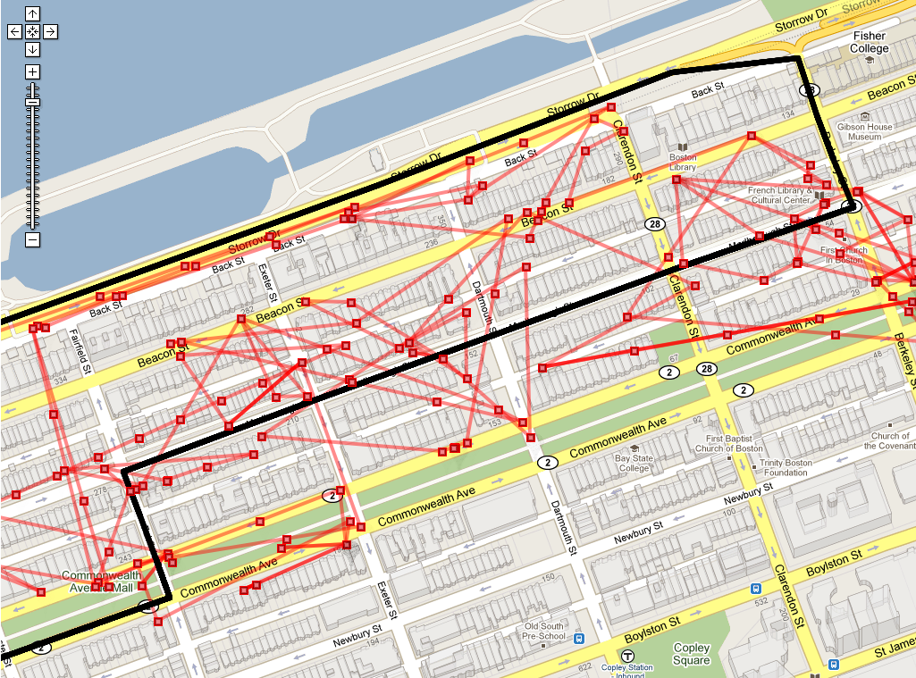
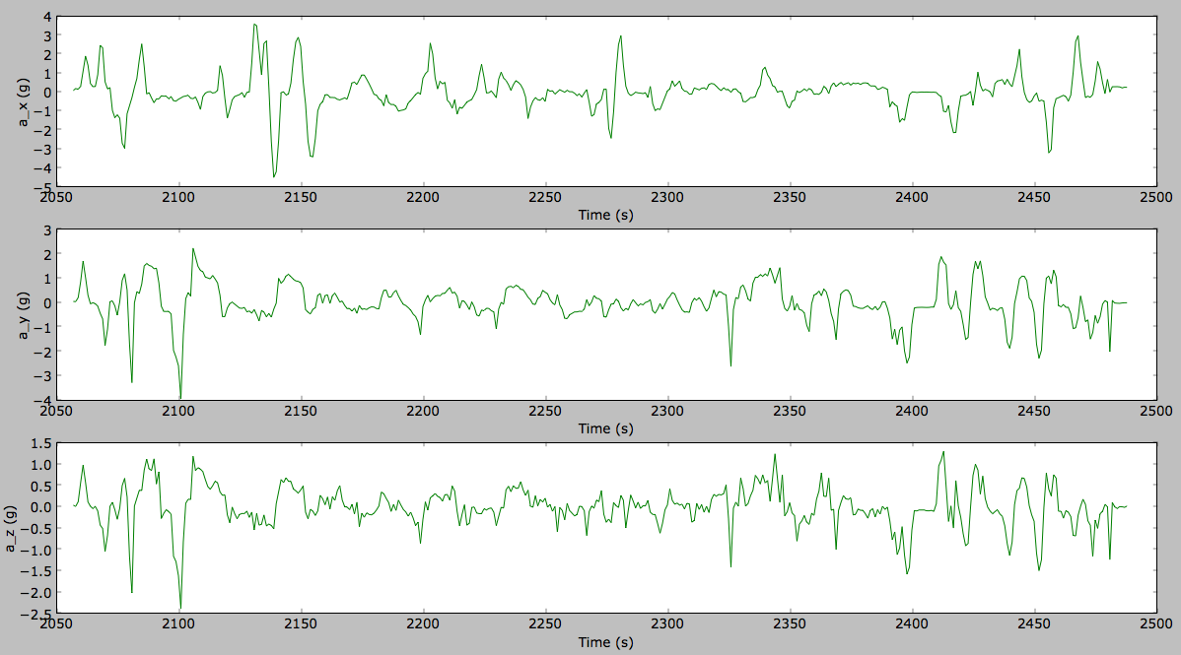
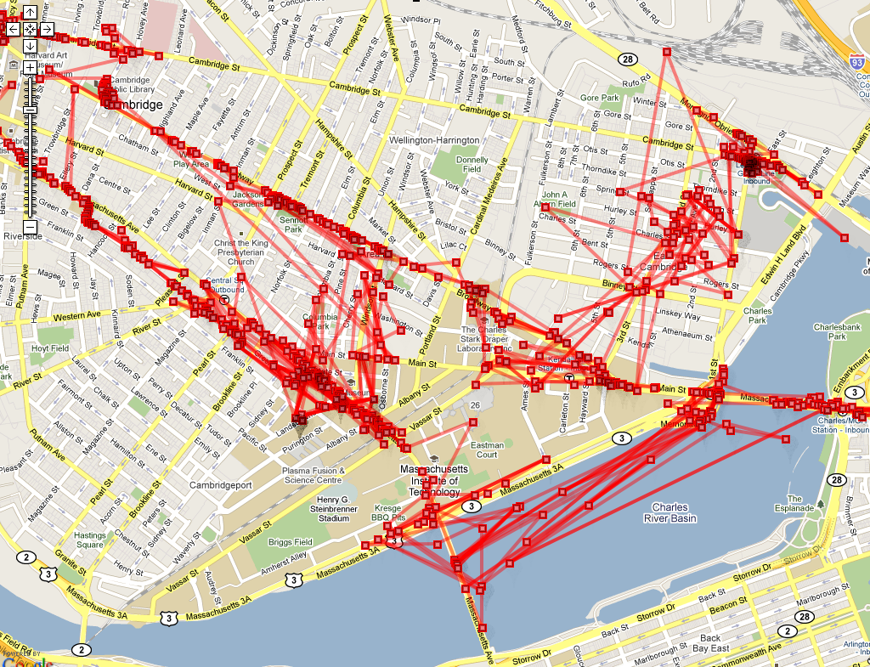
Noisy Data
Hours
Cellular/WiFi
locations
3-axis accel
Accurate probabilistic models from inherently
noisy data, gathered in a battery-efficient way
Notes:
Phone not oriented in fixed position, user can pick up the phone, reorient, etc.
Gravity vector changes depending on hills and orientation
Sensor has drift, sensitive to temperature changes

Slide 9
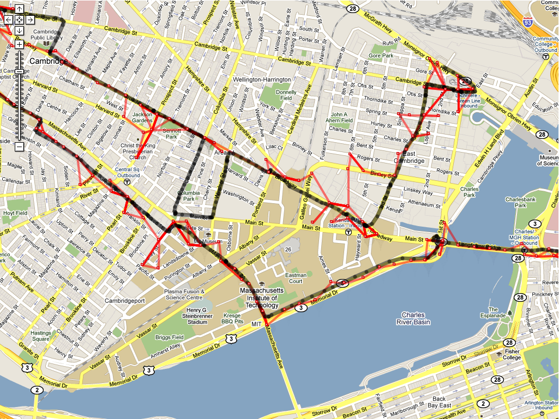
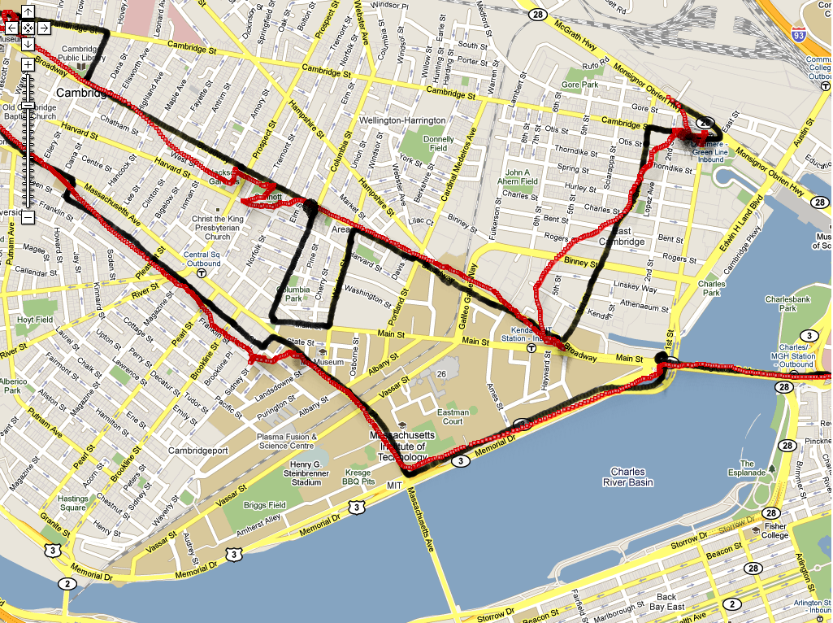
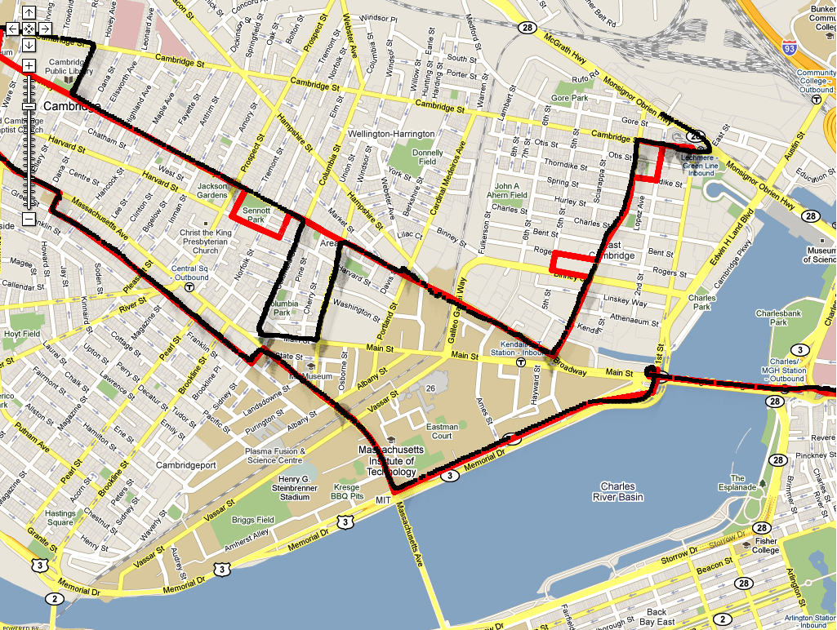
Accurate Models from Noisy Data
HMM RF fingerprints
to grid sequence
Raw points
HMM smooth grid to map
Smooth + interpolate
grid sequence
VTrack, SenSys 2009
CTrack, NSDI 2011
Notes:
I haven’t shown the grid lines here, they are kind of hard to see. Overlay grid on to second picture.

Slide 10
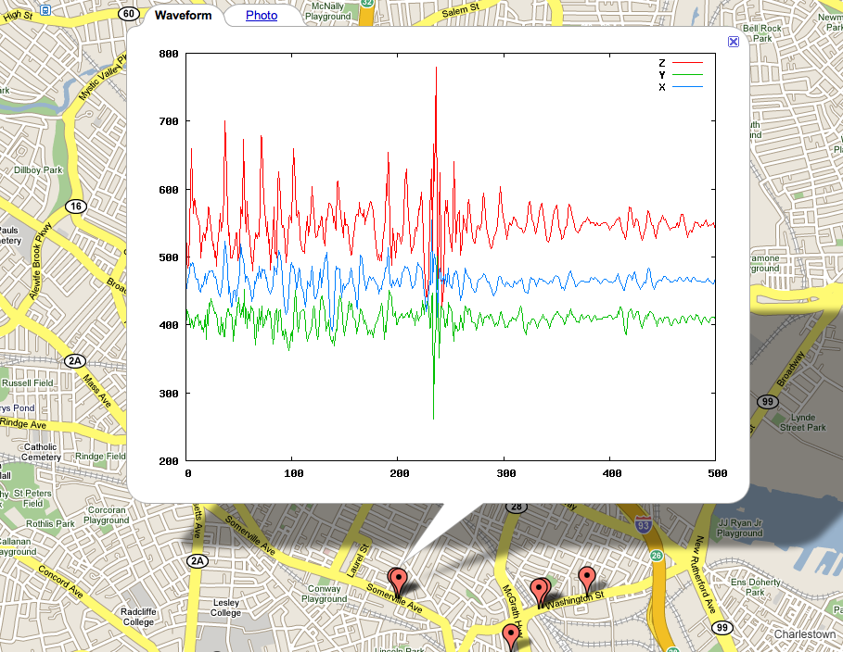
Pothole Patrol (P²)
Road infrastructure degrading rapidly
Over 500K pothole-related insurance claims/year
Thousands of damage claims per year against states
Not enough money to fix every problem
J. Eriksson, L. Girod, B. Hull, R. Newton, S. Madden, HB, Mobisys 2008

Slide 11
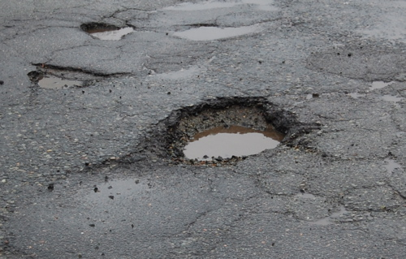
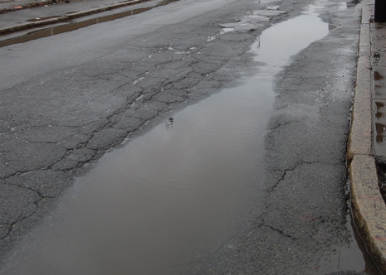
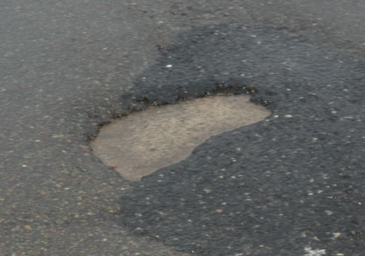
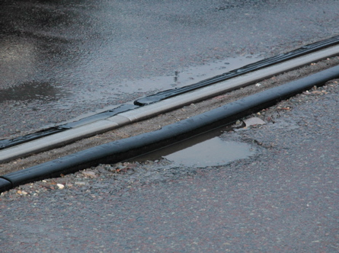
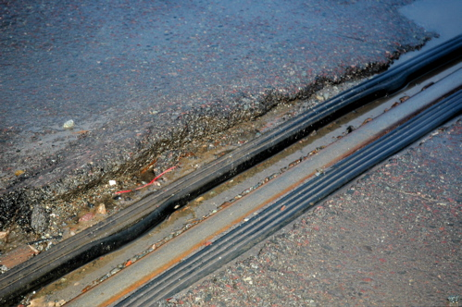
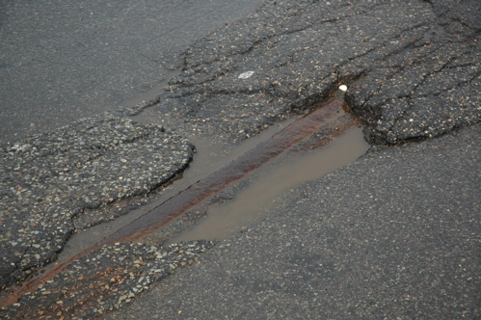
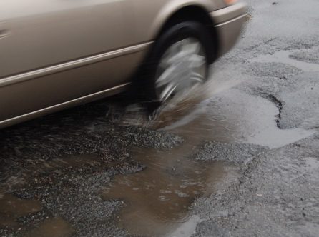
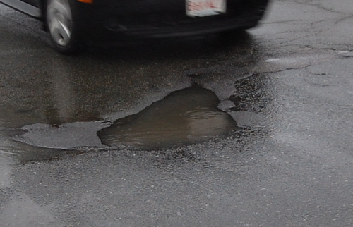
Notes:
potholes annoying, scary?
significant costs to cities, car owners
‘report a pothole’ programs
even lawsuits

Slide 12




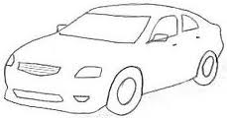
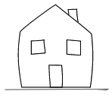
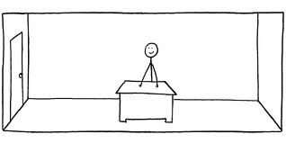
Code In The Air
Distributed Tasking & Coordination
GPS
WiFi
Cell
Walking
Running
Sitting
Accl
Gyro
Biking
Driving
Compass
CITA lowers the barrier for programming and executing distributed tasking applications
Mic
Indoors
Outdoors
AtHome
AtOffice
Light
Proximity
Barometer

Slide 13
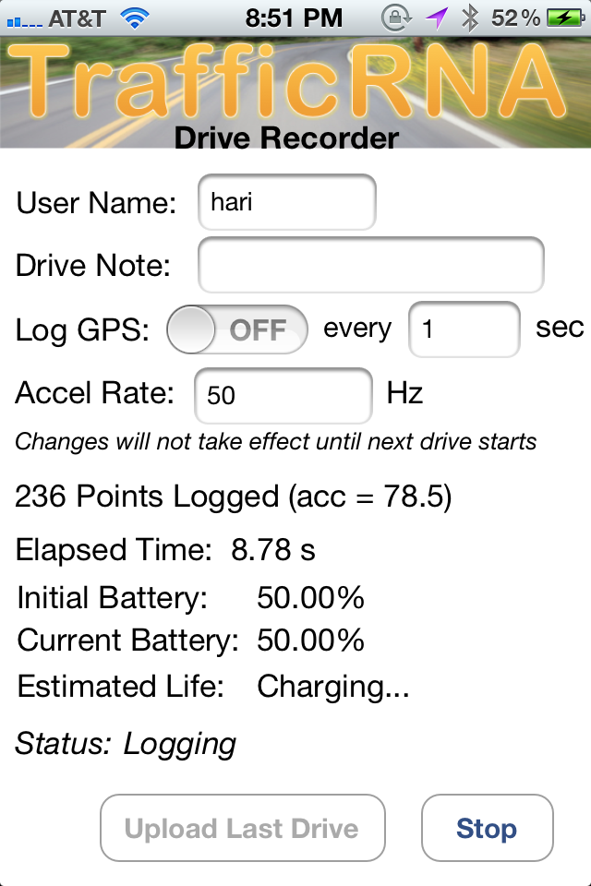
CITA Supports Tasking & Coordination
Background service runs continuously, captures sensor data
Apps: server-side scripts only, using activity as primitive (no sensing code)
Trigger actions when right conditions are met
End-user programming on mobile
Support coordination between multiple users or devices

Slide 14
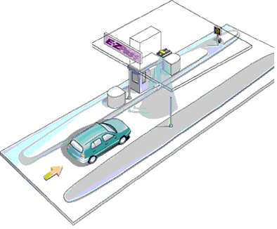
Changing User Behavior with
Smarter Tolling & Insurance Models
Antenna
Imagine a system with (almost) no
road-side tolling infrastructure
Software on mobile device
monitors location tracks
Device and server run protocol to compute payment or rebate
Device (user) does not trust server with location tracks
Server does not trust device (tampering)
Account ID

Slide 15
Applications
Usage-based tolls
Speeding tickets
  Did the driver ever travel faster than 70 mph?
Usage-based insurance
  How many miles this month did the driver travel on freeways?
  How many “hard braking” events?
Notes:
We looked at several different applications.;
This being the general protocol., we discuss four specific Say that our extensive example is the road pricing example
As one application we show how to compute times over speed limit

Slide 16
VPriv: Enabling Private Aggregates
Calculations for tolling, insurance, and violations are functions over time-location tuples
Compute such functions privately in zero-knowledge
VPriv designed from scratch; cryptographic commitment protocol w/ homomorphic encryption
Applicable to sum of cost functions
Efficient – 10000x faster than generalized reductions
R. Popa, HB, A. Blumberg, Usenix Security, 2009
R. Popa, HB, A. Blumberg, ACM CCS, 2011

Slide 17
Summary
Vehicular CPS should embrace mobile smartphones and use that as a “hub”
Real-time
vehicular
control
In-car
driver
feedback
… building
new roads
Driver reports
Safety analysis
Fixing
roads
milli
seconds
multiple
seconds
weeks-
months
minutes
days
Time
V2V
comm.
V2I: traffic,
navigation,
incidents
Tolling
Usage-based
insurance rebates

