Slide 1
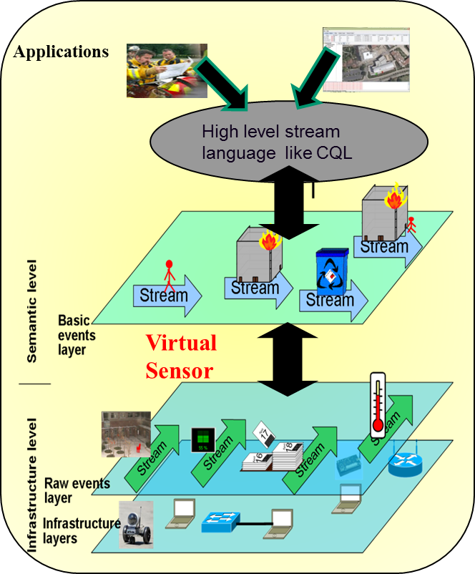
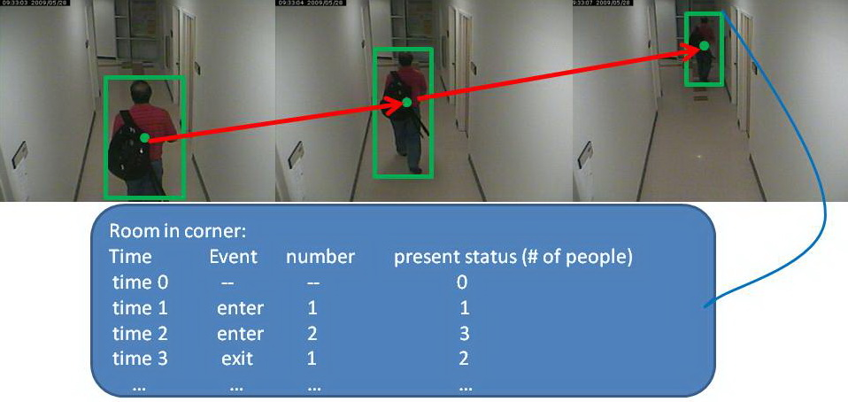
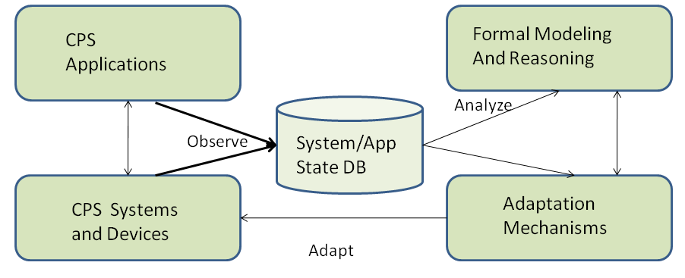
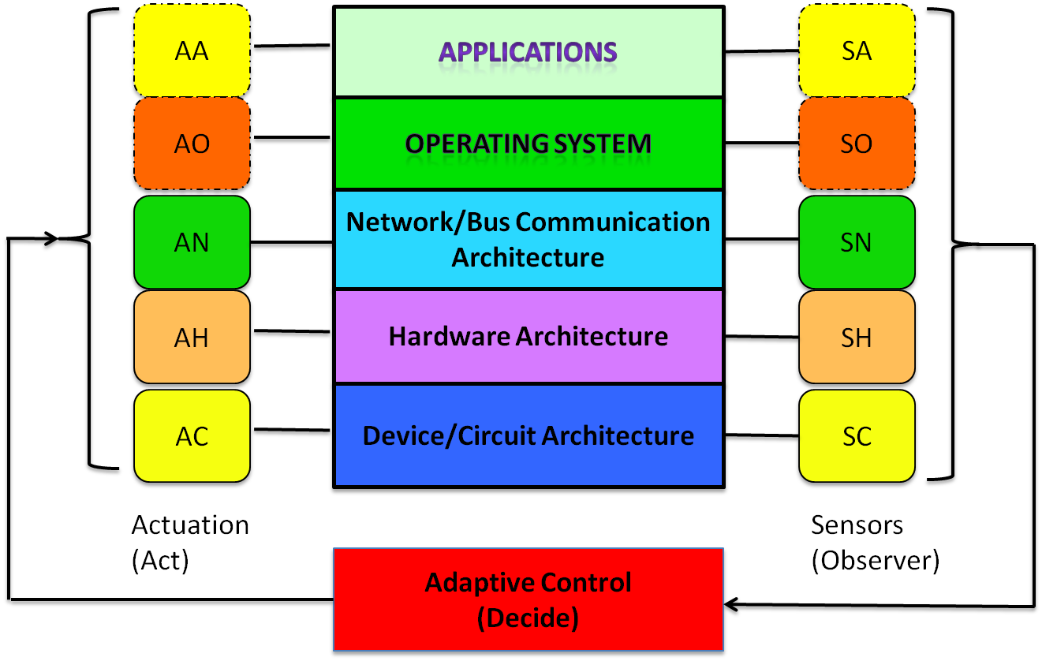
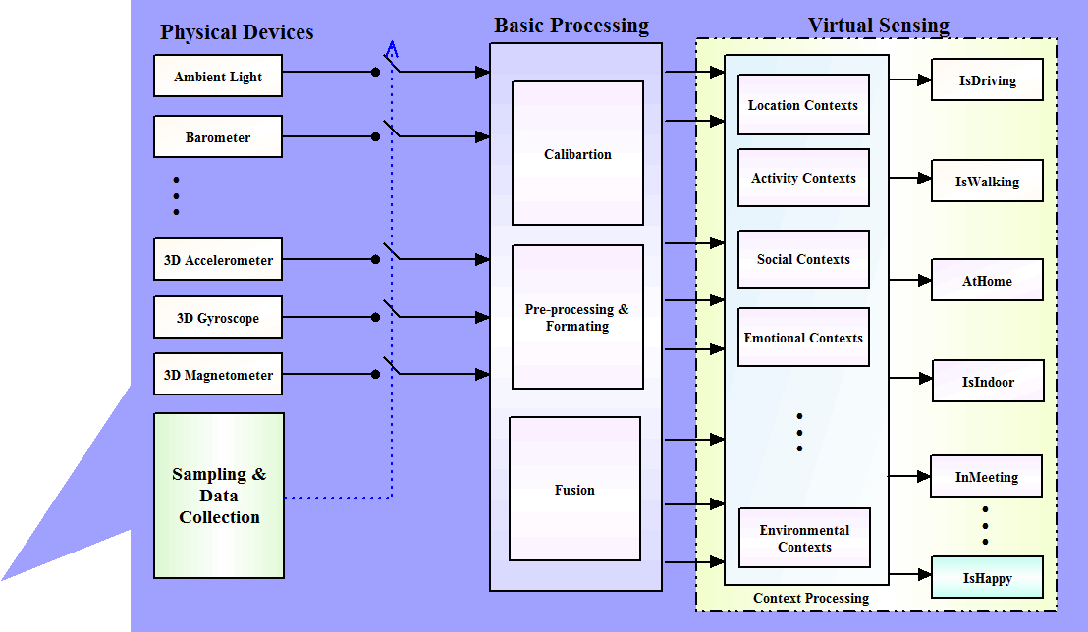
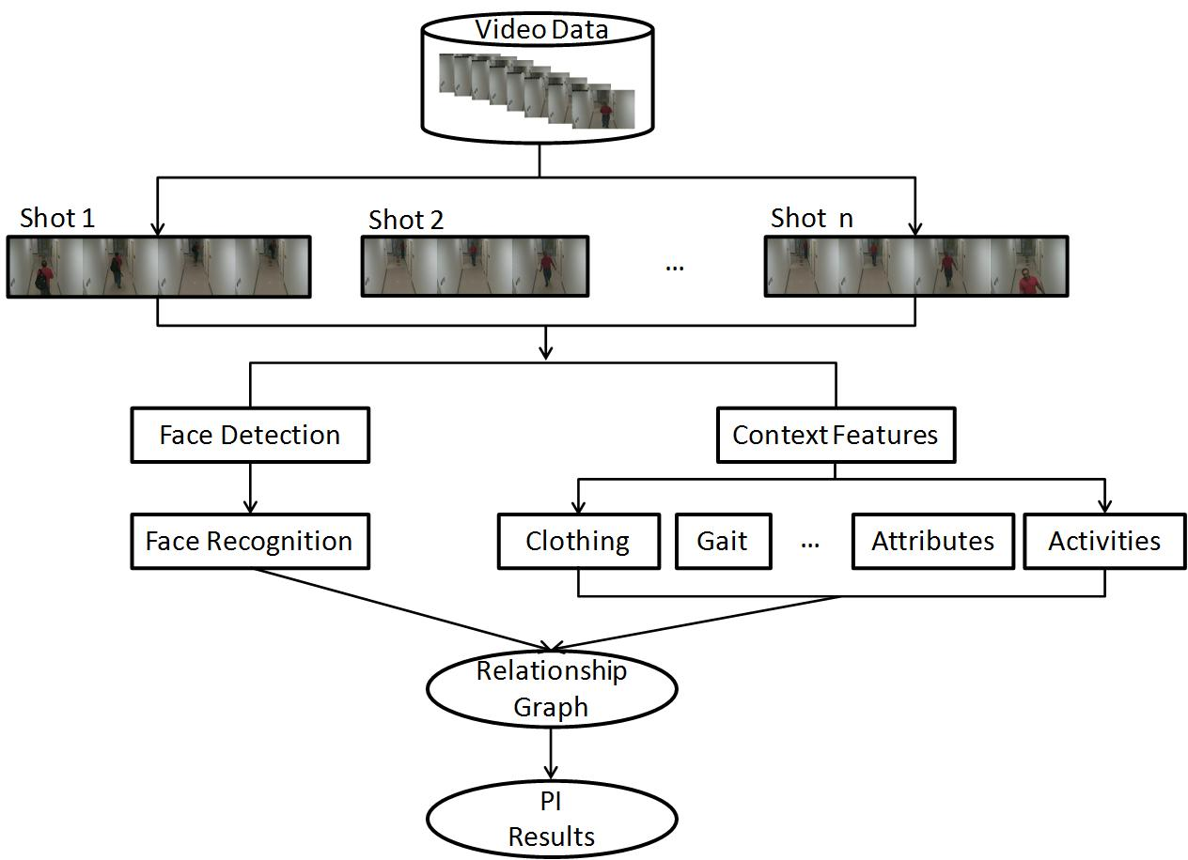
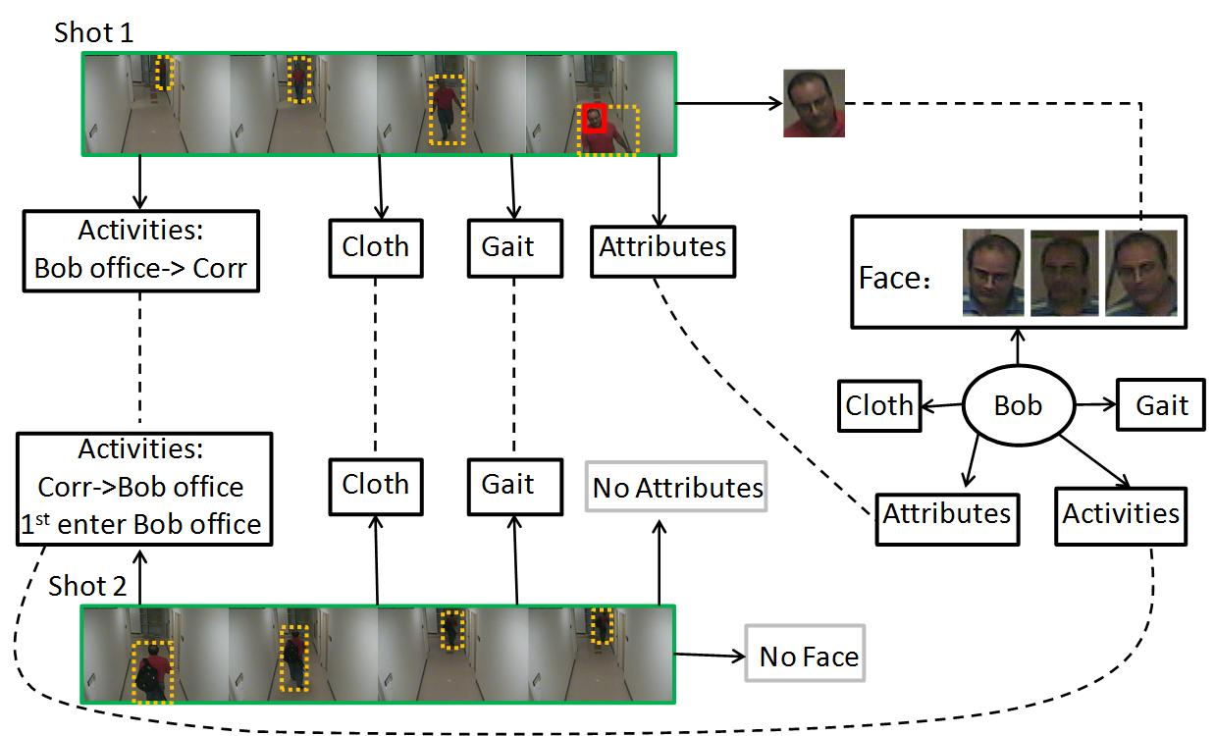
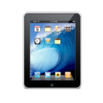
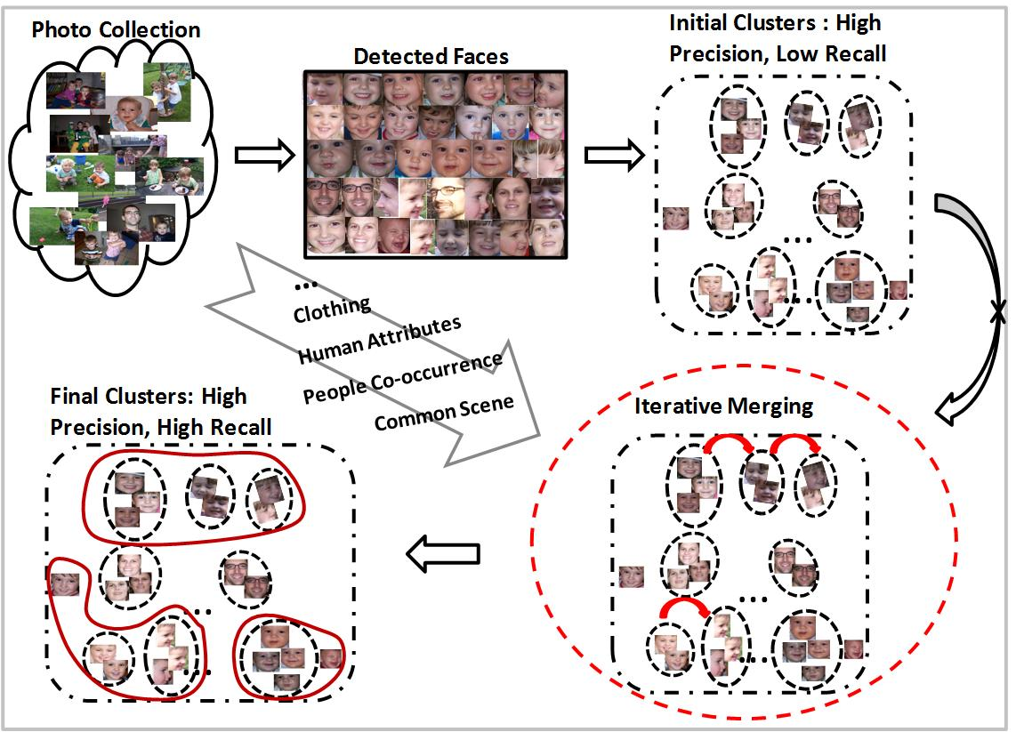
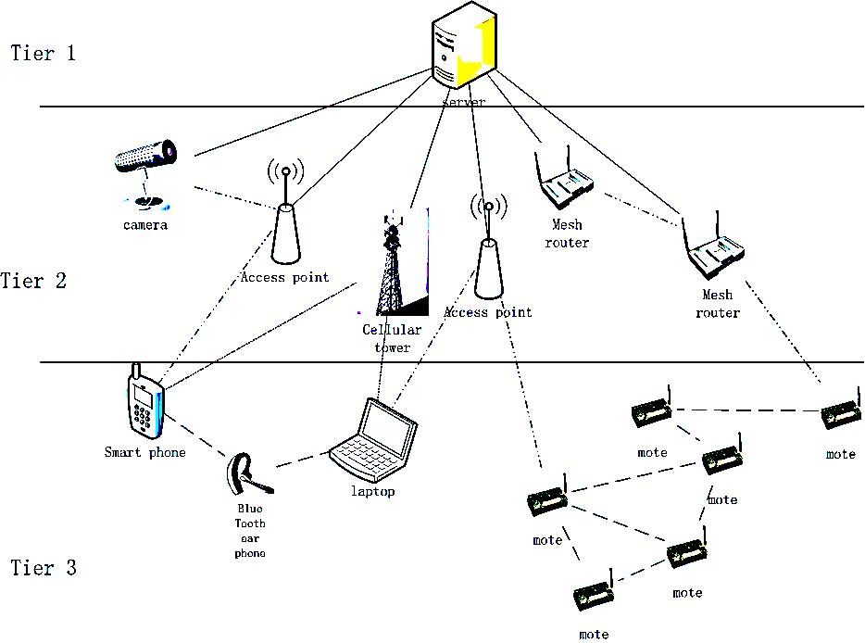
CYPRESS: Cyber-Physical RESilience and Sustainability
Dependability Techniques for Instrumented Cyber-Physical Spaces
Grit Denker, Nikil Dutt, Minyoung Kim, Sharad Mehrotra, Mark-Oliver Stehr, Carolyn Talcott, Nalini Venkatasubramanian
Nga Dang, Leila Jalali, Zhijing Qin, Santanu Sarma, Ronen Vaisenberg, Xiujuan Yi, Liyan Zhang
University of California, Irvine and SRI International
Goals and Objectives
Explores techniques for dependability and resilience and in instrumented cyber-physical spaces (ICPS).
Semantic foundations, cross-layer system architecture and adaptation services to improve dependability.
Reflective (observe-analyze-adapt) Architecture.
Digital state representation of ICPS guides a range of “safe” adaptations to achieve end-to-end infrastructure and information dependability
Semantic Middleware for ICPS
Information Dependability Techniques
Context Assisted Semantic Information Extraction
Adaptive Actuation for Event Detection
Face Recognition is challenging in a resource-constrained environment.
Leverage heterogeneous context information to improve the performance of person identification and face clustering for surveillance videos and personal photos.
Employ RelDC and Boostrapping idea to integrate heterogeneous context features.
Integrate Human-in-the-loop to achieve high quality results.
Raw Sensor
Data
Balance event capture vs. accuracy
Implement a lightweight, real-time scheduler applied in zoom-enabled camera networks
Modeled as Partially Observable Markov Model(POMDP)
Context-assisted Semantic Extraction
Human-in-the-loop
Reliable Semantics
Infrastructure Dependability Techniques
Infrastructure component errors/failures - Device Failures, Network Failures, Overload, Congestion
Cross Layer Design of Cyber Physical System-on-Chips (CPSoC)
Cross-layer virtual sensing makes ICPS devices self-aware for dependability
Case study: MPSoC mobile phone/processor systems. Autotune parameters to address tradeoffs in performance/power/thermal impact/reliability
Using Multiple Access Networks
Design of a multi-network management system that manages a hierarchical network structure with stable, resource-rich nodes closer to the root
Scheduling mechanisms to avoid radio interference; Cost-effective network state collection techniques; Lightweight query processing mechanisms
SenseDroid- Cooperative Sensing Platform
MINA – Multinetwork INformation Architecture
Area 1 : -> Camera 7
Area 5 : -> Camera 1, 3
Area 9 : -> Camera 5, 6, 1
Area 13 : -> Camera 3
: -> Camera 4, 8
Area 4 : -> Camera 1, 2
Context Based Semantic Information Extraction
Area 1 : -> Camera 7
Area 5 : -> Camera 1, 3
Area 9 : -> Camera 5, 6, 1
Area 13 : -> Camera 3
: -> Camera 4, 8
Area 4 : -> Camera 1, 2
Objectives
Exploit heterogeneous connectivity to enhance infrastructure dependability
Structure multiple networked devices into a hierarchical overlay and exploit overlay for flows
Collect global network state to enable effective, adaptive resource utilization, performance and device management, and fault detection.
Intelligent analysis on collected state will provide capabilities of tuning and adapting.
Provide visual decision aids to pro- or reactively improve network resilience
Framework
Context-assisted Person Identification for Videos
Internet /Public Cloud
Query/
Response
Example
Middleware
Broker
Cloud
Users
3G AP
Wi-Fi AP
Analyze
Achieving Resilience of Heterogeneous Networks Through Predictive, Formal Analysis
Maude is a rewrite logical based formal method enabling efficient reasoning
What happens if a node fails?
When and where to deploy additional resources?
How to mitigate effects of load or link changes?
…
Mobile
Users
…
…
Collaborative Sensing
Mobile Phone Sensing
Observe
Network tomography with link correlation
Employing Network tomography in Multinetwork context, to decrease the collection overhead
Exploiting heterogeneous link correlation can greatly improve the accuracy
Quality aware of network state information collection
Adapt
Path Switching over Multiple Networks
Quickly switch path when link failed
Flows can be enhanced by exploiting multiple paths
Network planning/reconfiguration based on Analyze results
Framework
Context-assisted Face Clustering for Images
Objective
Simple and Easy-to-Use Framework for Sensing and collaboration using mobile phone
Powerful additional sensing abilities and features for community of users by community of users
Understand user and group context efficiently
Building energy-efficient collaboration apps in the Android framework
Empowered by community of users
Distributed middleware framework
Provide API and libraries to perform:
Collaboration
Compressive Sensing
Virtual Sensing
Compressive Context Determination
Computational Offloading
Scalable sensing
Human-In-The-Loop
Preprocessing: Overlay Construction and Modeling
Tree based overlay in heterogeneous network
Modeling path duration time in dynamic, mobile, convergecast network
Contact PIs: Nalini Venkatasubramanian (nalini@ics.uci.edu) and Grit Denker (grit.denker@sri.com) Funded by the National Science Foundation (Project Nos. 1063596 and 1063597)

