Slide 1
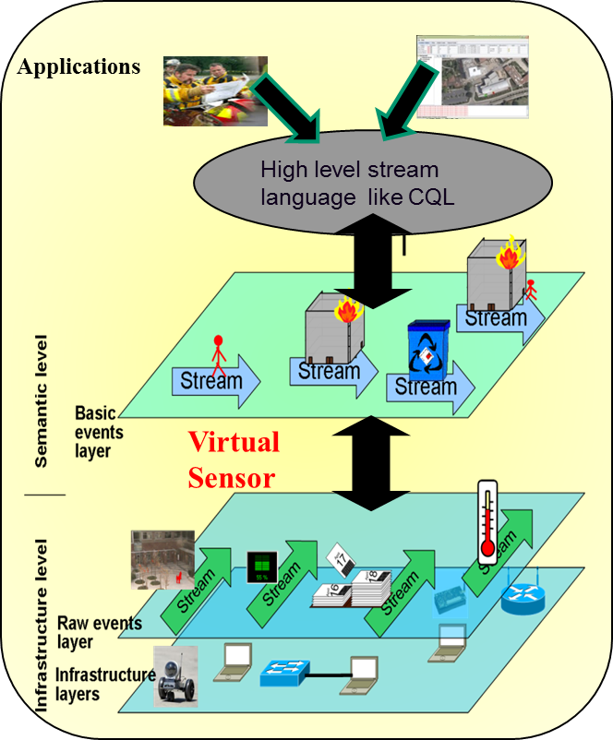
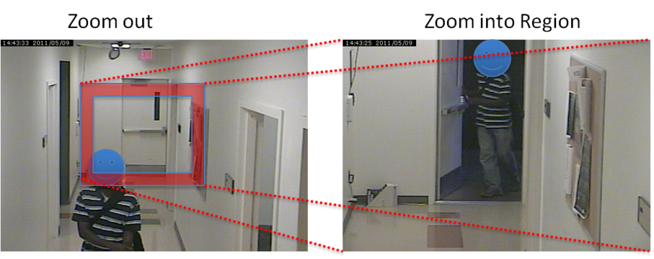
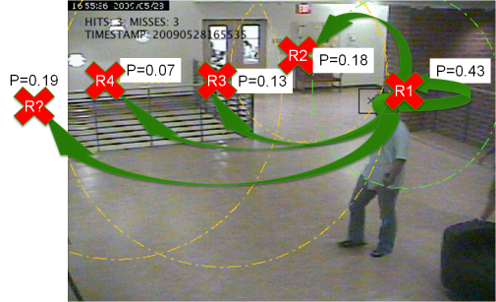
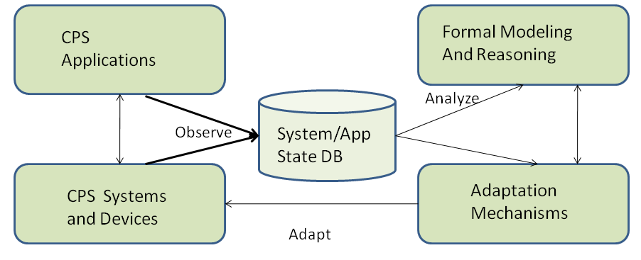
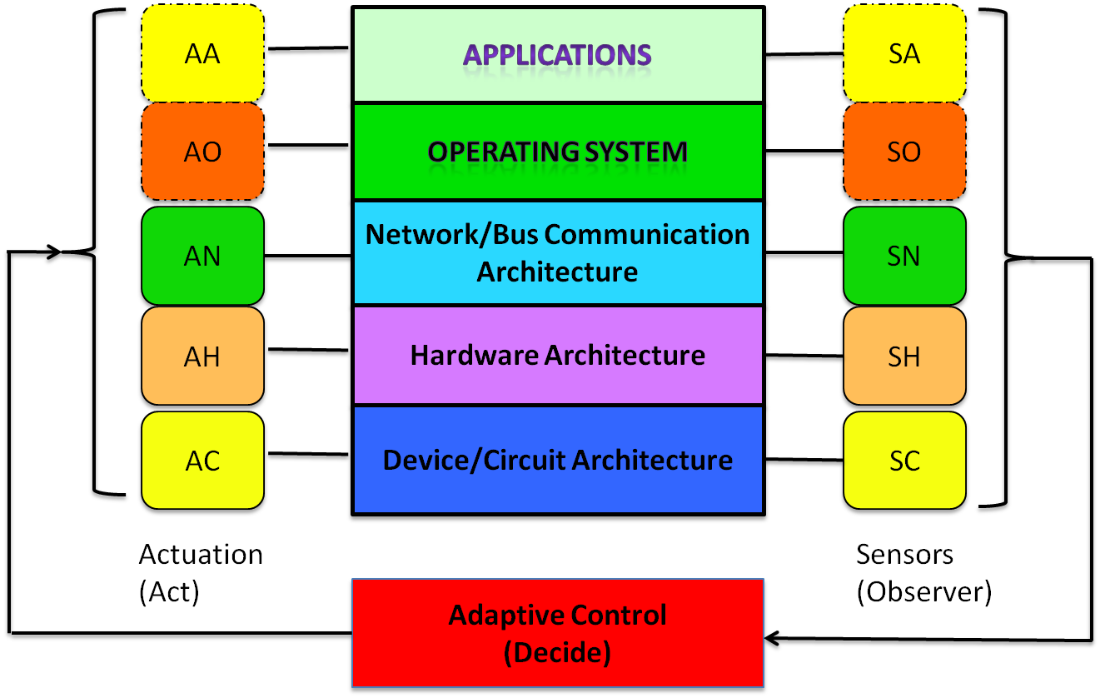
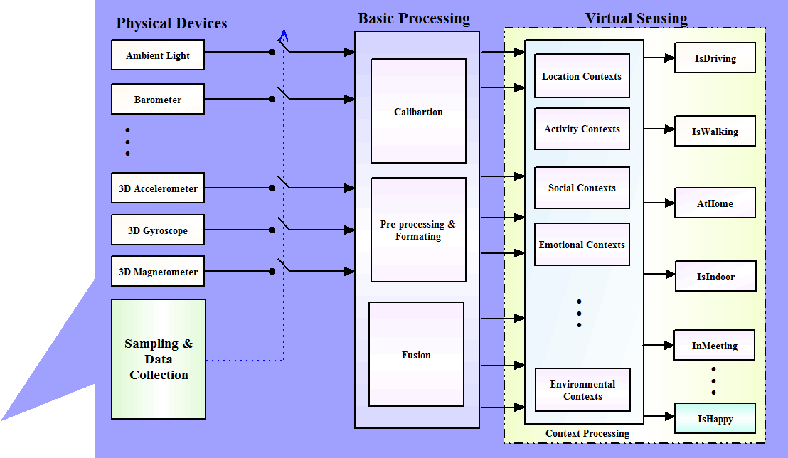
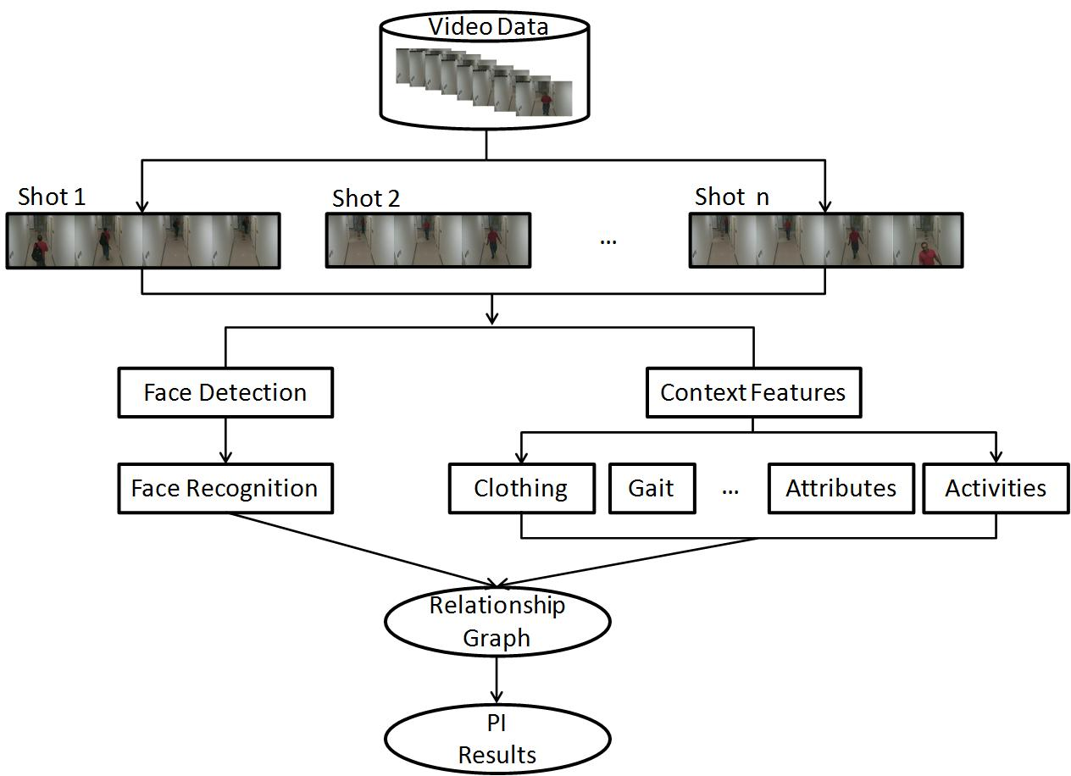
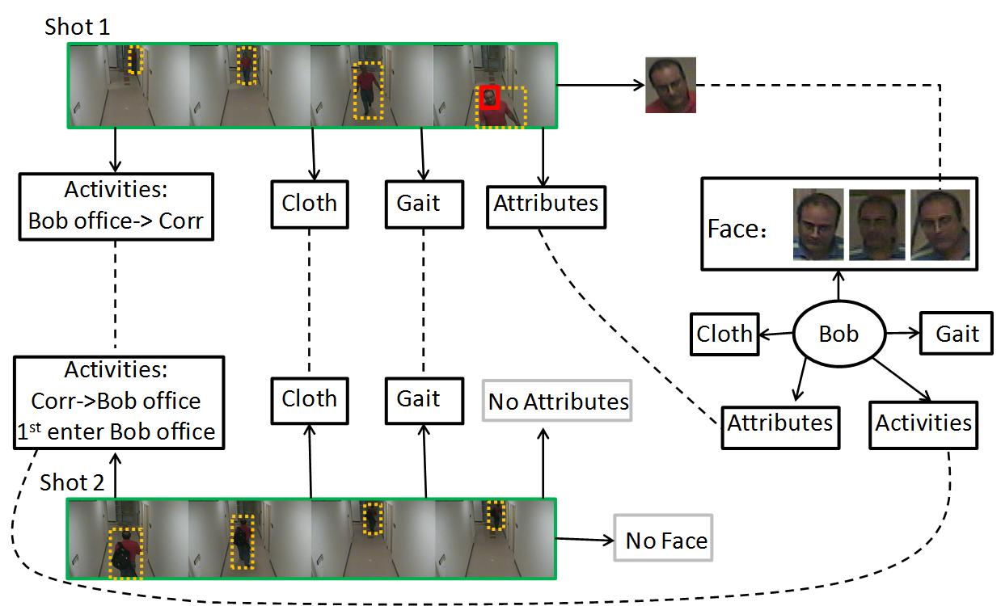
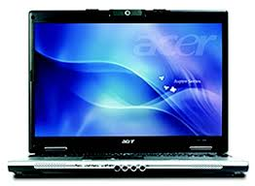
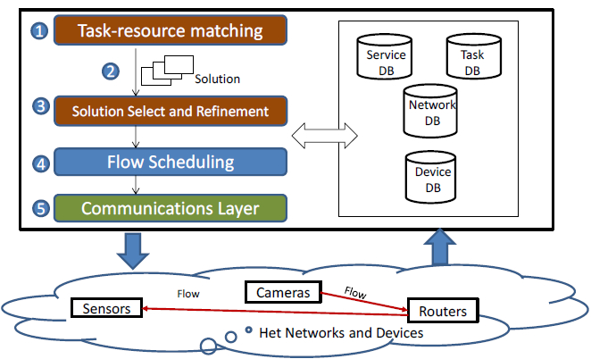
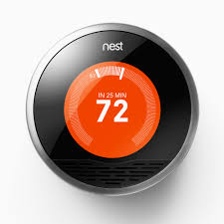
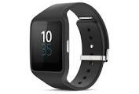
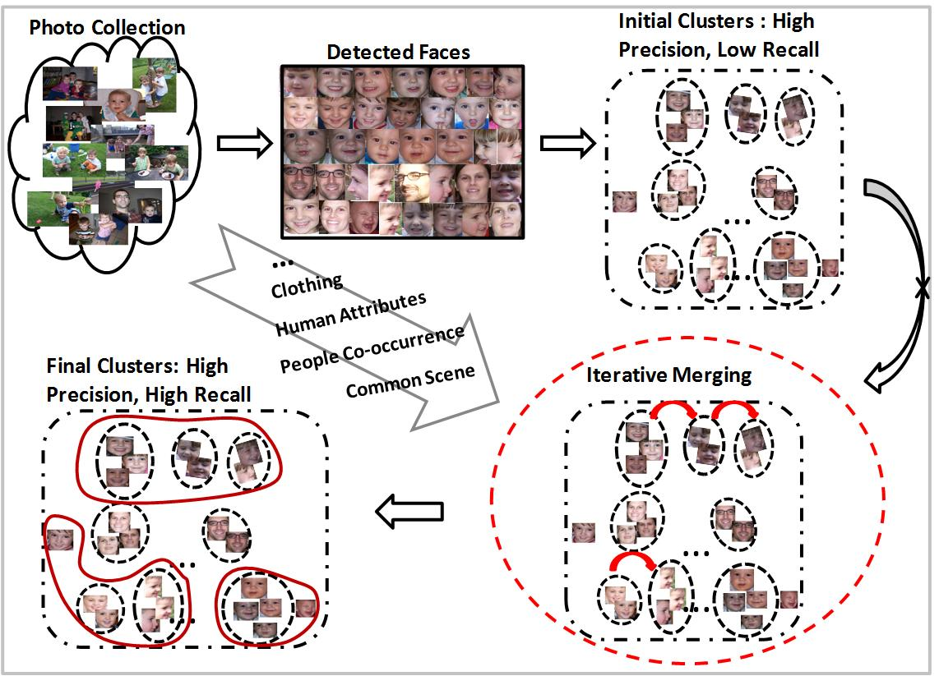
CYPRESS: Cyber-Physical RESilience and Sustainability
Dependability Techniques for Instrumented Cyber-Physical Spaces
Grit Denker, Nikil Dutt, Minyoung Kim, Sharad Mehrotra, Mark-Oliver Stehr, Carolyn Talcott, Nalini Venkatasubramanian
Leila Jalali, Zhijing Qin, Santanu Sarma, Ronen Vaisenberg, Xiujuan Yi, Liyan Zhang
University of California, Irvine and SRI International
Goals and Objectives
Explores techniques for dependability and resilience and in instrumented cyber-physical spaces (ICPS).
Semantic foundations, cross-layer system architecture and adaptation services to improve dependability.
Reflective (observe-analyze-adapt) Architecture.
Digital state representation of ICPS guides a range of “safe” adaptations to achieve end-to-end infrastructure and information dependability
Semantic Middleware for ICPS
Information Dependability Techniques
Context Assisted Semantic Information Extraction
Adaptive Actuation of Devices for Event Detection
Face Recognition is challenging in a resource-constrained environment.
Leverage heterogeneous context information to improve performance of person identification and face clustering for surveillance applications.
Employ RelDC (a graph-based entity resolution framework) to integrate heterogeneous context features.
Integrate Human-in-the-loop to achieve high quality results.
Raw Sensor
Data
Balance event capture vs. accuracy
Implemented a lightweight, real-time scheduler applied in zoom-enabled camera networks
Modeled as Partially Observable Markov Model(POMDP)
Context-assisted Semantic Extraction
Human-in-the-loop
Reliable Semantics
Infrastructure Dependability Techniques
Infrastructure component errors/failures - Device Failures, Network Failures, Overload, Congestion
Cross Layer Design of Cyber Physical System-on-Chips (CPSoC)
Cross-layer virtual sensing makes ICPS devices self-aware for dependability
Case study: MPSoC mobile phone/processor systems. Autotune parameters to address tradeoffs in performance/power/thermal impact/reliability
Using Multiple Access Networks
Exploiting multiple network to enhance infrastructure dependability
Design of a multinetwork management platform (MINA) for state capture/analysis
Exploiting Mobility
Event-driven mobile sensing where trajectory of mobile nodes is dictated by evolution of events in space/time.
Compute trajectory for mobile nodes while balancing energy/latency tradeoffs.
Formulated as a Dynamic Vehicle Routing Problem with Time Window (DVRPTW)
SenseDroid- Cooperative Sensing Platform
MINA – Multinetwork INformation Architecture
Area 1 : -> Camera 7
Area 5 : -> Camera 1, 3
Area 9 : -> Camera 5, 6, 1
Area 13 : -> Camera 3
: -> Camera 4, 8
Area 4 : -> Camera 1, 2
Context Based Semantic Information Extraction
Area 1 : -> Camera 7
Area 5 : -> Camera 1, 3
Area 9 : -> Camera 5, 6, 1
Area 13 : -> Camera 3
: -> Camera 4, 8
Area 4 : -> Camera 1, 2
Objectives
Exploit heterogeneous connectivity to enhance infrastructure dependability
Structure multiple networked devices into a hierarchical overlay and exploit overlay for flows
Collect global network state to enable effective, adaptive resource utilization, performance and device management, and fault detection.
Intelligent analysis on collected state will provide capabilities of tuning and adapting.
SDN Based Heterogeneous flows adaptation with multiple QoS requirements in Multinetwork Environment
Framework
Context-assisted Person Identification for Videos
Only one face detected!
Example
Internet /Public Cloud
Query/
Response
Middleware
Broker
Cloud
Users
Semantic technology (Ontologies and rules)
3G AP
High Level task description
Describe characteristics and capabilities of network and device resources as well as services
Describe IoT tasks as hierarchical semantic tasks that are refined through sequences or alternatives of low-level tasks
…
Wi-Fi AP
Mobile
Users
GAP
Capability list
Use RelDC (relation-based data cleaning) to integrate facial and context features
for improved results.
Context features can help to identify entities in the eight frames.
…
…
Low level resource specification
Framework
Context-assisted Face Clustering for Images
Collaborative Sensing
Mobile Phone Sensing
…
Objective
Simple Framework for sensing and collaboration using mobile phones
Powerful additional sensing abilities and features for community of users by community of users
Understand user and group context efficiently
Building energy-efficient collaboration apps in the Android framework
Empowered by community of users
Task KB
Resource KB
Developed Context –assisted framework to integrate multiple context features to improve face clustering results.
Distributed middleware framework
Provide API and libraries to perform:
Collaboration
Compressive Sensing
Virtual Sensing
Hardware/Software Co-design for
On-line Sensemaking
Context classification using Machine learning
Virtual sensing of user activities
Analyzer
Solution lists
Flow
Question:
Which route should a flow take, so that the QoS requirements of this flow is fulfilled?
Which route should all flows take, so that the QoS requirements of all flows can be fulfilled best?
Human-In-The-Loop
Network
We leverage human-in-the-loop to further improve data quality through iterative clustering and user feedback.
Contact PIs: Nalini Venkatasubramanian (nalini@ics.uci.edu) and Grit Denker (grit.denker@sri.com) Funded by the National Science Foundation (Project Nos. 1063596 and 1063597)

