Slide 1



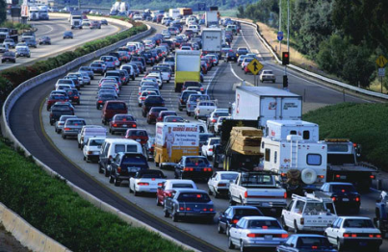
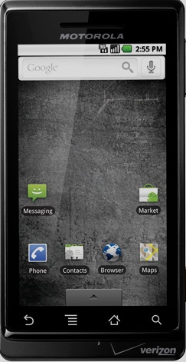

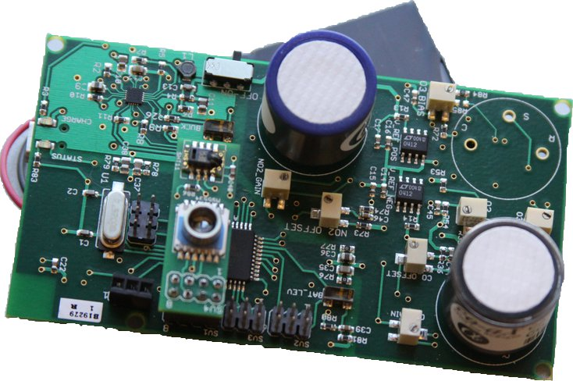
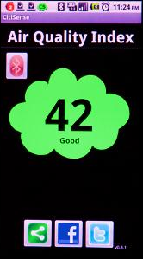
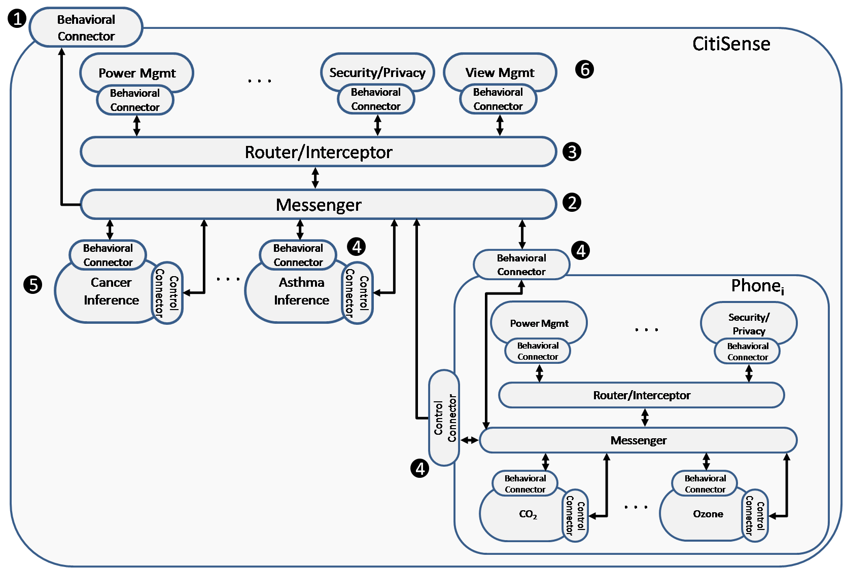
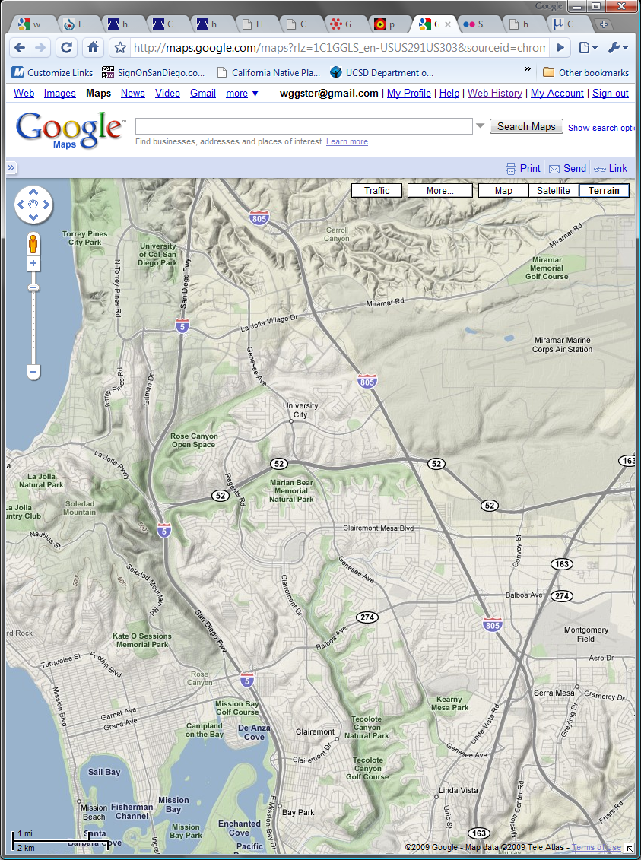
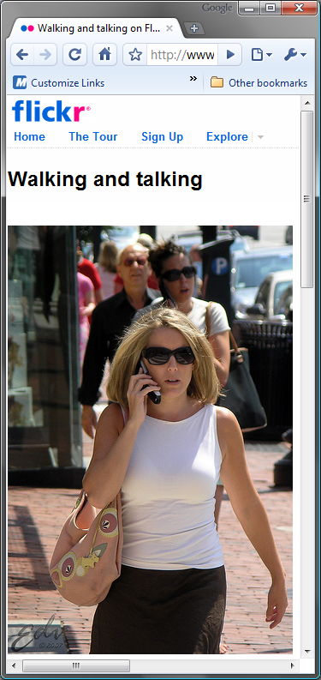
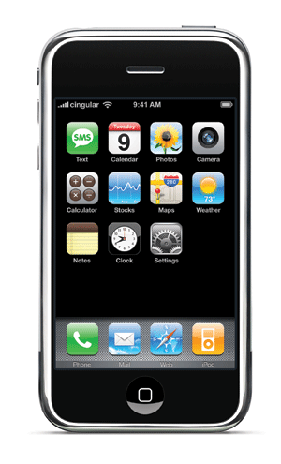

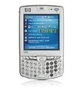

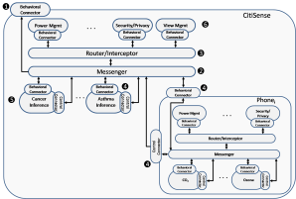





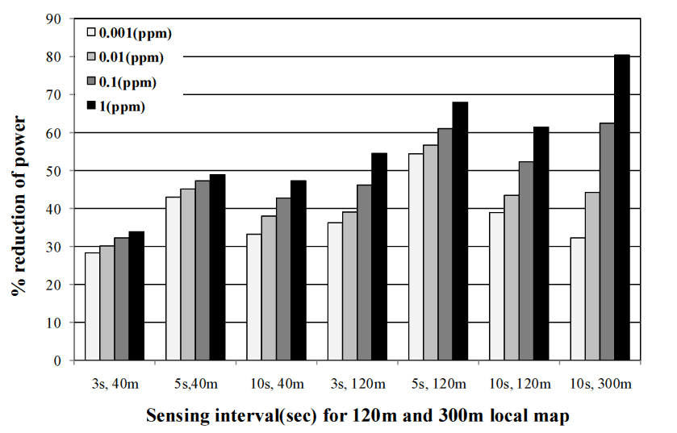
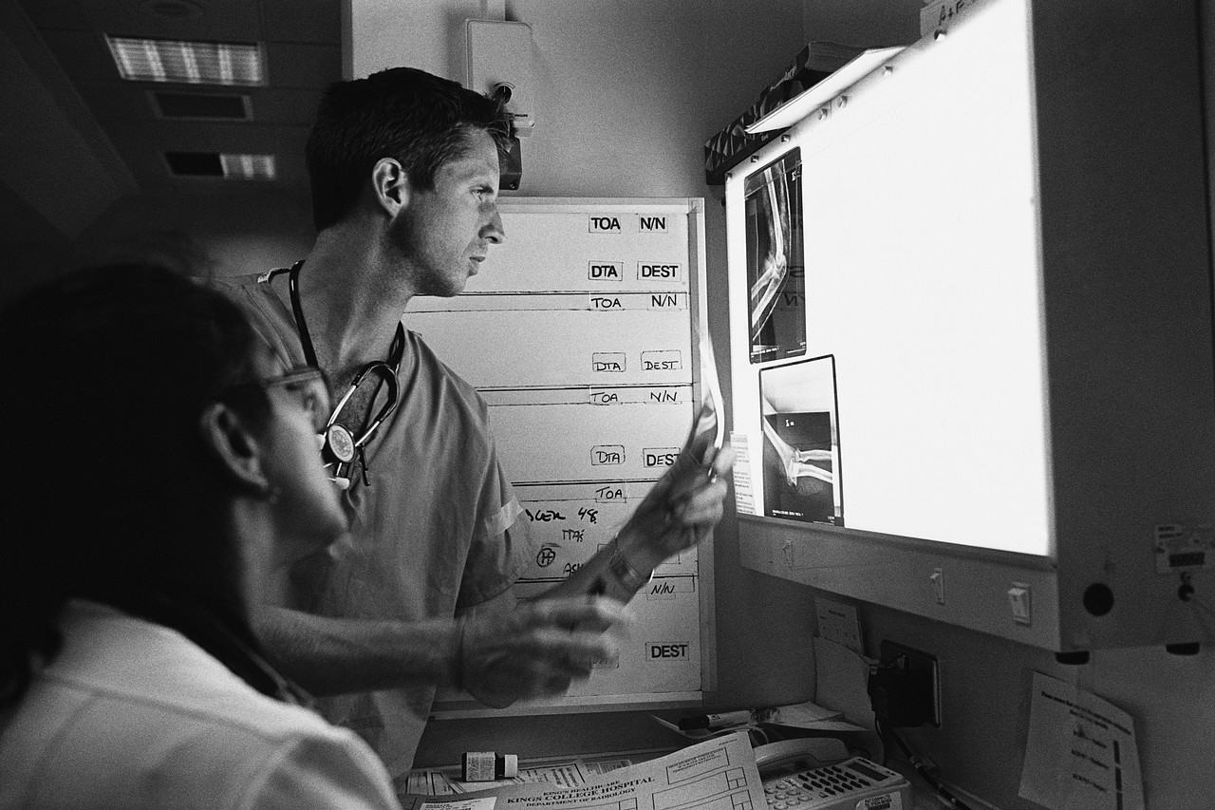

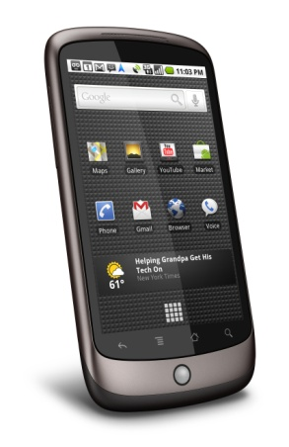
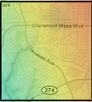

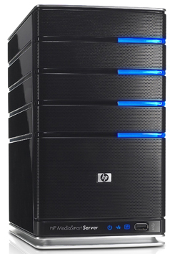
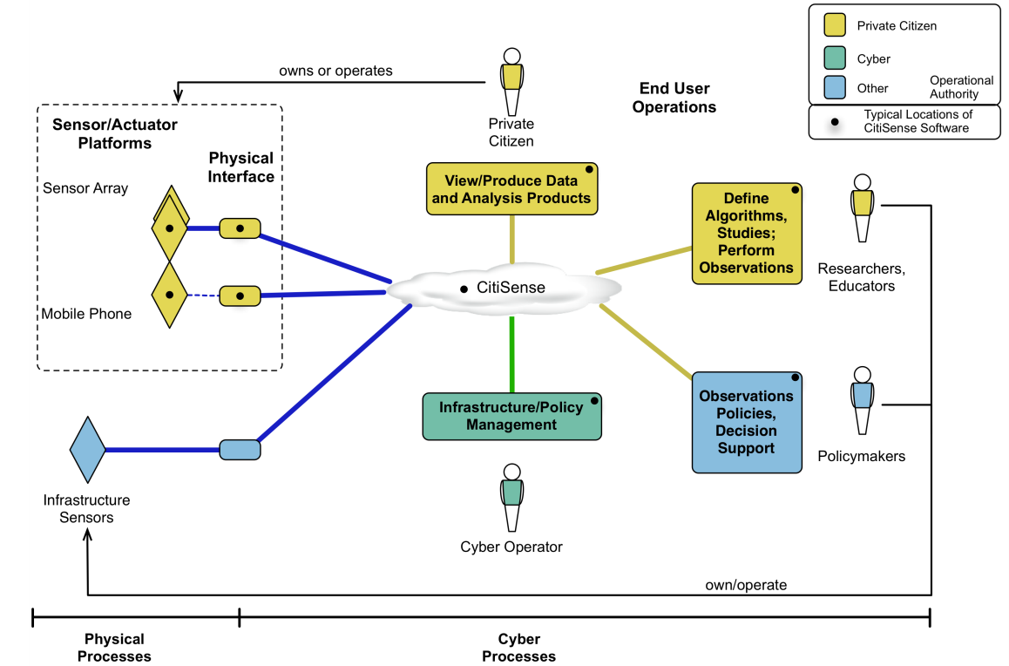
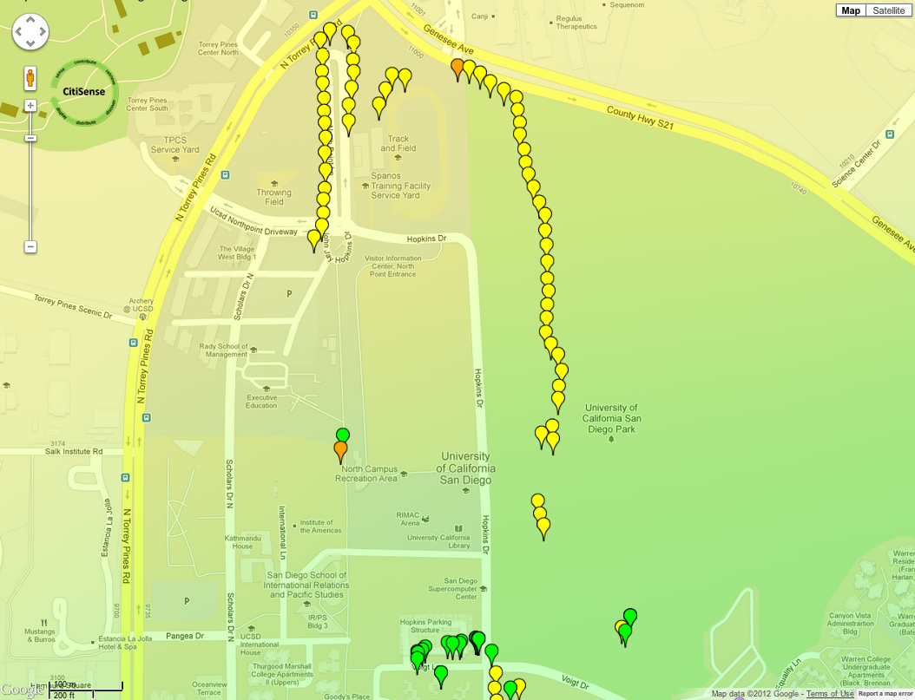
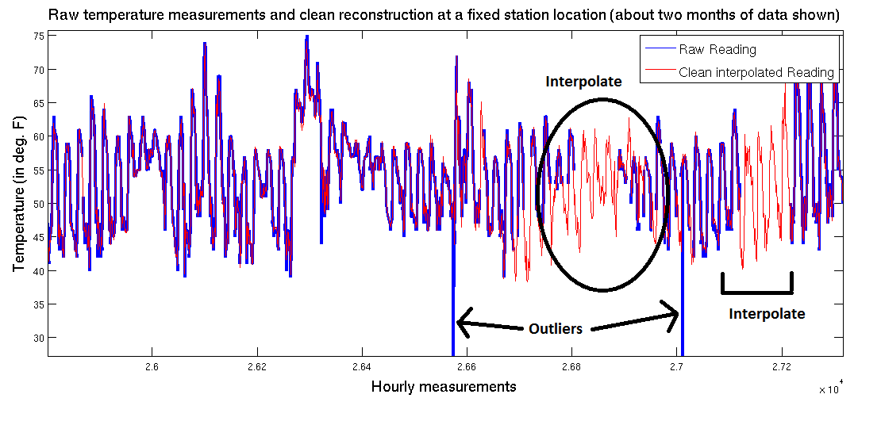



CitiSense – A Participatory Air Quality Sensing System for Real-Time User Feedback
William G. Griswold, Sanjoy Dasgupta, Ingolf Krueger, Kevin Patrick*, Tajana Rosing, Hovav Shacham,
Elizabeth Bales, Nima Nikzad, Nichole Quick*, Nakul Verma, Piero Zappi, Celal Ziftci
Computer Science and Engineering, UCSD * UCSD School of Medicine and Calit2
Motivation
Software Architecture
System
Air Quality Board: multilayer, low-power architecture for rapid prototyping and evaluation
Sensors for Carbon Monoxide, NO₂, Ozone
8-bit microcontroller, 128 KB Flash, 8 KB RAM, 4KB EEPROM, Bluetooth transceiver
Phone application with social bridge
Rich Services for server & Android phones
Energy Management
Utilize readings from other users → predictive model
Compare collected readings to predicted model, adapt upload of data to reduce power consumption
Power savings from 28% to 80%, dependent on mobility and acceptable error (simulation)
User Study
Completed full-scale field trials
  29 commuters w/ variety of transportation methods
  Pollution levels on commutes often above EPA forecasts, identified micro-environments of variation
  “I've become more aware of how things like freeways, power plants, etc. affect the surrounding area. I guess I always just thought of the atmosphere as being evenly mixed but it is not.”
Current Work
Collaborating with the EPA to validate sensor board
Deploy public displays of air quality data and study how sharing data effects small-community groups
Techniques for in-field sensor calibration
Interplay between environment and health is not fully understood
  158 million experience poor air quality, higher cancer rates
  30% public schools near highways, where asthma rates ↑ 50%
  Only 6 EPA monitors in SD Co., 4000 sq. mi., 3M residents
  Air pollution not uniformly distributed in space or time
  Challenges:
  Continuously monitor environment with wearable and environmental sensors, aggregate the data for analysis
  Quickly reflect personalized results back to populace,
  and support scientific studies of behavior and health
CitiSense integrates components for:
    Data collection, inference, and quality assurance
    Event notification and data distribution
    Security and privacy
  CitiSense employs the aspect-oriented Rich Services Arch.
  Decouples the message-based orchestration of services from the enactment of policies
  Provides separation of concerns, extensibility, and adaptability
CitiSense
contribute
sense
retrieve
W
L
EPA
C/A
S
F
Real (S ):
discover
Predict (S’ ):
“display”
t₀
t₁
t₂
t₃
t₄
t₅
t₆
t₇
t₈
distribute
Statistical AI
Latent variable based factorization model to overcome sparseness and noise (e.g., sensing and GPS errors)
Combines spatial and temporal interpolations
Generate pollution map for region using collected readings
System Architecture

