Slide 1




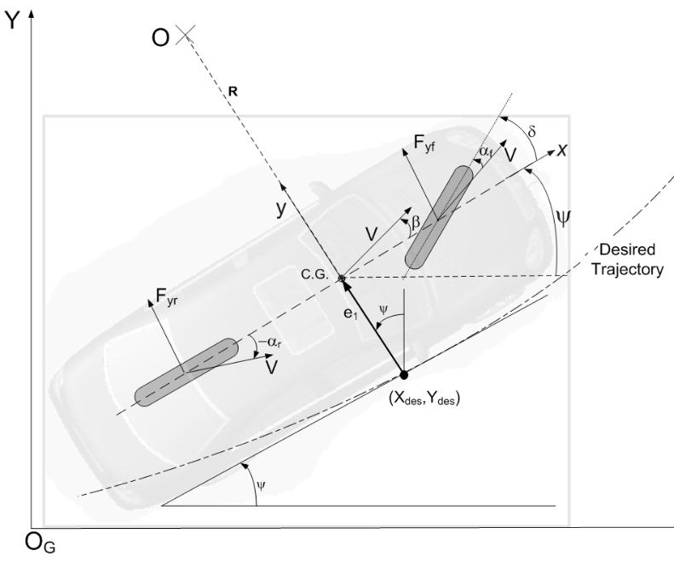

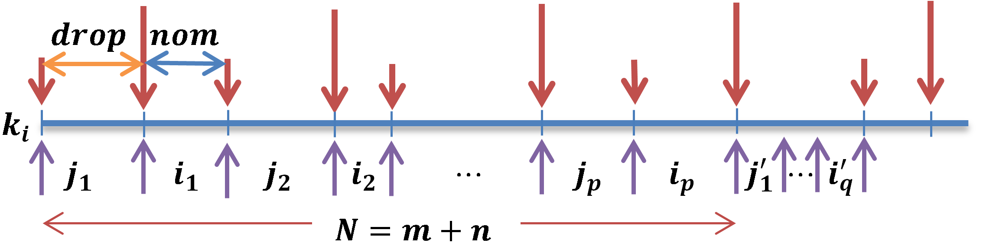
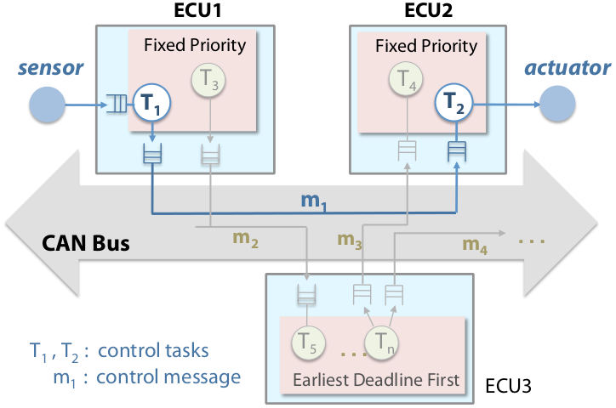
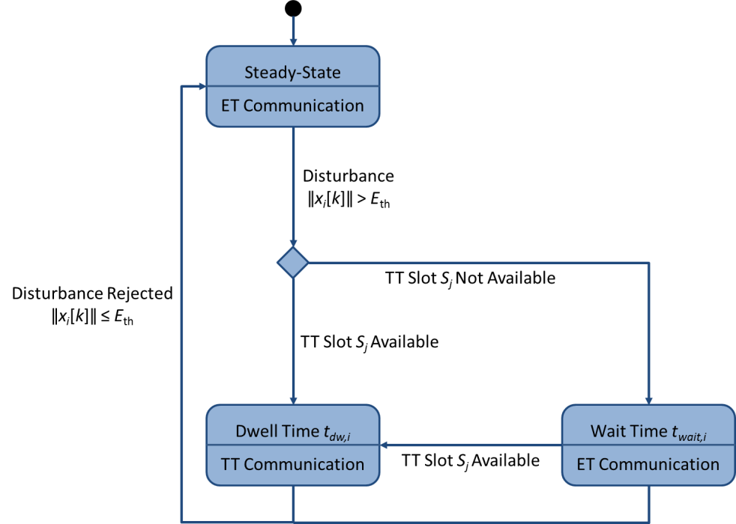
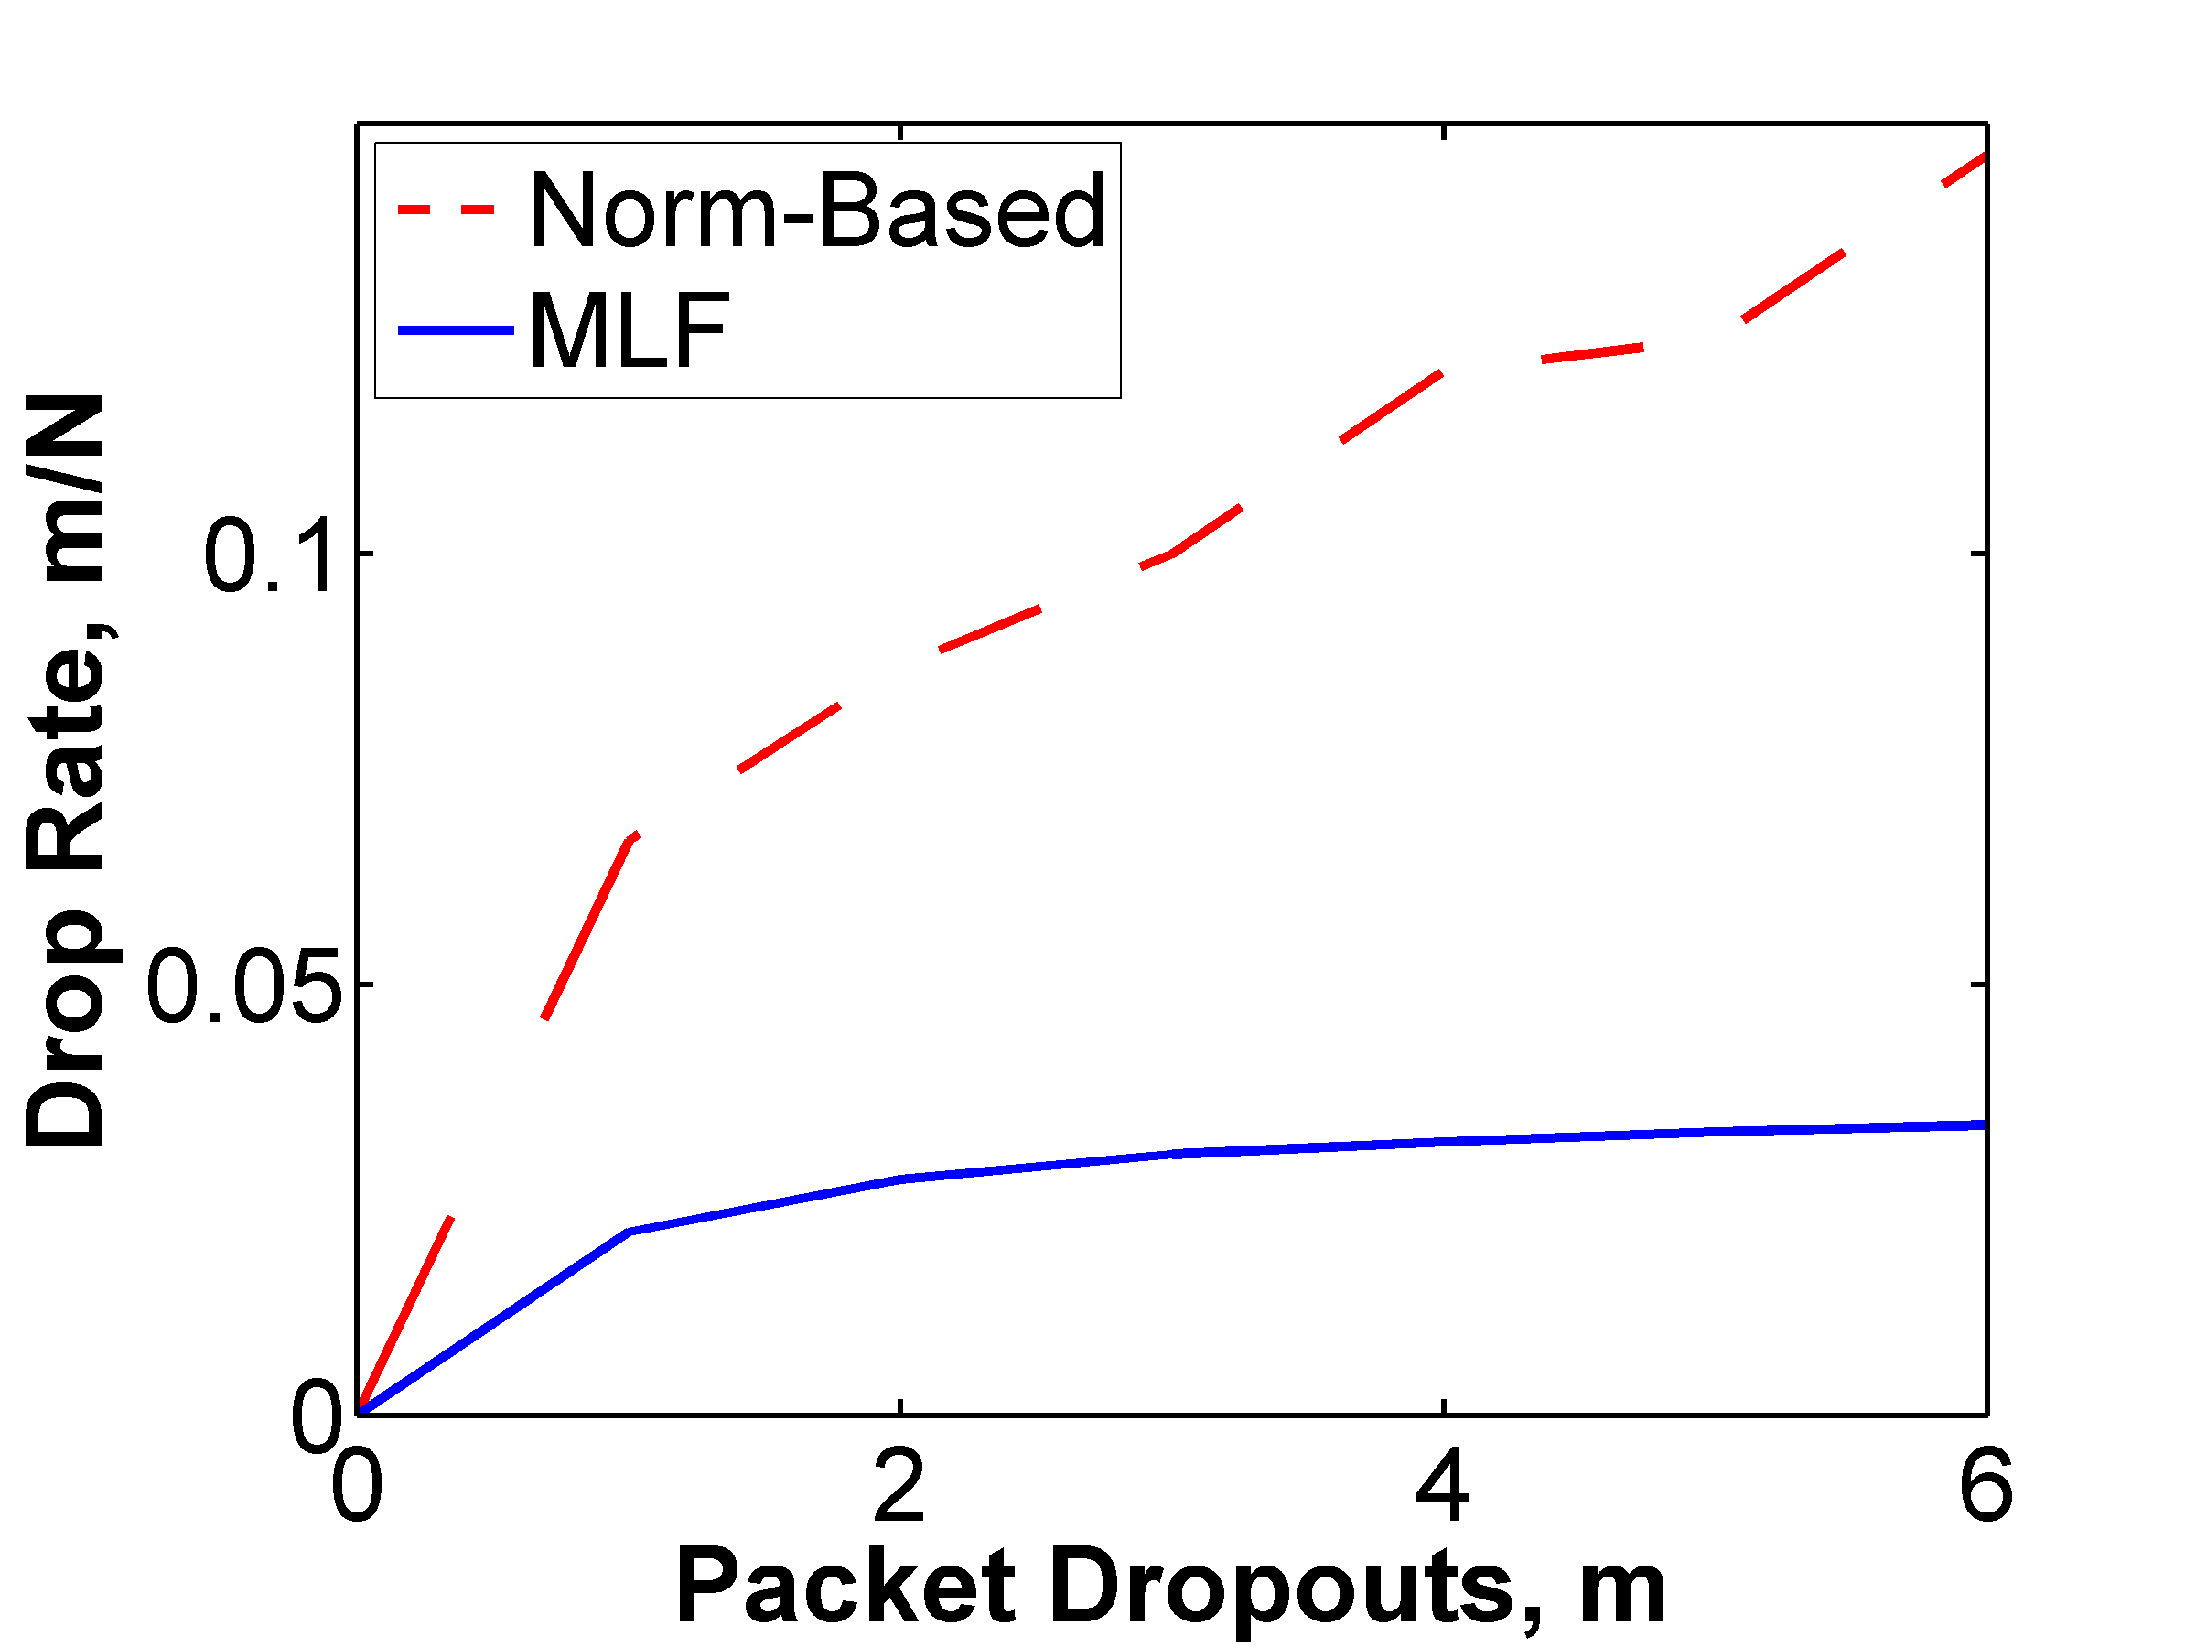
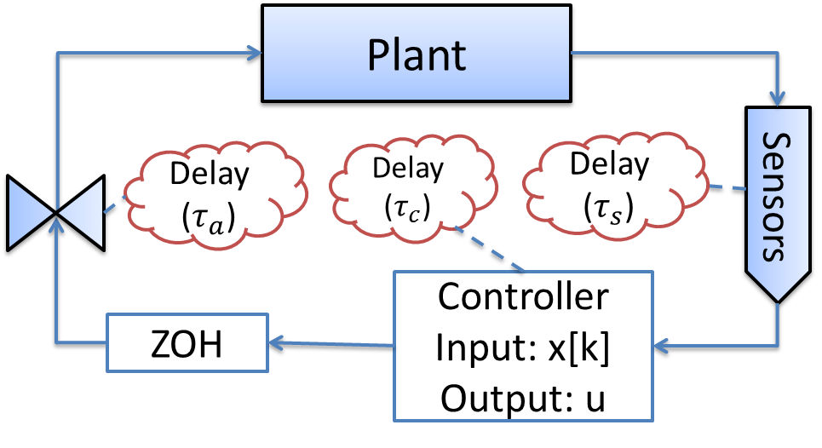
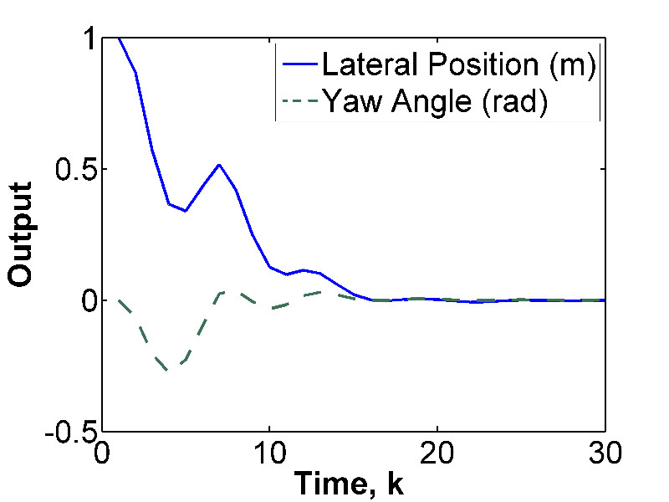
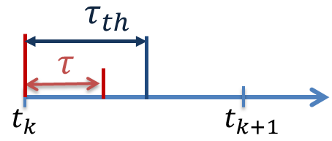
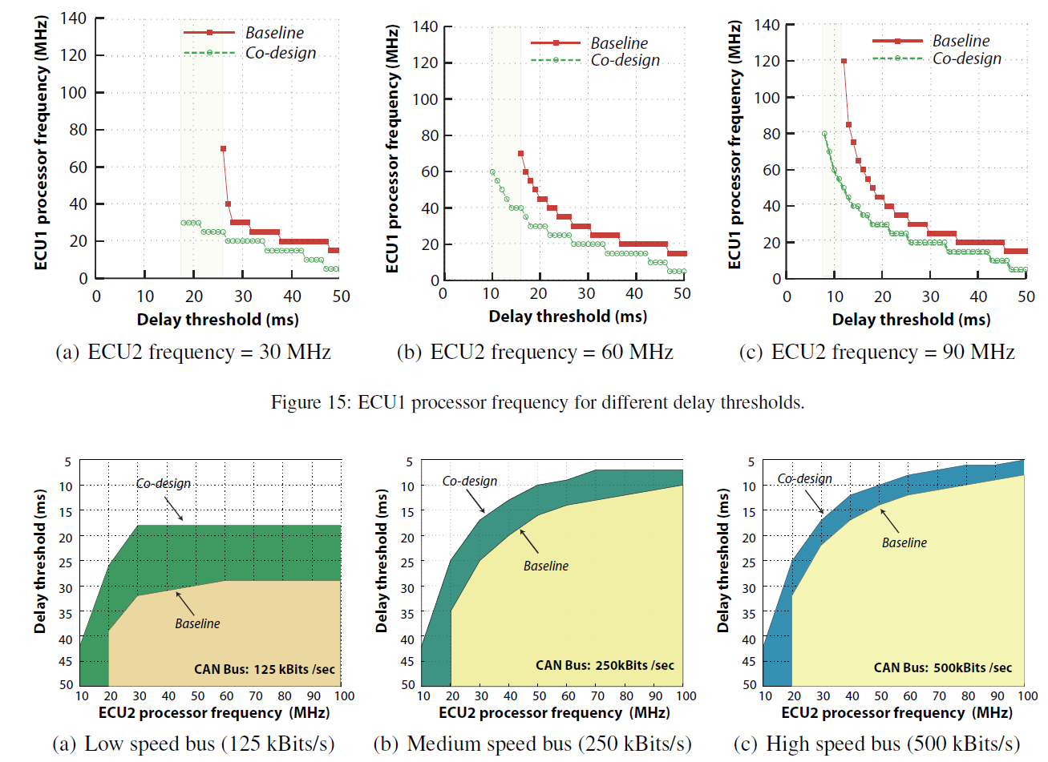
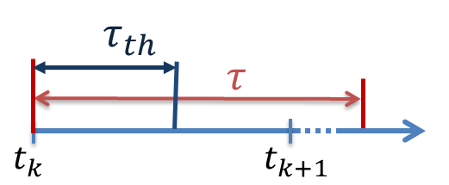
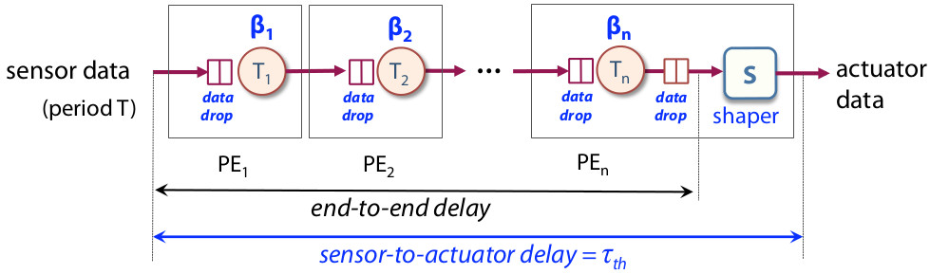
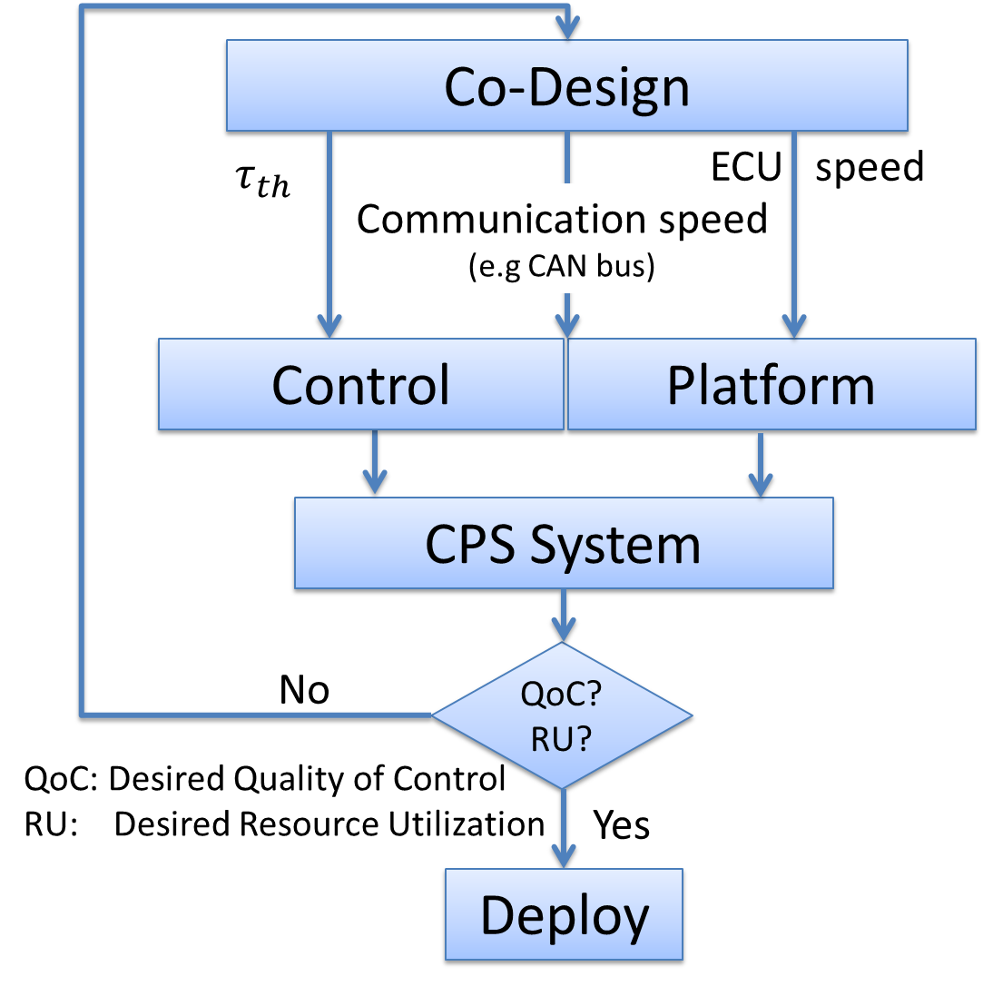
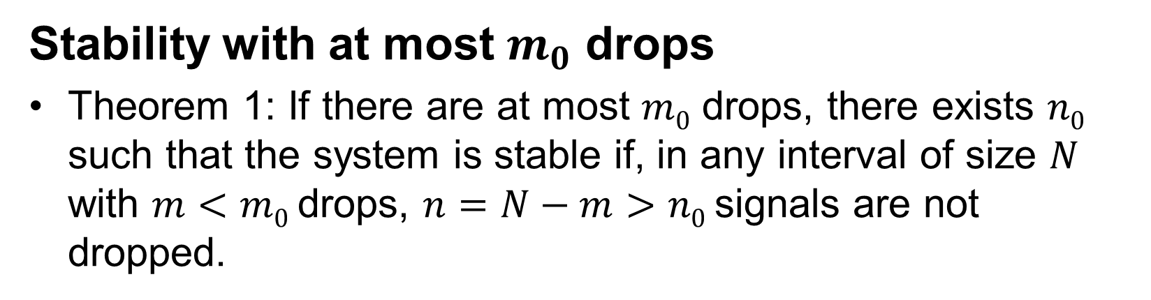
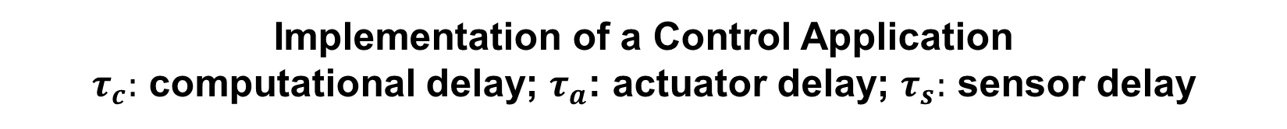
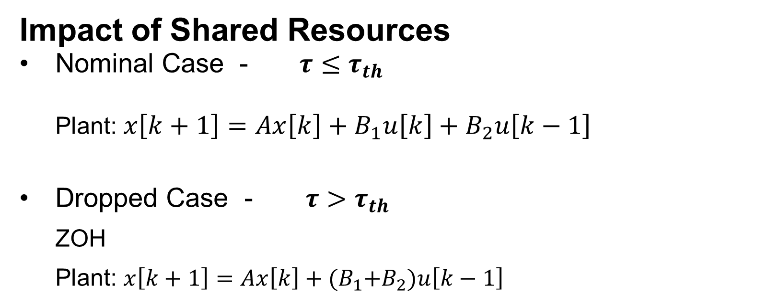
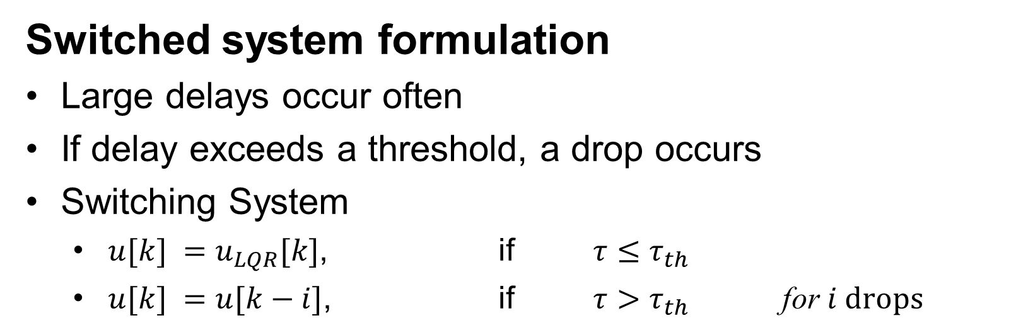
CPS: Medium: Collaborative Research: Co-Design of Multimodal CPS Architectures and Adaptive Controllers
Anuradha M. Annaswamy Linh T.X. Phan Oleg Sokolsky
Massachusetts Institute of Technology University of Pennsylvania
Objective
Control Design
Case Study
Non-Monotonicity of System Dynamics
Efficient implementation of multiple control applications in a Distributed Embedded System (DES)
Switched system formulation
Large delays occur often
If delay exceeds a threshold, a drop occurs
Switching System
  $u[k] =u_{LQR}[k]$, if $τ≤τ_{th}$
  $u[k] =u[k−i]$, if $τ>τ_{th}$ for $i drops$
Control system
Lane keeping system
  e₁ is position error
  e₂ is yaw angle error
Approach
Co-design of control and platform that delivers high quality of control with efficient resource utilization
Rationale
Several complex systems consist of multiple control and non-control applications mapped onto a DES
Resource sharing introduces delays
Significant transparency and flexibility available in platform design
Powerful analytical methods exist both for control of systems with delays and for estimation of end-to-end delays in real-time systems
Co-design of control and platform can leverage these methods
Hybrid communication protocols such as Flexray are often used in DES.
Messages are sent through segments
We propose a co-design that uses information from closed-loop responses to determine an efficient resource utilization for control systems under hybrid communication protocols.
Slots
Slots
1
2
3
1
2
3
Time-triggered
Event-triggered
Communication cycle
Control messages with nominal (i’s) and drops (j’s)
Platform
Control system is deployed
on two ECUs connected
by a CAN bus
ECU1 and ECU2 also run
higher-priority tasks from
other control loops and use
preemptive scheduling
Third ECU places additional load on the CAN bus
Used multi-mode control structure
Analyzed systems with non-monotonic behavior
  Leads to a less conservative schedulability analysis.
Stability with at most $m_{0}$ drops
Theorem 1: If there are at most $m0$ drops, there exists $n0$ such that the system is stable if, in any interval of size $N$ with $m<m0$drops, $n=N−m>n0$signals are not dropped.
Problem Statement
Slot 1
Co-design the controller and the DES architecture to control multiple applications with minimal DES resources.
LMI-based analysis
Multiple Lyapunov Functions(MLF)
  Stable mode
  Dropped mode
Benefits
  Less conservative than norm-based approach
  Drops can be non-consecutive
Simulation using Truetime + Simulink
For 6 non-monotonic control applications:
  Our approach: 3 slots
  Monotonic upper-bound: 5 slots
Reduced number of TT slots compared to those based on monotonic upper-bound
Control design
Satisfactory performance with up to 7 dropped messages over 40 samples
Slot 2
Implementation of a Control Application
$τ_{c}:$ computational delay; $τ_{a}$: actuator delay; $τ_{s}:$ sensor delay
Platform Design
Impact of Shared Resources
Nominal Case - $τ≤τ_{th}$
  Plant: $x\left[k+1\right]=Ax\left[k\right]+B_{1}u\left[k\right]+B_{2}u\left[k−1\right]$
Dropped Case - $τ>τ_{th}$
  ZOH
  Plant: $x\left[k+1\right]=Ax\left[k\right]+{(B}_{1}+B_{2})u\left[k−1\right]$
Co-design results
Slot 3
Architecture
A sequence of processing elements connected by buffers
  Processing elements are tasks on an ECU or messages on the network
Selected Publications
Co-Design Algorithm
Annaswamy A.M., Soudbakhsh D., Schneider R., Goswami D., Chakraborty S., “Arbitrated Network Control Systems: A co-design of control and platform for cyber-physical systems,” Control of Cyber-Physical Systems, Lecture Notes in Control and Information Sciences, Vol. 449, Ed: D.C. Tarraf, Springer Verlag, 2013.
Soudbakhsh D., Annaswamy A., “Parallelized model predictive control,” American Control Conference, Washington, DC, 2013.
Soudbakhsh D., Phan L.X, Sokolsky O., Lee I., and Annaswamy A., “Co-design of control and platform with dropped signals,” The 4th ACM/IEEE International Conference on Cyber-Physical Systems [ICCPS’13], Philadelphia, PA, 2013.
Masrur A., Goswami D., Chakraborty S., Chen J., Annaswamy A., Banerjee A., “Timing Analysis of Cyber-Physical Applications for Hybrid Communication Protocols”, Design, Automation, and Test in Europe (DATE2012), Dresden, Germany, March 2012
Voit H., Annaswamy A., Schneider R., Goswami D., Chakraborty S., “Adaptive Switching Controllers for Systems with Hybrid Communication Protocols”, American Control Conference (ACC 2012), June 2012.
P. Kumar, D. Goswami, S. Chakraborty, A. Annaswamy, K. Lampka, and L.Thiele, “A hybrid approach to cyber-physical systems verification”, in 49th Design Automation Conference, 2012.
Annaswamy A., Chakraborty S., Soudbakhsh D., Goswami D., “The Arbitrated Networked Control Systems Approach to Designing Cyber-Physical Systems”, NecSys 2012.
H. Voit, A. Annaswamy, R. Schneider, D. Goswami, S. Chakraborty , “Adaptive Switching Controllers for Tracking with Hybrid Communication Protocols”., Proceedings of the Conference on Decision and Control, Maui, HI, USA , 2012.
Design approach
Introduce buffer control into the platform
  Delayed samples are proactively dropped from buffers
  Benefits: Reduce resource consumption in the system, reduce delays of remaining samples
Use a shaper element into the architecture to ensure fixed sensor-to-actuator delay
Develop analysis methods based on Real-Time Calculus to account for buffer control
Our approach enables efficient design space exploration
Co-design always outperforms the baseline approach
Resource savings increase on more constrained platforms
Co-design provides a larger feasible design space

