Slide 1


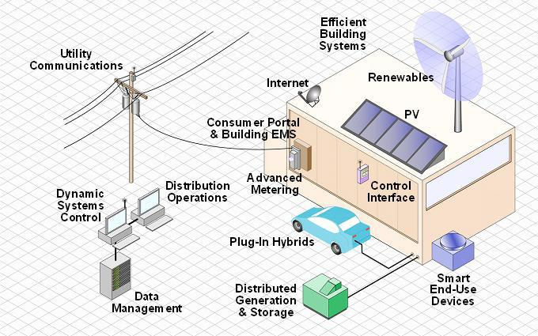
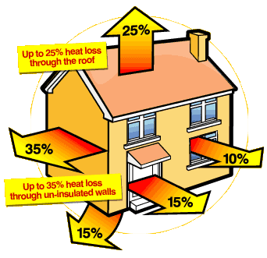
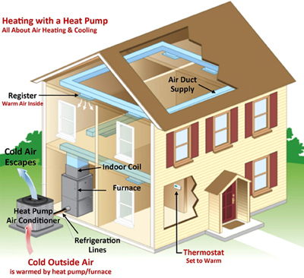
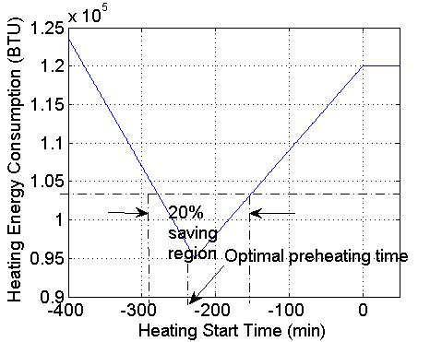
Sponsored by: NSF Grants CPS-1446582 & CPS-1446478
Cognitive Green Building: A Holistic Cyber-Physical Analytic Paradigm for Energy Sustainability
Ness Shroff (OSU), Qian Chen (OSU), Thomas Hou (VT), Wenjing Lou (VT)
Research Motivation
Future buildings are highly-engineered systems integrating cyber (sensing, communication, computation, & control) and physical (active/passive civil infrastructures) subsystems
Buildings are inefficient: Use 39% of energy, consume 70% of electricity, and account for 39% of CO₂ emissions
Current green building designs are simply organized around a set of energy consumption benchmarks (e.g., LEED) without taking a holistic CPS viewpoint.
Our Approach
Consider complex interactions between systems of systems, provide high degree of security, agility, and robustness.
Focus our research efforts along three interrelated thrust areas:
  Intra-Building Integrated Energy Management: Develop cognitive control schemes to adapt to: i) demand elasticity, ii) human comfort zones, and (iii) ambient environments
  Managing Multi-Building Interactions: Ensure that not only are the energy costs minimized, but also no instabilities caused in the power grid due to myopic actions.
  Coping with Anomalous Conditions: Building energy management under both physical (extreme weathers) and cyber (e.g., malicious cyber-attacks).
A unified analytical foundation for green building design that comprehensively manages energy sustainability.
Cognitive Intra-Building Integrated Energy Analytics
A Decomposition-Based Solution Approach:
  Given a charging/discharging policy, determine optimal preheat starting time.
  Determine optimal battery charging/discharging policy.
Open Research Tasks:
  Understanding fundamental limits of elastic energy saving with human comfort zone.
  Understanding spatial impact on building energy control.
  Exploiting statistical information of renewable energy inelasticity-based building energy minimization.
HVAC State Transitions
Building Energy Elasticity: A Motivating Example
Simulation Study: A building with heat pump in heating mode:
  Slow preheat (most efficient, but slow), Fast heating (least efficient, but fast), and maintaining
  Random occupant arrivals (optimal preheat time?)
If occupant arrives earlier than preheat starting time, then HVAC must be turned on immediately and fast heating (most costly) will be used
If occupant arrives later than preheat starting time, then HVAC starts slow preheating as scheduled. But once occupant arrives before preheating reaches set point (e.g., 70F), HVAC switches to fast heating mode.
If sufficient time before an occupant arrives, then HVAC goes through slow preheating and then maintaining mode (least cost).
Problem Formulation
Result: 54% energy saving under optimal preheat strategy; At least 20% saving as long as in 1-hour window containing the optimal preheat time
Cognitive Building-Clusters Energy Analytics
A Stochastic Approximation Approach:
  Inspired by utility maximization in comm.&netw. literature
Open Research Tasks:
  Interplay between utility provider and users on grid stability.
  More complex environmental and social dynamics with multiple utility providers.
  Understand the impact of uncertain inelastic building energy demands on the power grid.
A Green Building-Cluster
Each building equipped with a networked energy meter.
Two-way communication (AMI) with an energy controller.
E.g.: Multiple buildings on a university/corporate campus, or customers of a same utility company.
Problem Formulation
Building Energy Analytics for Anomalous Conditions
Sustaining Building Energy Supply under Extreme Weather
  Maximize the lasting days of local energy generation/storage while meeting basic energy demands
Cyber-Security for Energy Control
Autonomous context-aware key management for building energy sensors
3rd-party data integrity verification for cloud-based energy control server

