Slide 1
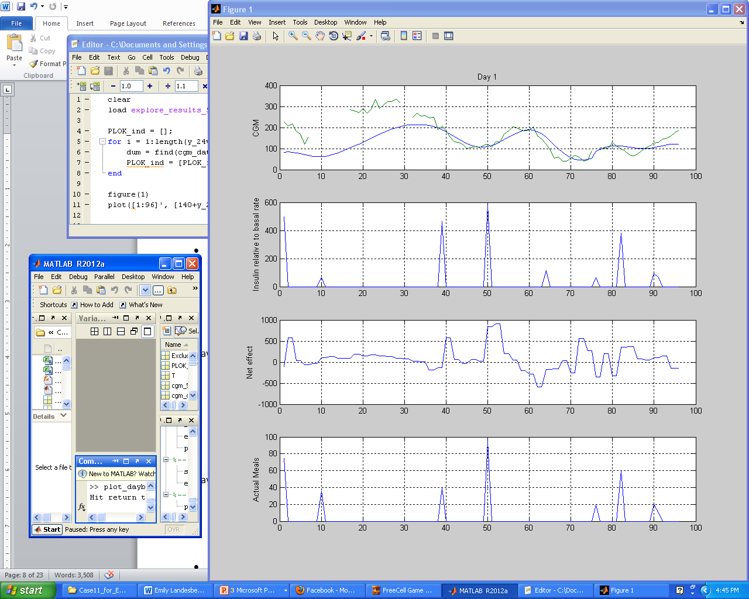
Control Subject to Human Behavioral Disturbances:
Anticipating Behavioral Influences in the Control of Diabetes
Stephen D. Patek (PI), Project CNS-0931633
School of Engineering and Applied Science, University of Virginia
Project Overview:
This project addresses the design of control systems where the principle disturbances are the result of routine human behavior, i.e. behaviors that are (i) random but cannot be treated as zero-mean, white noise processes and (ii) occur with statistical regularity but cannot be treated as periodic due to natural variation in human behavior.
Goal 1: To develop new mathematical models (“profiles”) of human behavioral disturbances, focusing especially on appropriate statistical characterizations of routine behavior.
Goal 2: To formulate and solve new control-theoretic models that seek to anticipate human behavioral disturbances
Target Application:
Control of blood glucose concentration for patients with Type 1 Diabetes Mellitus (T1DM), where meals and exercise are the main disturbances.
Hyperglycemia
Target Blood
Glucose Range:
70-180 mg/dl
(DCCT, 1993)
Food
Physical
Activity
Insulin
Hypoglycemia
(Severe Hypo)
Estimating Behavioral Disturbances via Deconvolution: “Net Effects”
Goal: Since people are notoriously inaccurate when it comes to behavioral self-reporting (e.g. food diaries), methods of reconstructing behavioral influences from sensor data are needed.
Opportunity: With an LTI system model it is possible to recover behavioral influences via decovolution.
Challenges:
The inverse is not unique and has to be computed as the solution to a regularized optimization problem.
The inverse has to account for true nonlinear and time-varying effects (e.g. circadian rhythm), so the unknown input isn’t necessarily zero-mean or sparse.
Approach: Outer-loop optimization of LTI model parameters based on the “shape” of the L₂- regularized inverse solution.
Behavioral Initialization of Closed-Loop Control of Diabetes:
Goal: To optimize the “basal” insulin delivery as a set-point for closed-loop control of diabetes.
Approach: Use carbohydrate “net effect” curves to replay and optimize the patient’s basal profile over a preliminary data collection period.
Compute carbohydrate net effects from a patient-individualized mathematical model.
Use clinical guidelines to iteratively propose modifications to the basal profile, avoiding changes within two-hours of meals, validating improvements with net effect replays.
Report median optimized basal rate for each 30-minute interval of day, subject to constraints: (i) no more that +/- 25% change and (ii) at most seven basal “levels”.
Status: Clinical trials underway; one subject completed- reduced risk of pre-lunch hypoglycemia.
Hypoglycemia
In Silico Validation
100 in silico type 1 adults (FDA-accepted simulator)
3 maladapted initial basal profiles (high, low, nominal basal)
Simulated 7-day data collection (random meals)
Performance of optimized profile assessed over a subsequent 7-day period
Hyperglycemia
CGM (mg/dl)
Dawn Effect
Insulin (mU/min)
Correction Bolus
Net Effect (mg/min)
Counter Regulation
Actual Meals (g)
Time of Day (5min. Bins)
Optimized Response for One In Silico Patient
Acknowledgement: NSF-CNS-0931633. Please direct correspondence to patek@virginia.edu.

