Slide 1
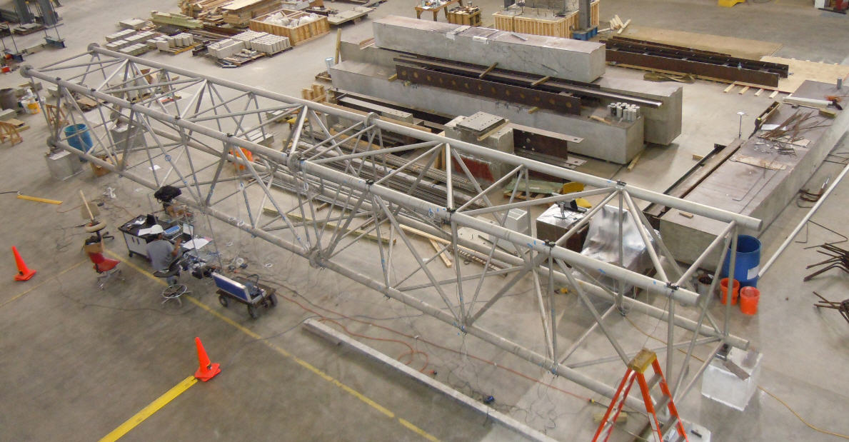
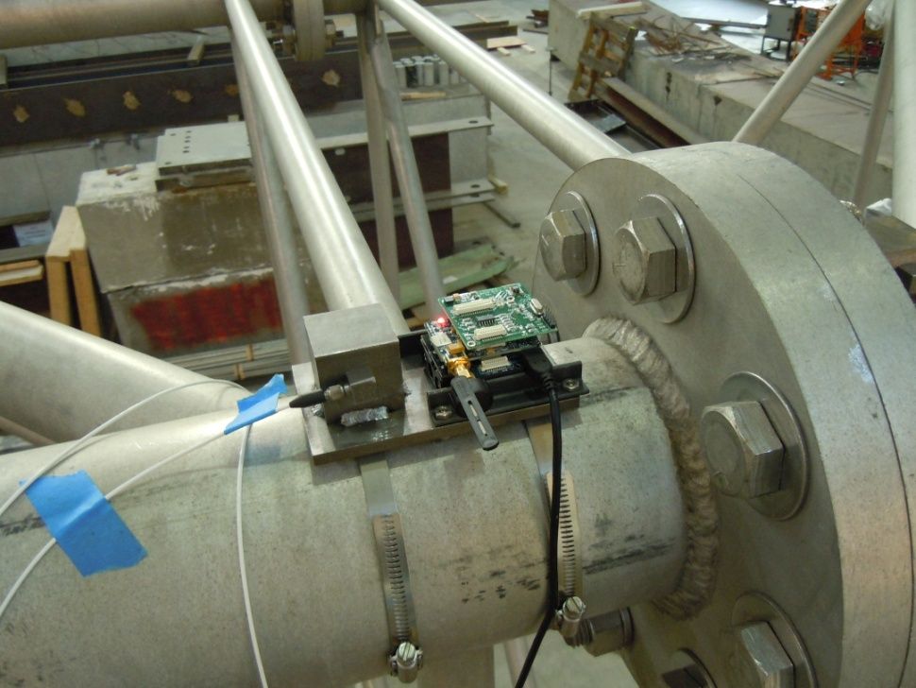
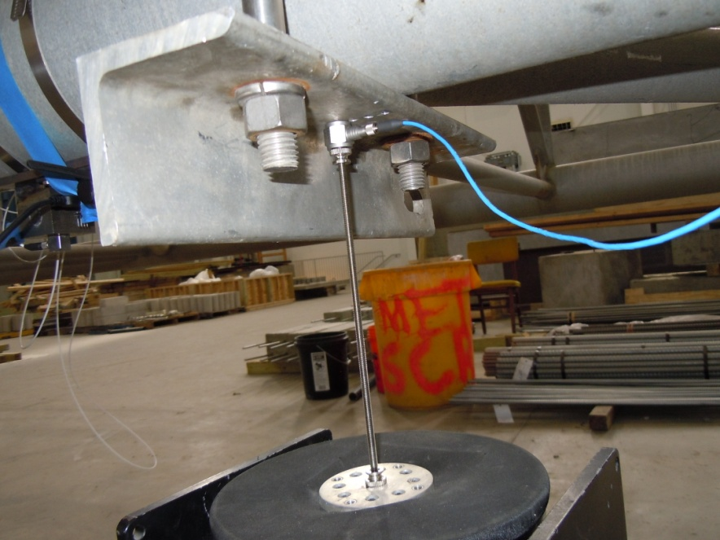


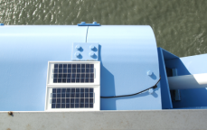
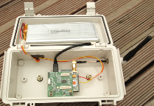
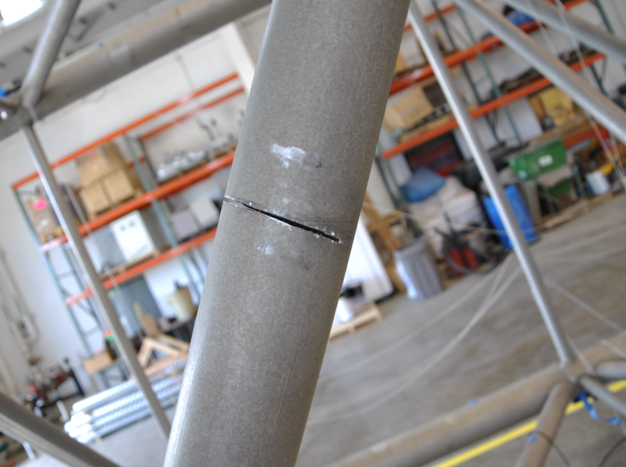
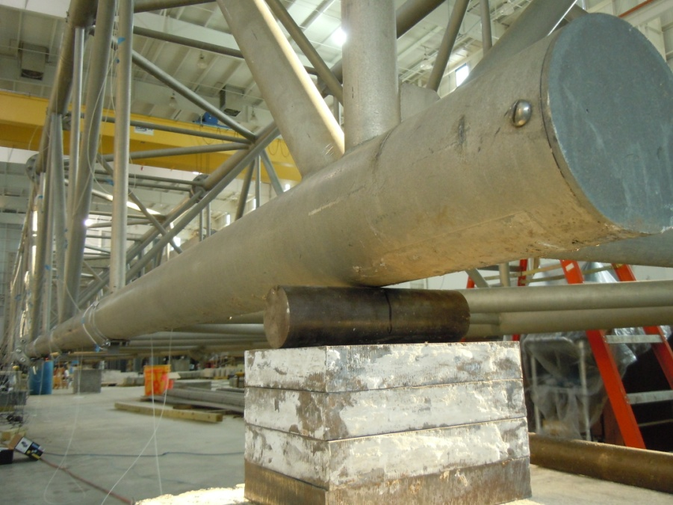
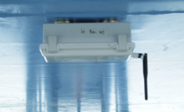
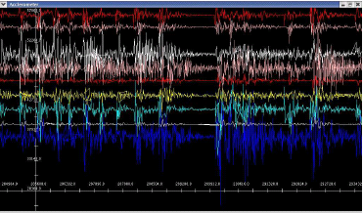
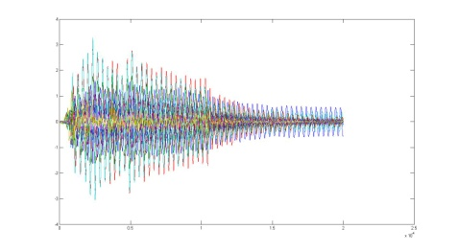
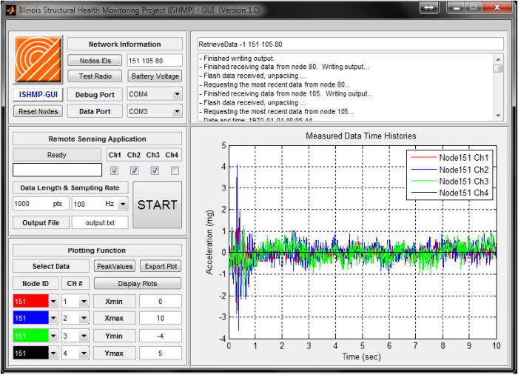
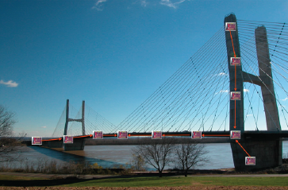
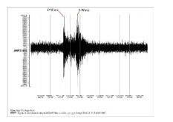
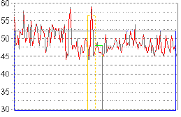
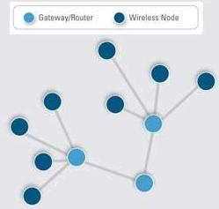




Cyber-Physical Co-Design of Wireless Monitoring and Control for Civil Infrastructure
Chenyang Lu¹, Gul Agha², Shirley Dyke³, Bill Spencer²
¹Washington University in St. Louis ²University of Illinois at Urbana Champaign ³Purdue University
http://bridge.cse.wustl.edu
Overview
Full Scale Truss Experiment
Jindo Bridge Monitoring
American Society for Civil Engineers 2009 Report Card: more than 26% of U.S. bridges are deficient or obsolete
Wireless Sensor-Actuator Networks (WSANs) enable monitoring and control of structures at high temporal and spatial granularity, without retrofitting a wired infrastructure
Today, WSAN design is largely redone from scratch for each deployment, with monitoring and control systems designed in isolation
Our goal: to develop and validate a reusable cyber-physical systems framework for distributed structural monitoring and control based on WSANs
Seoul
Daejeon (KAIST)
Jindo Bridge
Jindo
Distributed, multi-level damage detection system deployed on a full scale truss at Purdue.
Damage detection results matched actual damage locations.
Established evaluation criteria for control stability.
Studied structural control algorithms under the impacts of wireless networking delay and data loss.
Field validation of wireless sensor-based monitoring of a cable-stayed bridge in Korea
Long-term autonomous monitoring using 113 wireless smart sensors
Establishment of an international testbed
Objectives
Structural Control Simulator
Monitoring Services Toolsuite
A unified middleware architecture and abstractions for hierarchical distributed sensing and control
A reusable middleware service library
Customizable time synchronization and synchronized sensing routines
A holistic energy management scheme
Dynamic sensor and actuator activation strategies
Deployment and empirical validation in lab and on an in-service, multi-span bridge
Structural Model
Modular, service-oriented
software library for
assembling scalable
monitoring applications
Core services: universal
sensing, time synchronization, reliable communication, multi-hop routing, power management, numerical library
Used by 75 groups in 15 countries
Structural Response
Wireless Network
Simulator
Earthquake
Wireless Traces
Discrete Controller
y(n)=Cx(n)+Du(n)
x(n+1)=Ax(n)+Bu(n)
Delayed Structural Response
A cyber-physical simulator combining structural models and wireless networking simulation
Incorporate realistic structural models and wireless traces from a real-world bridge and building.
Integration of Simulink and a TinyOS simulator enables fast CPS development and simulations.
“Dubbed the Illinois Structural Health Monitoring Project, the sensor network was designed to create a reliable alternative to traditional structure inspection techniques, which can be expensive and unreliable.”

