Slide 1
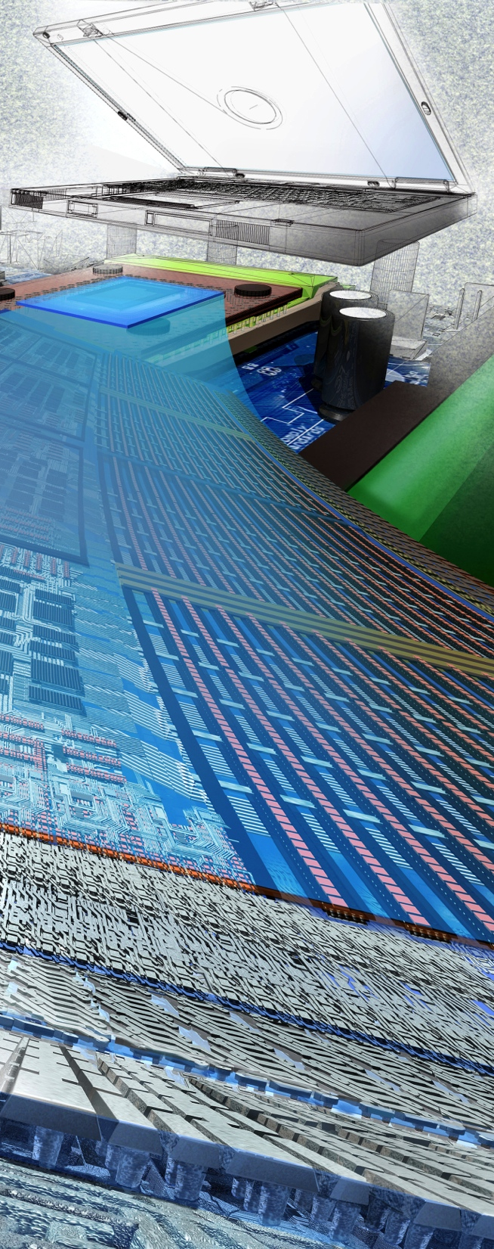


Cyber-Physical Systems (CPS) –a National Priority
David Corman, Program Director for CPS
(on behalf of Suzanne Iacono
NSF Assistant Director (Acting) for Computer and Information Science and Engineering)
Grace Wang
NSF Deputy Assistant Director for Engineering
Image Credit: Exploratorium.
Notes:
Good morning. Thank you for gathering here today for the Fifth Annual Principal Investigators’ Meeting of the Cyber-Physical Systems Program. My name is Suzanne Iacono, Acting NSF Assistant Director for Computer and Information Science and Engineering. With me on stage today is also Grace Wang, NSF Deputy Assistant Director for Engineering.
On behalf of my colleagues at the National Science Foundation and the sister federal agencies that are part of the CPS Program, I would like to welcome you all to Arlington, Virginia –and the wider Washington DC Metro area.

Slide 2
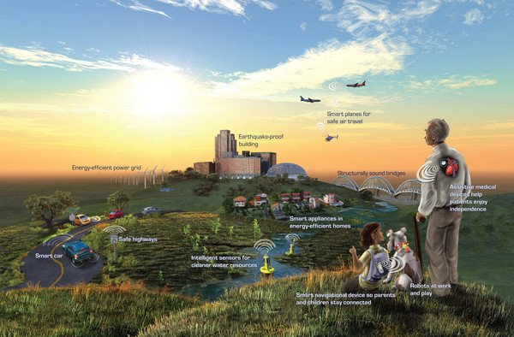
Imagine a world …
Notes:
I know that almost everyone gathered here today are either already a CPS investigator or supports CPS through partnerships of various kinds. However, I want to take this opportunity to take stock of why we are working together, very hard, in this important domain. To look forward imagine what the future –enabled by technologies, will look like.
Imagine a world that is safe, secure, healthy, vibrant, and resilient. Such a world requires technologies, systems, and infrastructures of that are smart, connected, working together and interdependently.
We need to advance large-scale systems and infrastructures such as efficient power grid, intelligent and safe highways, structurally sound bridges that can assess their own health;
We need smart technologies in everyday systems such as smart cars, energy efficient buildings and homes, and smart appliances
And we also need dependable personal technologies such as smart phones and smart/safe medical devices
Already, you are hearing the word “smart” repeated a few times. You will hear it a few more times before this meeting is over. Indeed, “Smart” or in other word “Better” technologies, systems, and infrastructures is what we strive to achieve in the CPS Program.

Slide 3
Cyber-Physical Systems
Deeply integrate sensing, computation, communication, and control into physical systems
Transportation
Energy and Industrial Automation
Healthcare and Biomedical
Critical Infrastructure
Faster and safer aircraft
Improved use of airspace
Safer, more efficient cars
Homes and offices that are more energy efficient and cheaper to operate
Distributed micro-generation for the grid
Increased use of effective in-home care
More capable devices for diagnosis
New internal and external prosthetics
More reliable power grid
Highways that allow denser traffic with increased safety
Pervasive computation, sensing and control
Networked at multi- and extreme scales
Dynamically reorganizing/reconfiguring
High degrees of automation
Dependable operation with high assurance of reliability, safety, security and usability
Notes:
As its name suggests, the Cyber-physical systems program seeks to advance research to better our understanding and enable us to engineer systems that deeply integrate the sensing, computation, and communications –which make up the “cyber” component – and the physical systems.
Characteristics of a cyber-physical system include:
Pervasive computation, sensing and control
Networked at multi- and extreme scales
Dynamically reorganizing/reconfiguring
High degrees of automation
Dependable operation with high assurance of reliability, safety, security and usability
CPS is ubiquitous in almost all industries and domains of today – including: transportation, energy and industrial automation, healthcare and biomedical, and critical infrastructure

Slide 4
In a few words…
Cyber-physical systems are smart, complete systems of tomorrow;
Cyber-physical systems will enable ubiquitous technologies and applications for the future.
Advances in cyber-physical systems will reshape our world with more responsive, secure, and efficient systems that:
  Transform the way we live
  Drive economic prosperity
  Underpin national security
  Enhance societal well-being
  Users can bet their life on
Notes:
In a few words.
Cyber-physical systems are smart, complete systems of tomorrow; and
Cyber-physical systems will enable ubiquitous technologies and applications for the future.
Advances in CPS will shape our world with more responsive, secure, and efficient systems that:
Transform the way we live
Drive economic prosperity
Underpin national security
Enhance societal well-being
Users can bet their life on

Slide 5
NSF model for expediting progress
Application Sectors
Abstract from sectors to more general principles
Apply these to problems in new sectors
Build a new CPS community
Encourage other communities to join
energy
aeronautics
agriculture
Core Science,
Technology,
Engineering
Safety
Control
Verification
automotive
manufacturing
Real-time
Systems
Networking
medical
Security
civil
chemical
materials
Notes:
To achieve these goals and further illustrate the implication of CPS research, here is what we endearingly call the “CPS flower model” that illustrates the relationships between CPS application domains and the core science that the CPS program supports.
By abstracting from the particulars of specific systems and application domains, the CPS program aims to reveal cross-cutting fundamental scientific and engineering principles that underpin the integration of cyber and physical elements across all application sectors.
To expedite and accelerate the realization of cyber-physical systems in a wide range of applications, the CPS program also supports the development of methods, tools, and hardware and software components based upon these cross-cutting principles, along with validation of the principles via prototypes and test beds.
SUZI: Now I would like to turn this over to my colleague, Grace Wang, who will discuss the CPS Program from the national perspective as well as NSF’s past and present investment into the program
GRACE: Thank you Suzi.
Good morning. My name is Grace Wang, I am the NSF Deputy Assistant Director for Engineering. I am delighted to see everyone here today.

Slide 6
Some CPS Program Info
Since CPS Launch in 2009:
  Over $220M investment
  Over 275 awards
  350+ PIs and Co-PIs in 35 states
  60 new awards in FY13 (35 projects)
  Over $35M investment in FY13, over $40M in FY14
  Three Classes of awards (Breakthrough, Synergy, and Frontier)
    Three on-going Frontier awards
  CAREER awards
    FY 13 was first year for CAREER CPS
Notes:
And here are some information on the CPS program since its launch in 2009.
Since CPS Launch in 2009:
Over $200M investment
250 awards
350+ PIs and Co-PIs in 35 states
60 new awards in FY13 (35 projects)
Over $35M investment in FY13, over $40M in FY14
Three Classes of awards (Breakthrough, Synergy, and Frontier)
Three on-going Frontier awards
FY 13 was the first year with CAREER CPS awards. We are growing the CAREER base in FY 14 and are working with ENG

Slide 7
CPS Support the Nation’s Priorities
Broadband & Universal Connectivity
Secure Cyberspace
Health & Wellbeing
Transportation & Energy
Education and Workforce Development
Environment & Sustainability
Manufacturing, Robotics, & Smart Systems
Emergency Response & Disaster Resiliency
Notes:
As you know, the Engineering Directorate co-sponsors the CPS program with the CISE Directorate. We recognize the importance of CPS research to the nation’s domestic economy and global competitiveness.
Indeed, advances in CPS are closely intertwined with and will have a pervasive impact on many of our national priorities.
For example, CPS research enable advance manufacturing, robotics, smart systems, environment and sustainability, emergency response
and on to healthcare and wellbeing,
CPS supports the national transportation and energy system, secured, connected cyberspace, and education and workforce development.

Slide 8
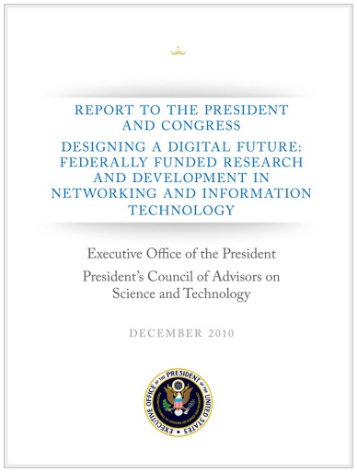
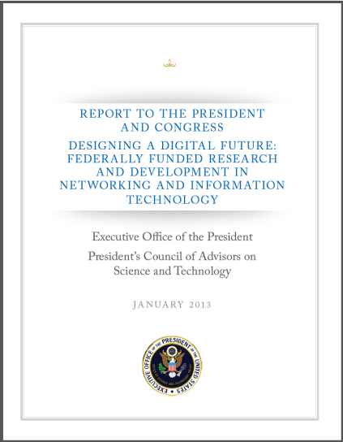
A National Imperative
2007 PCAST NITRD Report –Recommended cross-disciplinary programs to accelerate work in CPS by Federal R&D agencies
2010 PCAST NITRD Report – Expanded this recommendation to energy, transportation, health care, and homeland security
2011 PCAST Advanced Manufacturing Report – Recommended investments to strength US leadership in the areas of robotics, cyber-physical systems, and flexible manufacturing
2012 PCAST NITRD Report – Identify networking and information technology [NIT]-enabled interaction with the physical world, health IT, and cybersecurity continue to be important, and remain as critical focal points in 2012 and beyond.
Notes:
The importance of CPS research is also recognized at the national level. For example, CPS is highlighted in the following reports by the President’s Council of Advisors on Science and Technology (PCAST)
The PCAST 2007 report recommended that Federal R&D agencies strengthen existing programs or create new, cross-disciplinary ones programs to accelerate work in this area.
The 2010 PCAST Networking and Information Technology (NIT) R&D report expanded on this recommendation, particularly as it applied to energy, transportation, health care, and homeland security.
The PCAST 2011 report on Advanced Manufacturing has called for focused investments in advanced manufacturing to “strengthen U.S. leadership in the areas of robotics, cyber-physical systems, and flexible manufacturing” as a means to promote sustainable economic growth and job creation. These recommendations, consistent with President’s Innovation Strategy (2011), all arise from the accelerated demand and the increasing technical challenges they bring for new capabilities and services all deemed to be intelligent or “smart,” including transportation systems, medical technologies, buildings, and manufacturing.
The 2012 PCAST NITRD Report – Identify networking and information technology [NIT]-enabled interaction with the physical world, health IT, and cybersecurity continue to be important, and remain as critical focal points in 2012 and beyond

Slide 9
CPS Support across NSF
Cyber-Physical Systems
Smart Health & Wellbeing
Science, Engineering & Education for Sustainability (SEES)
National Robotics Initiative (NRI)
Secure and Trustworthy Computing (SaTC)
CISE Core Programs
Cyber-Physical Systems (CPS)
Expeditions
Notes:
At NSF, CPS is a foundation-wide initiative that is co-sponsored by the CISE Directorate and the Engineering Directorate.
The CPS program also involves other programs and initiative at NSF such as the National Robotics Initiative, the Secure and Trustworthy Cyberspace program, the Smart and Connected Health program, amongst others…
Beyond NSF, CPS also is an inter-agency program that is supported by the Department of Transportation, the Department of Homeland Security, and new this year, NASA. We are looking forward to adding more agencies to the CPS program in the future.

Slide 10


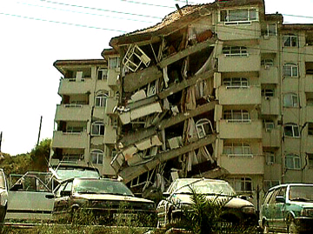
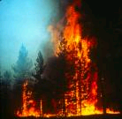
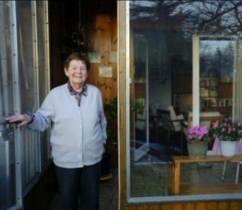
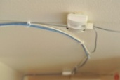
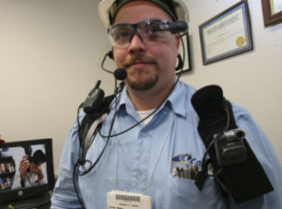
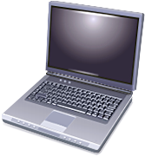



CPS Support Emerging Global Priorities
Environment Sensing
Emergency Response
Situation Awareness: Humans as sensors feed multi-modal data streams
Percepts (sensors)
Agent (Reasoning)
Actions (controllers)
People-Centric Sensing
Smart, safe, connected, vibrant urban spaces
Resilient, secured, interdependent systems
Public Sensing
Social Sensing
Personal Sensing
Source: Sajal Das, Keith Marzullo
Notes:
As the CPS program continues to grow and evolve, the program management team continues to seek new challenges and opportunities to shape the program going forward.
Two examples of new focuses for the CPS program are:
Smart City – CPS technologies and systems enable smart, connected, safe, and vibrant urban environment
and
Resiliency – CPS enable advanced preparedness and accelerated post-disaster recovery
This PI meeting will include discussions on these two topics. Specifically, tomorrow morning you will hear a presentation on the NSF Critical Resilient Interdependent Processes and Systems (CRISP) program.
And tomorrow afternoon there will be a panel discussion on research opportunities with Smart City.

Slide 11
Cyber-Physical Systems (CPS)
Fifth Annual Principal Investigators’ Meeting
Image Credit: Exploratorium.
Notes:
And with that, I thank everyone for being here today. I look forward to meeting many of you and hearing of your work.
Here again is Suzi
SUZI: Thank you Grace.
On behalf of my NSF colleagues and the sister agencies that are part of the CPS program, I would like to thank everyone again for convening here today for this important meeting. I wish you a successful two days and hope you will also take this opportunity to enjoy Washington DC.

