Slide 1
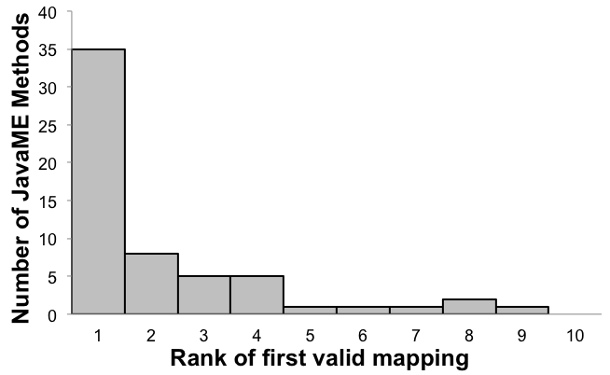
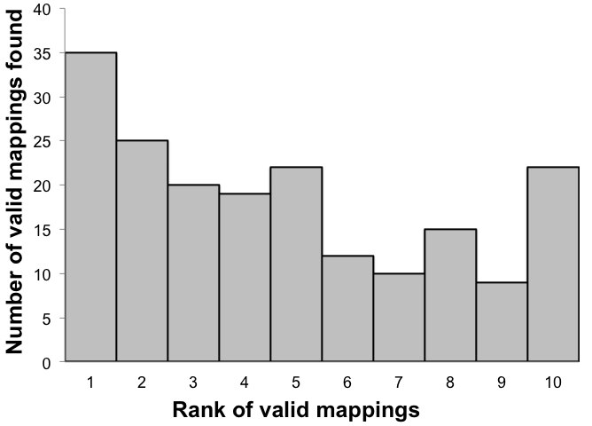
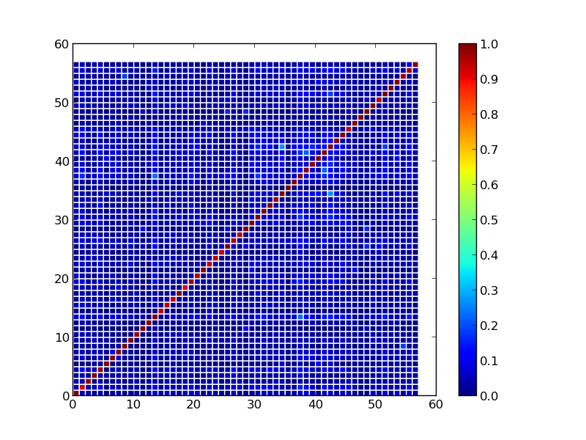
CPS:Small: Establishing Integrity in Dynamic Networks of Cyber Physical Devices
Vinod Ganapathy (Rutgers), Ulrich Kremer (Rutgers) and Trent Jaeger (Penn State)
CNS-0931992 and CNS-0931914
Two Problems: Cross-platform Apps & Duplicate Apps
API Mapping: Our Approach
Implementation & Results
Identified mappings between JavaME graphics API and Android graphics API
True mappings found within the list of top 10 for 71% of JavaME methods
Distributions of mappings:
Multitude of systems employing cyber physical devices: health monitors, household appliances, automobiles, consumer electronics
Problem 1: Assisting cross-platform app development by inferring API mappings
Devices differ in
Operating platforms
Manufacturers
Physical specifications
Apps are being developed for each platform
Cumbersome to write a new app for each platform
One solution is porting apps developed for one platform to another platform
Problem 2: Detecting duplicate apps on a single platform
Third-party apps being developed for cyber physical systems
Exponential rise in number of apps available
Need mechanisms to identify authentic apps from counterfeit ones
Step 1: Collecting Application Pairs
Find existing applications on both platforms implementing the same functionality
For ex., TicTacToe game on JavaME and TicTacToe game on Android
Applications may have been independently developed
Problem 2: Detecting Plagiarized Apps
Step 2: Produce Execution Traces
Counterfeit apps created by copying source code of original apps
Previous approaches use static analysis to detect duplicate apps
Sophisticated techniques such as program obfuscation can easily evade detection by static analysis
Execute applications on both platforms performing same actions for both
Log invoked method calls in execution traces
Intuition: Functionally similar traces should contain functionally equivalent method calls
Produce multiple traces, providing different input, and thus forcing different execution path
Problem 1: Inferring Likely Mappings Between APIs
Our Solution: Dynamic Approach
Porting Applications Across Platforms
Step 3: Probabilistic Inference
Plagiarized apps produced by program transformation will behave identically as the original app
Observe the run-time behavior of apps to create unique birthmark of each app
Use sequences of API methods invoked to compute birthmark
Compare apps in pairs by comparing their birthmarks
Plethora of types of computing devices: smartphone, tablet, laptop, desktop
Different smartphone platforms: iPhone, Android, Blackberry, JavaME
Porting applications across platforms is painful
A key problem in porting is finding correspondence between cross-platform APIs
Input: A pair of traces
Output: Likely mappings between methods in the traces
Factor Graph Model to compute probability of mapping
Uses similarity between attributes of method calls in traces
Attributes: Frequency, position, name, context
API Mapping Problem
Given: Source API and target API
To find: Functionally equivalent method(s) in target API for each method in source API
Types of mappings: 1-1, 1-many, many-1, many-many
Multiple correct mappings exist for one source API method
Step 4: Combining mappings across trace pairs
Graph showing similarity values between pairs of apps
Diagonal shows similar apps
Weigh each mapping probability by confidence in the mapping
Higher the method occurrences, more is the confidence

