Slide 1


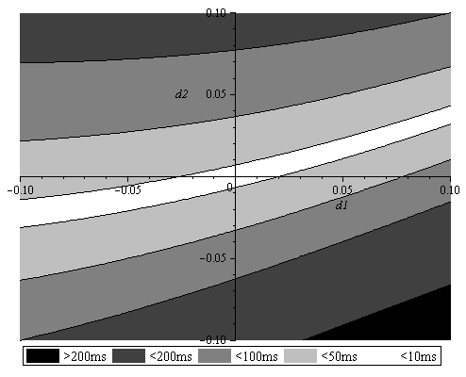
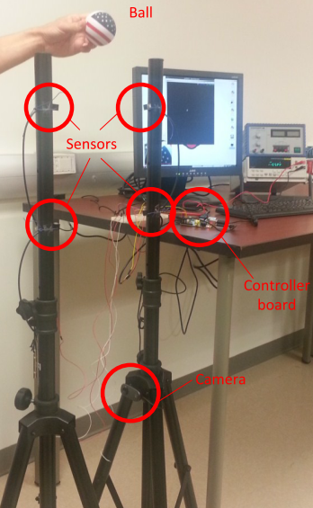
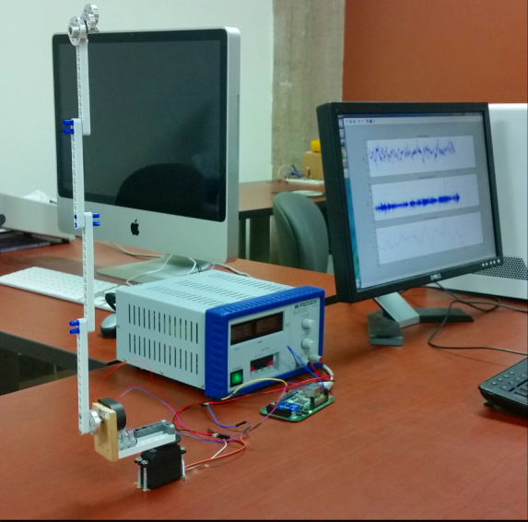
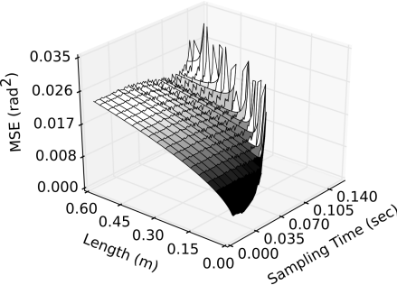
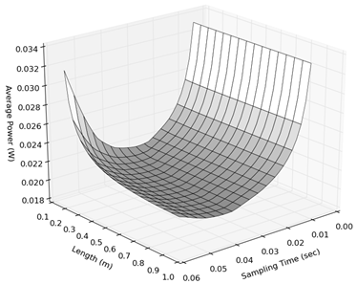
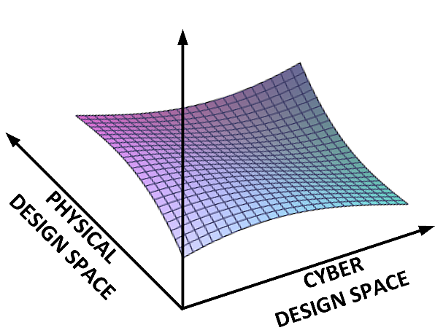
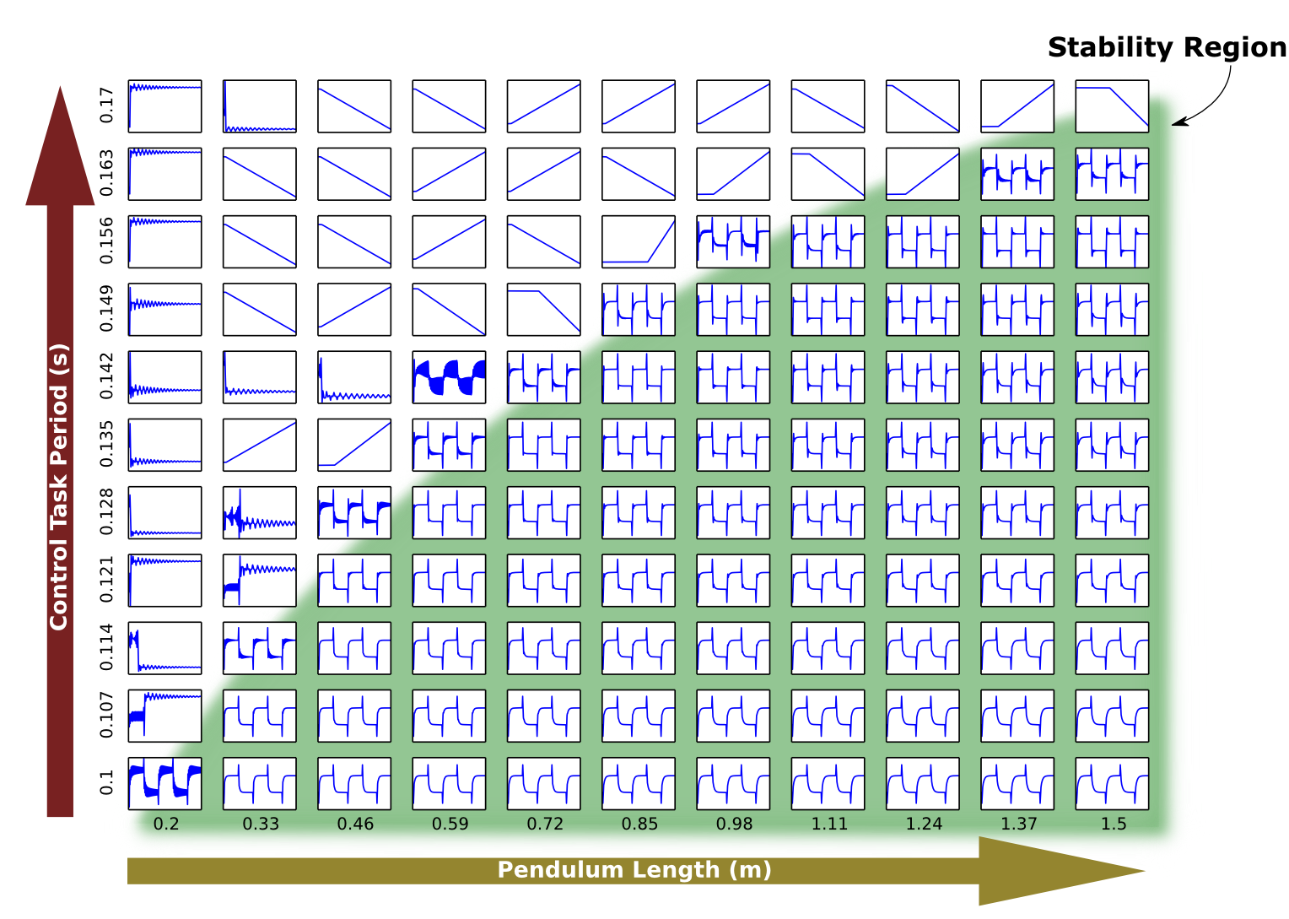
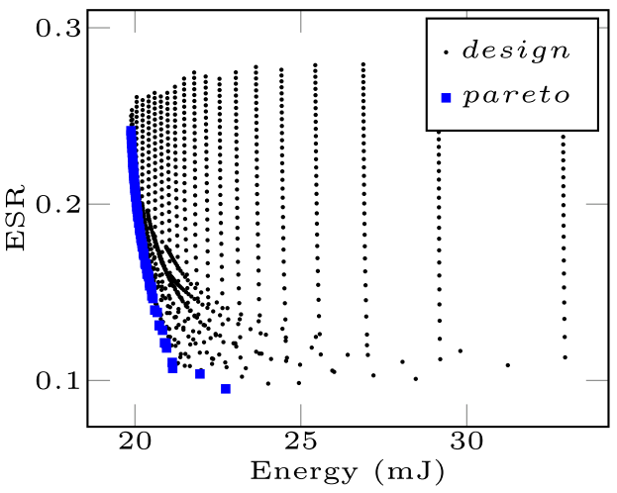
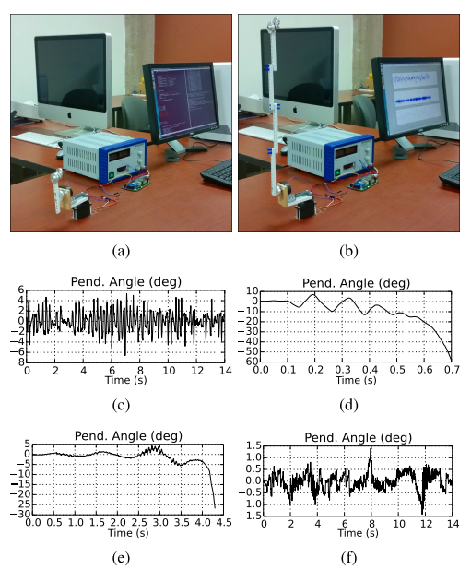
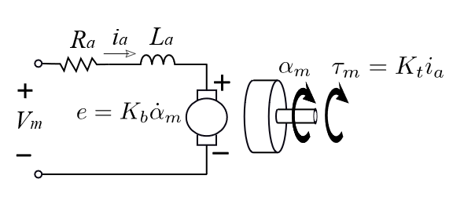
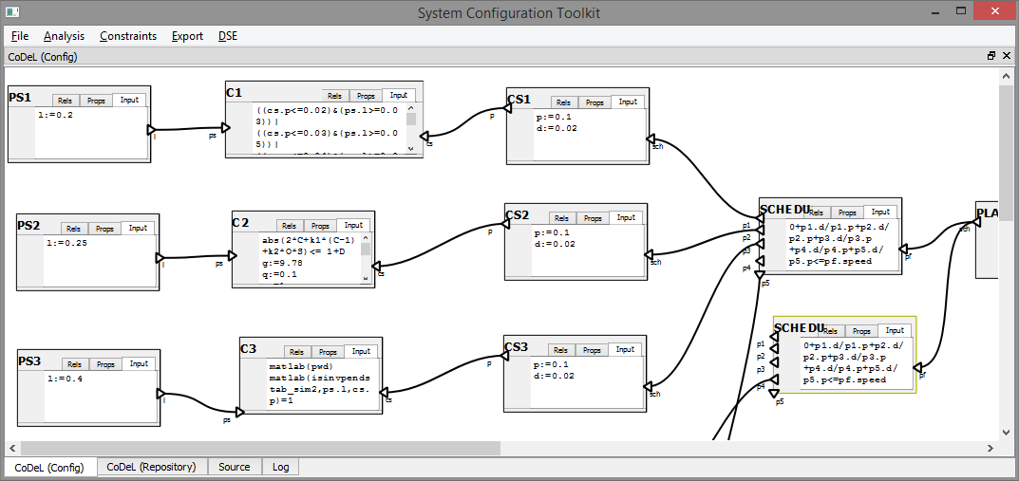
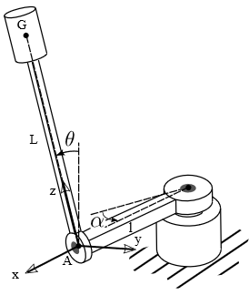
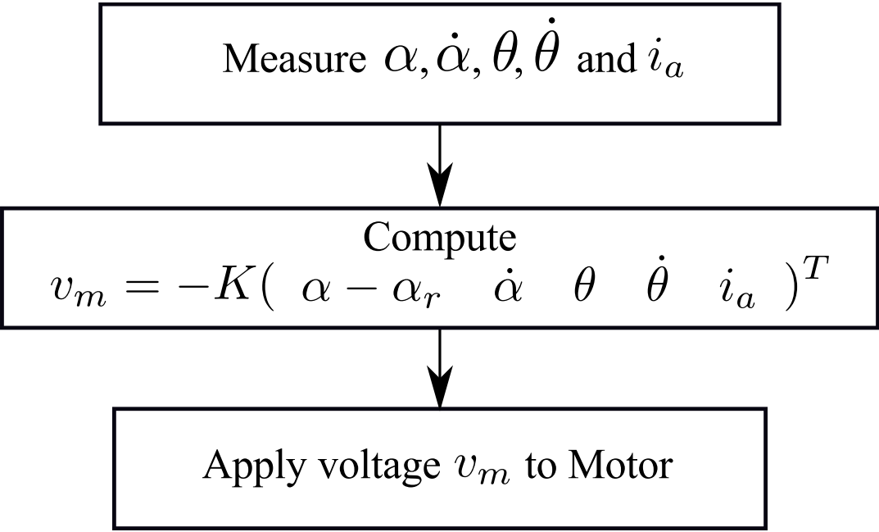
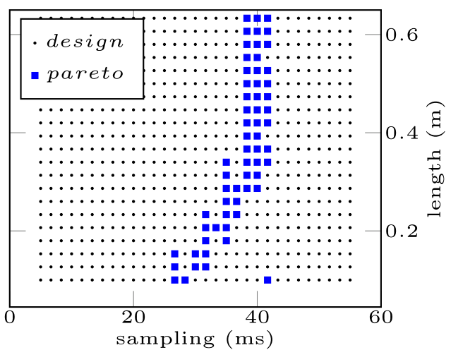
Center for Embedded and Cyber-physical Systems University of California, Irvine
EXPLORATION OF THE CYBER-PHYISCAL DESIGN SPACE
Project: Design Science for Cyber Physical Systems (DesignSciCPS)
Cyber-physical design space
The Project
Development of a Design methodology for Cyber-Physical Systems (CPS)
= a sequence of necessary and sufficient models, design decisions, and tools that systematically lead from a specification to the design of the final product.
Goals
Identification of superior Cyber-physical system designs
Automatic exploration, taking into account domain-specific knowledge
Research Topics
Modeling of Physical System and Control
Modeling of the Cyber System (Scheduling, Composability)
Modeling and coping with uncertainties (faults, model s)
Exploration strategies (Satisfiability, Tool support)
Quality of a CPS design depends on a complex, multi-dimensional, multi-disciplinary design space
Physical design space (e.g. size, strength, pressure, voltage),
Cyber design space (e.g. frequency, architecture, platform)
delay sensor 2 (s)
delay sensor 1 (s)
Performance, Quality
Processing delay (s)
Complex combined design space
Rotary Inverted Pendulum: Control Quality (top) and Power consumption (bottom) are determined by length (physical) and sampling rate (cyber)
Dropping height (m)
Falling Ball Example: System error as function of different sensor delays (top), required sensor position for different processing times and dropping heights (bot).
Exploration
Holistic CPS design space exploration instead of sequential separation of concerns
Apply parametric models of physical, cyber, and control, designed by domain experts
Update control algorithm in context of cyber and physical systems (control-space-pruning)
Automatic co-simulation and evaluation to assess properties and obtain superior design points to be implemented
Use Case
Instantiation in component-based framework
Run | Pruned | Size | Time
Simulink, interpreted |  | 10⁷ | 259 days (est)
Simulink, interpreted | + | 10⁴ | 7177 sec
Modelica, compiled |  | 10⁷ | 162 days (est)
Modelica, compiled | + | 10⁴ | 4471 sec
Modelica, parallel | + | 10⁴ | 87 sec
‘small’ controller
Parametric models of pendulum, DC motor, LQR control, and cyber system with fixed sampling rate
Systematic exploration with OpenModelica precompiled simulations on a 48 core Opteron server takes less than 90 seconds
Result: Control-to-energy consumption trade-off Pareto curve. Highlighted in blue are superior design points.
‘Large’ controller
Stability region for cyber-physical design space after controller pruning
Practical validation: small vs. large pendulum design
Project Contact: Steffen Peter (st.peter@uci.edu) Principle Investigator: Tony Givargis (givargis@uci.edu)
Web: cps.ics.uci.edu
Supported by the National Science Foundation under NSF Grant 1136146

