Slide 1




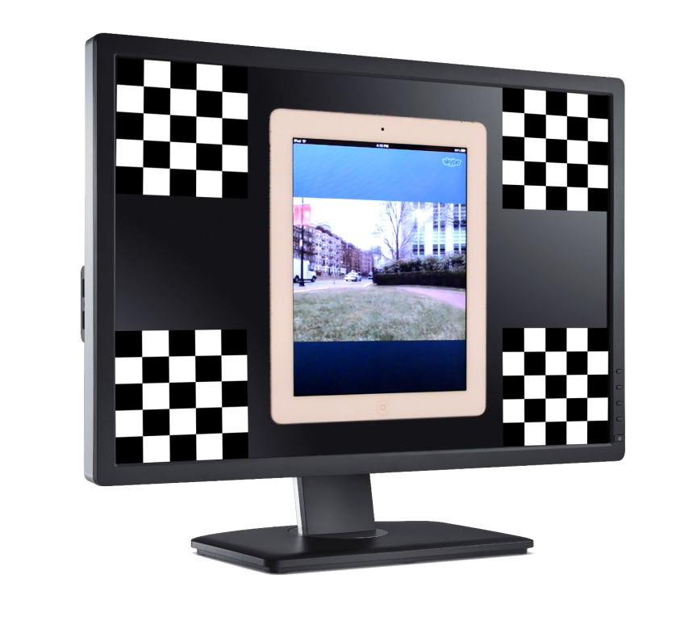
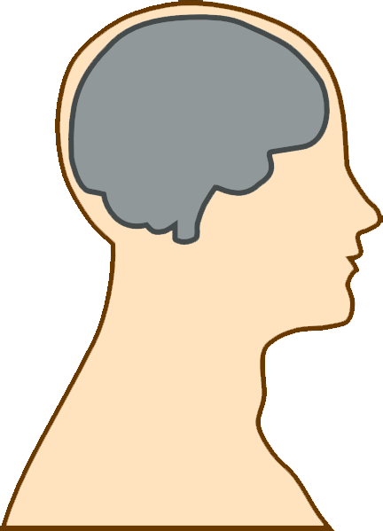
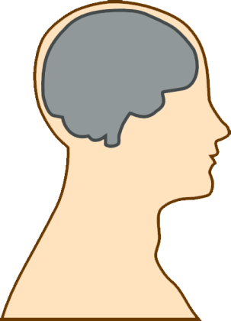
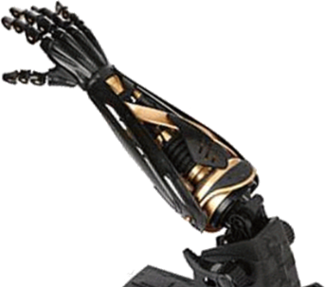

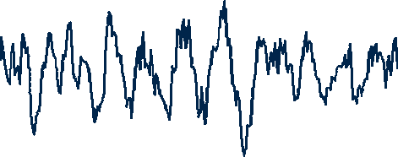
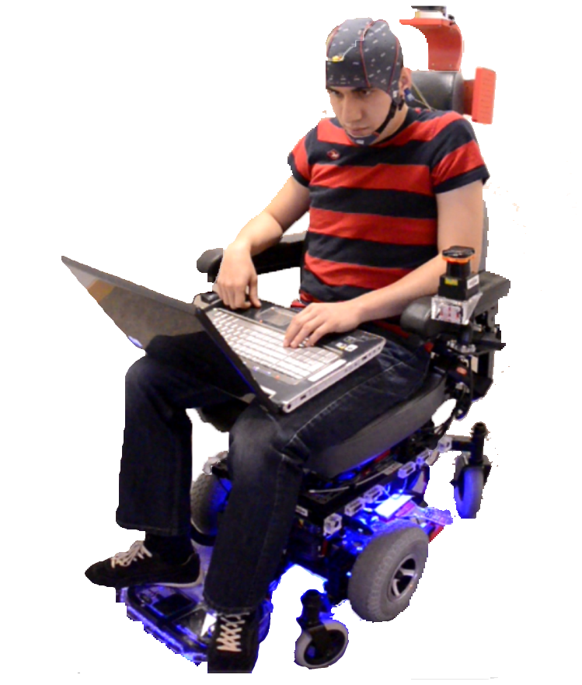
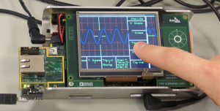
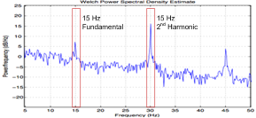
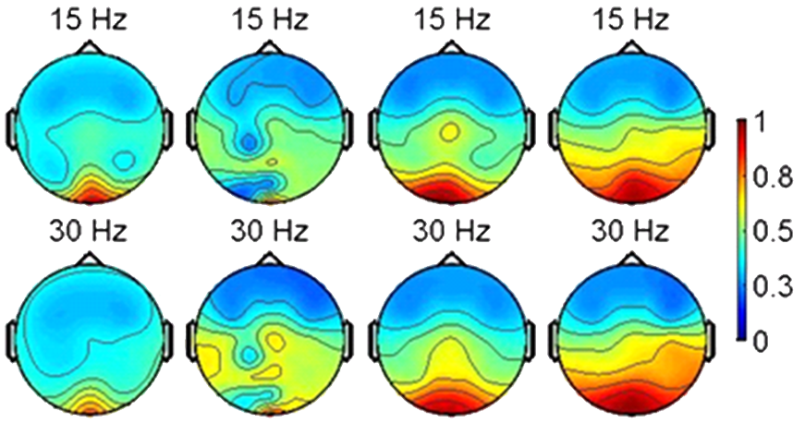
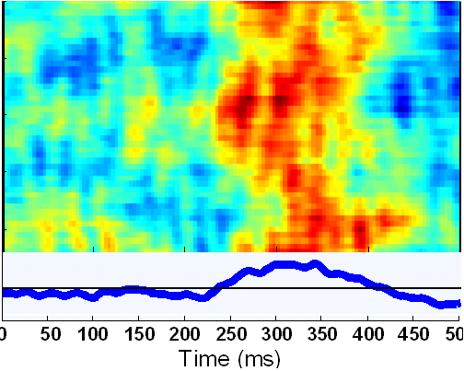
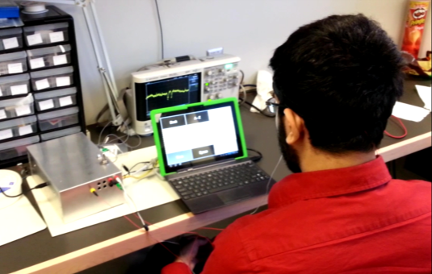
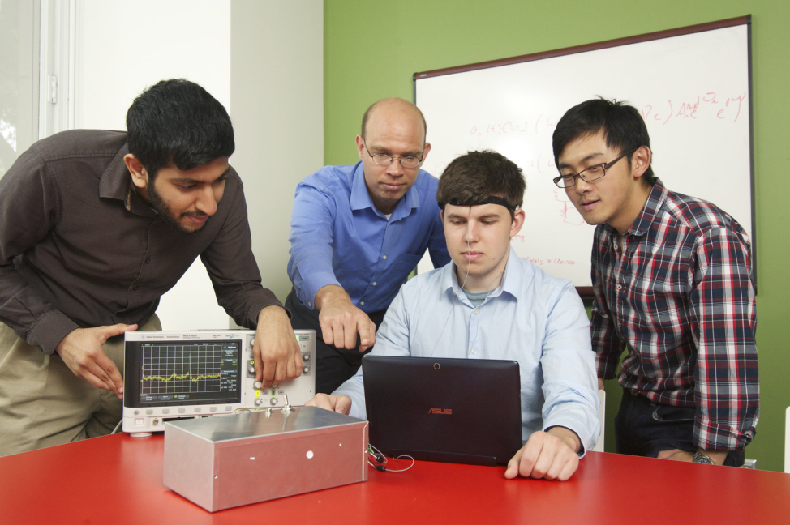
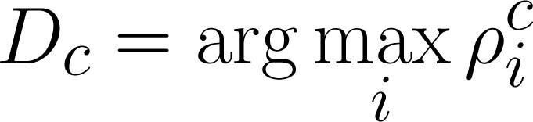
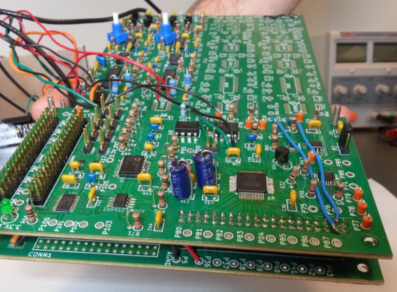
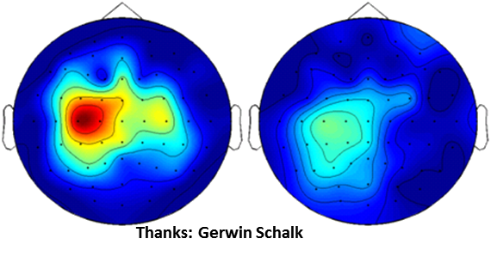
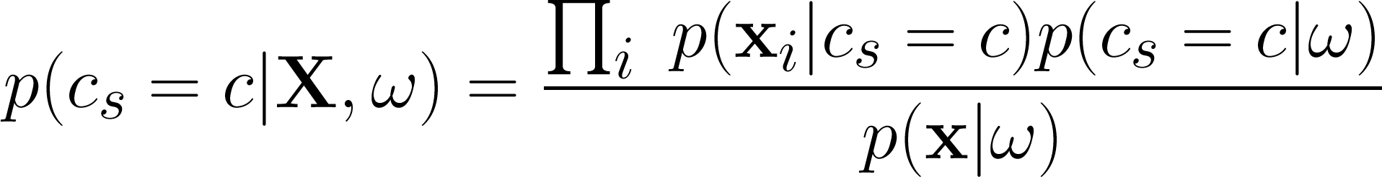

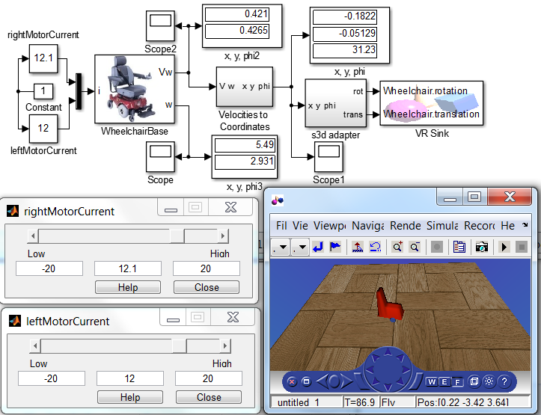
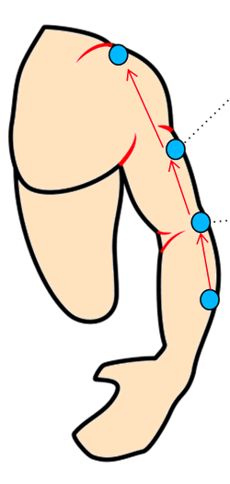

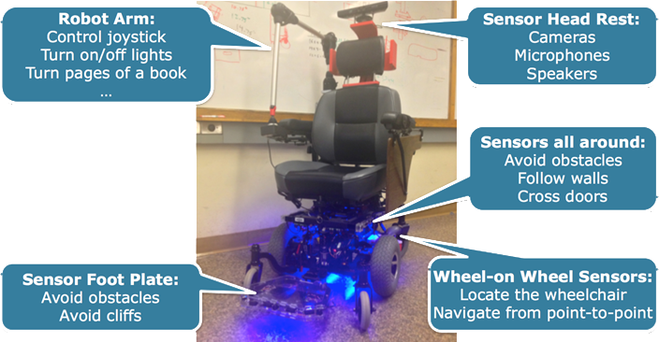
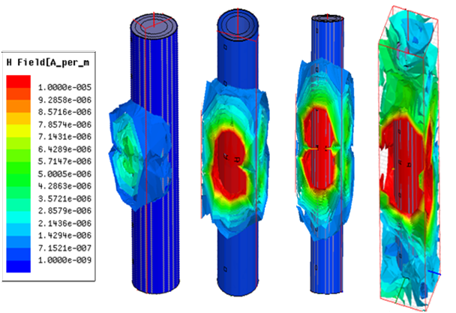
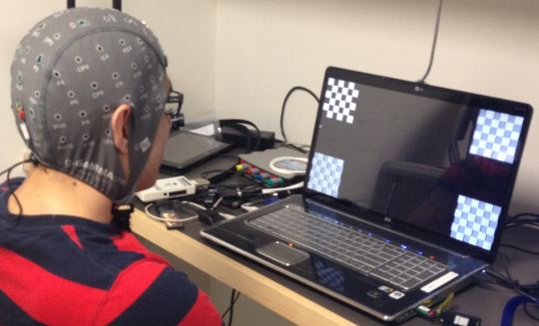
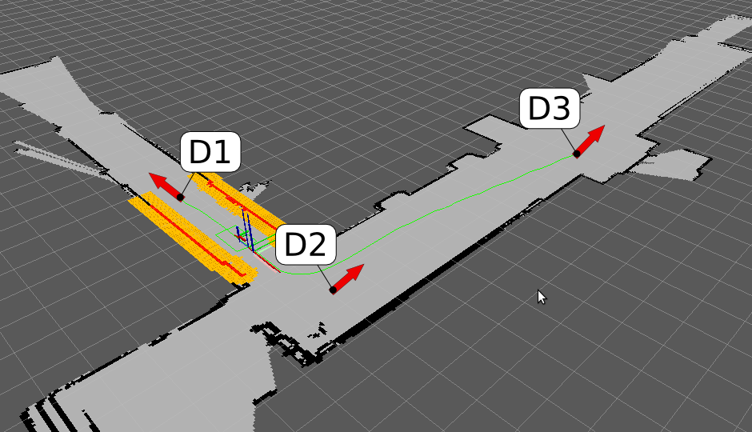


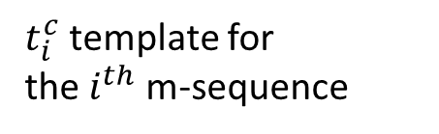


Holistic Design Methodology for Automated Implementation
of Human-in-the-Loop Cyber-Physical Systems
Gunar Schirner, Deniz Erdogmus, Kaushik Chowdhury
Northeastern University
Taskin Padir
Worcester Polytechnic Institute (WPI)
Supported by NSF
Grant 1136027, 1135854
Objectives
Sensory Perception
Processing
Environment
Establish a holistic design framework that integrates physical environment modeling, providing an automated path from algorithm design to embedded implementation.
Advance Body/Brain Computer Interface (BBCI) technology by incorporating context aware inference and learning of task-specific human intent estimation.
Develop robotic actuators that operate robustly and semi-autonomously under uncertain aim (such as navigation) and environmental conditions.
Design retargetable, reliable and efficient real-time communication framework integrating physically distributed components.
Deliver an open framework and prototyping platform as an enabler for accelerated research for human-in-the-loop cyber-physical systems.
Body/Brain Sensors
Sensors
time
Actuators
Wireless Body Area Network.
Embedded System
(HW/SW)
Inference
Engine / Control
System diagram of Human-in-the-Loop Cyber Physical System
SSVEP-controlled Robot \Wheelchair
Context-aware BBCI Design
Rapid Prototyping of Human-in-the-Loop Systems
Exploits visual cortex response patterns observed due to periodic visual stimulus flickering.
Objectives
Design modular, affordable, BCI platform integrating:
  Acquisition & Real-time Processing
Devise automation framework to synthesize HilCPS applications
  Empower algorithm researcher: produces embedded solution with push of button
Current Results
8 channel EEG front-end, 16bit A/D
  SNR: 24.5 dB @ 10uV 10Hz
  Input referred noise: 1.83uV
Low power, heterogeneous compute platform: Bfin 527 500Mz, Spartan 3E
Real-time streaming to Matlab
Initial Matlab -> C synthesis
Steady state visual evoked potentials
(SSVEP)
Spatial distribution of single-channel correct classification probability among 4 m-sequences for 4 subjects, 15 & 30 bits/sec.
Frequency
Temporal stimulus pattern is
010101010101….
Different symbols have different bit presentation rates.
Frequency resolution of PSD estimation imposes a limit.
Artifacts and background brain activity overlap with stimulus response in Fourier domain.
PRBS
Temporal stimulus pattern is
111010100001….
Different symbols have different bit sequences.
Number of distinct sequences imposes a limit.
Codes are ultra-wideband.
Narrow-band artifacts present a smaller problem.
Visual or auditory evoked P300
response (ERP)
${ ρ}_{i}^{c} :$ correlation score
$$ρ_{i}^{c}= s^{cT}t_{i}^{c}$$
$t_{i}^{c}$ template for
the $i^{th}$ m-sequence
$s^{c}$ : windowed EEG
Motor imagery (MI) or other synchronization / desynchronization activity in the motor cortex
$D_{c} :$ decision for channel c
Fusion with context information
EEG evidence:
ω
context information
Robotic Assistive Technology
Wireless Body Area Networks
Objectives
Design and validate shared control algorithms for HiLCPS.
Design and control a modular, compliant robotic arm.
Model proper autonomy levels HiLCPS.
Implement active control algorithms for robot motion coordination for effective and sensor-based mobile manipulation.
Model-Based Design for HiLCPS
(1) Concept of body coupled communication concept
(2) Galvanic coupling-communication at multiple tissue layers
SKIN
Top View
Primary Current Flow
C
SKIN
Z_{L}^{S-S}
B
Transmitter
(tx)
+
Secondary Current Flow
F
-
~
FAT
Z_{L}^{F-F}
Side View
MUSCLE
Bone
i
A
Z_{L}^{M-M}
Human Arm Model
The signal current flows through the path D_{E} between the tx electrodes, and along D_{L} between the tx and rx electrodes, which results in a voltage V_{out} at the rx.
Coupling Electrodes
Z_{L}^{B-B}
Z_{D}^{B-B}
Z_{D}^{M-M}
Z_{D}^{F-F}
Z_{D}^{S-S}
D_{E}
Z_{T}^{M-M}
Z_{T}^{B-B}
BONE
Detecting Electrodes
Electrodes
SKIN
MUSCLE
BONE
Z_{T}^{F-F}
D_{L}
FAT
Aim: To derive electrical-circuit equivalent models for analyzing the channel gain, for wireless communication through inner tissue-layers.
Z_{T}^{S-S}
Receiver
(rx)
Adaptive motion control with parameter estimation for HiLCPS.
Research Goal: Use the body as the communication channel to transfer sensory data from
on-skin and implanted sensors. Body tissue serves as impedances along the longitudinal (Z_{T}), depth (Z_{D}) and transverse (Z_{T}) directions, which we need to model using electrical circuits.
V_{out}
D_{S}
Information Source
Discrete Channel with Noise
Destination
(3) Lumped parameter circuit model
-
+
Human
Intent
Brain-Computer Interface
Robot
(4) Results
Lumped circuit model
Simulation
BCI (human)
input
Transition Model
(Context)
Sensor Model
(Human model)
We resolve the current passing through each vertex and the voltage between them using Kirchhoff's laws. These equations give output voltage at the rx
Simulation
Context Sensitive Probabilistic Filter
Hector SLAM
EKF
2D map
Navigation Stack
Semi-autonomous control of the wheelchair from an SSVEP-BCI.
pose
Global
planner
Local
planner
Field spreading out of the body for different tx signal frequency: 100 KHz (left most), 500 KHz, 1 MHz and 10 MHz (right most). The ideal operating range of frequency is found to be between 10 KHz and 1 MHz.
Gain at muscle tissue layer Vs frequency using finite element modeling based simulation and our electrical equivalent circuit model for 10 (blue) and 20 (red) cm separation between tx and rx sensors
IMU
LIDAR
Motor Controller

