Slide 1

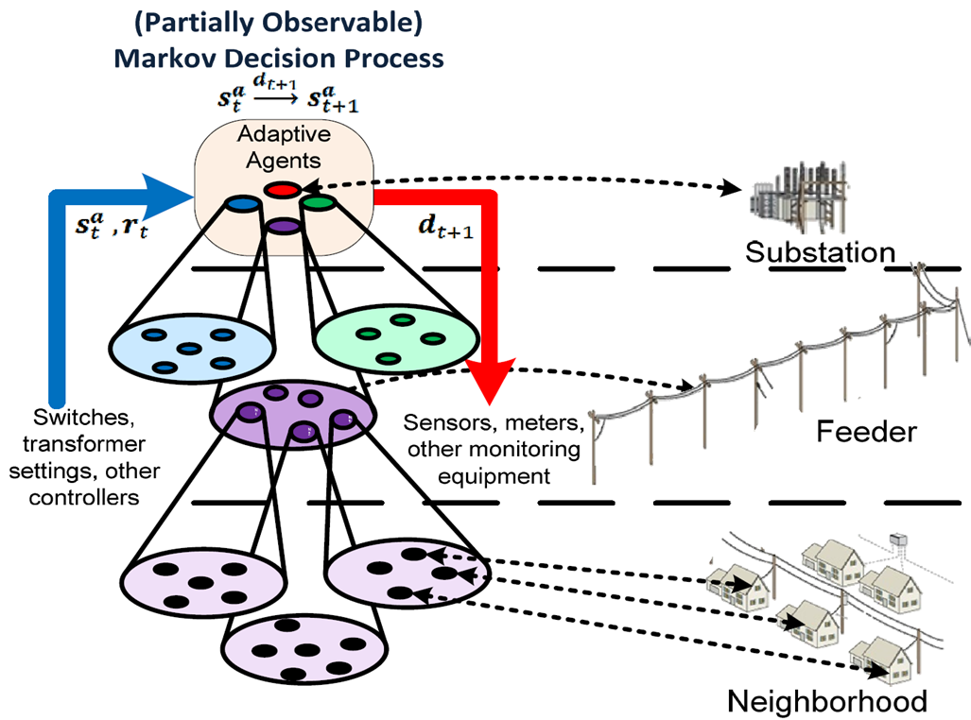
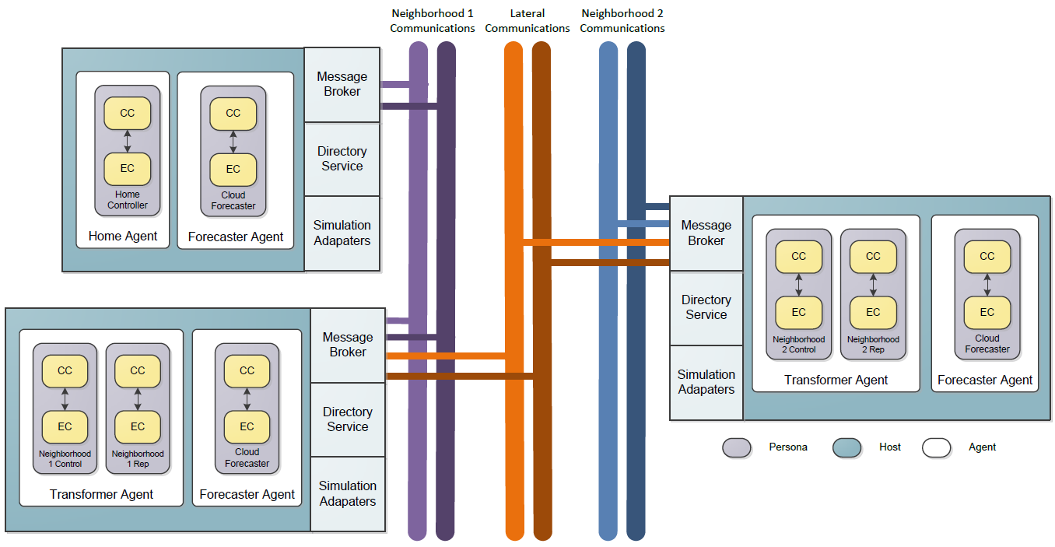
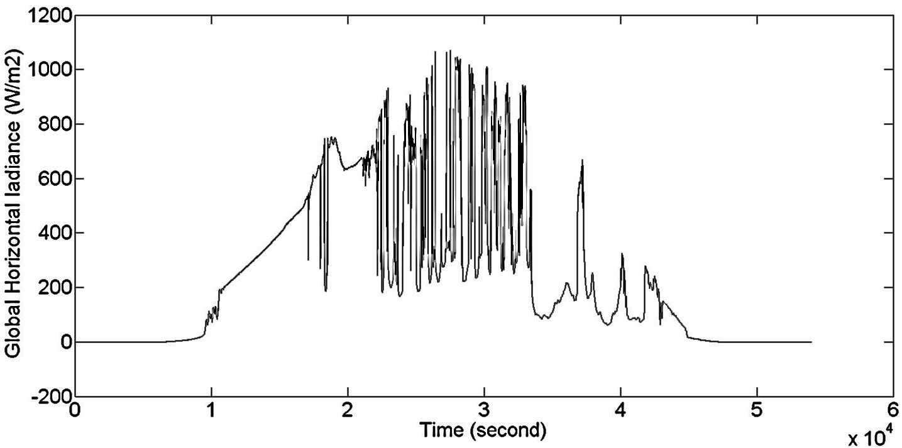
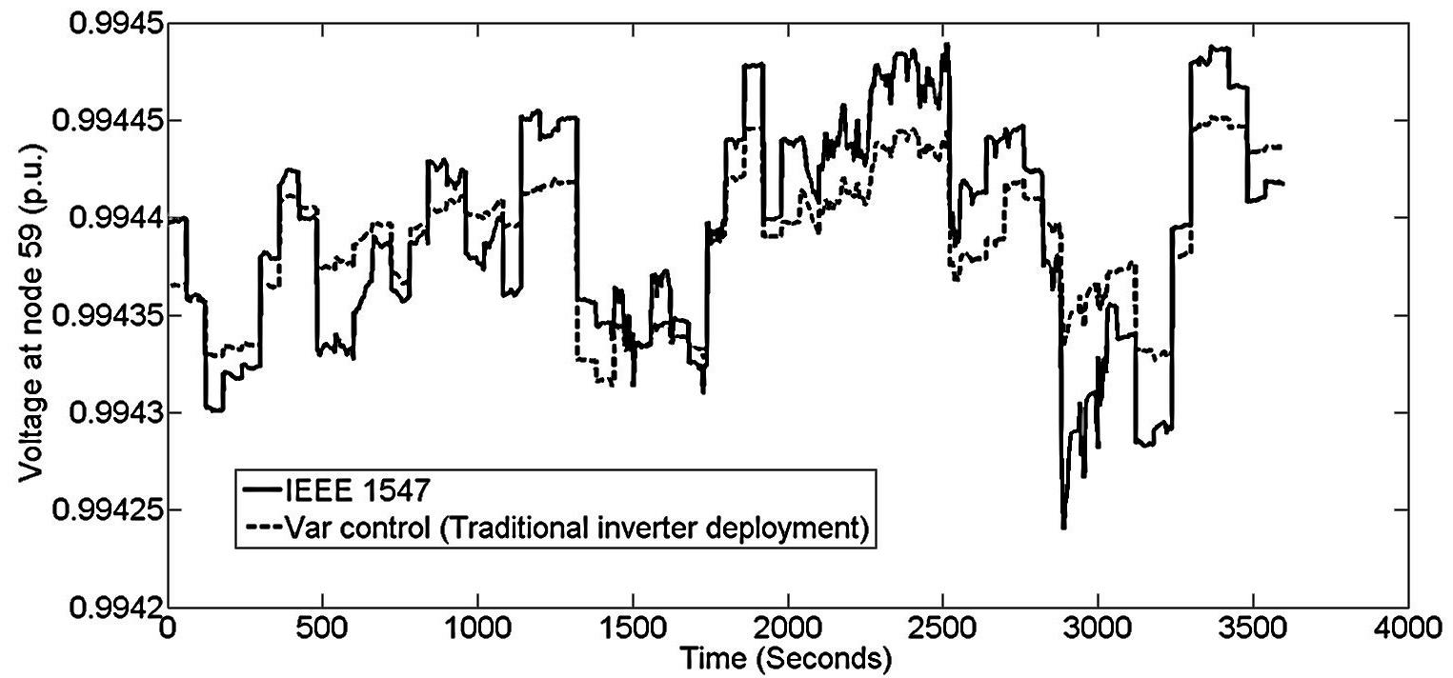
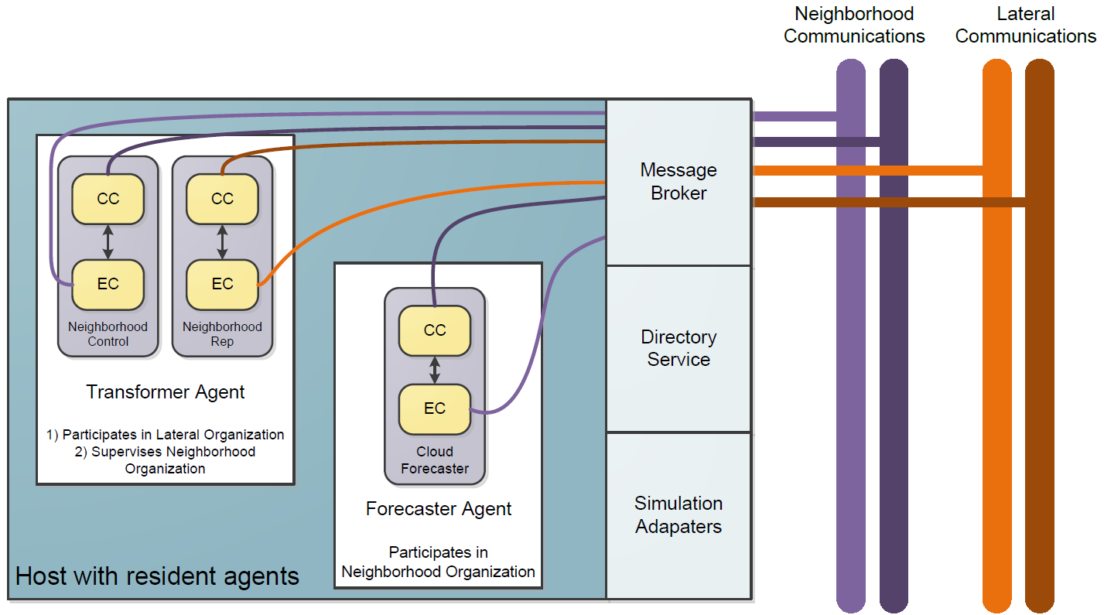
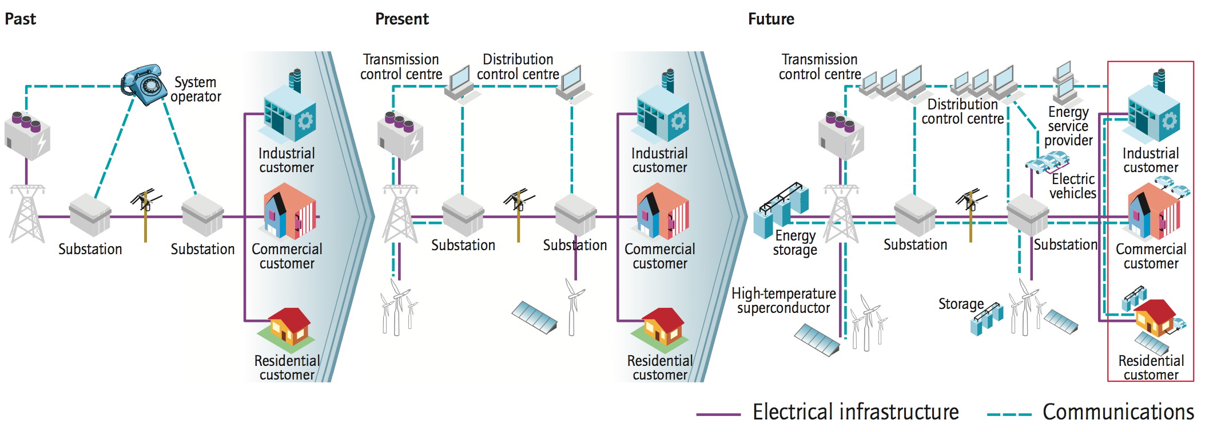

Holonic Multi-Agent Control of Intelligent Power Distribution Systems
NSF-CPS Award No. CNS - 1136040
  Project Team
  Electrical and Computer Engineering: Anil Pahwa, Sanjoy Das, Bala Natarajan, Noel Schulz Computing and Information Sciences: Scott DeLoach, Simon Ou, Dan Andresen, Gurdip Singh
  Graduate Students: Shafiul Alam, Denise Case, Ahmad Malekpour, Daniel Wang Undergraduate Students: Thomas Ehlmann, Greg Martin
Abstract: The project will demonstrate a holonic multi-agent system architecture (HMSA) capable of adaptively controlling future electrical power distribution systems, which are expected to include a large number of renewable power generators, energy storage devices, and advanced metering and control devices. The project will produce a general, extensible, and secure cyber architecture based on holonic multi-agent principles to support adaptive PDS. It will produce new analytical insights to quantify the impact of information delay, quality and flow on the design and analysis of the PDS architecture. The architecture produced by this project will be capable of optimizing performance and maintaining the system within operating limits during normal and minor events, such as cloud cover that reduces solar panels output. The architecture will also allow the operation of a distribution system as an island in emergencies, such as hurricanes/earthquakes, grid failures, or terrorist acts.
HMAS to Physical System
HMAS Architecture
State Estimation Using Compressed Measurements
Agents Act in Multiple Organizations
Control Components (CC) provide administrative support for functioning within an organization
Execution Components (EC) provide technical support for carrying out domain-specific task assignments.
  Two-dimensional compressed sensing approach efficiently compress the measurements by exploiting spatio-temporal correlation of generation/load.
Voltage Control with Smart Inverters
Secure Real-Time Microkernel
Global Horizontal Irradiance
Voltage with IEEE 1547 (no control) and reactive power control with traditional size inverter
  An open source Microkernel based embedded RTOS
Reliability, the OS must be reliable and always available most of the time running without malfunctions.
Resilience, the OS must be able to prevent rogue software from denying resources to other parts of system, and could be discovered and recovered on the fly.
Hard Real-Time, the OS is deterministically guarantee that all accepted tasks are accomplished in time and in expected order.
Local Optimizations Support Central Control
Distributed Control Actions Chosen Locally
Centralized Support Control Actions Chosen in Response to Aggregated Needs
Q_{C}
Q_{c}
Q_{max}
Voltage Variation Index (VVI)
IEEE 1547 | Traditional inverter deployment | 20% oversized inverter
0.0037 | 0.0018 | 0.0017
P
Q_{min}
P
Q_{L}
Q_{L}
Traditional Inveter
Oversize Inverter
Source: International Energy Agency (http://www.iea.org/)
Intelligent Power Distribution Systems
http://ipds.cis.ksu.edu/
Electrical and Computer Engineering
Computing and Information Sciences

