Slide 1


Hybrid Control Tools for Power Management and Optimization in Cyber-Physical Systems
Magnus Egerstedt, Yorai Wardi, Sudha Yalamanchili
{magnus, yorai.wardi, sudha.yalamanchili}@ece.gatech.edu
Georgia Institute of Technology
Patrick J. Martin
pjmartin@ycp.edu
York College of Pennsylvania
hypower.gatech.edu
CNS-1239221, CNS-1239225

Slide 2
Project Goals
Foundational principles for the co-optimization of power and performance for CPS.
Efficient computational tools for optimization in federated control systems.
Applications in robotics, sensor networks, and multi-core processors.
Education materials to facilitate CPS education.
hypower.gatech.edu

Slide 3
Personnel
PIs
Magnus Egerstedt - Multi-agent systems
Patrick J. Martin - CPS cloud computing
Yorai Wardi - Hybrid optimal control
Sudha Yalamanchili - Multi-core processors
Graduate Students
Matt Hale
Tina Setter
Usman Ali
Karthik Rao
Xinwei Chen
Undergraduate Students
Travis Eichelberger
Paul Glotfelter
Samuel Nelson
hypower.gatech.edu

Slide 4
Hybrid Centralized-Decentralized Decision Systems
Centralized information in distributed systems is captured through an aggregating agent.
  Enables multi-agent optimization with global constraints.
  Agents exchange information with the aggregator.
  Each agent computes its own state values while the aggregator computes Kuhn-Tucker multipliers.
hypower.gatech.edu

Slide 5
Hybrid Centralized-Decentralized Decision Systems
PhysiCloud provides a cyber-physical cloud computing infrastructure that supports the aggregator framework.
  Provides cloud-like access to cyber-physical resources.
  Provides resiliency to network and power failures.
hypower.gatech.edu

Slide 6
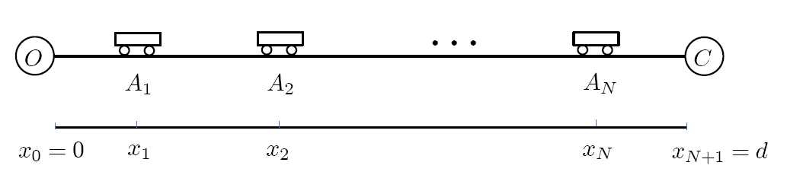
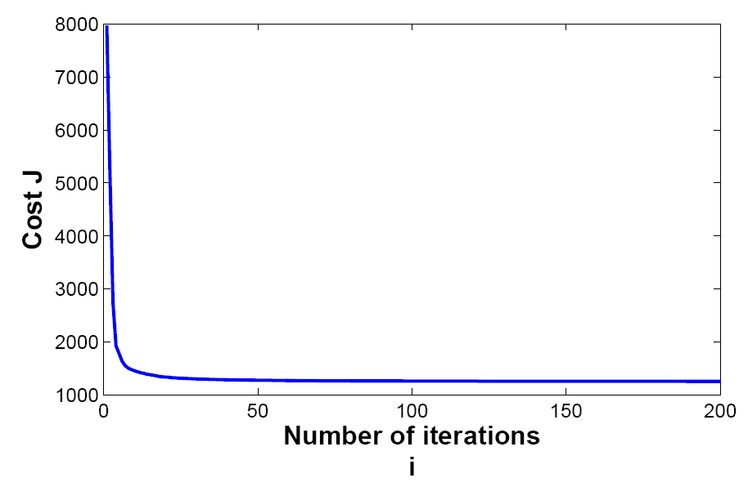
Power Aware Communication
Path planning for minimal communication/motion energy.
Example:
Combines communication and mobility costs in a unified manner.
  Fast computational tools allow for minimization of motion and communication energy
Optimal positioning computed within 9s!
hypower.gatech.edu

Slide 7
Performance Regulation for Multi-Core Processors
Frequency Scaling utilized for throughput regulation.
Infinitesimal Perturbation Analysis allows for effective estimation of multi-core behavior.
Decentralized per-core regulation of throughput.
hypower.gatech.edu

Slide 8
Performance Regulation for Multi-Core Processors
Temperatures regulated using Dynamic Voltage Frequency Scaling.
Plant model incorporates leakage power and temperature coupling.
Fast and robust decentralized controller.
hypower.gatech.edu

Slide 9
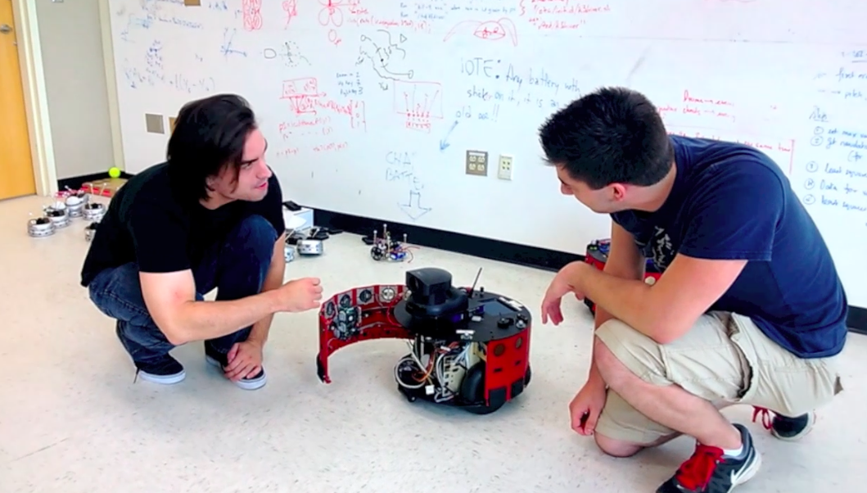
Student Education Program
Student exchange program
  Graduate students travel to YCP
  Undergraduate students travel to GT
Establishment of research co-op experience for YCP undergraduates.
hypower.gatech.edu

Slide 10
Future Work
Hybrid centralized/decentralized optimization, coordination, and control design using the PhysiCloud architecture.
Deployment of power-aware control algorithms on teams of mobile robots.
Implement power-aware optimization and regulation tools on multi-core chips.
hypower.gatech.edu

