Slide 1


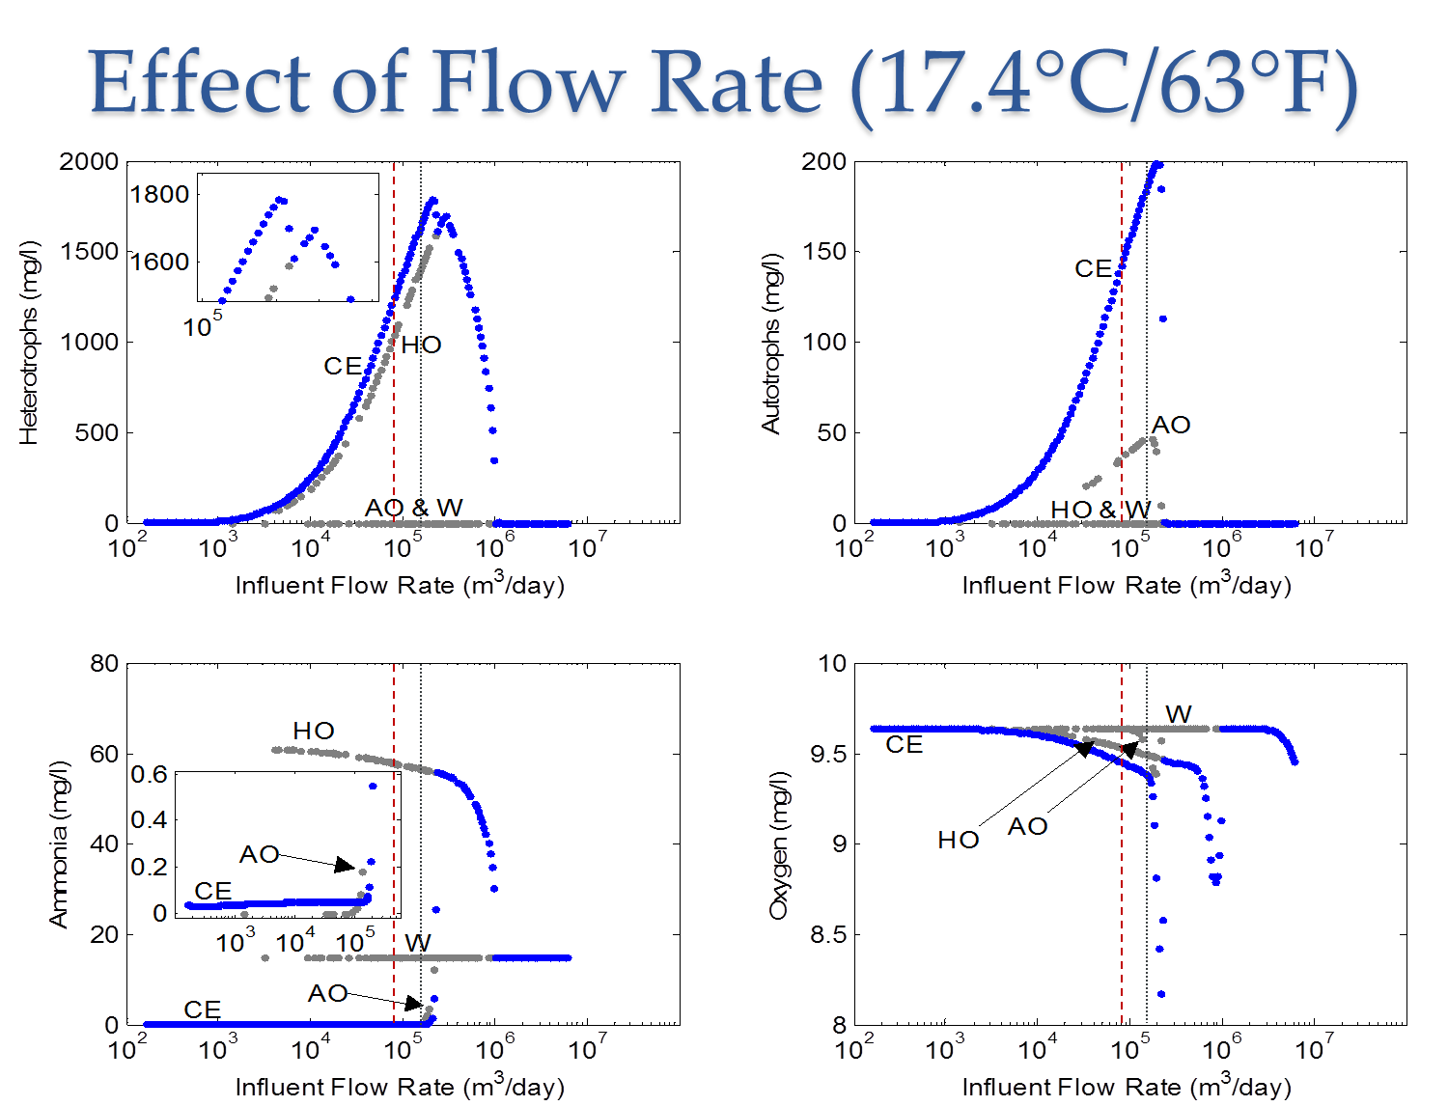
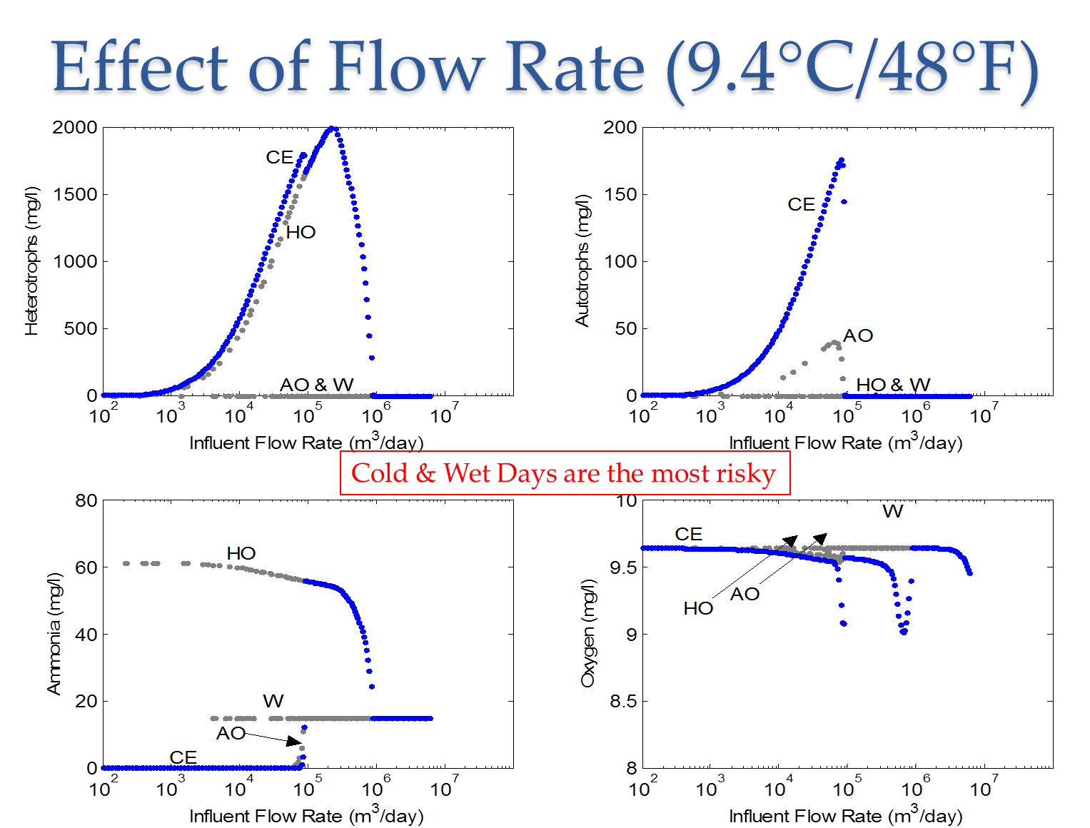
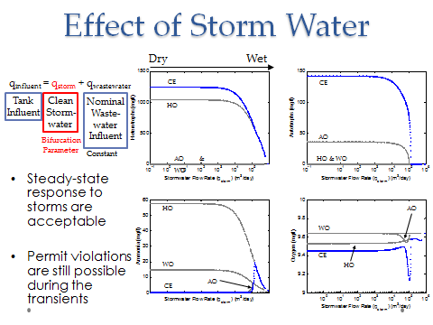
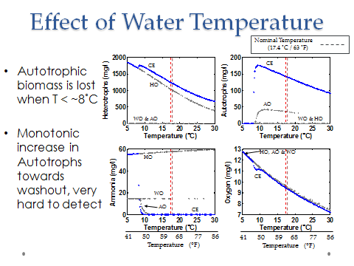
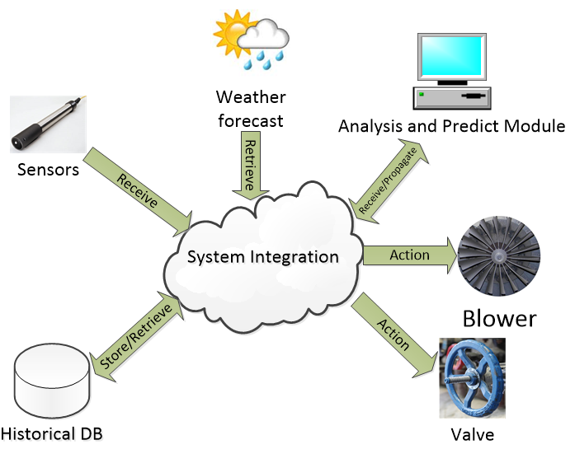
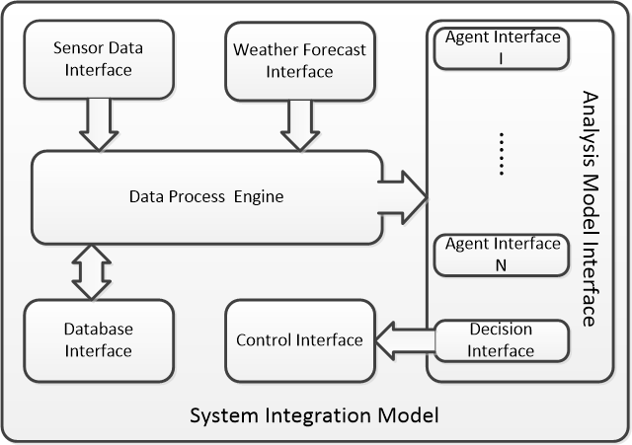
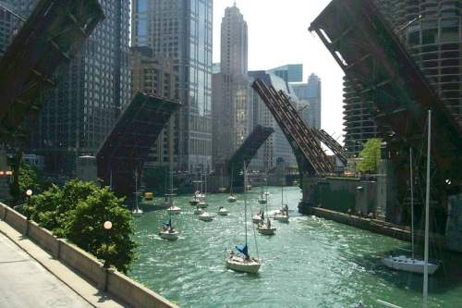
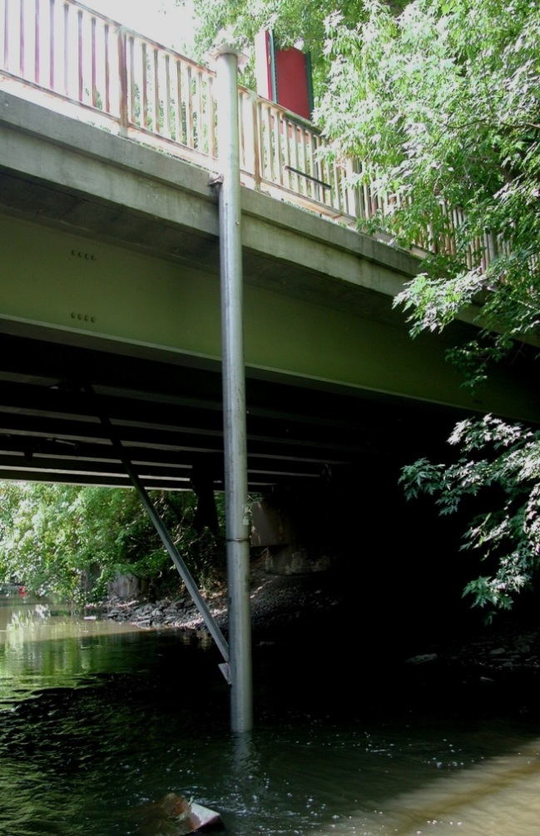
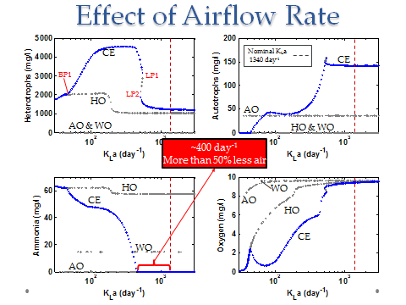
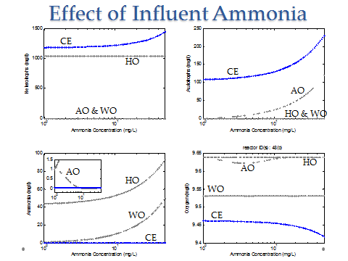
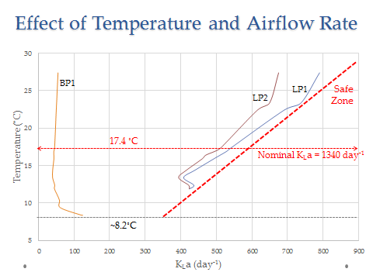
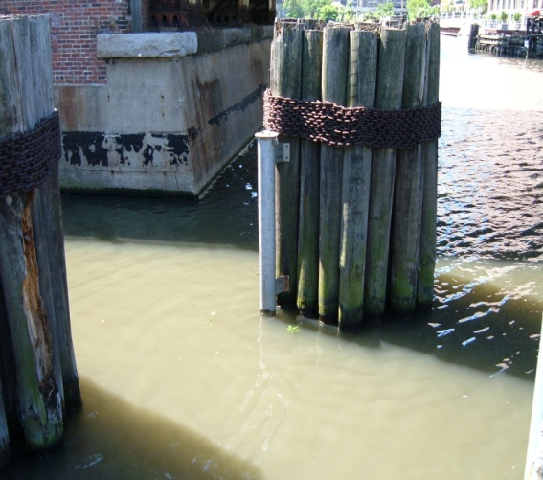
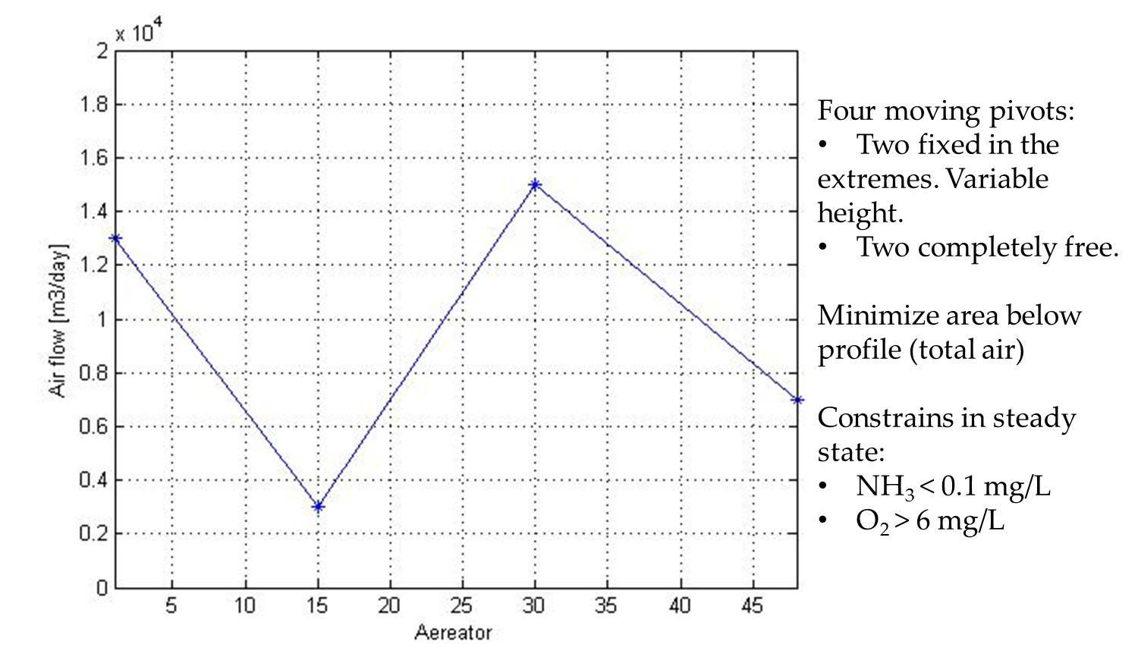
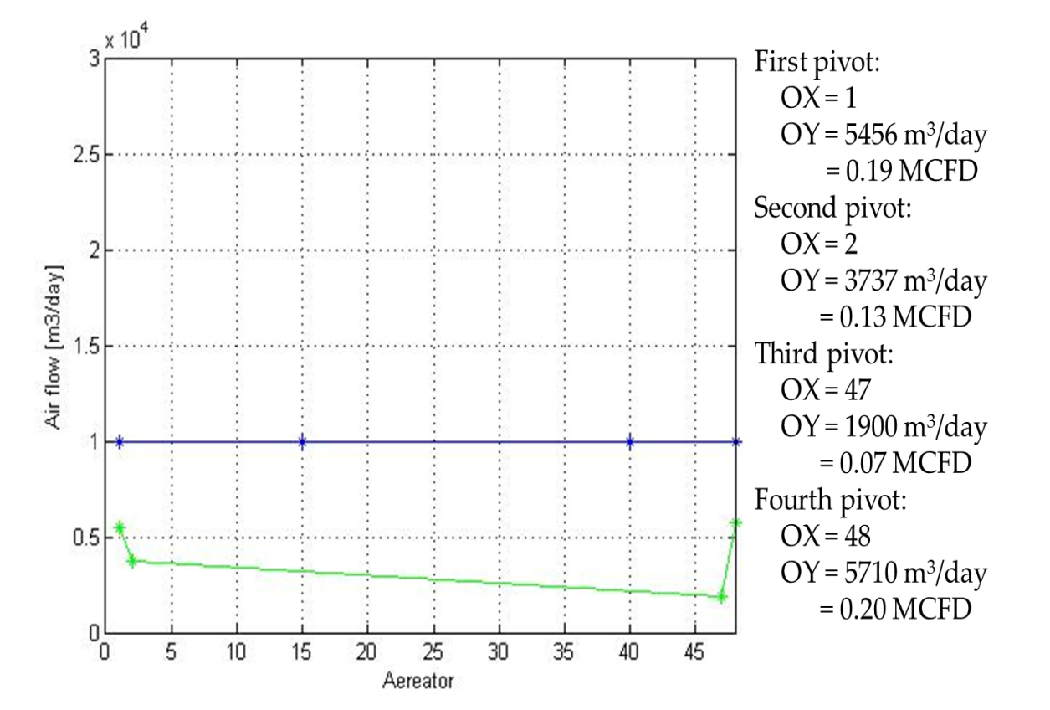
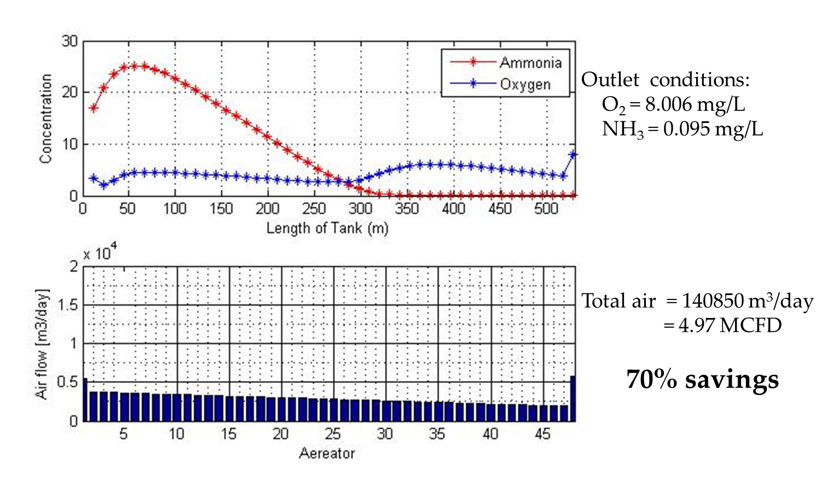
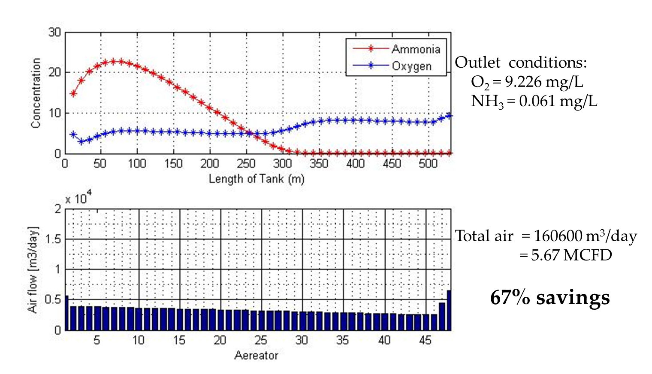
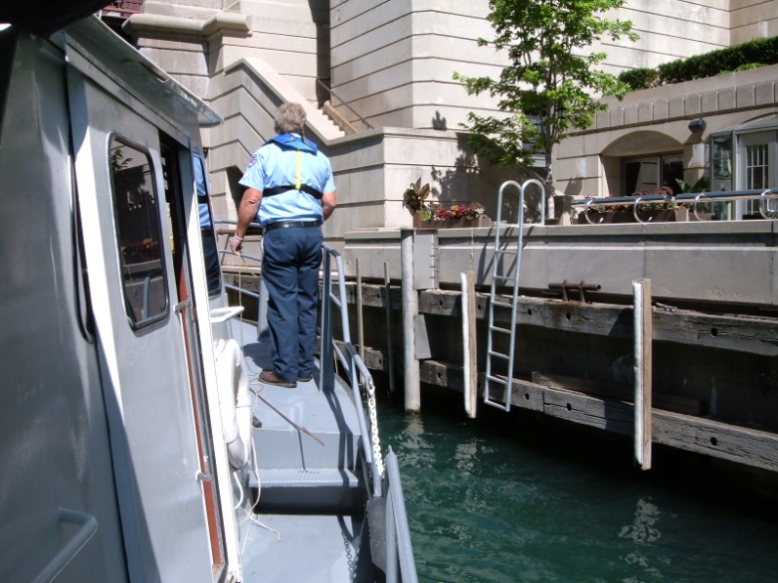
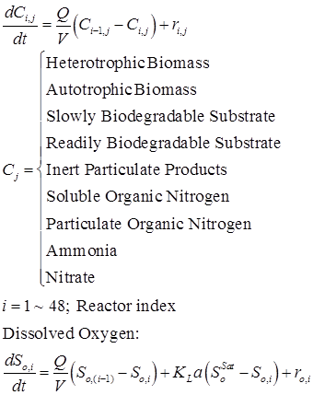
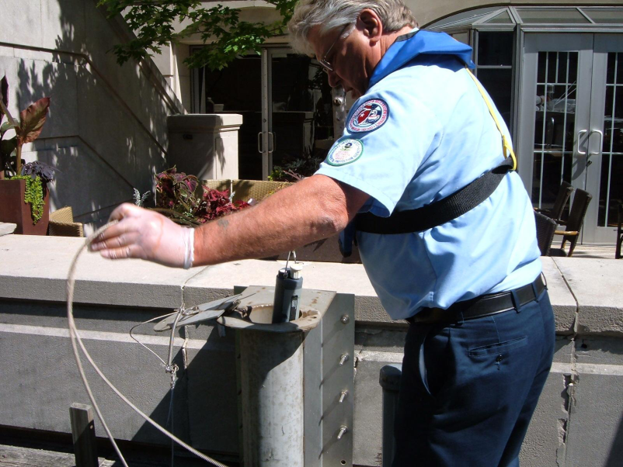
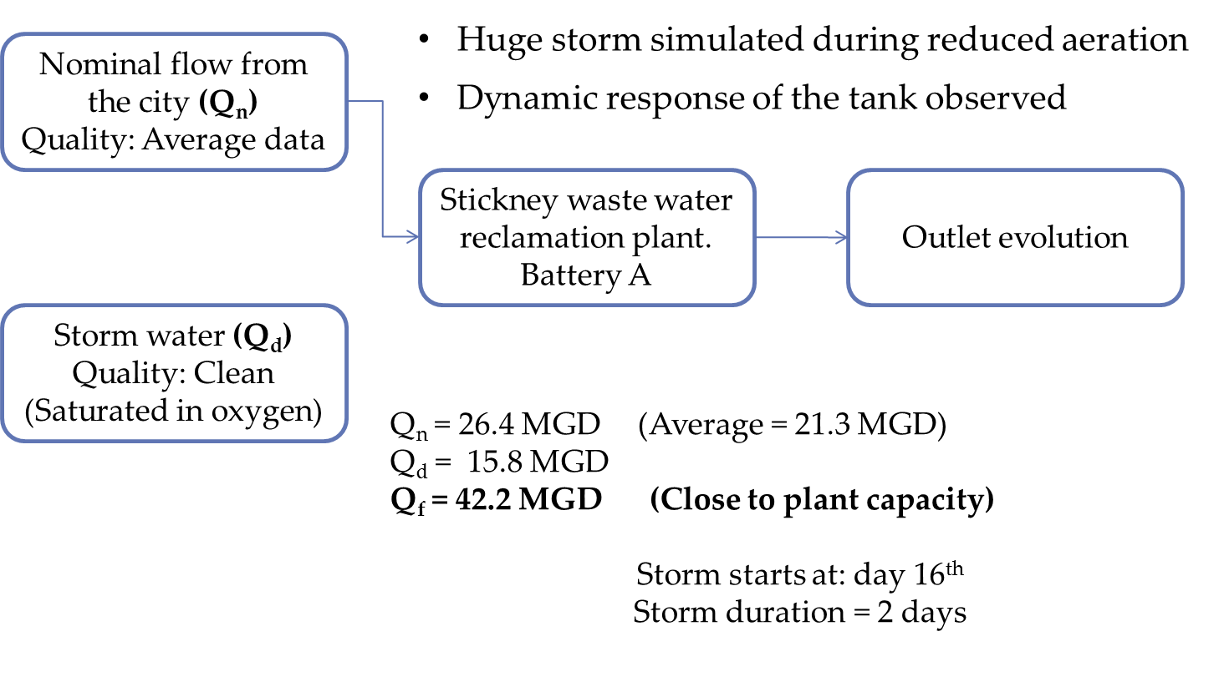
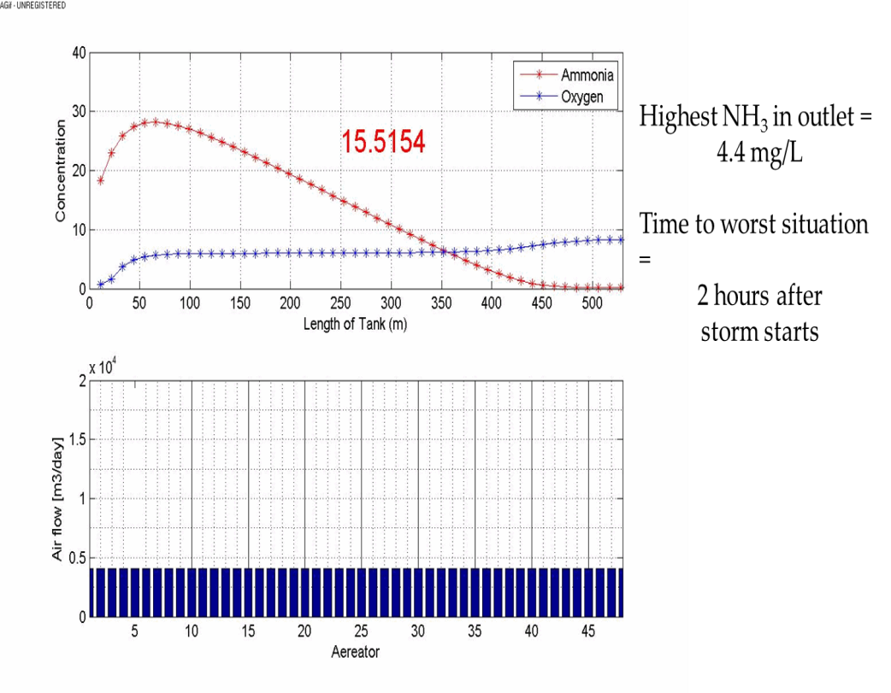
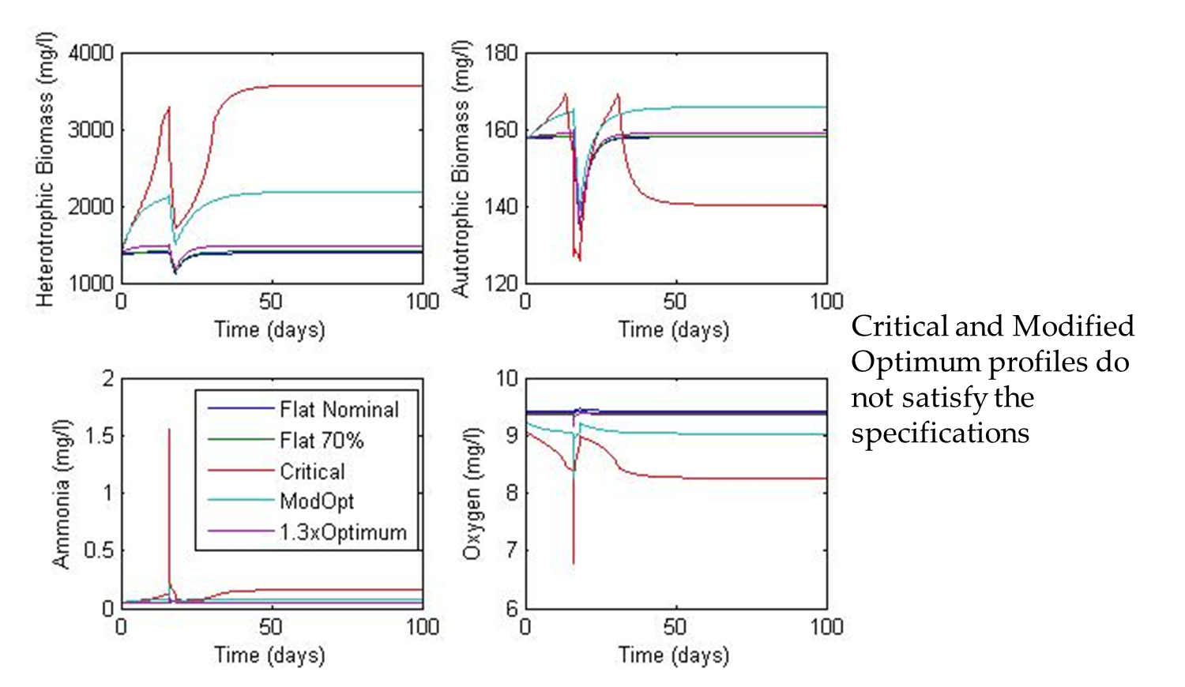
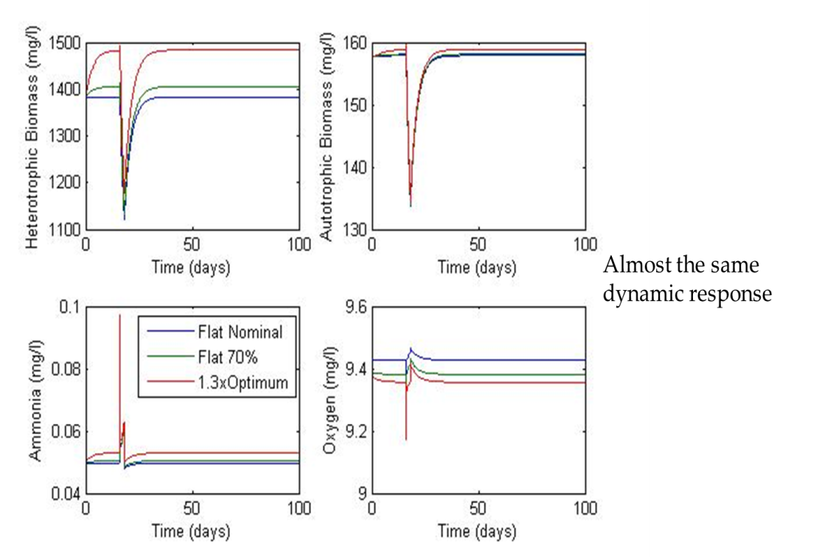
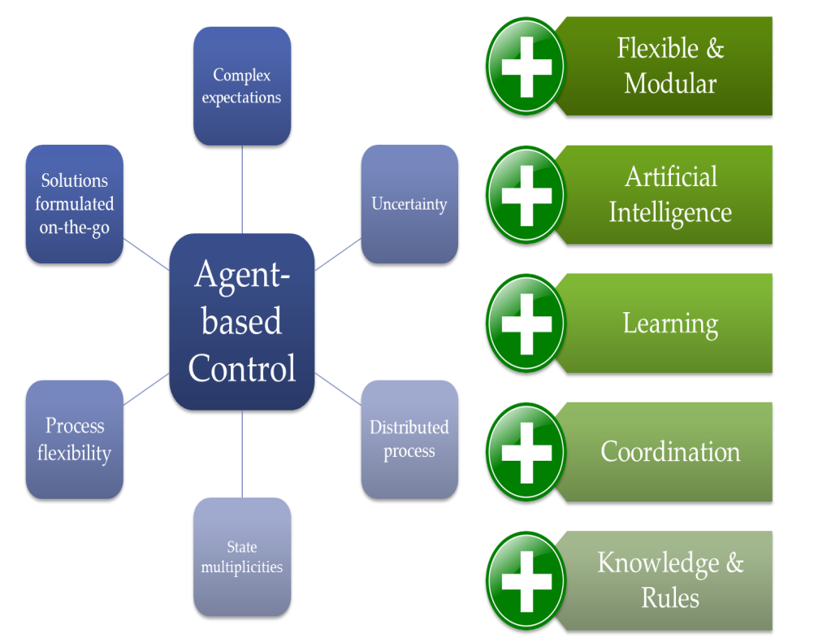
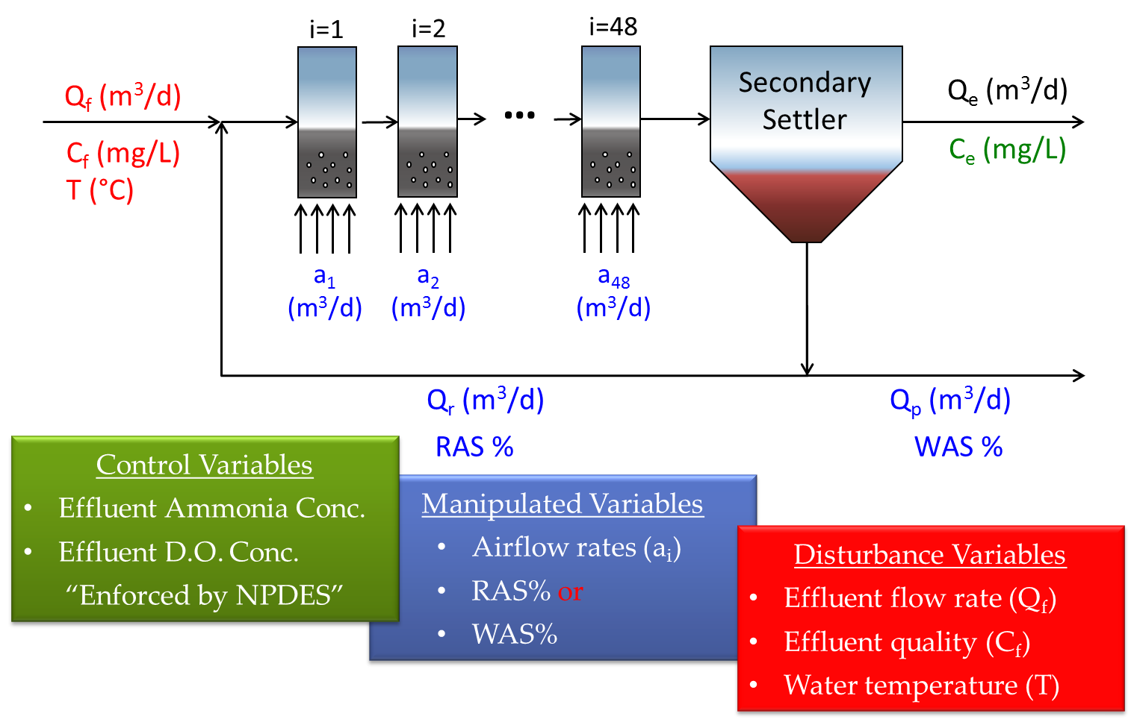
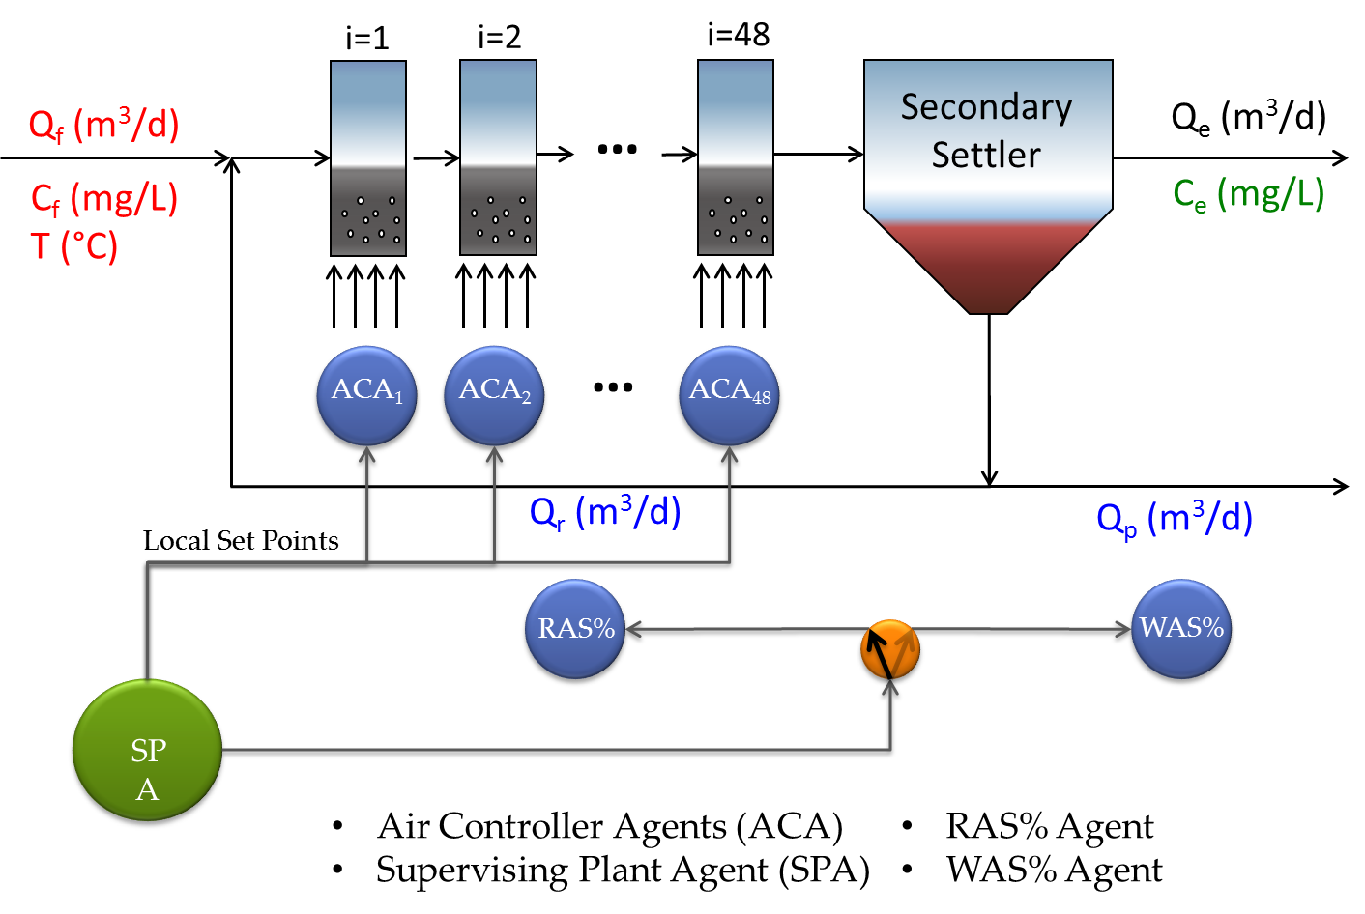
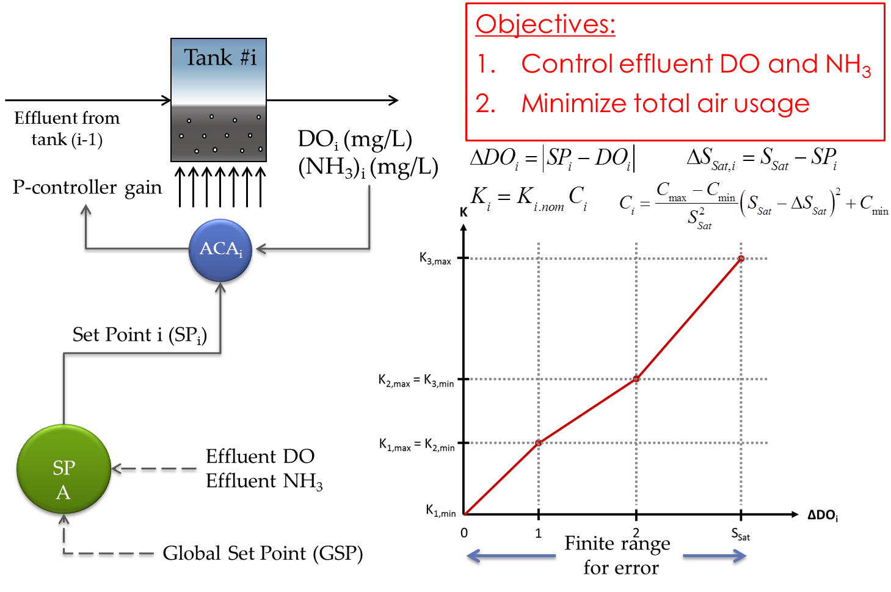
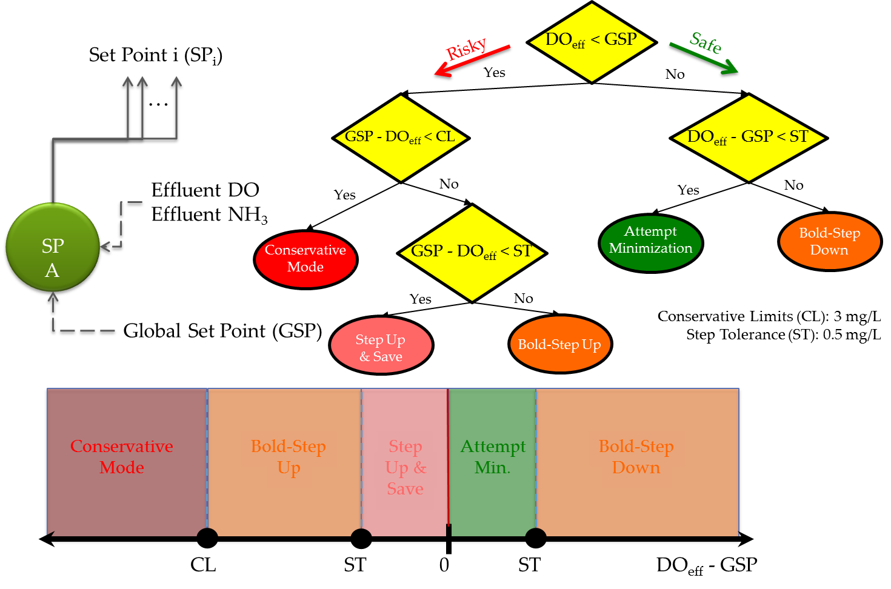
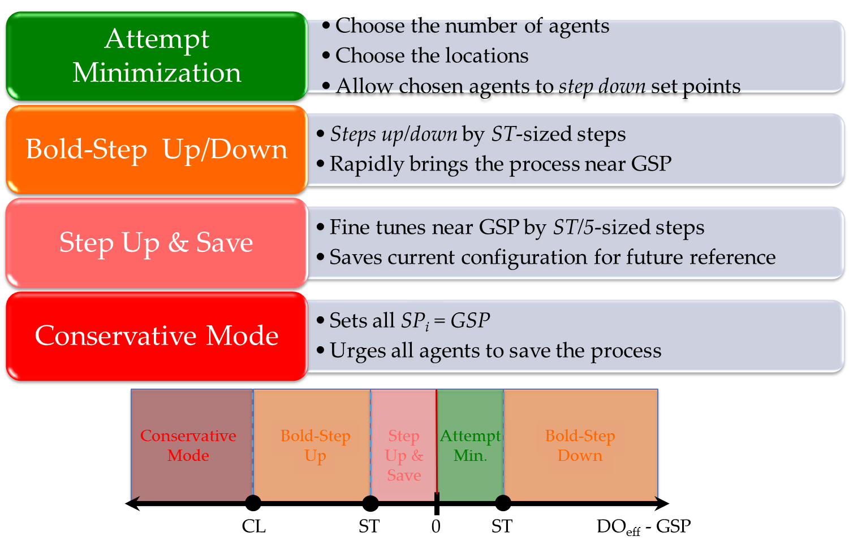
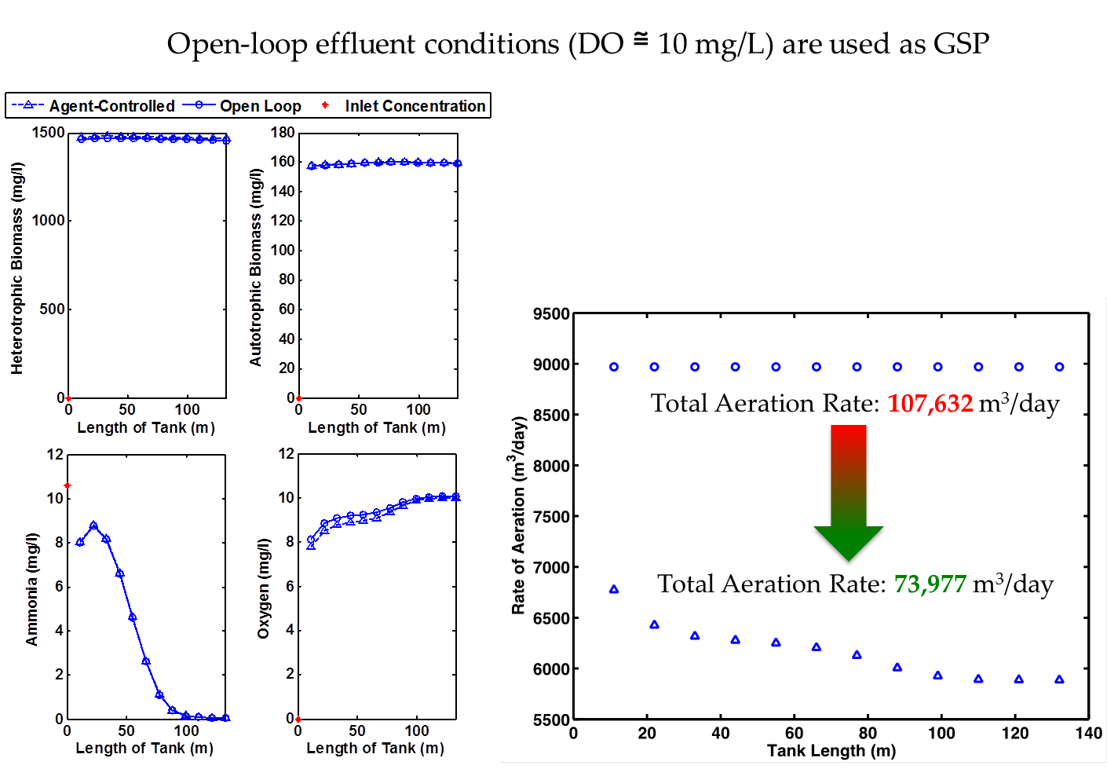
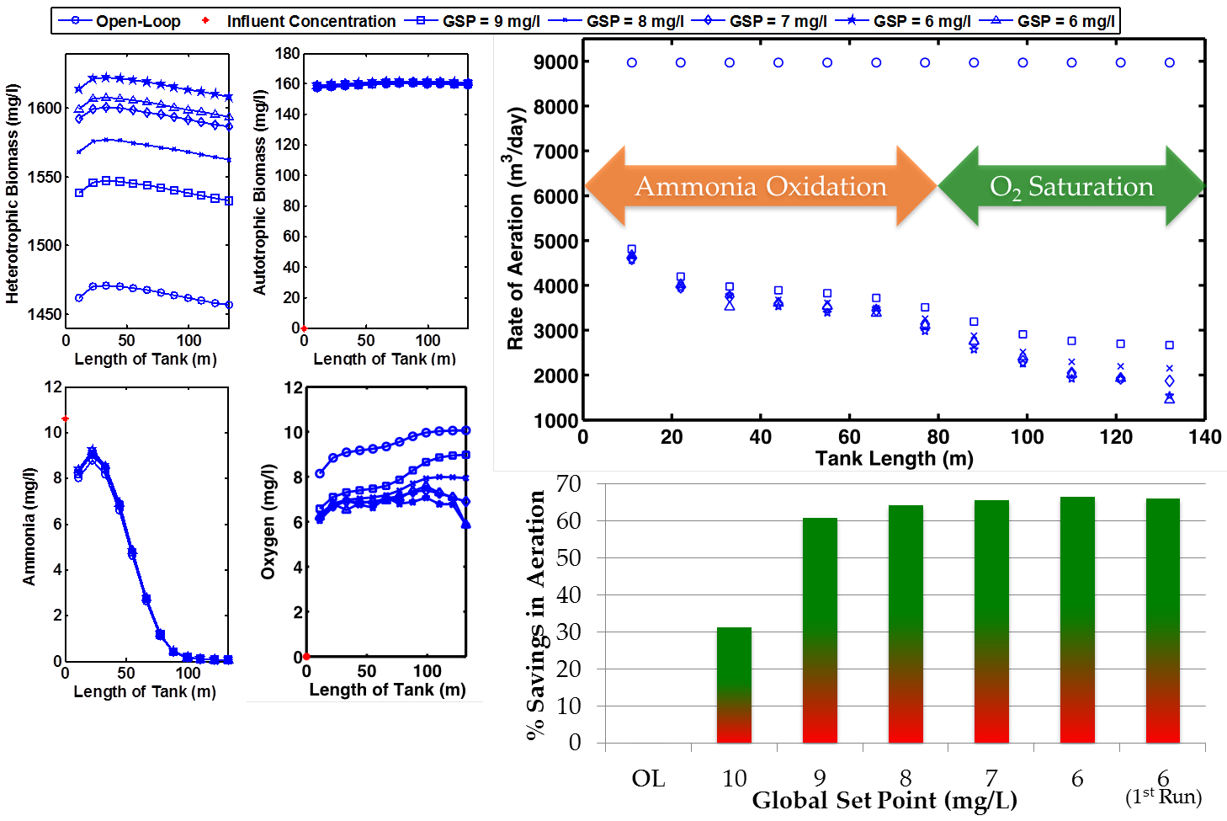
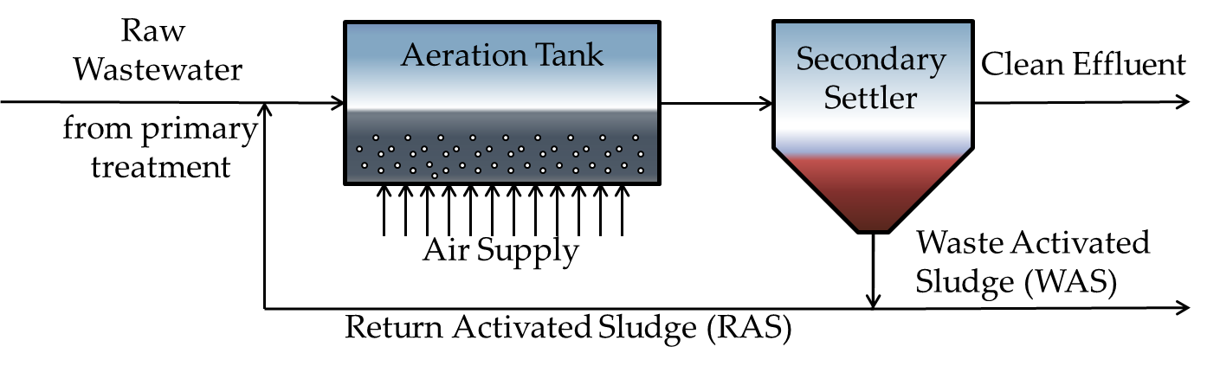
Managing Loosely Coupled Networked Control Systems with External Disturbances
PI and Co-PIs: Xiang-Yang Li, Shang-Ping Ren, Paul Anderson, Fouad Teymour, Illinois Institute of Technology
Wireless Networking Research Group @ www.cs.iit.edu/~winet
Water Resource Systems
System Integration
Source waters: Lakes, rivers, and groundwater
Water treatment systems: Municipal and industrial
Wastewater treatment systems: Municipal and industrial
Key water quality indicators
Chemical assessment
Dissolved oxygen
Chemical oxygen demand (COD)
Biochemical oxygen demand (BOD)
pH
Nitrate
Phosphate
Physical assessment
Temperature
Total suspended solids (TSS)
Turbidity
Biological assessment
Conclusions:
1)Plant is resilient to transient disturbances
2)Resilience requires energy
3)Cold/wet days and storms present risks
4)Aeration can be decreased by at least 50%
5) Agent-based control can be very helpful
DO Criteria
March to July
> 5.0 mg/L minimum at all times
> 6.0 mg/L 7-day mean (2)
August to February
> 3.5 mg/L minimum at all times
> 4.0 mg/L 7-day mean
> 5.5 mg/L 30-day mean
System Overview
System Model
What we have done:
MWRDGC DO Monitoring: History
October 1994 ~ May 1996: Weekly DO surveys of the Chicago Area Waterways. Water samples collected manually, chemically fixed in field, returned to laboratory for titration.
1998: Initiated comprehensive CDOM program to characterize Chicago Area Waterways (CAWS)
Initial two-year focus on the Chicago River; expanded to Calumet River in 2001. Program further expanded to wadeable streams in 2005.
Data have been used for calibration and verification of a water quality model for the CAWS used in IEPA’s UAA study.
Site visit & survey
2) Historical operation data
3) Aeration tank profiling
4) Multi-agent systems
5) Network communication
6) Water-related sensors testing
7) Analysis, optimization, and control of the activated sludge process
Balancing aeration and robustness
Optimization algorithm
Optimization results
Optimum profile
Modified optimum profile
Analysis of sludge process parameters
Aeration tank model
Wastewater
Aeration Tank
Secondary
Settler
Clean Effluent
Successful CDOM Program Requires Intensive QA
Currently, Thirty-Two Locations Monitored
  DO, water temperature, and specific conductivity measured hourly at all locations;
  pH and turbidity at selected locations
Monitors in protective enclosures deployed for seven continuous days
Monitors exchanged over a period of 3 days / week (Tuesday to Thursday)
Calibrated and serviced monitors deployed weekly to replace monitors retrieved from field
Winkler DO Check sample taken during monitor exchanges
Housings cleaned weekly April-November, monthly December-March
Cross-sectional DO measured during April, August, and November
Air Supply
Waste Activated
Sludge (WAS)
Return Activated Sludge (RAS)
i=2
Discretize
Dynamic response to storms
Dynamics during storms
Dynamic response: 5 profiles
Dynamic response: 3 profiles
Wastewater
i=1
…
i=48
Secondary
Settler
Clean Effluent
Air Supply
Waste Activated
Sludge (WAS)
Is continuous DO monitoring necessary to determine compliance with standards? Are perpetual CDOM programs practical and reasonable ?
Settler model
Return Activated Sludge (RAS)
Problem: Water Resource Management
Minimize: System cost required to realize more efficient and effective operations
Subject to: Human health, environmental quality, commerce & industry needs
Standard model:
Ideal settler: No solid matter in clean effluent
Continuation model:
Solids in clean effluent, if Q_{waste} flow >> Q_{design}
Aeration tank
effluent
Secondary
settler
Effluent
Conclusions: There are different options for the aeration profile: Same dynamic response with only 70% of the current air usage; Using the 1.3xoptimum profile can have almost the same dynamic response, meets permits well, and results in around 55% savings
Cyber Physical Systems application:
Intelligent sensor networks and software achieve more efficient and effective operations
Information from the network/software system results in a change in operations
Range in the response times:
  Real-time response for water/wastewater treatment
  Long-term response times for watershed management
Solids + soluble
components
Soluble
components
Agent-based control of activated sludge process
Return activated
sludge (RAS)
Waste activated
sludge (WAS)
Motivation
Process overview
Control agents
Aeration controller agents
Steady state tank profiles
Objectives
Normal conditions
Develop a mathematical abstraction of the CPS, and an online decision model that takes into account temporal and spatial dependencies among actions;
Develop algorithms and policies to effectively manage the system and optimize its performance with respect to applications’ quality of service requirements;
Develop an agent-based event-driven framework to facilitate engineers easily monitor, (re)configure and control the system to achieve optimized results. Methodologies, algorithms, protocols and frameworks will be evaluated on test-beds and by our collaborating institution.
Supervising Plant Agents
SPA heuristics
Normal set points
Reduced set points
Operation Challenges
Major challenges in CPS application:
Lack of real-time data of biochemical oxygen demand (BOD) and ammonia
Insufficient real-time feedback from sensor systems
Historical influence scenarios classification
Plant response to influence perturbations
Possibilities of aeration saving
Steady state tank profiles
Challenges to help WRP to be cost-effective, reliable, and sustainable
Aeration requirement cannot be determined based solely on effluent quality
Effluent permit limits are static, but the physical and chemical characteristics of the influent are constantly changing
Energy demand for aeration is based on influent conditions, but this demand could be totally different even dealing with similar perturbations
Optimal sensor temporal resolution and spatial distribution deployment are unknown.
Future research tasks
1. Improve RAS and WAS agents
2. Adjust knowledge-base (KB) of successful configurations
3. Improve response time
4. Challenge the control framework
Special thanks: Dr. Catherine O’Connor, Judith Moran, and many other MWRDGC personnel
Funding support from NSF CNS-1035894.
Additional information available online at:
  http://www.cs.iit.edu/~winet
  http://www.cs.iit.edu/~xli/
Potential parameters to study:
1) Wastewater flow rate 4) Influent composition
2) Stormwater flow rate 5) Aeration rate
3) Wastewater temperature

