Slide 1
Medical Device CPS Testbeds: Candidate Testbed for Research and Development on Cyber Physical Medical Device Systems
Oct 17, 2013
NSF CPS PI Meeting
Arlington, VA USA
Julian M. Goldman, MD
Medical Director, Partners HealthCare Biomedical Engineering
Anesthesiologist, Mass Gen Hospital/Harvard Medical School
Director/P.I., Medical Device Interoperability Program
www.jgoldman.info
Notes:
Integrated Clinical Environment

Slide 2
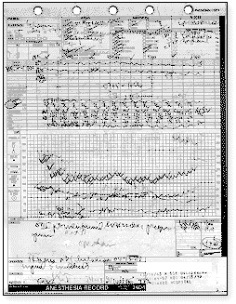
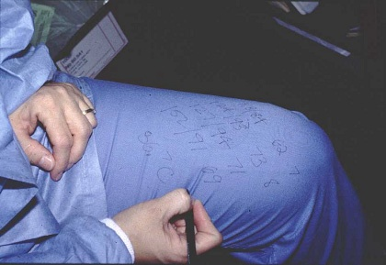
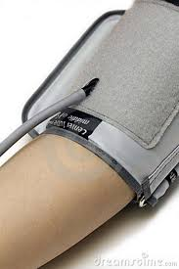
Antithesis of medical CPS?
Notes:
https://encrypted-tbn0.gstatic.com/images?q=tbn:ANd9GcSH6KU16xdOt2OiMN0wo3P_LsORWzxK0l1dZxldL1cY_RgPwWOX

Slide 3
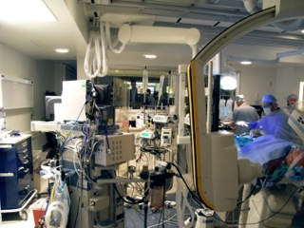
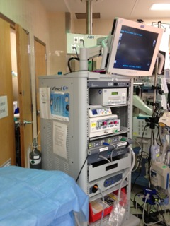
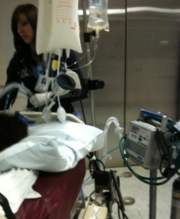
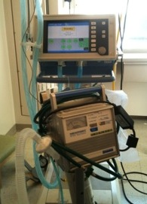
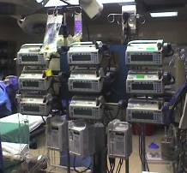
TODAY:
Limited access and integration of data
Only manual coordination of devices.
Loops NOT closed

Slide 4
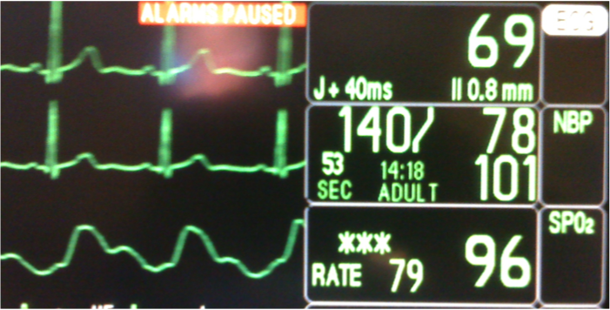
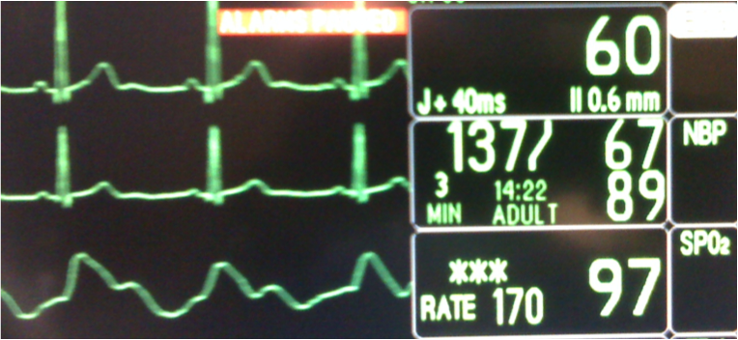
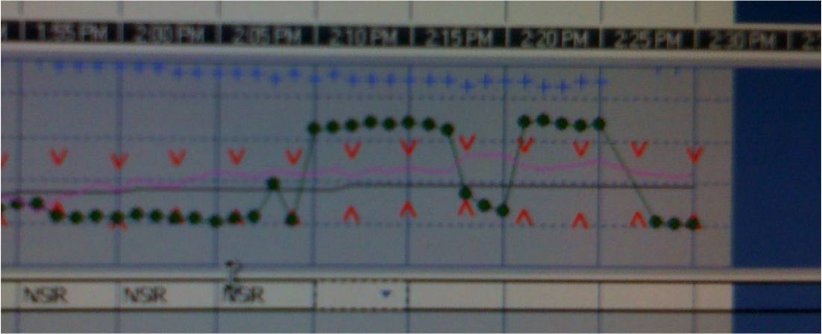
Problem – Pulse-rate counting error due to atypical plethysmogram (waveform).
Waveforms and metadata are NOT included in EHR
Patient data
ECG data
ECG data
Pulse Ox data
EMR data

Slide 6
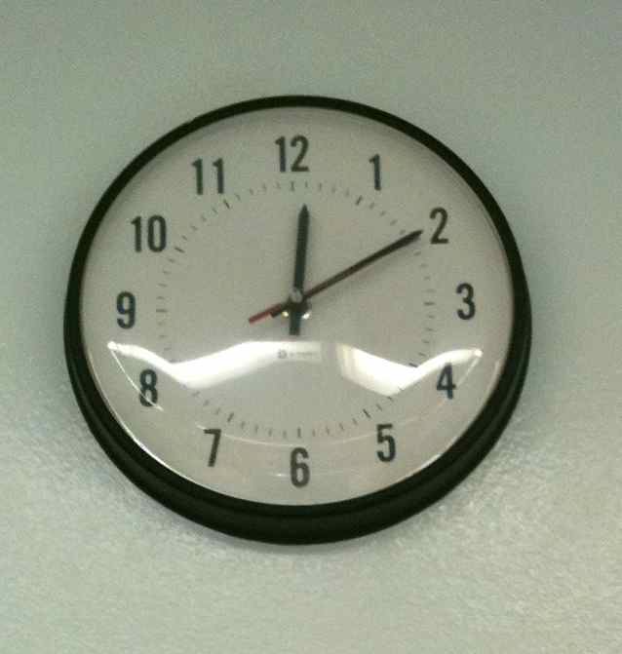
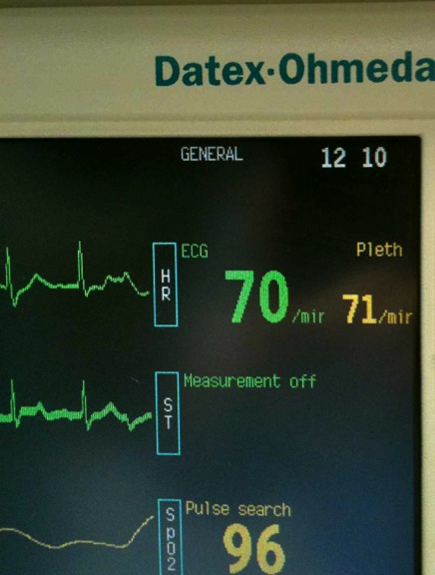
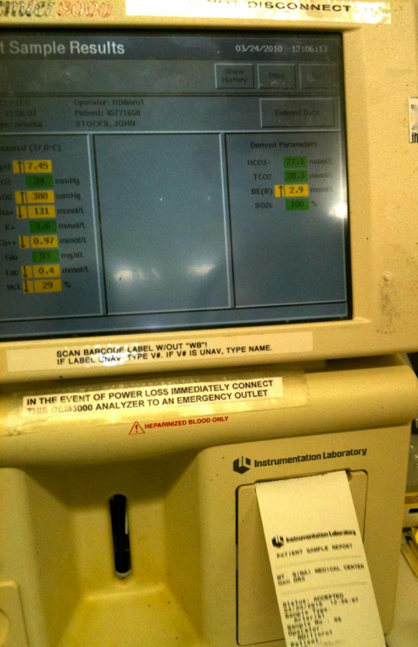
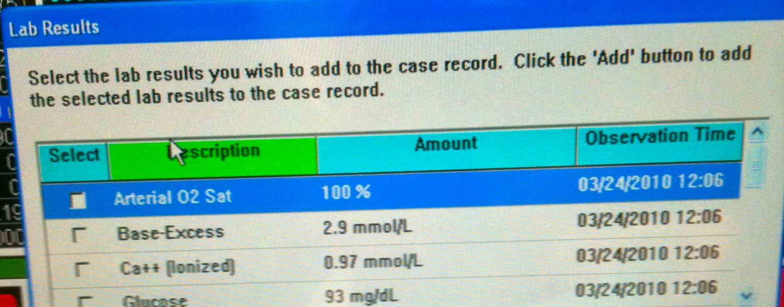
EMR time
stamp error
Blood gas
analyzer in OR

Slide 7
CPS Testbed from the Clinical Perspective
NEEDS …
Can Provide …
Medical Researchers and
Advanced Clinical Practitioners:
Expert assessment of new technologies
Can’t close the loop on workflow
Can’t close loop on safety
Data gaps
Effectiveness of interventions are difficult to assess
Lack of standardization of care
High cost of delivery
Emerging needs in new care environments
Innovation is slow
Need reliable and safe integration of clinical environments
Use proposed solutions in clinical environment
Clinical research to obtain new data, assess safety and effectiveness
Publish clinical results
Identify gaps -> CPS community

Slide 8
CPS Testbed from the CPS CS & Engineering Perspective
NEEDS …
Can Provide …
CPS Computer Science and Engineering Research Community
Solutions to clinical needs
Access to (de-identified) patient data files
Clinical workflow
Physiologic signals
Phys-device system behaviors/interactions
Simulated clinical data (variety and range)
Non-clinical development and testing environment
Rapid prototyping of networking, system integration, signal processing, sensors, actuators, etc.
Signal analysis
Data integration frameworks
Apps and platforms
Closed-loop control capabilities
New sensors, actuators
New methods energy delivery
Real-time visualization
Robotic devices
Etc.

Slide 9
Standard for the “Integrated Clinical Environment” ASTM F2761-09
“Essential safety requirements for equipment comprising the patient-centric integrated clinical environment (ICE) — Part 1: General requirements and conceptual model”
Provides a standards-based system architecture intended to support safe interoperable medical systems
Recognized by FDA 8/2013: http://www.gpo.gov/fdsys/pkg/FR-2013-08-06/pdf/2013-19020.pdf
Notes:
Developed by experts convened through MD PnP, TATRC BAA

Slide 10
Integrated Clinical Environment framework
ASTM standard F2761-09
Clinician
Integrated Clinical Environment (ICE)
ICE Supervisor (run apps)
External
Interface
ICE Network
Controller
ICE Data
Logger
ICE Interface
ICE Interface Adapter
ICE Interface
Medical Device
Medical Device
Other Equipment
Patient
Notes:
Need better figure

Slide 11
ASTM F2761-09: Essential safety requirements for equipment comprising the patient-centric integrated clinical environment (ICE)
The ICE standard specifies general requirements, a model and framework for integrating equipment to create an Integrated Clinical Environment (ICE), including:
The characteristics necessary for the safe integration of medical devices and other equipment, via an electronic interface, from different manufacturers [heterogeneous] into a single medical system for the care of a single patient. Enables creation of new “virtual” devices
Requirements for a medical system that is intended to have greater error resistance and improved patient safety, treatment efficacy and workflow efficiency than can be achieved with independently used medical devices
Requirements for design, verification, and validation processes of a model-based integration system for an Integrated Clinical Environment
*
**

Slide 12
RESOLVED, That our American Medical Association (AMA) believes that intercommunication and interoperability of electronic medical devices could lead to important advances in patient safety and patient care, and that the standards and protocols to allow such seamless intercommunication should be developed fully with these advances in mind. Our AMA also recognizes that, as in all technological advances, interoperability poses safety and medico-legal challenges as well … ”
as of July 2009:
American Medical Association
World Federation of Societies of Anesthesiologists
American Society of Anesthesiologists
Massachusetts Medical Society
Anesthesia Patient Safety Foundation
Society for Technology in Anesthesia
Society of American Gastrointestinal Endoscopic Surgeons
Notes:
7 societies have endorsed this (or similar statement).

Slide 13
Integrated Clinical Environments of the Future
ICE - “Integrated Clinical Environment”
Silos of stand-alone medical devices and IT will be integrated.
“Apps” will leverage the ICE:
Smart alarms, safety interlocks, and closed-loop control will enable “error resistant” systems
Comprehensive data acquisition for clinical care, research, and adverse event analysis (Black-box recorder)
Biomed equipment management
Patient ID and correct clock time will be bound to device data
Apps for Clinical Decision Support (CDS) will run on standardized ICE platforms, which enables global sharing of apps
Specialized app development tools will empower clinicians/researchers to rapidly prototype and then customize apps and new devices on the fly

Slide 14
ICE Testbed example PUTTING IT TOGETHER:
Research
Lab Development and Assessment
Clinical ICE Data logger prototype [DoD, NIST]
Smart clinical alarms apps [NSF, NIH]
Patient Controlled Analgesia infusion safety interlock (Physiologic closed-loop control) [NIH, NSF]
Development: Devices, tools, simulators, SMEs
Test in non-clinical lab
Verification and validation
Data and workflow simulation
Assess compatibility with other devices and networks
Assess security
CPS Themes:
Time synchronized clinical + device data recording
Data fusion and patient context (state); app interactions
Command & Control in system-of-systems
Gaps, Needs, new solutions
Clinical Environment ICE Testbed
MGH clinical pilot 2014
Supported by fed grants, MGH, manufacturers

Slide 15
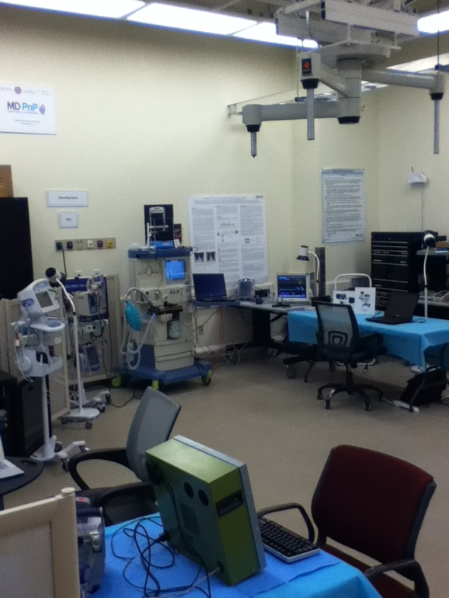
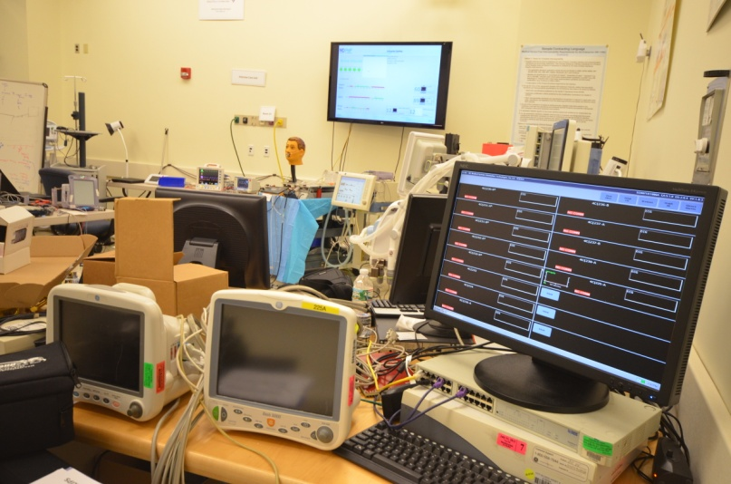
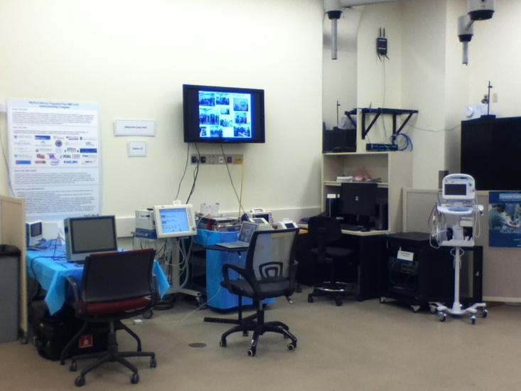
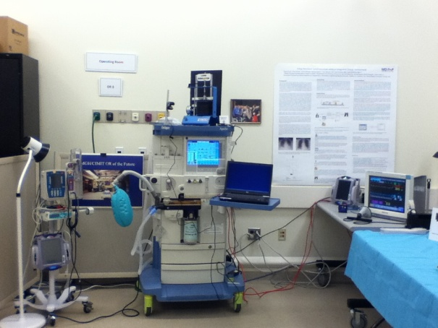
MIT Hackathon Planned
Nov 2013

Slide 16
ICE CPS Testbeds should support:
Simulation of medical devices, clinical data, clinical workflow
Evaluation of medical device and HIT communications standards and system architectures
Sharing, testing, benchmarking of clinical data analysis and signal processing algorithms
Sharing and reuse of tools and equipment to enable rapid prototyping
Storing and sharing of experimental (de-identified) data
Pathway to enable clinical research and share results

Slide 17
Videos

