Slide 1
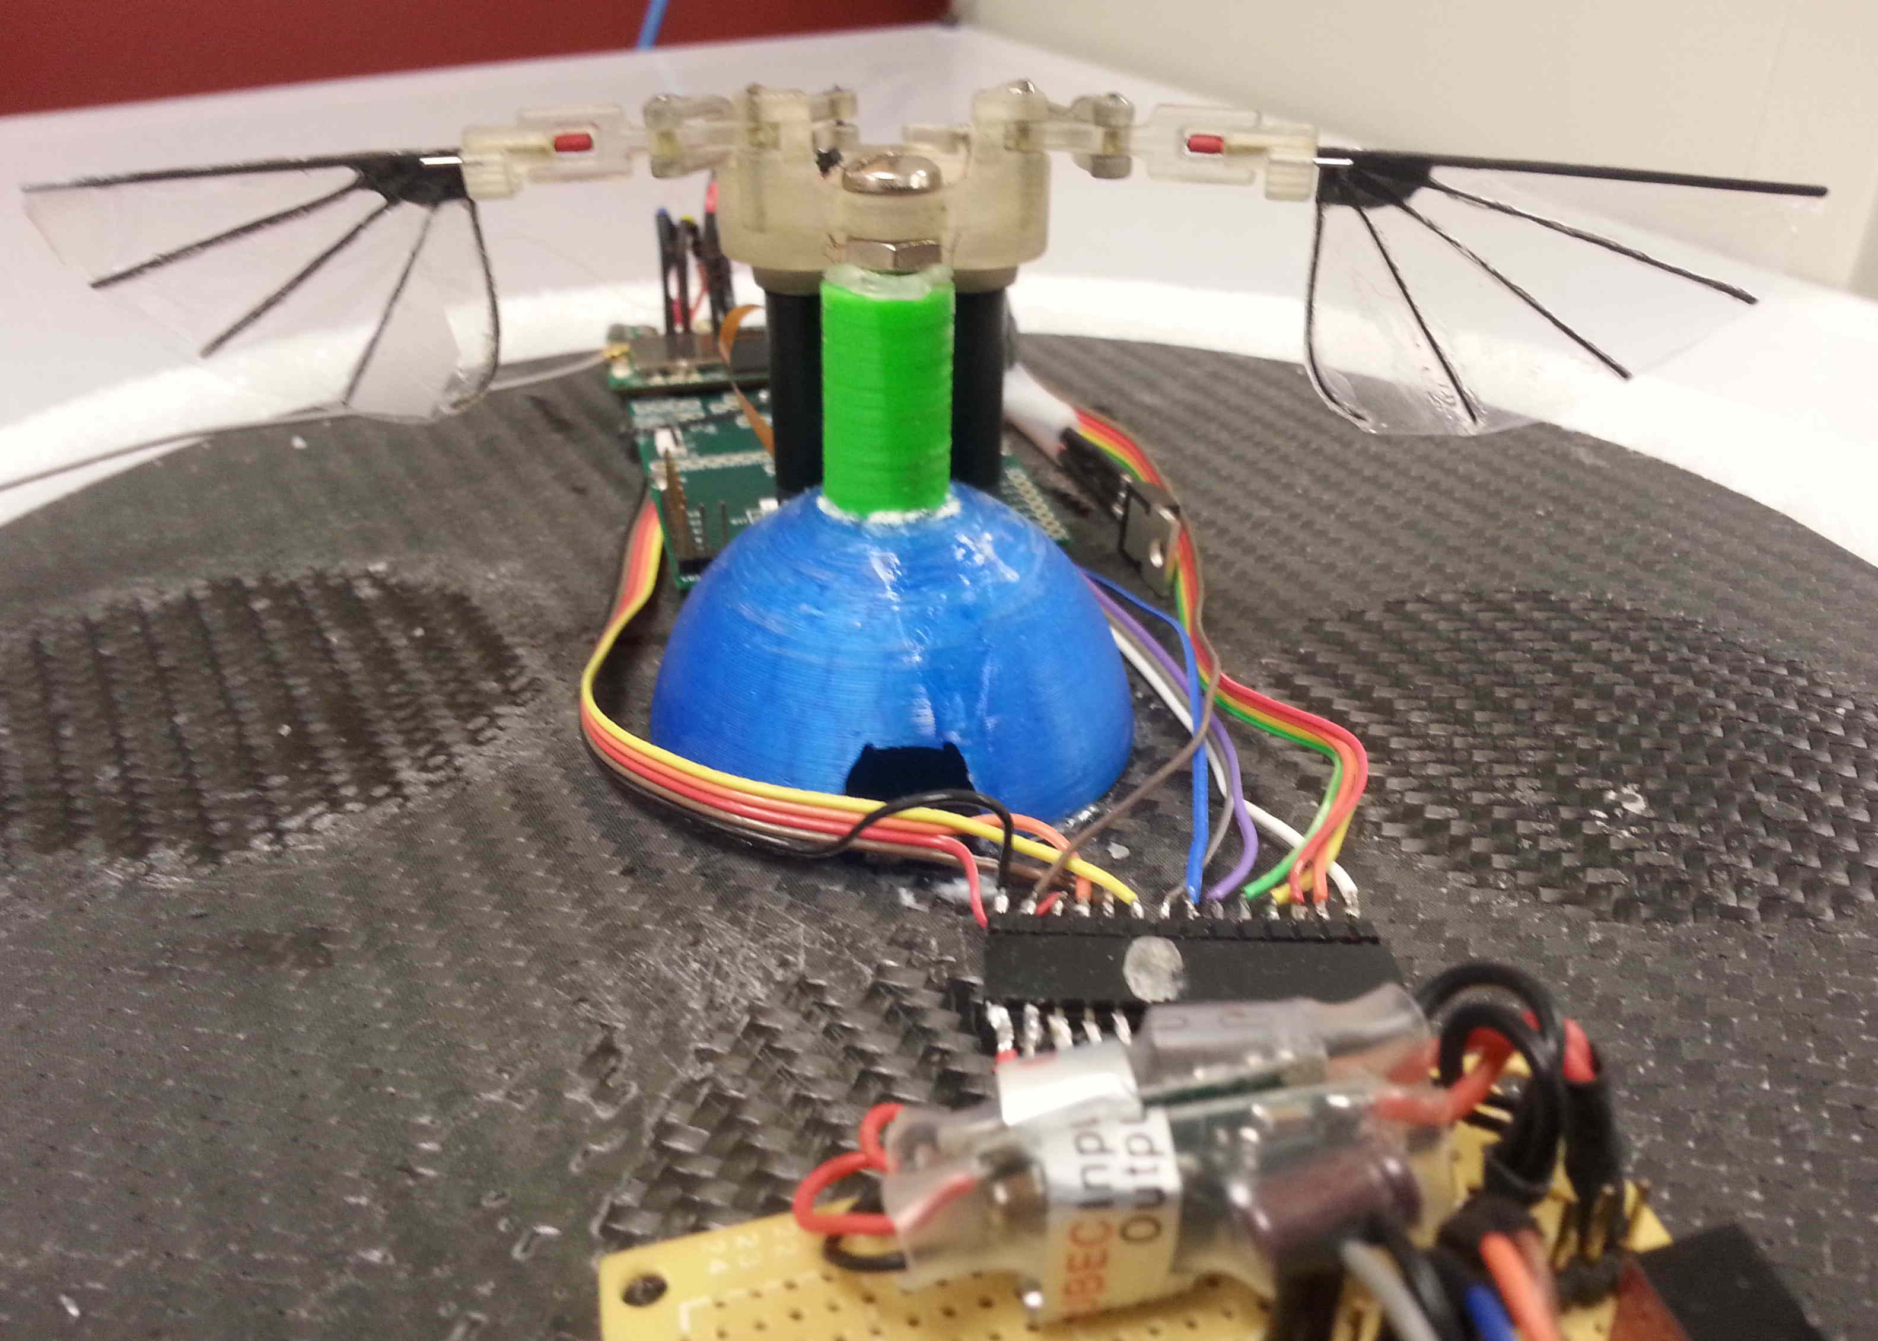


Methodologies for Engineering with Plug-and-Learn Components: Synthesis
and Analysis Across
Abstraction Layers
John C. Gallagher
john.gallagher@wright.edu
Wright State University
Garrison W. Greenwood
greenwd@pdx.edu
Portland State University
Eric T. Matson
ematson@purdue.edu
Purdue University
1
Introduction
2
EMCC Model Inference
CyberPhysical Systems (CPS) that modify themselves to improve performance or repair damage often rewrite the modular relationships that make system modeling or Verification and Validation (V&V) possible. In this project, we are exploring methods to create self-modifying CPS systems that, in addition to self-improving or self-repairing, are also capable of maintaining system models that support the use of V&V techniques.
A first step toward our whole goal is to construct adaptation so that system models required for V&V are updated automatically while adaptation occurs. To this end, we introduced the concept of Evolutionary Model Consistency Checking as a means of maintaining consistency between a system and its model via continuous checking and updating based on treating objective function evaluations already being conducted as part of controller and/or wing gait adaptation to also make inferences about the system’s current properties.
EMCC is applied as follows:
Examine the hierarchical model to identify any invariant parameters, which we will define as model parameters that remain constant during the operation of the modeled device.
Examine the hierarchical model to identify any invariant behavioral states into which the system could be placed. We define an invariant behavioral state as a persistent system state in which at least some system state values are held constant.
Examine the hierarchical model to identify any damage parameters that quantify damage to specific subsystems. We define damage parameters as values that parameterize system damage at some level of abstraction in the model system.
Construct a system of equations that relates expressions involving invariant and damage parameters to expressions that are direct consequences of being in invariant behavior states.
Modify or augment the objective function evaluations so that they find solutions that correct existing damage and allow the system to be controlled into the invariant behavior states defined in the system of equations constructed in item (iv) above.
With the information collected in (v), solve the system of equations for the unknown damage parameters. Update the system model appopriately.
We have successfully applied the above methodology to diagnosing wing damage in the RoboFly model using hovering as a behavioral invariant. In thousands of random damage cases, the EMCC modified adaptation learned wing gaits that restored correct hover behavior and allowed for solution of wing damage parameters. In no case was any cycle-averaged wing damage ever estimated more than 3% away from its actual value.
Initially, we are creating and testing these methods for several Flapping-Wing Micro Air Vehicles (FW-MAV) that adapt their flight controllers to recover correct flying behavior after damage to one or both of their wings. The primary behavior restoring adaptations occur at the level of wing gaits, which exist at a level of abstraction level below that of the
Before Learning Invariant State
After Learning Invariant State
Damage Estimate based on “before” and “after” learning wing gaits. Note that we can create a new correct model of wings using the existing model and information we get for free during wing gait learning. Using this method, it’s possible to keep the underlying vehicle dynamics model “fresh” without doing full system identification.
Shown is the world Z axis (altitude controller for the vehicle assuming cosine wing gaits. The on-board learning engines find new wing gaits for the left and right wings that restore correct hovering. Of course, those changes break the assumptions underlying the cycle-averaged forced model inside the hover controller and change the relationships in the hierarchical system model, also breaking V&V capability. EMCC modifies the learning so that the models are updated as a consequence of the learning, restoringin both model truth and V&V capability.
A schematic FW-MAV based on the Harvard RoboFly. Many of our initial investigations are based on computer models of this vehicle
vehicle models upon which flight control is based. This means that, even if flight control is restored, it is unlikely that the vehicle models implicit in the flight controller are still accurate. These inaccuracies would prevent continued use of traditional V&V methods to formally assess system correctness.
3
The Next Steps
Inferring the underlying physical structure of a system under control from the processes adapting that control has large potential application in air vehicles and other self-adapting CyberPhysical Systems.
Currently the EMCC inference process is conducted by a human with no automation. Going forward, we will automate the process of identifying behavioral invariant states, constructing damage parameter estimators in those states, and generating adaptive learning objective functions that simultaneously adapt control and solve the damage function equations to enable appropriate updating of the underlying system models. It is expected this automated EMCC will be integrated both within wing gait adaptation and agent-based outer loop control adaptation.
In-Flight learned left and right wing gaits for a simulated Harvard RoboFly style vehicle with a damaged wing. These wing motions restore proper frequency to force relationships needed by the flight controller. However, if restoring correct flight during learning was the only concern, we still wouldn’t know how the wings were damaged or if there were long term consequences of that damage.
A prototype FW-MAV test vehicle. This vehicle is attached to a puck that is floated on a cushion of air. It propels itself using wing generated aero forces along the surface of the table. Like with the simulated version, this vehicle will learn wing gates to counteract the effects of wing damage and EMCC will be used to update vehicle models to diagnose that damage so that formal V&V remains possible
In this three part effort, we are building real vehicles and vehicle models. With those real and simulated vehicles, we are co-designing adaptive flight controllers and adaptive wing-gait oscillators that, in addition to restoring correctly flight, also extract system models to ensure V&V is possible during and after adaptation.
This material is based upon work supported
by the National Science Foundation under grant
numbers CNS-1239196, CNS-1239171, and CNS-1239229
Opinions expressed in this poster are those of the authors and
do not necessarily reflect those of the National Science Foundation.

