Slide 1
Methods and Tools for Verification of Cyber-Physical Systems
Chris Myers, Jian Wu, Zhen Zhang
University of Utah
Hao Zheng, Yingying Zhang, Ping Hou
University of South Florida

Slide 2
Introduction
Cyber-Physical Systems (CPS) are deployed in a wide variety of safety critical applications from avionics, medical, and automotive domains.
For these applications, it is essential to create a precise specification and formally verify that the implementation behaves as specified.
The formal verification of these systems presents a wide variety of challenges.
Models of these systems must represent the physical world, analog sensors and actuators, computer hardware and software, networks, and feedback control.
These models must deal with the fact that correctness may depend on timing, concurrency, system dynamics, and stochastic behavior.

Slide 3
Unified Modeling Formalism
Our research project has developed a general unified hybrid system modeling formalism that is capable of representing continuous and discrete dynamics, timing, and stochastic behavior (Thacker/2009).
These models must unify elements normally described in a variety of formalisms such as:
Hardware description languages such as VHDL/VHDL-AMS/SystemVerilog used for hardware.
Continuous modeling languages such as SPICE and Simulink used for analog circuits and the physical environment.
Programming languages such as C for software.
System level modeling languages such as SystemC for complete systems.
To achieve these goals, the labeled Petri net (LPN) model has been developed as well as techniques to generate them from various languages and simulation data.

Slide 4
LPN Model for a Faulty Buffer.

Slide 5
Improving Verification Capacity
The complexity of CPS models makes the formal verification of them extremely difficult.
To address this, it is essential to develop more scalable verification methods.
In particular, we have developed:
Automated model abstraction methods to reduce model complexity (Thacker/2010,Yao/2010).
Partial order reduction methods to address model concurrency (Zhang/2012).
Symbolic methods to utilize efficient data representations (Zheng/2012a).
Compositional reasoning methods to exploit model structure (Zheng/2012b).

Slide 6
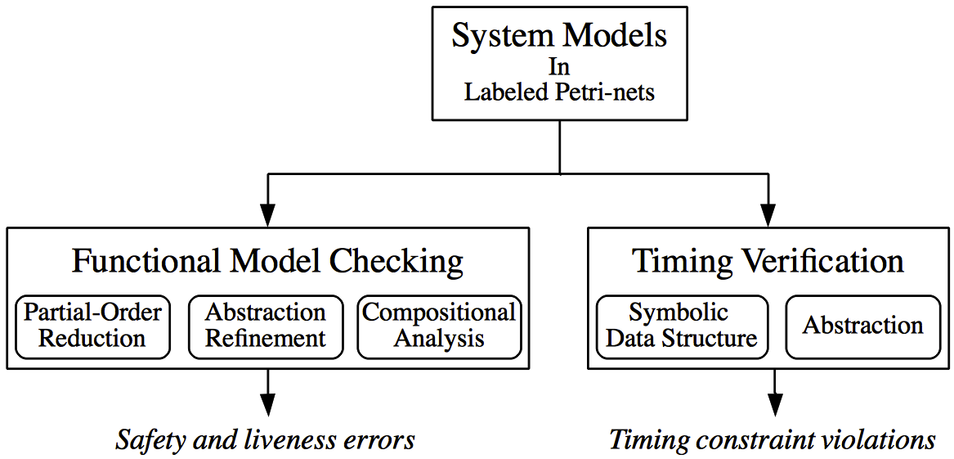
Verification Methodology Details

Slide 7
Motivating Example
Now possible to integrate multiple cores on a single chip forming a network-on-chip (NoC).
In automotive electronic systems, there are often more than 50 electronic control units (ECUs) to operate everything from the entertainment system to the anti-lock breaks.
Each ECU is statically tied to specific sensors and actuators so processing power cannot be shared, and an ECU failure causes a malfunction in the corresponding sensor/actuator.
An NoC approach makes mapping between ECUs and sensors/actuators flexible allowing for sharing of processing power and enabling fault tolerance by having spare units.
Professor Yoneda (NII/Tokyo) and his colleagues are designing such an NoC of ECUs.

Slide 8
A 4x4 NoC Routing Mesh of Automotive ECUs

Slide 9
Fault Tolerant Routing
An NoC routing protocol must be carefully designed to avoid deadlock and be fault-tolerant while still achieving latency and throughput goals.
Glass/Ni propose restricting the allowed ``turns'' in order to guarantee absence of deadlock and that a packet can always be routed around a single failed router.
If faults occur on the links, the Glass/Ni protocol can experience deadlock and a single link failure can cause a packet to not be routable.
Yoneda et al. proposed a modified version of the protocol which forwards fault information, but this method still cannot consider link failures on the south and west edges of the grid.
Our new routing protocol allows illegal ``turns'' without blocking on them, resulting in both deadlock freedom and a guarantee to avoid any single link failure without extra fault forwarding hardware.

Slide 10
Deadlock Problem
Fault Forwarding
Our New Protocol

Slide 11
LEMA Verification Tool
CPS systems such as this NoC router design are complex, and various aspects must be verified.
Complicated by the need to reason about concurrent, timing, and stochastic behavior.
Developing LEMA, a verification tool for CPS.
This tool must be able to verify numerous things including:
Functional properties such as the protocol does not deadlock, and the circuit implementation is free of hazards.
Timing properties such as meeting a required response time.
Stochastic properties such as the probability of a packet being lost.
A prototype version of LEMA for Windows, Linux, and MacOS is available from our website.

Slide 12
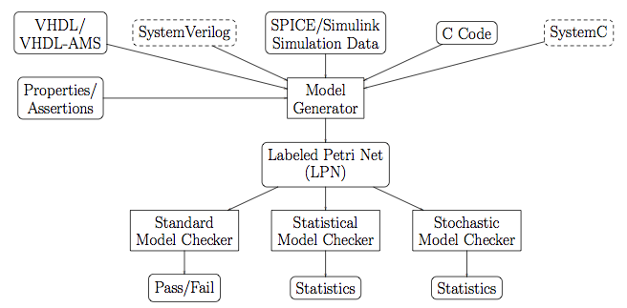
LEMA Tool Flow

Slide 13
Conclusion
The verification methods proposed will enable the design and implementation of cyber-physical systems with higher reliability and fault tolerance.
Since such systems are becoming ubiquitous, these improvements should have tremendous impact.
The abstraction and hierarchical approaches will allow large systems to be analyzed and verified in a unified framework efficiently, thus improving confidence in the final products.
Should allow design margins to be reduced, improving performance and reducing cost.
Please see: http://www.async.ece.utah.edu/CPS-Project/

Slide 14
References
(Thacker/2010) R. Thacker, K. Jones, C. Myers, and H. Zheng. Automatic abstraction for verification of cyber-physical systems. In The 1st ACM/IEEE International Conference on Cyber-Physical Systems, April 2010.
(Thacker/2009) R. Thacker, C. Myers, K. Jones, and S. Little. A new verification method for embedded systems. In The 27th IEEE International Conference on Computer Design, October 2009.
(Yao/2010) H. Yao, H. Zheng, and C. Myers. State space reductions for scalable verification of asynchronous designs. In 2010 IEEE Int. High Level Design Validation and Test Workshop, November 2010.
(Zhang/2012) Y. Zhang, E. Rodriguez, H. Zheng, and C. Myers. An improvement in partial order reduction using behavioral analysis. In IEEE Computer Society Annual Symp. on VLSI, August 2012.
(Zheng/2012a) H. Zheng, A. Price, and C. Myers. Using decision diagrams to compactly represent state space for explicit model checking. In 2012 IEEE Int. High Level Design Validation and Test Workshop, November 2012.
(Zheng/2012b) H. Zheng, E. Rodriguez, Y. Zhang, and C. Myers. A compositional minimization approach for large asynchronous design verification. In 19th Int. SPIN Workshop on Model Checking of Software, July 2012.

