Slide 1
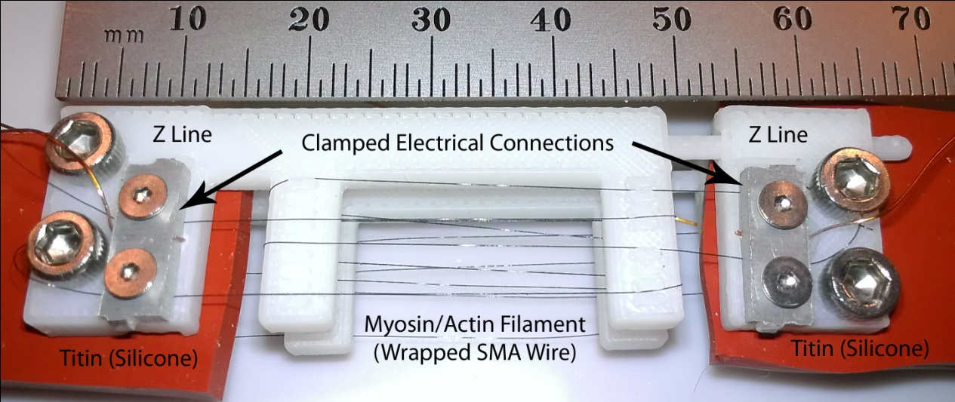
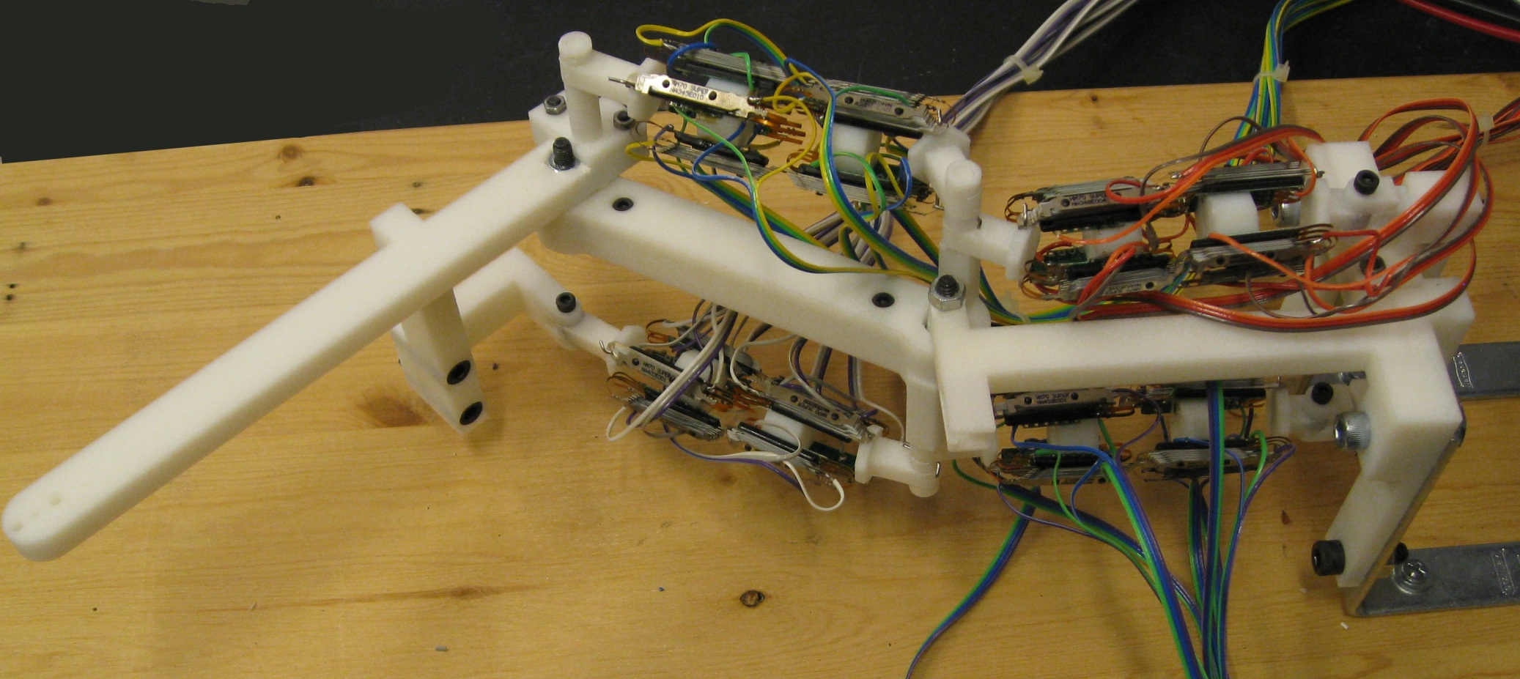
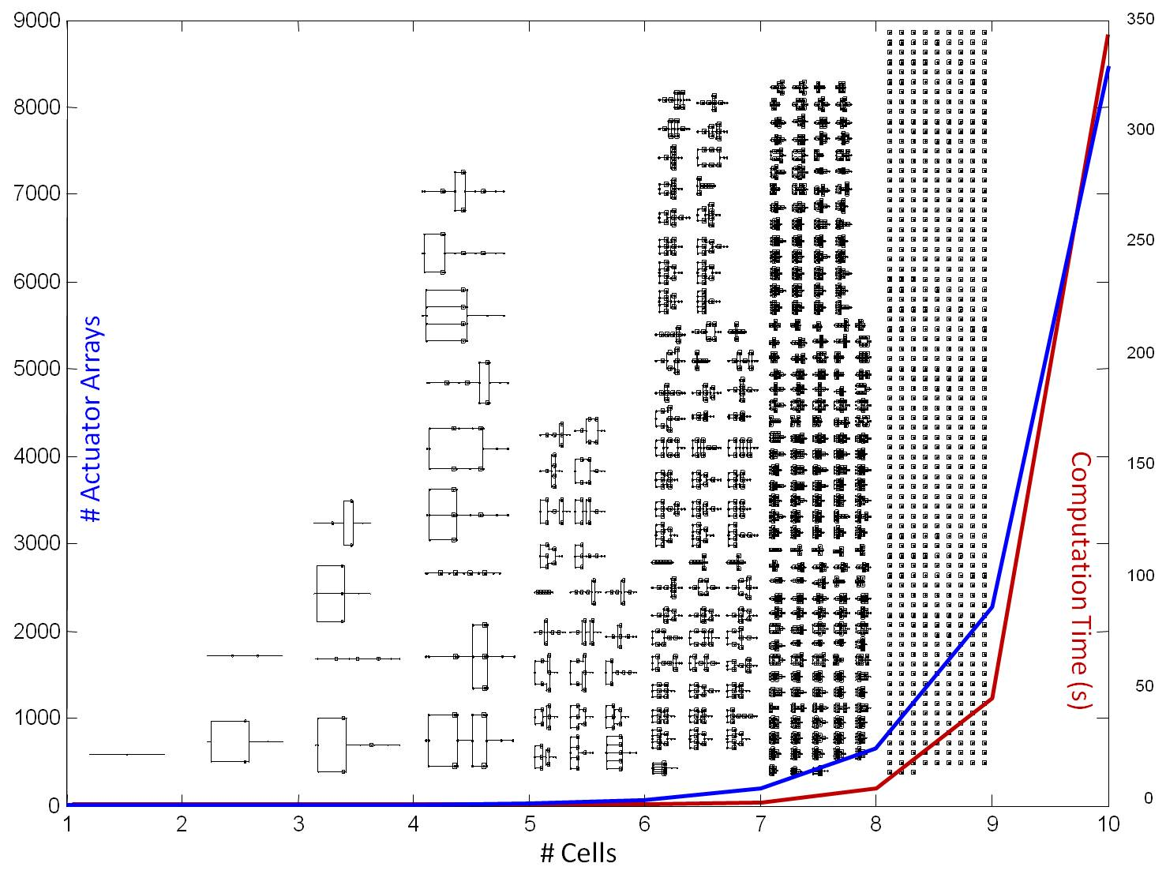
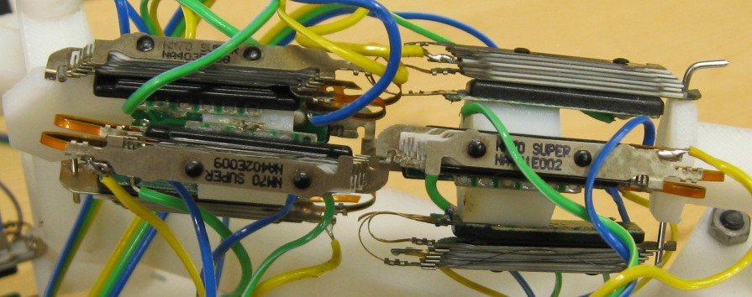
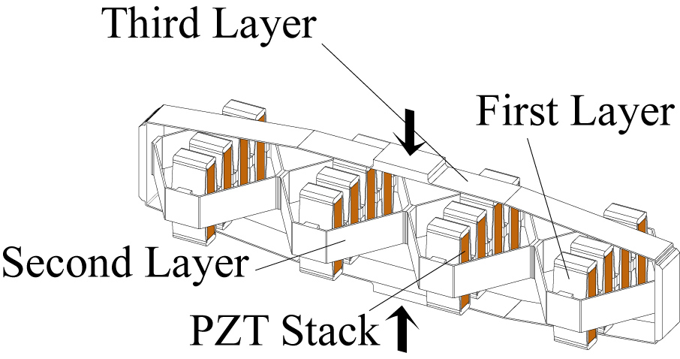
Modeling and Control of Modular Actuator Arrays
David MacNair, Joshua Schultz, Jun Ueda
George W. Woodruff School of Mechanical Engineering, Georgia Institute of Technology
This research was supported by an NSF grant Cyber-Physical Systems
ECCS-0932208.
Introduction
Array Dynamics
Natural Movement Based on Signal Dependent Noise
Human muscles are composed of thousands of flexible, low-force contractile fibers called sarcomeres. The muscle movement, a single degree of freedom, is determined through many on-off inputs recruiting sarcomeres, each of which add to the output force. Robotic cellular actuator arrays are conceptually similar. Flexible, low-force contractile cells are combined to produce higher-force output and control robotic devices. The actuator arrays have similar dynamic responses as human muscle, and the structural elasticity allows the cells to be combined into complex layouts, or topologies, and for the resulting array to correctly interact with the environment.
Different actuator array topologies yield a wide range of strength, displacement, and robustness characteristics. Static and dynamic analysis follows the Expanded Fingerprint Method, a modified Graph Theoretic method developed for systems with repeating actuation units connected through complex topologies. The method utilizes incidence matrices G and H to encode the topology and generate the equations of motion for the system.
Human-like motion is characterized by a straight or slightly curved trajectory with a smooth, bell-shaped end-point velocity. A key feature of human motion is the presence of motor variability and consequent errors in task performance, which can be modeled as multiplicative noise in the system. The concept of floating-point quantization and activation of cellular actuator arrays, inspired by Henneman’s size principle, was developed to mimic neuromotor variability and noise. When non-uniform actuator arrays are employed, each cell in the array can generate a different level of output force. By mapping the force output of each cell, an order from least to greatest can be determined and thus floating-point quantization can be utilized. The quantized control architecture could thus be an alternative to the conventional signal-dependent-noise approach used in computational modeling of neuromotor mechanisms. Initial results show that a source of Gaussian noise is not necessary for the multiplicative noise in human systems, and instead quantization errors behave like the observed signal dependent noise. An experimental robot arm with SMA actuators will validate the proposed control framework.
[G] Outgoing Structure
[H] Incoming Structure
Cell 7
m₁
m₂
m₃
m₄
m₅
m₆
m₇
m₈
c₁ c₂ c₃ c₄ c₅ c₆ c₇ c₈ c₉ c₁₀ c₁₁ c₁₂ c₁₃ c₁₄
m₁ m₂ m₃ m₄ m₅ m₆ m₇ m₈
0.5
Cell 1, 6
Cell 5
1 | 1 | 1 | 1 | 1 | 0 | 0 | 0 | 0 | 0 | 0 | 0 | 0 | 0
0 | 0 | 0 | 0 | 0 | 1 | 0 | 0 | 0 | 0 | 0 | 0 | 0 | 0
0 | 0 | 0 | 0 | 0 | 0 | 1 | 0 | 0 | 0 | 0 | 0 | 0 | 0
0 | 0 | 0 | 0 | 0 | 0 | 0 | 1 | 1 | 0 | 0 | 0 | 0 | 0
0 | 0 | 0 | 0 | 0 | 0 | 0 | 0 | 0 | 1 | 1 | 0 | 0 | 0
0 | 0 | 0 | 0 | 0 | 0 | 0 | 0 | 0 | 0 | 0 | 1 | 1 | 0
0 | 0 | 0 | 0 | 0 | 0 | 0 | 0 | 0 | 0 | 0 | 0 | 0 | 1
0 | 0 | 0 | 0 | 0 | 0 | 0 | 0 | 0 | 0 | 0 | 0 | 0 | 0
5 | L₁
1 | L₂
1
2
2 | L₃
2
1
# | L₄
c₁
c₂
c₃
c₄
c₅
c₆
c₇
c₈
c₉
c₁₀
c₁₁
c₁₂
c₁₃
c₁₄
0 | 1 | 0 | 0 | 0 | 0 | 0 | 0
0 | 0 | 1 | 0 | 0 | 0 | 0 | 0
0 | 0 | 1 | 0 | 0 | 0 | 0 | 0
0 | 0 | 1 | 0 | 0 | 0 | 0 | 0
0 | 0 | 0 | 1 | 0 | 0 | 0 | 0
0 | 0 | 0 | 0 | 1 | 0 | 0 | 0
0 | 0 | 0 | 0 | 0 | 1 | 0 | 0
0 | 0 | 0 | 0 | 0 | 1 | 0 | 0
0 | 0 | 0 | 0 | 0 | 0 | 1 | 0
0 | 0 | 0 | 0 | 0 | 0 | 0 | 1
0 | 0 | 0 | 0 | 0 | 0 | 0 | 1
0 | 0 | 0 | 0 | 0 | 0 | 0 | 1
0 | 0 | 0 | 0 | 0 | 0 | 0 | 1
0 | 0 | 0 | 0 | 0 | 0 | 0 | 1
L₁
0.4
Cell 12, 13
Force (N)
Cell 9, 14
0.3
Cell 10, 11
L₂
0.2
m₂
m₅
L₁ L₂ L₃ L₄
0.1
Cell 2, 3, 4
Cell 8
m₁
m₃
m₆
m₈
m₁ m₂ m₃ m₄ m₅ m₆ m₇ m₈
L₃
0
m₄
m₇
Hex Binary
&1 = 00001
&E = 01110
&10 = 10000
Hex Binary
&1 = 00001
&6 = 01110
&8 = 10000
Hex Binary
&1F = 11111
0
5
L₁ L₂ L₃ L₄
# &1 &E &10 &1 &6 &8 &1F
Time (s)
10
Variance in Cell Forces
#3
SMA Actuator Array
SMA Cell
1
#11
Actuator array cells consist of a linear actuator connected in series with a flexible element. The actuator can be based on any linear actuation technology so long as:
The actuator follows a known displacement versus time function when activated.
That function is minimally dependent on external force.
The actuator can be represented as a spring, rigid or flexible, with the displacement being modeled as a pure force preloading the spring.
Force (N)
#8
Cell #2
#10
#10
0
#2
#2
Time (s)
Impulse command
Time (s)
Time (s)
Twitch to Tetanus: A series of closely spaced stimuli develops an additive force response with a 1 DOF input to the redundant system.
0.015
Floating-point quantization
ON-OFF Command Timing
Proportional signal-dependent noise
0.01
Theoretical upper bound
Minimum-switching discrete-switching vibration suppression is an open loop switching technique developed for point to point motion of quantized systems that results in reduced residual vibration. The technique was applied to piezoelectric cell array actuators operating a camera positioner. Results showed that an appropriate modulation of switch timings provides better controllability of modular actuator than using un-modulated inputs. Intersample discretization combines a discrete time closed loop controller with a mapping from a continuously variable control signal to a switching signal between neighboring discrete values. The piezoelectric cell array used a tri-layer amplification structure and the analysis used a 2-port model basis to analyze the structure.
0.005
All possible actuator array topologies, given a number of cells, can be automatically generated.
The number of possible topologies increases exponentially with the number of cells.
0
0
0.05
0.1
0.15
0.2
Theoretical lower bound
SMA modular actuators
0.25
0.3
0.35
Publications
[1] David MacNair and Jun Ueda, "A Fingerprint Method for Variability and Robustness Analysis of Stochastically Controlled Cellular Actuator Arrays," The International Journal of Robotics Research, Volume 30, Issue 5, pp. 536 - 555, April 2011.
[2] Joshua Schultz and Jun Ueda, "Experimental Verification of Discrete Switching Vibration Suppression," IEEE/ASME Transactions on Mechatronics, Volume 17, Issue 2, pp. 298 - 308, April 2012.
[3] Joshua Schultz and Jun Ueda, "Two-Port Network Models for Compliant Rhomboidal Strain Amplifiers," IEEE Transactions on Robotics, conditionally accepted.
[4] David MacNair and Jun Ueda, "Dynamic Cellular Actuator Arrays and Expanded Fingerprint Method for Dynamic Modeling," Robotics and Autonomous Systems, Special Issue on Reconfigurable Modular Robotics, submitted July 2012.
David MacNair
Ph. D. Candidate
Joshua Schultz
Ph. D.
Dr. Jun Ueda
Assistant Professor

