Slide 1
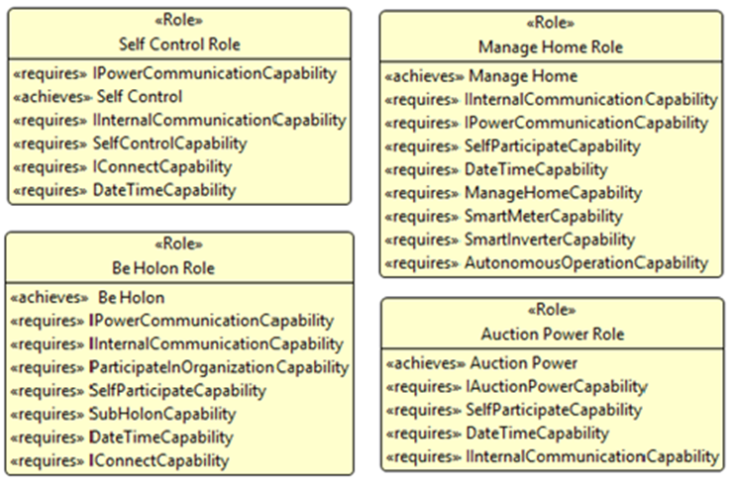
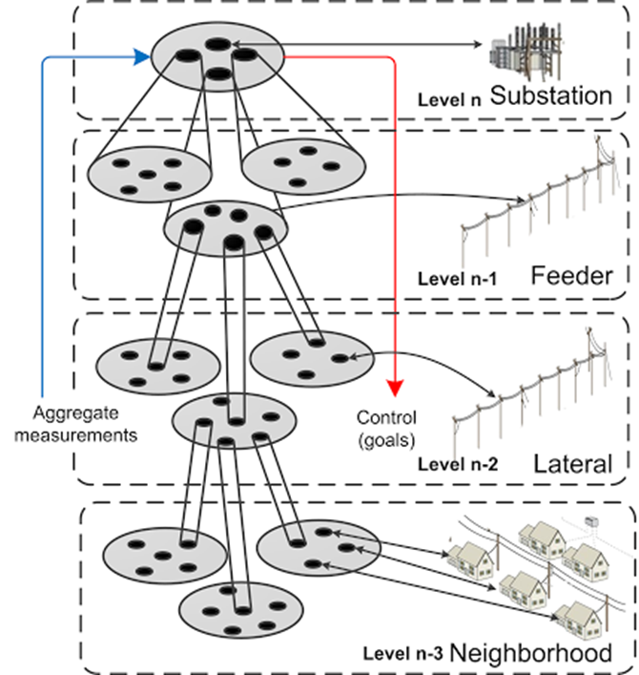
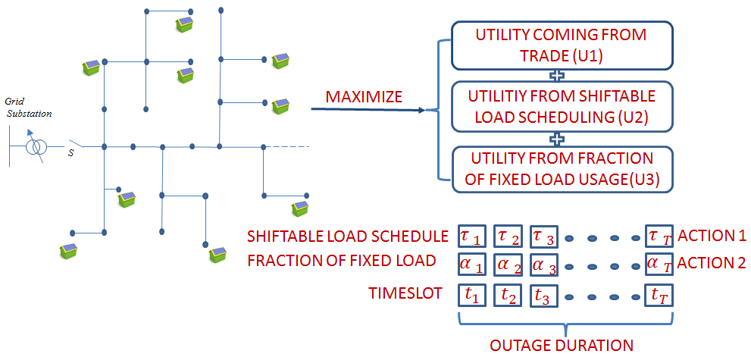
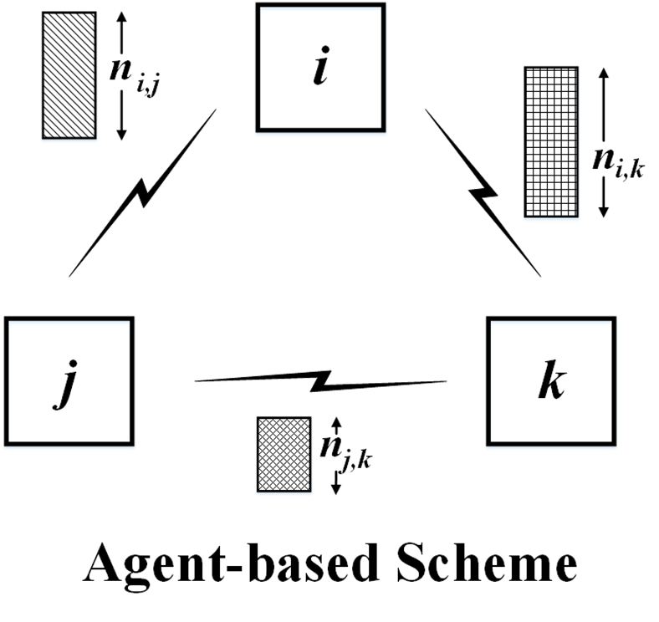
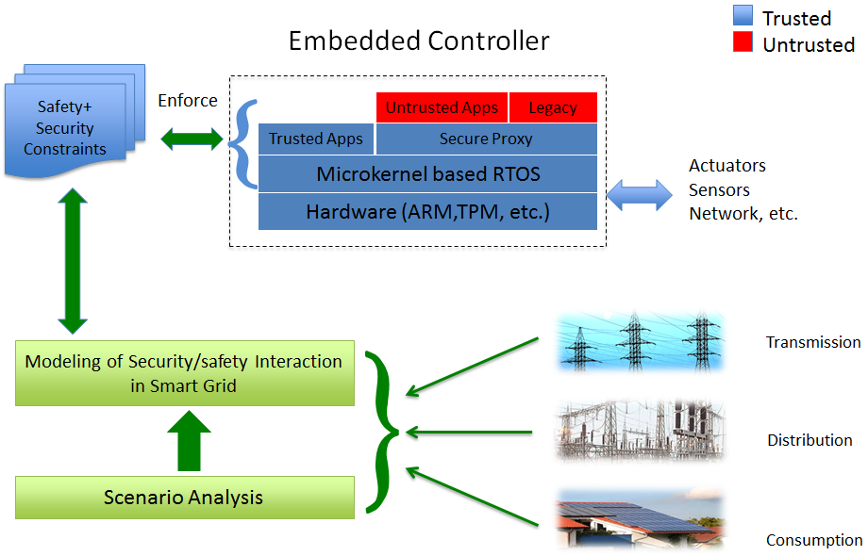
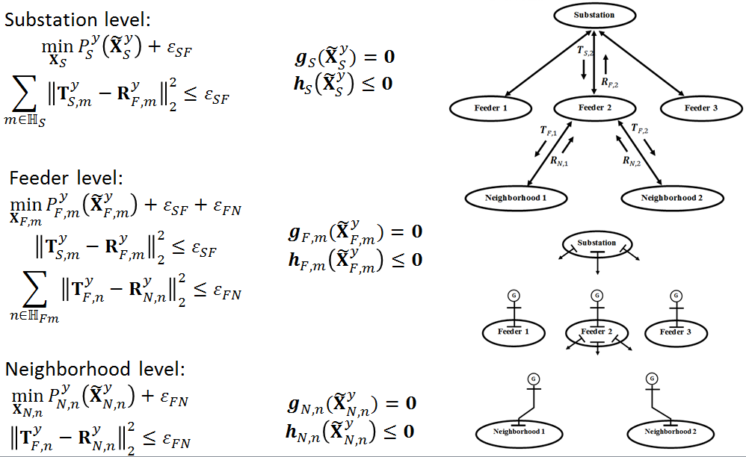
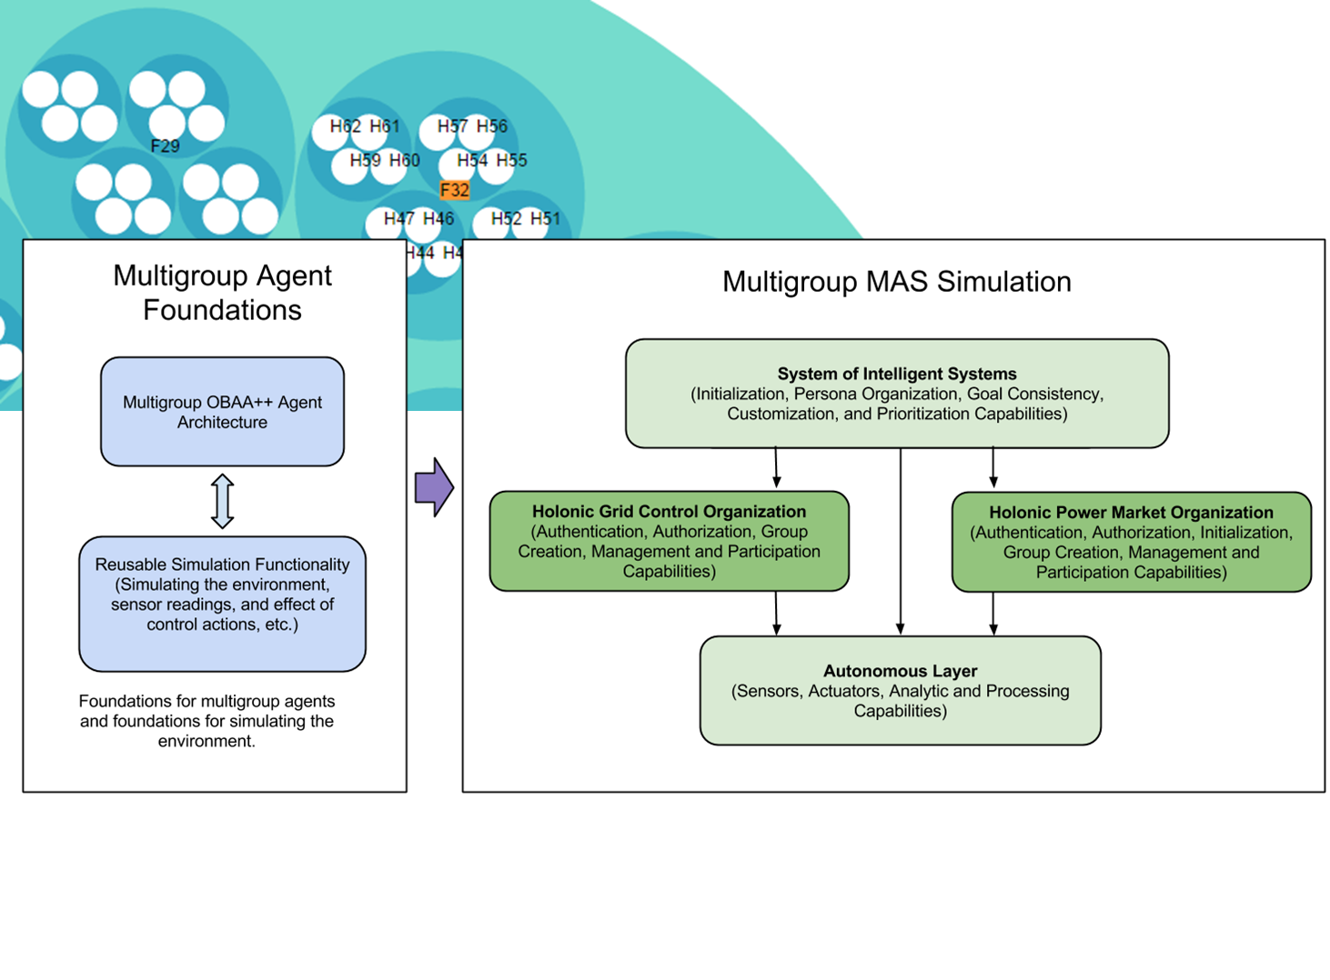
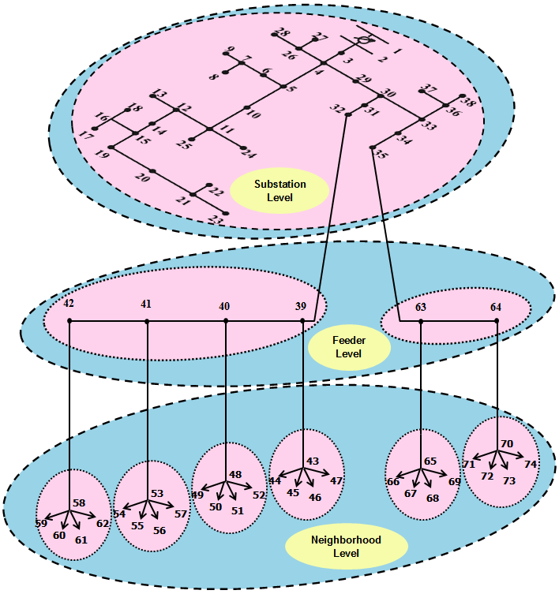
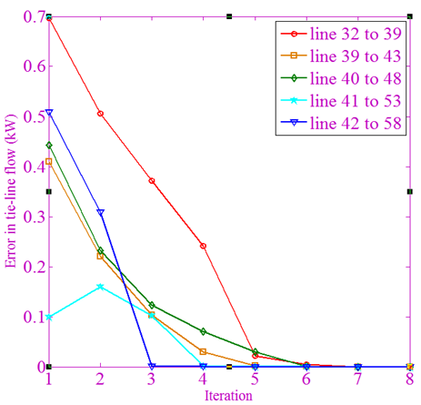
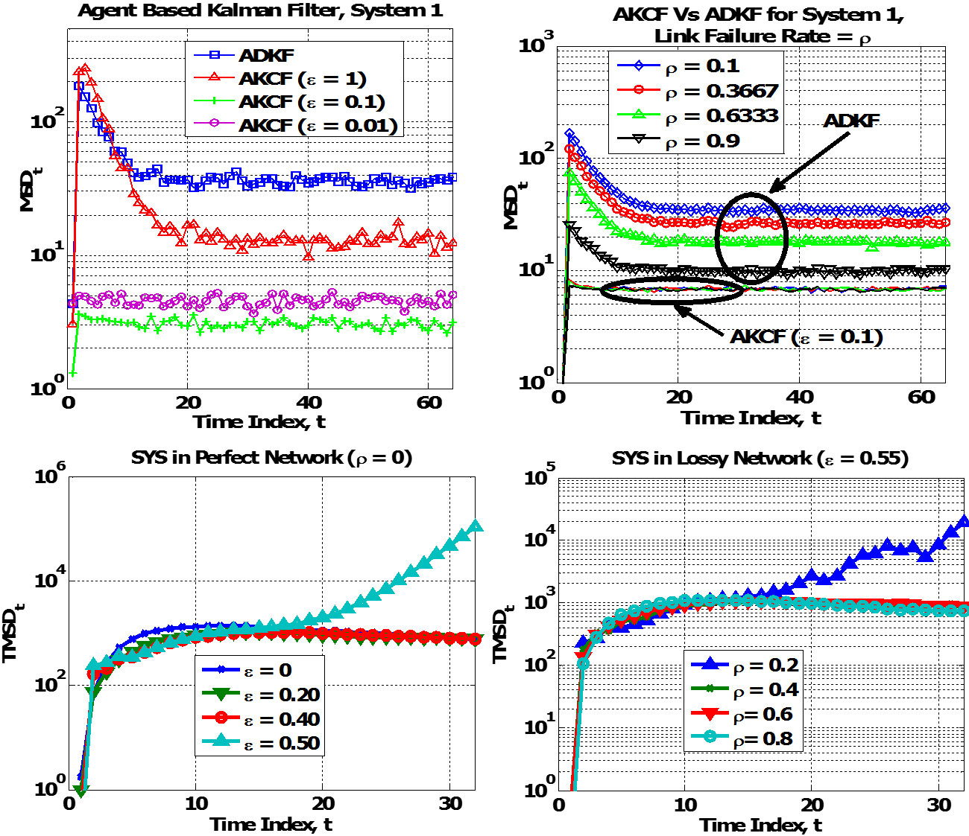
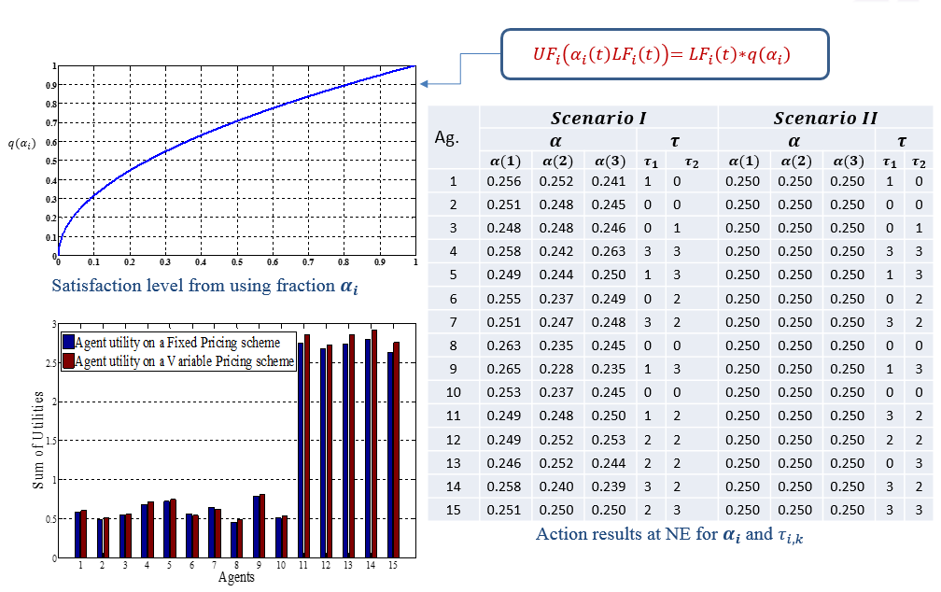
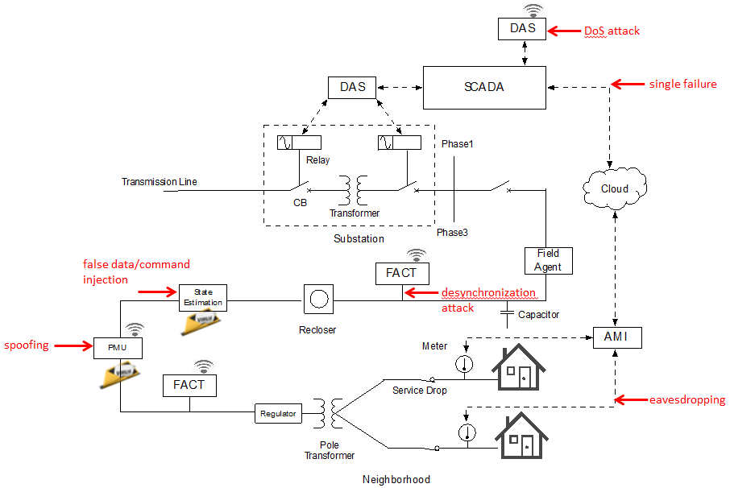

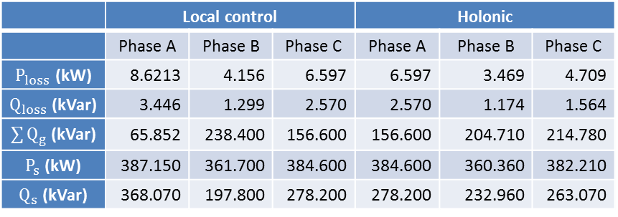
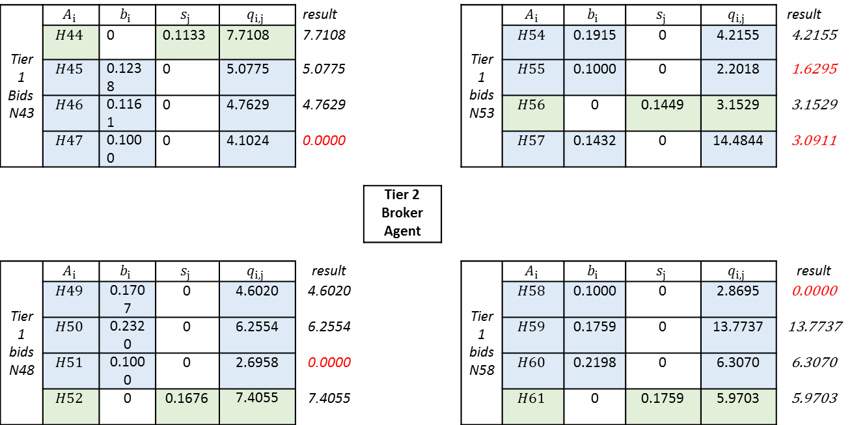
Holonic Multi-Agent Control of Intelligent Power Distribution Systems
NSF-CPS Award No. CNS - 1136040
  Project Team
  Electrical and Computer Engineering: Anil Pahwa, Sanjoy Das, Bala Natarajan, Noel Schulz Computing and Information Sciences: Scott DeLoach, Simon Ou, Dan Andresen
  Graduate Students: Shafiul Alam, Denise Case, Nazif Faqiry, Ahmad Malekpour, Daniel Wang
Abstract: The project demonstrates a holonic multi-agent system (HMAS) architecture capable of adaptively controlling future electrical power distribution systems, which are expected to include a large number of renewable power generators, energy storage devices, and advanced metering and control devices. The project provides a general, extensible, and secure cyber architecture based on holonic multi-agent principles to support adaptive PDS. It will produce new analytical insights to quantify the impact of information delay, quality and flow on the design and analysis of the PDS architecture. The architecture will be capable of optimizing performance and maintaining the system within operating limits during normal and minor events, such as cloud cover that reduces solar panels output. The architecture will also allow the operation of a distribution system as an island in emergencies, such as hurricanes/earthquakes, grid failures, or terrorist acts.
HMAS to Physical System
Voltage Control
State Estimation
Online Energy Trading
Secure Microkernel
HMAS Architecture
  Goal: An agent architecture that can support HMAS for cyber-physical systems; simulation of multigroup organizations of distributed CPS agents in Intelligent Power Distribution Systems.
Motivation: Distribution losses average about 7% in the U.S. (262.72 Billion kWh); 4% in distribution system
Challenge: Scalability
Goal: Inverter PV Var scheduling;
Three-level hierarchical optimization;
Centralized methods: Precise solution;
Decentralized methods: Fast solution;
Reducing computational complexity.
Goal: Formulate Agent-based Kalman Filter for a Dynamical System; Investigate Estimator performance under Lossy Communication Network;
Explore the Bounds of Filter Parameters from Lyapunov Stability Analysis.
Goal: Develop a general model for energy trading; maximize agent and overall utility; design a setting where selfish agents can autonomously act.
Goal: Enforce security, safety in smart grid
Understand the diversity of power grid control
Extracts crucial security and safety constraints
Using layered approach guarantees secure policies
Design a new secure embedded platform
Implements secure policies from bottom-up
  Real-time and functional correctness
Approach: Network of Cooperative Agents.
Agent observes “part” of the dynamics.
“Physical” Neighbors: Share the State Elements. Neighborhood Information Exchange: Local Estimates of only the “Shared” State Elements.
Approach:
AKCF
Consensus
ɛ- Degree of consensus
ADKF
Diffusion
Uniform weighting
Tier 1 Bids N43 | $$A_{i}$$ | $$b_{i}$$ | $$s_{j}$$ | $$q_{i,j}$$ | result |  |  | Tier 1 bids N53 | $$A_{i}$$ | $$b_{i}$$ | $$s_{j}$$ | $$q_{i,j}$$ | result
 | $$H44$$ | 0 | 0.1133 | 7.7108 | 7.7108 |  |  |  | $$H54$$ | 0.1915 | 0 | 4.2155 | 4.2155
 | $$H45$$ | 0.1238 | 0 | 5.0775 | 5.0775 |  |  |  | $$H55$$ | 0.1000 | 0 | 2.2018 | 1.6295
 | $$H46$$ | 0.1161 | 0 | 4.7629 | 4.7629 |  |  |  | $$H56$$ | 0 | 0.1449 | 3.1529 | 3.1529
 | $$H47$$ | 0.1000 | 0 | 4.1024 | 0.0000 |  |  |  | $$H57$$ | 0.1432 | 0 | 14.4844 | 3.0911
 |  |  |  |  |  | Tier 2 Broker Agent
Tier 1 bids N48 | $$A_{i}$$ | $$b_{i}$$ | $$s_{j}$$ | $$q_{i,j}$$ | result |  |  | Tier 1 bidsN58 | $$A_{i}$$ | $$b_{i}$$ | $$s_{j}$$ | $$q_{i,j}$$ | result
 | $$H49$$ | 0.1707 | 0 | 4.6020 | 4.6020 |  |  |  | $$H58$$ | 0.1000 | 0 | 2.8695 | 0.0000
 | $$H50$$ | 0.2320 | 0 | 6.2554 | 6.2554 |  |  |  | $$H59$$ | 0.1759 | 0 | 13.7737 | 13.7737
 | $$H51$$ | 0.1000 | 0 | 2.6958 | 0.0000 |  |  |  | $$H60$$ | 0.2198 | 0 | 6.3070 | 6.3070
 | $$H52$$ | 0 | 0.1676 | 7.4055 | 7.4055 |  |  |  | $$H61$$ | 0 | 0.1759 | 5.9703 | 5.9703
Performs better and more robust
Model of Distribution Grid:
Results:
q = quantity in kwh
b,s = bid price in cents/kwh
 | Local control |  |  | Holonic
 | Phase A | Phase B | Phase C | Phase A | Phase B | Phase C
$P_{loss}$ (kW) | 8.6213 | 4.156 | 6.597 | 6.597 | 3.469 | 4.709
$Q_{loss}$ (kVar) | 3.446 | 1.299 | 2.570 | 2.570 | 1.174 | 1.564
$\sum{Q_{g}}$ (kVar) | 65.852 | 238.400 | 156.600 | 156.600 | 204.710 | 214.780
$P_{s}$ (kW) | 387.150 | 361.700 | 384.600 | 384.600 | 360.360 | 382.210
$Q_{s}$ (kVar) | 368.070 | 197.800 | 278.200 | 278.200 | 232.960 | 263.070
Intelligent power distribution agents were enhanced to achieve the goals of multiple independent organizations; agents collaborated in two concurrent holarchies:
one for power quality control and one for autonomous online power auctions.
bounds on ɛ and ρ are violated
Results match for small-scale system; execution time: 93 seconds for distributed approach and 225 seconds for centralized approach; centralized approach is not applicable for large-scale system.
The sum of customer utilities under Variable Pricing (20.269) is higher than that of under Fixed Pricing (19.578).
Intelligent Power Distribution Systems
http://ipds.cis.ksu.edu/
Electrical and Computer Engineering
Computing and Information Sciences

