Slide 1
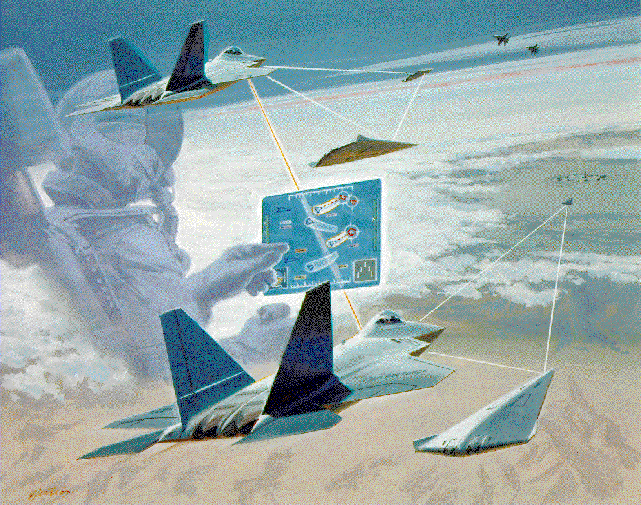
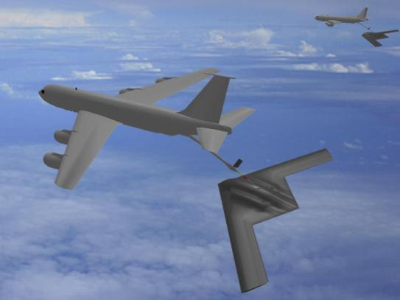
The Future Trends of Autonomy
From single vehicle to cooperative vehicles
  Moving from a lone vehicle to teams of homogeneous or heterogeneous packages
From remote use to integrated operations
  Moving from separate airspace and bases into integrated operations, airspace, and bases
From automated to autonomy
  Dealing with the dynamic and complex environments and reacting to the unpredicted
From single purpose to general purpose
  Moving from a single purpose, i.e. ISR, to multi-purpose next-gen UAS
Distribution A: Distribution Unlimited -- Approved for Public Release –88ABW-2012-3321
Notes:
Distribution A: Distribution Unlimited -- Approved for Public Release –88ABW-2012-3321

Slide 2
Trusted Autonomy
Are my decision trees and state diagrams correct?
  Given accurate information, in a known situation, WILL I MAKE THE CORRECT DECISION?
What about the unexpected?
  When I encounter a new situation, WILL I MAKE A SAFE DECISION?
Can I trust my perception of the situation?
  Given the information I have, WHAT ASSURANCE DO I HAVE THAT THE INFORMATION IS CORRECT?
As I interact with other systems, how prevent undesired emergent behavior?
  Is there a way to certify this system in a piece-wise fashion?

