Slide 1
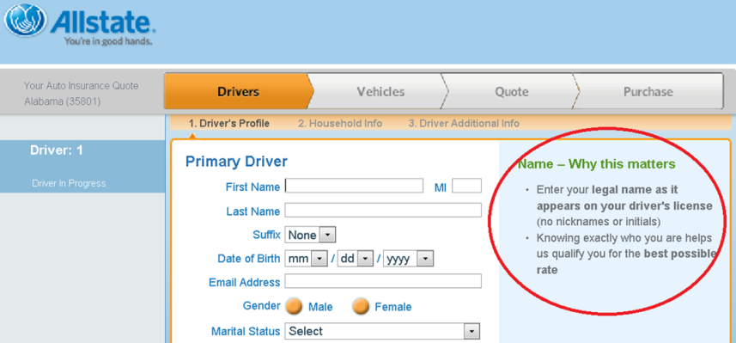
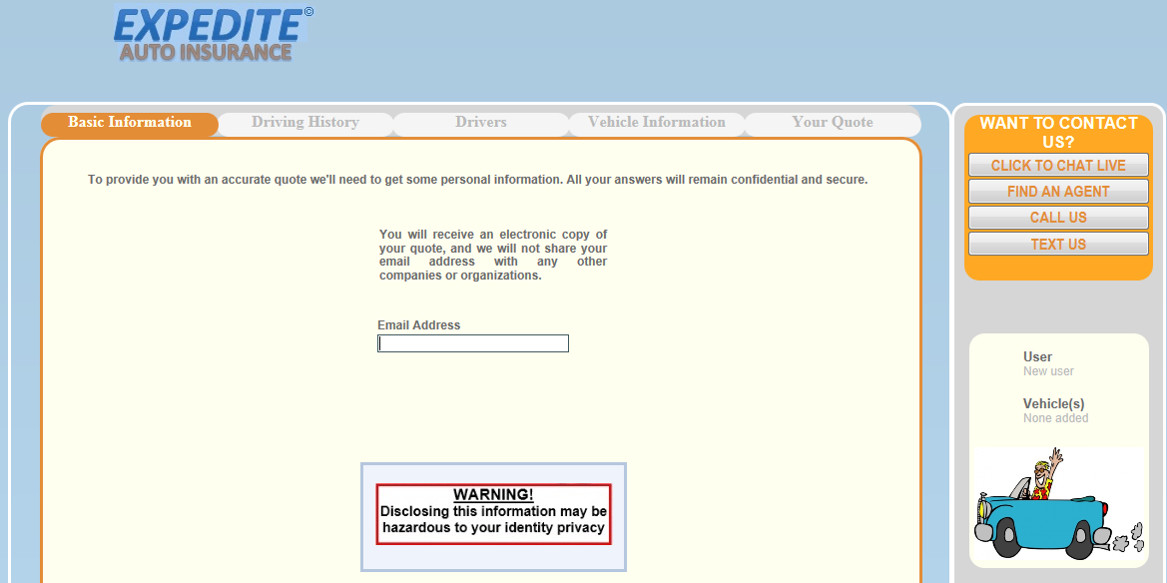
Psychological Attacks and Mitigations
Sandra Carpenter & Feng Zhu
The University of Alabama in Huntsville
The objective of this project is to identify psychological cyber-attacks and design mitigations to help people better protect their privacy and identity.
Research findings are disseminated in both social psychology and computer science.
The Challenges
Our Approach
Attackers exploit psychology as often as technology
11,000,000 people experience identity theft in the US every year
3,200,000/year are victims to scams in the UK
Extends models of risk reduction to computer privacy
Determines whether warnings can have significant impact on people’s identity exposure decisions
Tests on hand-held devices and web sites
Mindlessness Attacks
Mitigations using Warnings
Automatic compliance to a request is known as mindlessness
People seem to use a heuristic “rule” that they need to provide any information that is requested
e.g., giving one’s phone number or zip code at store check-out counters
Mindlessness has been successfully used to perpetrate scams through email, via advertisements on websites, and via cell phone messages
Experimental setting
Used the same website as in the attack experiment
Manipulated three levels of the warning word: “warning,” “hazard,” or “caution”
Our goal: To ascertain the most successful word in reducing identity disclosure
A 3 Warning words x 2 Identity Information (driver’s license or email address) between participants design (see screen shot below)
Experimental setting
Results
We created an online insurance quote site (similar to that of Allstate) as a context for requesting identity information under mindlessness attacks
The research was presented to participants as a beta test of the quality of a website designed by a new, local insurance company
In the attack condition, justifications included explanations for why the information was being requested (but not actually necessary to respond to the user’s queries)
45 participants. 30 years or older and had purchased automobile insurance in the past
Percent of Participants Providing Information in the Warning Conditions
Warning (ID) | Percentage | Z-test Scores (p-value) | Odds Ratio
Caution (DL) | 0% | -8.49 (.001) | 86.4
Hazard (DL) | 0% | -8.49 (.001) | 94.5
Warning (DL) | 7.7% | -5.84 (.001) | 54.0
Caution (email) | 41.7% | -4.10 (.001) | 66.8
Hazard (email) | 9% | -10.49 (.001) | 343.0
Warning (email) | 63.6% | -2.51 (.012) | 29.4
Results
Note: without warning messages, 75% of participants provided driver’s license information and 100% participants provided email addresses.
Summary and discussion
The odds of providing driver’s license information were 5.5 times greater in the attack condition than in the mindlessness control condition
Warnings can be effective countermeasures for mindlessness attacks
The research provides beginning guidance for effective warnings to mitigate attacks

