Slide 1
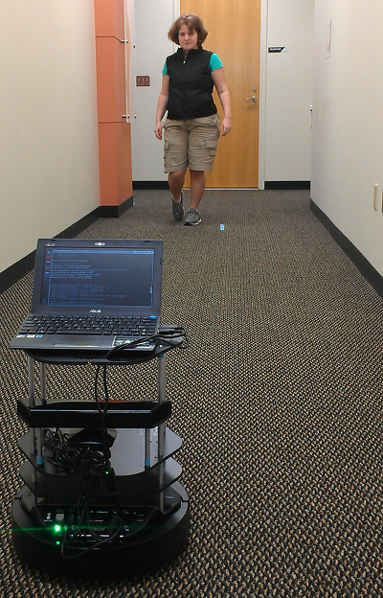
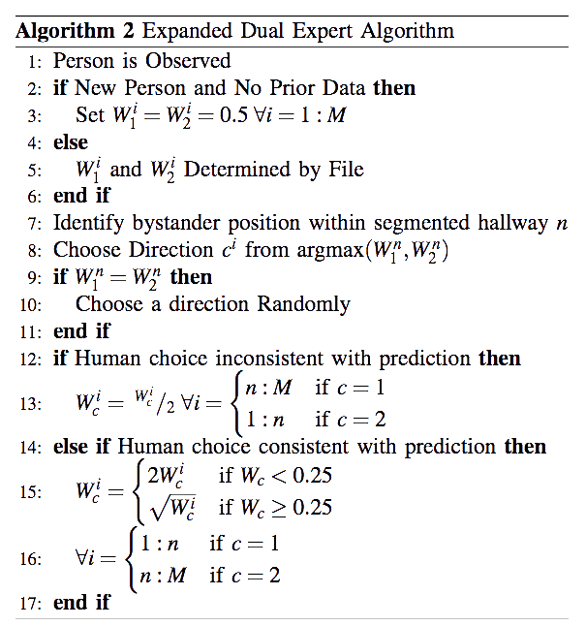
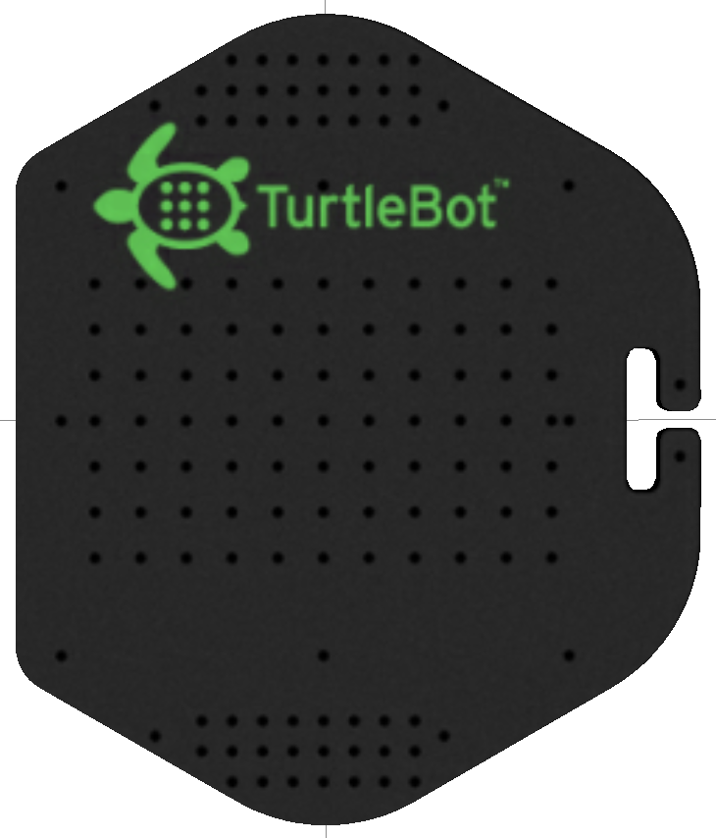
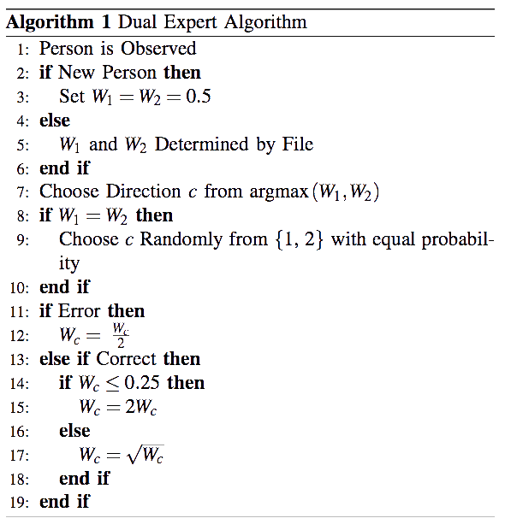
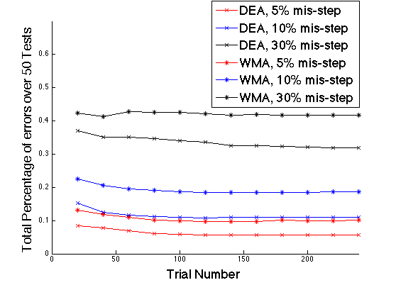
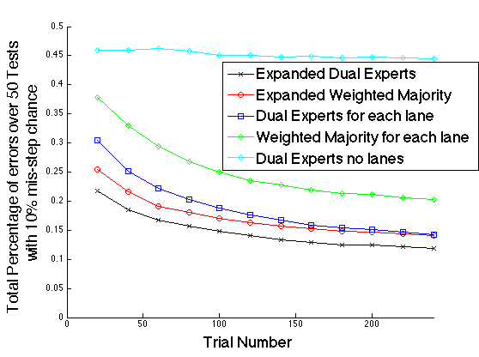
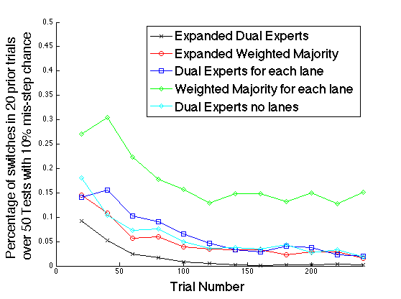
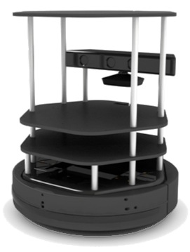
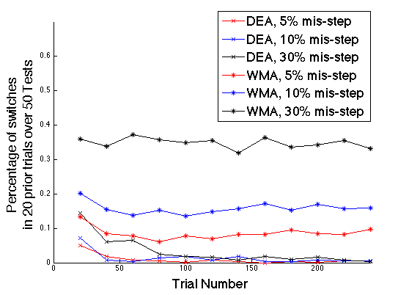
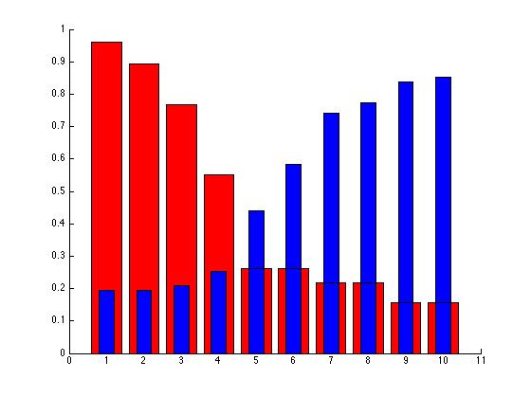
Robust Algorithms for Mobile Robots
to Learn Human Preferred Movement in a Hallway
Carol Young and Fumin Zhang
School of Electrical and Computer Engineering
cyoung44, fumin@gatech.edu
Research Goal
Dual Expert Algorithm (DEA)
Expanded DEA (EDEA)
The goal is to learn the preferred human avoidance direction when robot and human encounter head on in a hallway. Since indoor environments with heavy foot traffic, like office building and hospitals, use mobile robots. For the implementation to be a success the robot must be able to navigate around bystanders, individuals who are not its primary user, in a way that is predictable, intuitive, and meets the expectation of robot interactivity.
For encountering a single bystander in the center of a hallway while approaching head on as shown in the figure below.
1
2
3
4
Side 1
Side 2
EDEA provides the same benefits of DEA, intuitive and predictable, while removing the assumption that the bystander must start in the center of the hallway.
DEA determines the direction for the robot to turn based off of a comparison of weights that is then updated after each interaction. It is proven to have a bounded number of errors (intuitive) and a limited number of switches (predictable) when compared to the Weighted Majority Algorithm (WMA)
Intuitive: The robot responds appropriately to a bystander. The robot should turn towards the wall not chosen by the bystander.
Predictable: The robot behaves consistently between interactions. The wall the robot turns towards should remain consistent
Meets expectations: The robot cannot imply it has more capacity to interact than it actually has. Since stopping implies the robot can respond to requests from bystanders. The robot should not stop.
Experimental Results
EDEA is compared with, WMA expanded using the same updating as applied above, DEA applied in each hallway segment, WMA applied in each hallway segment, and DEA applied without segmentation. With a 10% rate of mis-steps EDEA has the lowest rate of incorrect predictions (bottom left) and the least rate of switching (bottom right), with that rate going towards 0.
Results
DEA had fewer incorrect predictions of turning directions than WMA for bystanders that had a 5%, 10% and 30% chance of deflecting in their non-preferred direction, a.k.a. making a mis-step.
Assumptions
The robot is similar in footprint to the size of the bystander, thus both must deflect to pass in a typical hallway setting
The robot moves at the casual walking speed of the bystander
The robot is equipped with sensors and software to identify a bystander and their movements.
Bystanders tend to use the center of the hallway, deflect away from the robot to a preferred direction.
Obstacle avoidance behavior has been implemented on the robot so that it will not collide with the bystander.
DEA also has fewer switches than WMA for bystanders that had a 5%, 10% and 30% chance of making a mis-step. The amount of switches from DEA also decreased towards 0 as the number of trials increased which was not seen in WMA
The averaged weights of all sections after 4 live experiments also shows an increased difference in weights in starting positions near the walls. This corresponds to decreased switching in those section
Acknowledgements: This research work was supported by ONR grants N00014-09-1-1074 and N00014-10-10712 (YIP), NSF grants ECCS-0841195 (CAREER), CNS-0931576, OCE-1032285, IIS-1319874, and an ARCS Scholar Award
Notes:
UPDATE FROM NEW RESULTS ET ALL FROM PAPER

