Slide 1
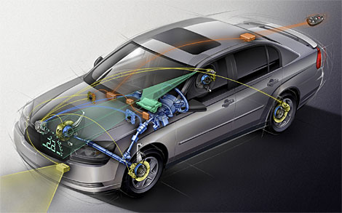
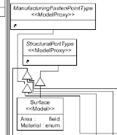
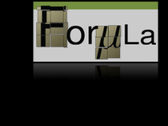
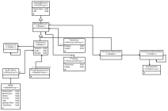
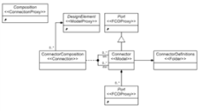
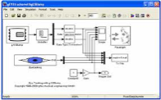
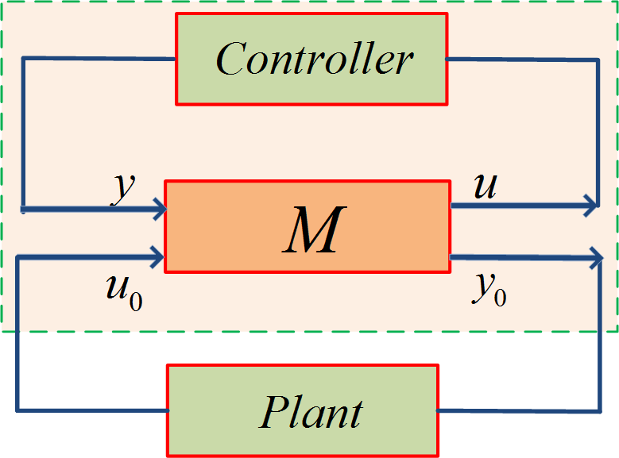
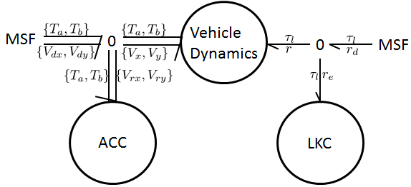
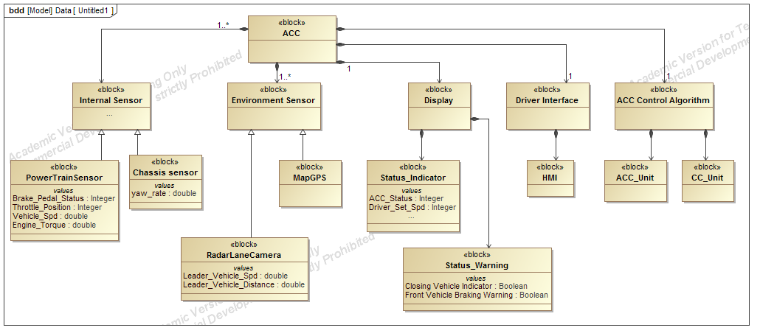
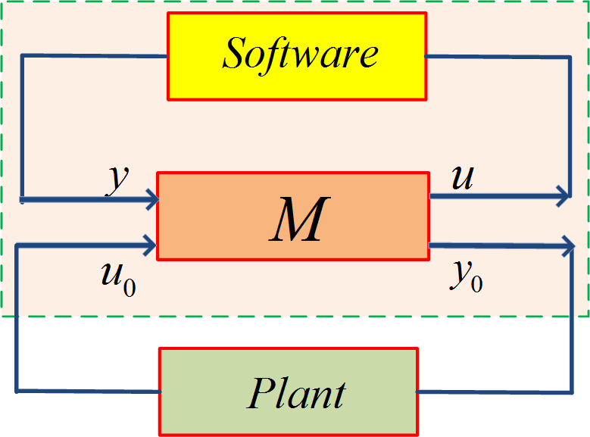
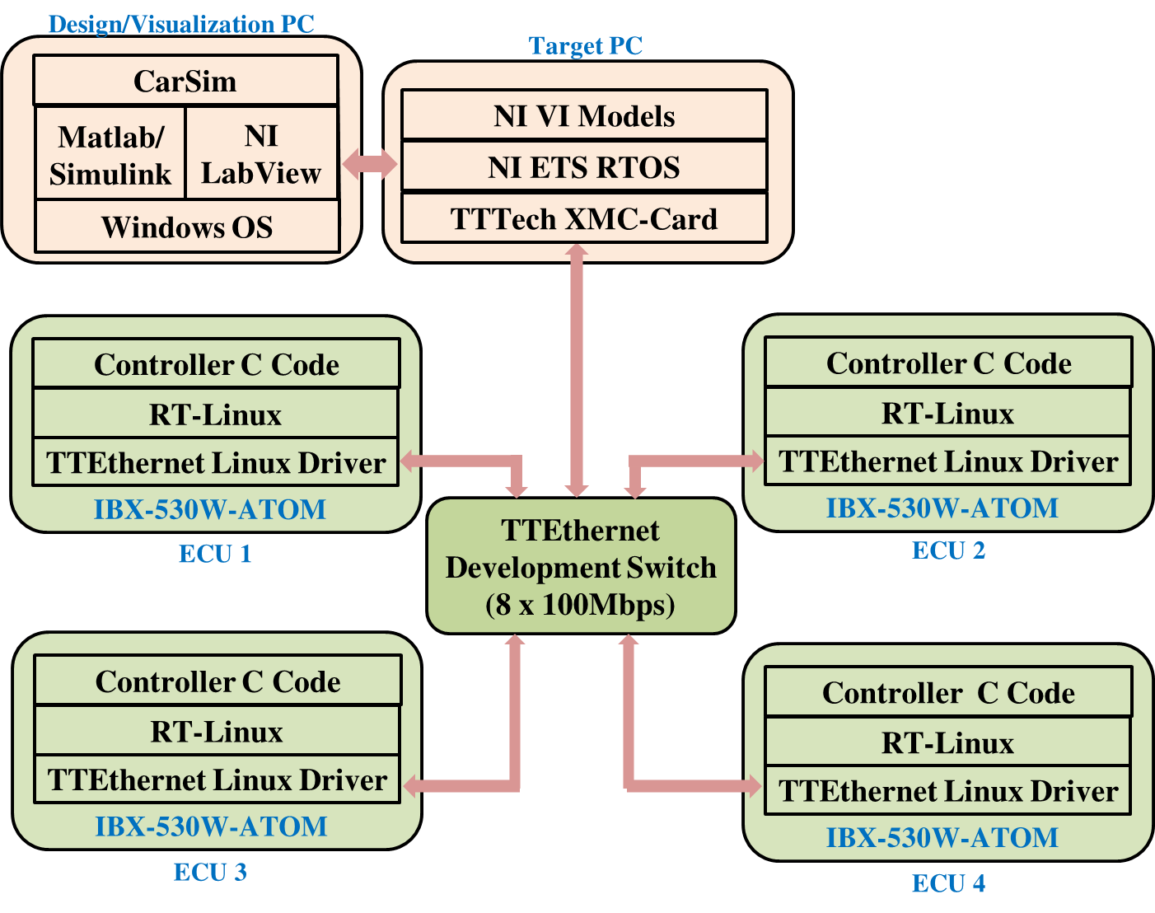
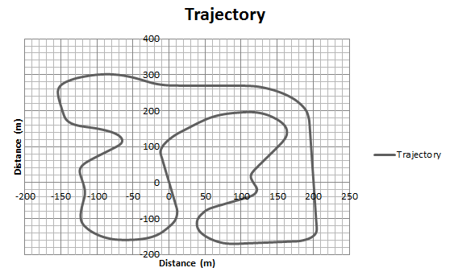
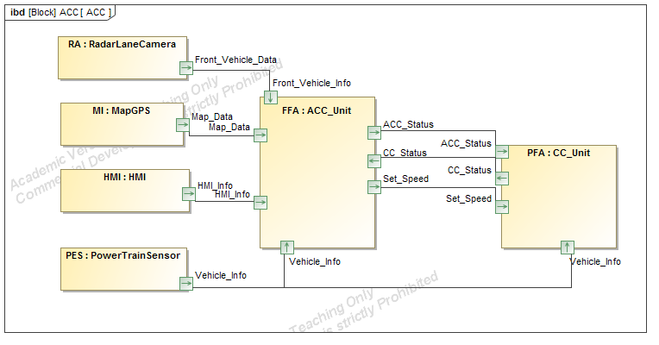
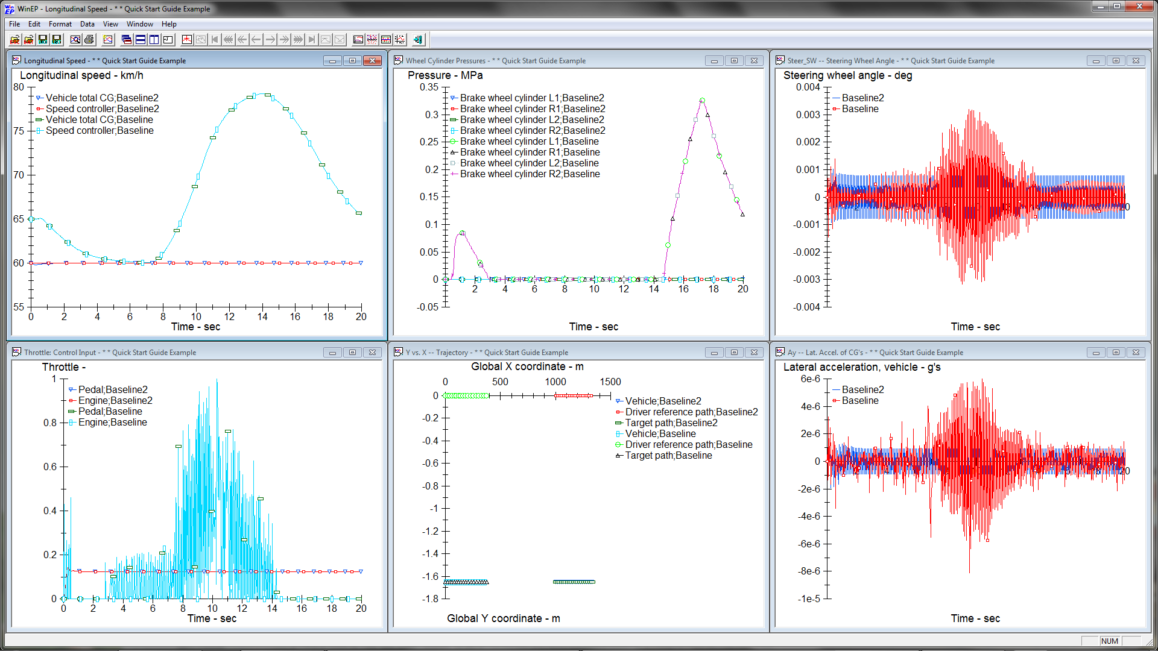
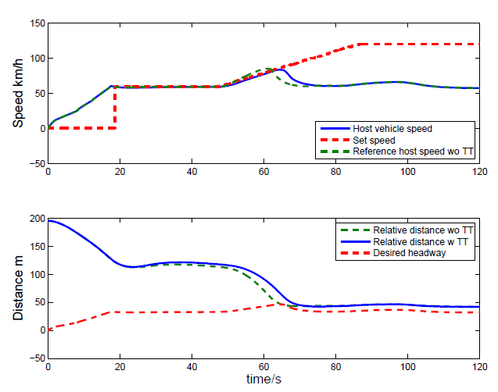
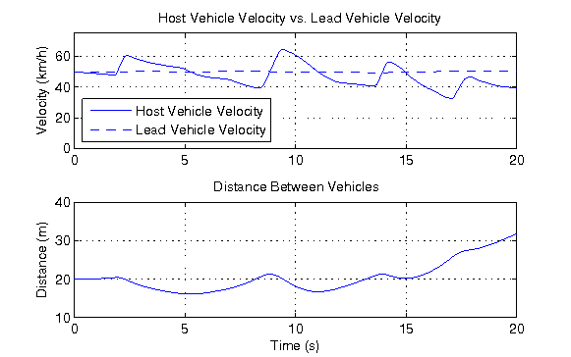
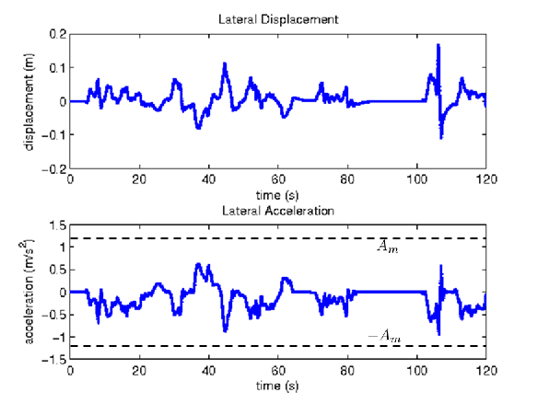
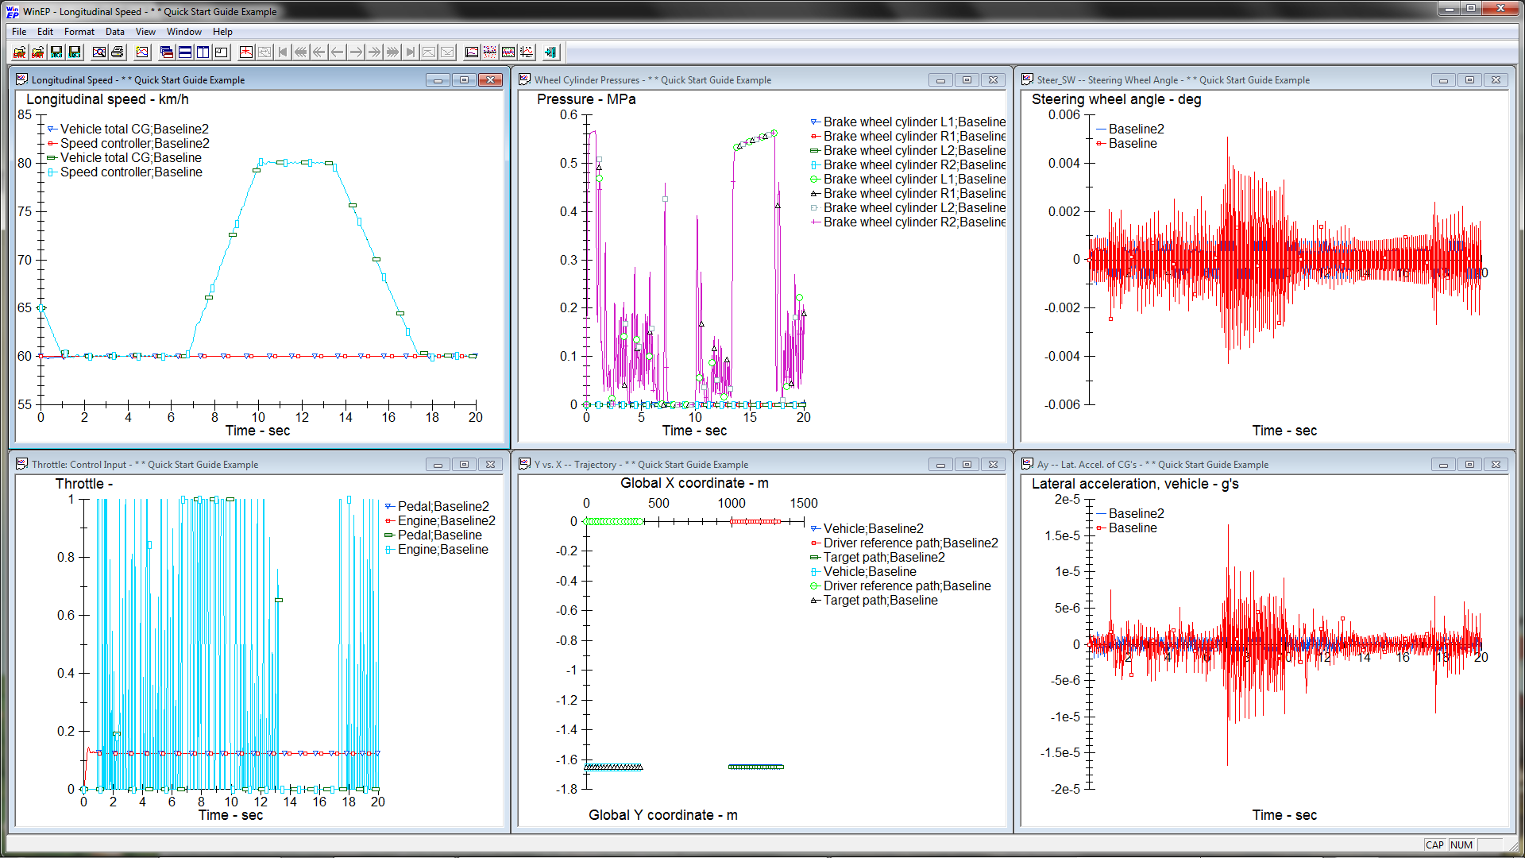
Science of Cyber-Physical System Integration
Janos Sztipanovits¹, Xenofon Koutsoukos¹, Gabor Karsai¹, Panos Antsaklis², Vijay Gupta², Bill Goodwine², John Baras³, Shige Wang⁴
¹Institute for Software Integrated Systems, Vanderbilt University
²Department of Electrical Engineering, University of Notre Dame
³Department of Electrical and Computer Engineering, University of Maryland at College Park
⁴General Motors R&D
Next generation vehicles
System Integration
Modeling Heterogeneous Domains
Model Integration Language
Next generation vehicles will include active safety, autonomous driving, and diverse energy conversion systems
Design and engineering such vehicles requires a new synthesis-based paradigm
The new design approach should facilitate integration and quick adoption of new technology
The project objective is to develop the scientific foundations and a new systems engineering approach for CPS integration
Model Integration Language - CyPhy
Structural Semantics
Semantic Backplane
Physical
Hierarchical decomposition
Cyber
Hierarchical Ported Models /Interconnects
Structured Design Spaces
Model Composition Operators
Behavioral
Semantics
Component hierarchy
Electromagnetic
Refinements
Transformation
Semantics
Semantic
Translators
Thermal
Continuous/discrete time
abstraction
abstraction
abstraction
abstraction
Semantic Interface
CyPhy ←→SL/SF
Physical domains
Mechanical
Logical time
Hydraulic
Discrete event
SL/SF
MetaModel
CAD Integration
MetaModel
CAD
Meta
CyPhy ←→ SEER
Electrical
Behavior abstractions
Behavior Abstraction Layers
Dymola
CyPhy ←→ CAD
Pro-E
Domain Specific Tools and Frameworks
Foundation for MILs: Formal, composable semantics and semantic interfaces
Model-Based Controller Design
Passivation: From Control to Software
Passivity-Based Control Software Design
Model based system design approach for an embedded controller unit for Adaptive Cruise Control (ACC)
Verify that ACC is able to maintain desired separation from the lead vehicle
Analyze controller real-time perfomance
Consider a passivation method given by an input/output transformation matrix M
By appropriate choices of the matrix M, desired passivity indices for the closed-loop system can be guaranteed
When the control algorithm is implemented in software, time-varying delays may not be avoided
The transformation matrix M can be used to reduce the delay effects and improve the closed-loop system performance
M can be computed by minimizing the tracking error using non-gradient optimization
Simulink + CarSim
Compositional control design using port-Hamiltonian systems
Adaptive Cruise Controlller (ACC)
Lane Keeping Controller (LKC)
Model transformation from block diagram to AADL
system ACC
features
Map_info: feature group ACC_Map_socket;
ACC_state: out data port;
end ACC;
system implementation ACC.impl
subcomponents
FFA: system ACCUnit;
PFA: system CCUnit;
FLC: system LKI;
RA: device RadarLaneCamera;
MI: device MapGPS;
PES: device PowerTrainSensor;
HMI: device HMI;
connections
C1: port FFA.ACC_state -> ACC_state;
C2: port FFA.CC_Engage_Flag -> PFA.CC_Engage_Flag;
C3: port PFA.CC_state -> FFA.CC_state;
C4: feature group MI.Map_info -> Map_info;
...
C20: feature group PES.VehicleInfo -> FLC.Vehicle_info;
end ACC.impl;
Simulink + Truetime + CarSim
Acknowledgments:
National Science Foundation (NSF) Award CNS-1035655

