Slide 1

George J. Pappas
Joseph Moore Professor
School of Engineering and Applied Science
University of Pennsylvania
pappasg@seas.upenn.edu
Science of Cyber-Physical Systems
Bridging CS and Control

Slide 2
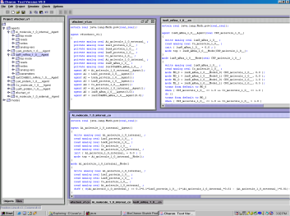
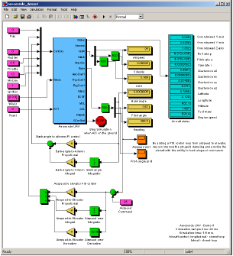
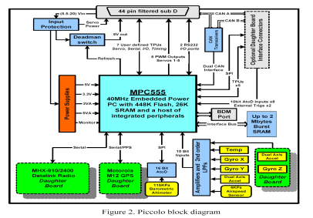
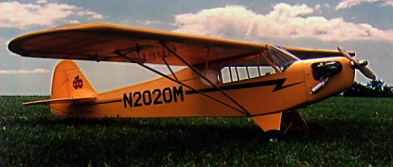
Control and computing hierarchies
Notes:
2

Slide 3
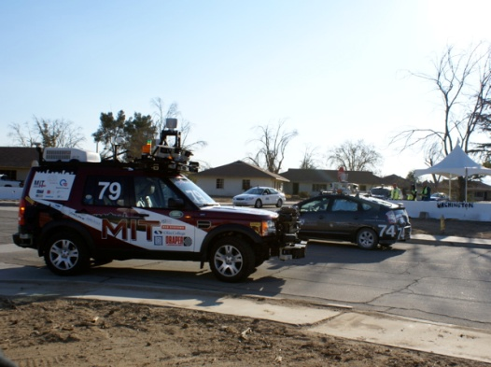
DARPA Urban Challenge
RNDF
MDF
Mission Planner
Waypoints
Status
Hand coded
Finite State Machine
+
map
Sensor
Information
Ref. Traj.
Status
Controller

Slide 4
Control and computing hierarchy
Task
Programming
Language
Temporal logics, automata, DES
Control
and
Sensing
Control systems, Kalman filters
Real-time
computing
Time-triggered architectures, RTOS
Notes:
4

Slide 5
How to analyze the overall design?
Task
Programming
Language
Technical Challenges
Integrate control and computing (hybrid systems)
Translate models of control and computing
Unified systems view of control and computing
Interfaces between control and computing
Quantifiable, cross-cutting, robust interfaces
Control
and
Sensing
Real-time
computing
Notes:
5

Slide 6
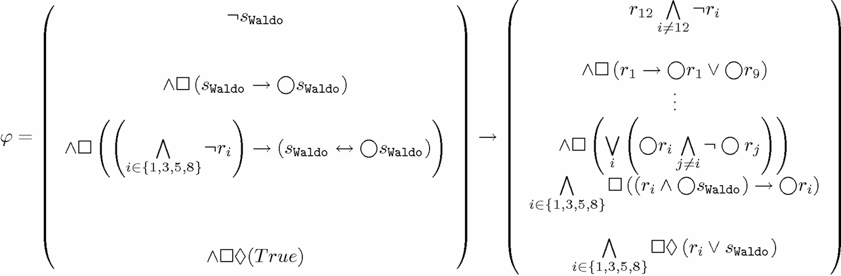
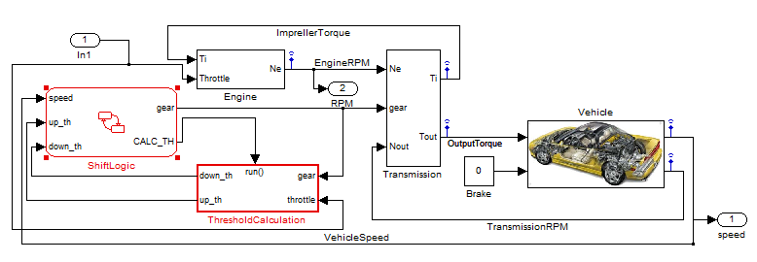
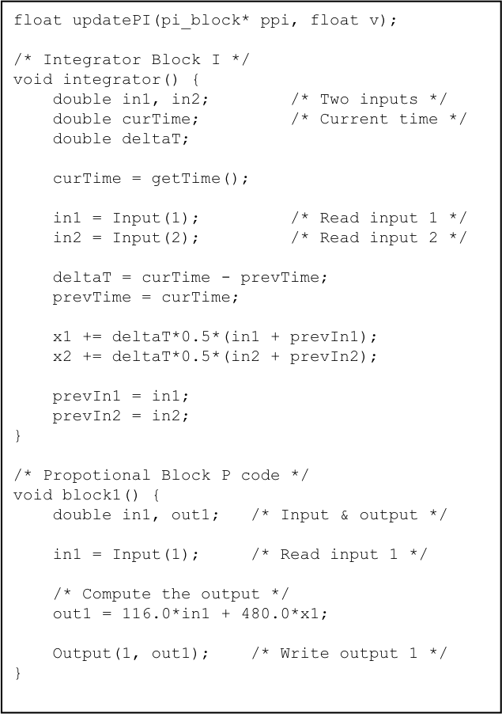
A CS view of the same hierarchy
Task
Programming
Language
Control
and
Sensing
Real-time
computing
Notes:
6

Slide 7

What is the relationship between computer programs?
Program
Syntax
Transition
System
Semantics
Notes:
7

Slide 8
Established relationships

Slide 9
What is the relationship between computer programs?
Notes:
9

Slide 10
Temporal logics
Bisimulation relations preserve all properties expressed in LTL, CTL, and CTL*
Simulation relations preserve all properties expressed in fragments of CTL
Language equivalence preserves all properties expressed in LTL
CTL
LTL
CTL*

Slide 11
Finite bi-simulations of hybrid automata*
Theorem*: All timed automata admit a finite bisimulation
CTL* model checking is decidable
*R. Alur and D. Dill, A theory of timed automata, Theoretical Computer Science, 1994
*G. Lafferriere, G.J. Pappas, S.S. Sastry, O-minimal hybrid systems, Mathematics of Control, Signals, and Systems, 2000
*R. Alur, T. Henzinger, G. Lafferriere, G.J. Pappas, Discrete abstractions of hybrid systems, Proceedings of IEEE, 2000
*A. Chutinam, B.H. Krogh, Verification of infinite-state systems using quotient transition systems, IEEE Transactions on Automatic Control, 2001

Slide 12
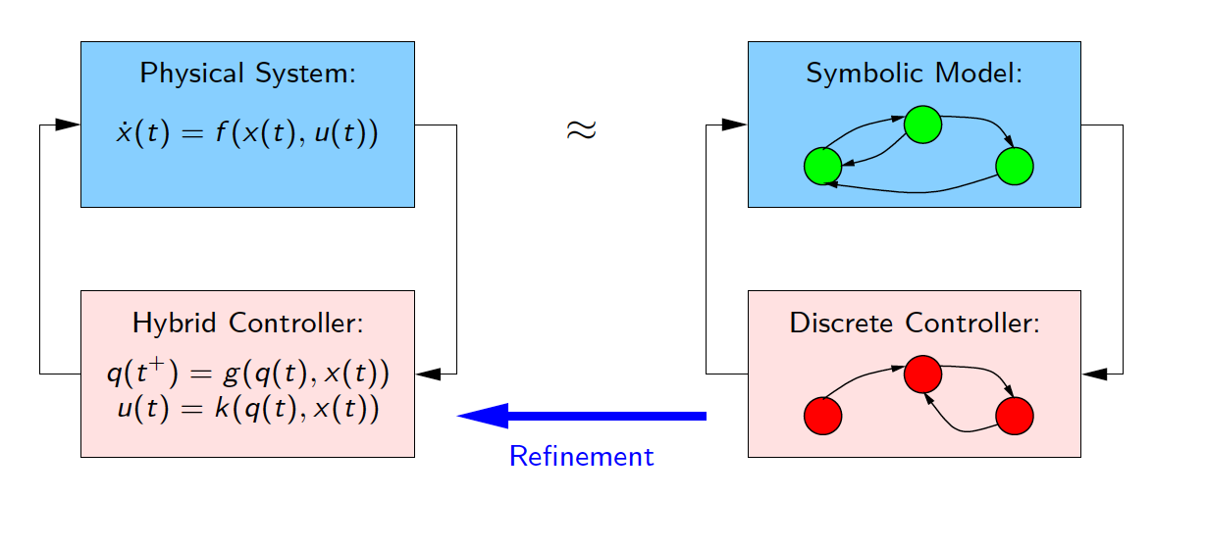
Symbolic controller synthesis*
*P. Tabuada and G. J. Pappas, LTL control of discrete-time linear systems, IEEE Transactions on Automatic Control, 2006
*C. Belta, V. Isler, G.J. Pappas, Discrete abstractions for robot planning and control, IEEE Transactions in Robotics, 2005
*L. Habets, P.J. Collins, J. van Schuppen, Reachability and control synthesis for PWA hybrid systems, IEEE Transactions on Automatic Control, 2006

Slide 13
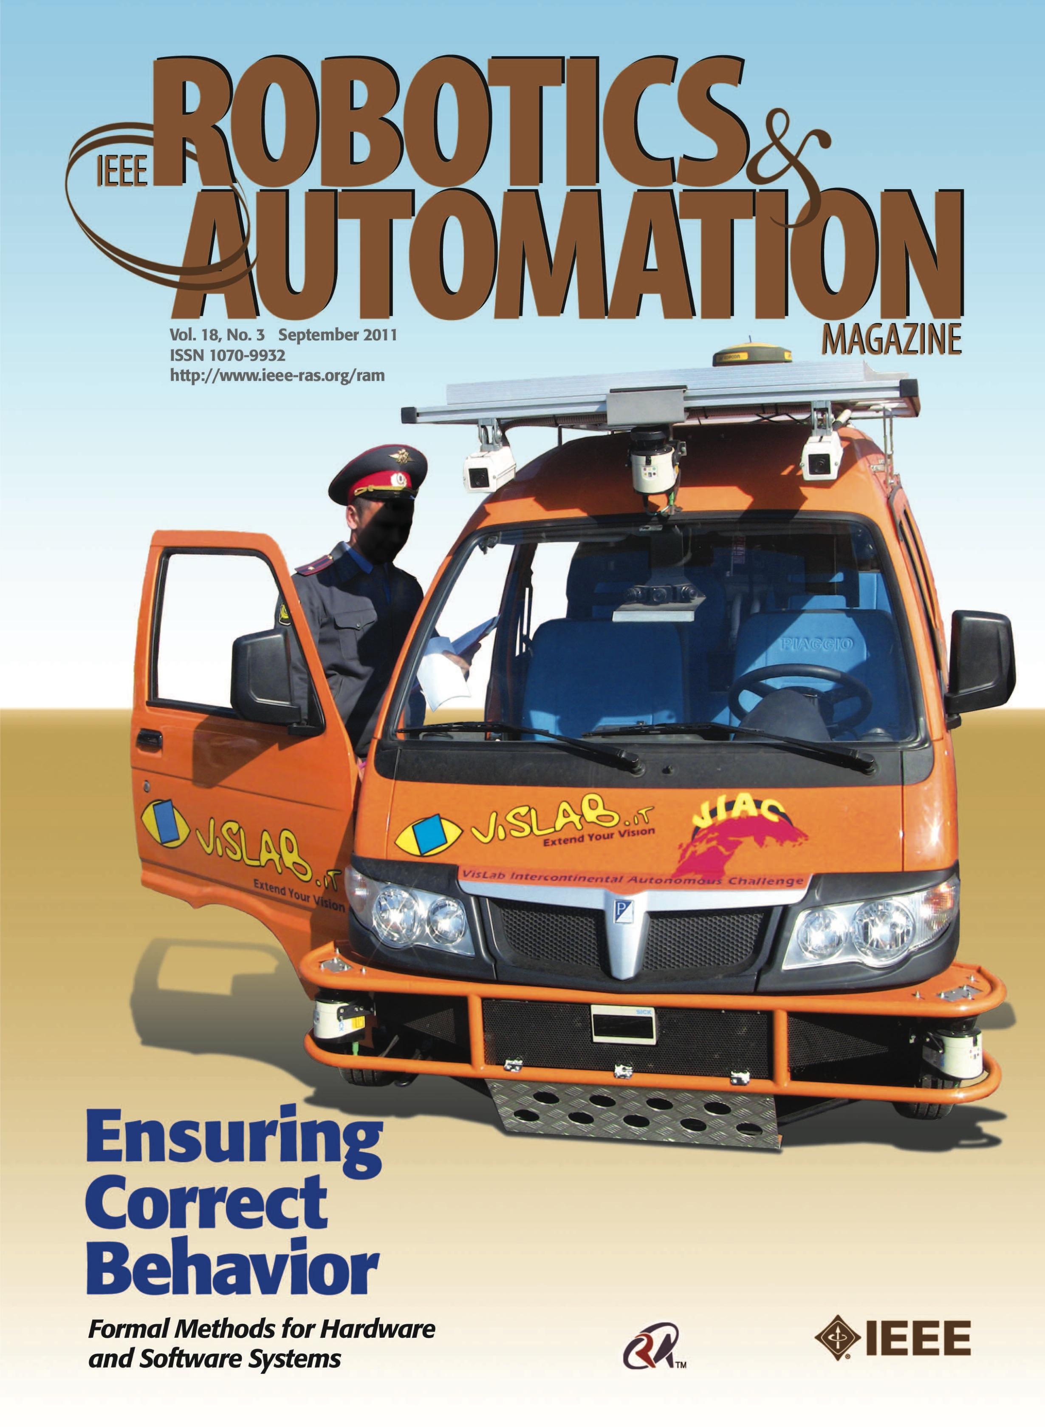
LTL mission planning
for mobile robots
Notes:
13

Slide 14
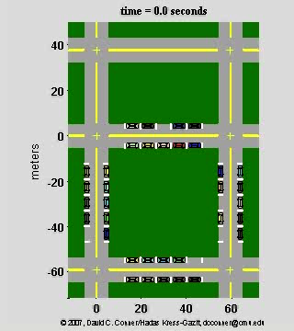
Valet parking
“Drive around the environment, while obeying traffic rules, until you find a free parking space, and then park”
300+ continuous controllers
5000+ discrete modes
*H. Kress-Gazit, D. C. Conner, H. Choset, A. Rizzi and G. J. Pappas. Valet Parking without a Valet, IROS 2007, Best Paper Award Finalist

Slide 15
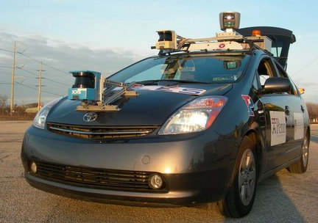

DARPA Urban Challenge
“Drive through a sequence of checkpoints in an urban environment while obeying traffic laws”

Slide 16
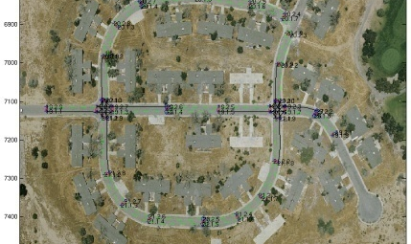
DARPA Urban Challenge NQE
*H. Kress-Gazit and G. J. Pappas. Automatically Synthesizing a Planner and Controller for the DARPA Urban Challenge, IEEE CASE, 2008

Slide 17
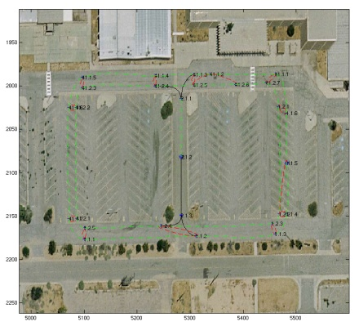
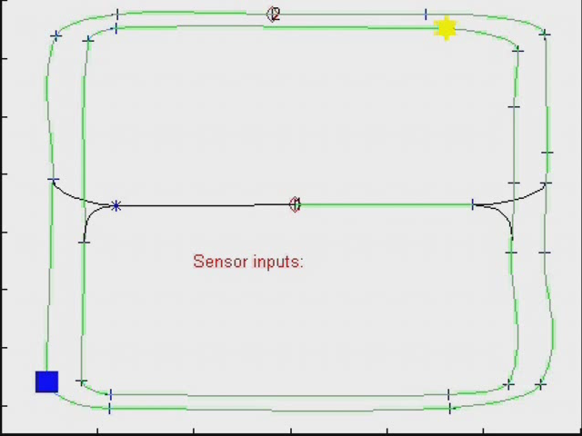
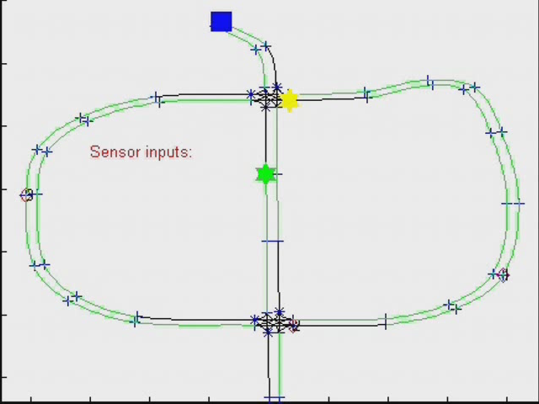
DARPA Urban Challenge NQE
Robot moving
Robot stopping
Other vehicles
Obstacles
*H. Kress-Gazit and G. J. Pappas. Automatically Synthesizing a Planner and Controller for the DARPA Urban Challenge, IEEE CASE, 2008

Slide 18
From exact to approximate
Exact relationships useful for binary answers/relations
Exact results are fragile with respect to uncertainty
When interacting with the physical world, we need approximations
  Labeled Markov processes (Desharnais et. al., TCS 2004)
  Quantitative transition systems (de Alfaro et. al., ICALP 2004)
  Quantitative generalizations of languages (Henzinger, DLT 2007)
Approximate system relationships
  Enable larger system “compression”
  Quantify error/complexity tradeoffs
  Provide measures of robustness
  Potentially introduce different algorithms

Slide 19
A theory of approximation
for CPS
Notes:
19

Slide 20
Approximate relationships*
Define pseudo-metrics on the set of transition systems:
Exact notions captured as zero sections of pseudo-metrics.
*A. Girard and G.J. Pappas, Approximation metrics for discrete and continuous systems, IEEE Transactions on Automatic Control, May 2007.

Slide 21
Hierarchy of approximation metrics*
*A. Girard and G.J. Pappas, Approximation metrics for discrete and continuous systems, IEEE Transactions on Automatic Control, May 2007.

Slide 22
Computational approaches for various classes

Slide 23
Approximations of nonlinear continuous systems
We are looking for Lyapunov-like functions satisfying

Slide 24
Bridging CS and control
Approximate Bi-simulation
Discrete systems
Continuous systems
Computer Science
Control Theory

Slide 25
Approximate symbolic control*
Incrementally stable nonlinear systems admit symbolic representations
Symbolic model complexity depends on quality of approximation
A.. Girard, G. Pola, P. Tabuada, Approximately bisimilar symbolic models for incrementally stable switched systems, IEEE Transactions on Automatic Control, 2009

Slide 26
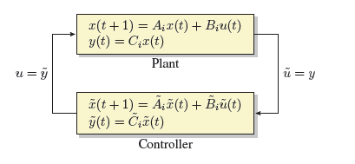
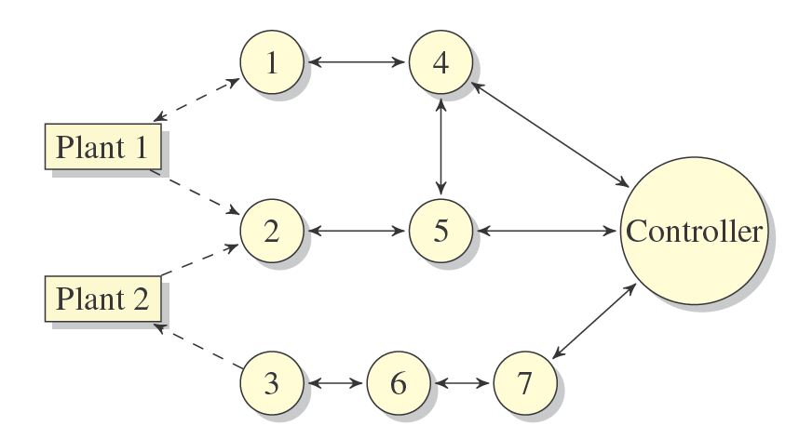
Control over TTA architectures*
Model based
Control design
+
Error can be
computed exactly*
-
TTA Control
Execution
*T. Nghiem, G. Pappas, A. Girard, R. Alur, Time triggered implementations of dynamic controllers, ACM Transactions on Embedded Computing Systems, August 2012.

Slide 27
Approximations across the hierarchy
Task
Programming
Language
Temporal logics
Control
and
Sensing
Control systems
Real-time
computing
Time-triggered architectures
Notes:
27

Slide 28
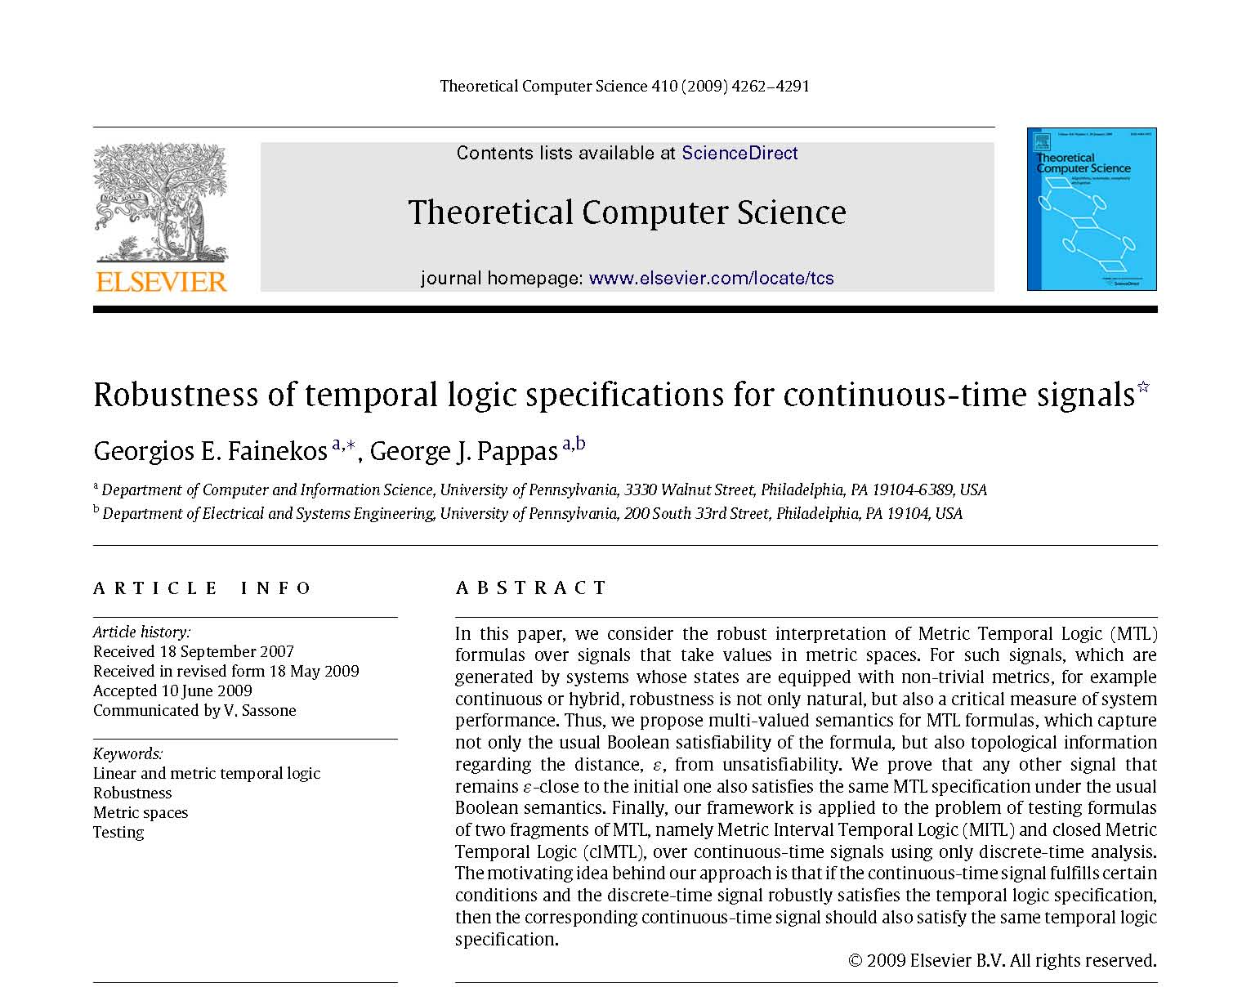
Robustness
Notes:
28

Slide 29
Temporal logics over continuous signals
LTL / MTL
Φ = □(p₁◊_{≤2} p₂)
Boolean Semantics
True, False

Slide 30
Temporal logics over continuous signals
|ε|
|ε|
LTL / MTL
Φ = □(p₁◊_{≤2} p₂)
Boolean Semantics
?

Slide 31
Robust semantics of temporal logics*
|ε|
|ε|
LTL / MTL
Φ = □(p₁◊_{≤2} p₂)
Robust Semantics
*Georgios Fainekos and G. J. Pappas. Robustness of temporal logics over continuous signals, Theoretical Computer Science, 2009.

Slide 32
Robust semantics of temporal logics
|ε|
|ε|
LTL / MTL
Φ = □(p₁Y◊_{≤2} p₂)
Robust Semantics
Intuition: Largest tube that preserves semantics

Slide 33
Impact of TTA on mission planning and control
LTL
φ
If then
φ
Temporal logic
satisfaction
R₂
φ
Temporal logic robustness
TTA Controller
Implementation
R₁

Slide 34
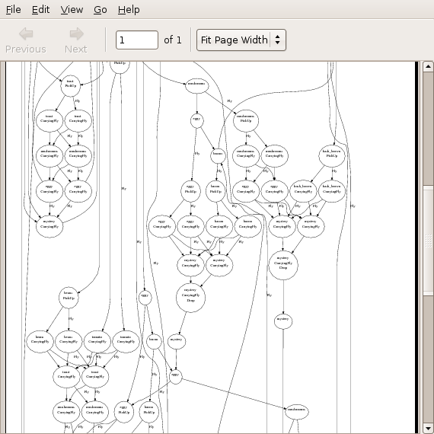
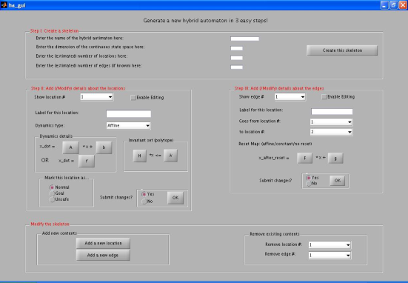
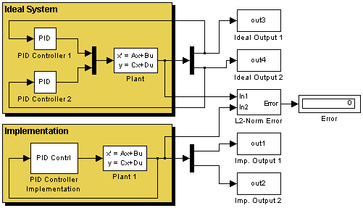
Tools
LTLMOP (Cornell University)
  Temporal logic robot planning and control
PESSOA (U.C.L.A)
  Approximate symbolic control of nonlinear systems
MATISSE (U. Joseph Fourier)
  Approximate bisimulation computations
LTLcon (Boston University)
  LTL control of linear systems
TALIRO (Arizona State, Colorado, NEC Labs)
  Verification using robustness

Slide 35

Future challenges …
Heterogeneous composition of C and P components
Approximation and robustness across C and P domains
Robust interfaces
Quantitative bridges across computing and control
Notes:
35

