Slide 1
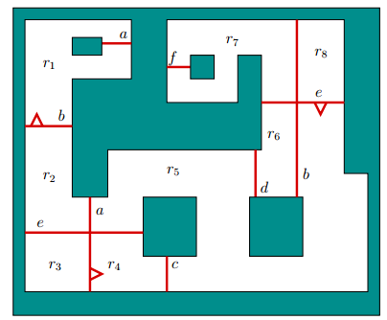
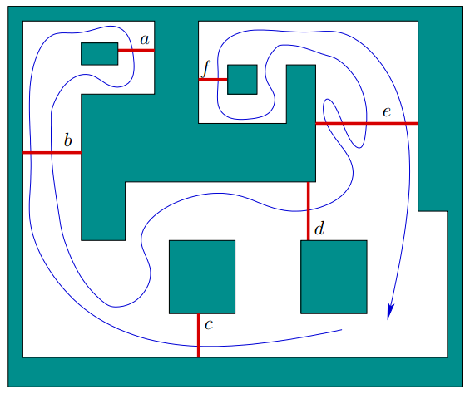
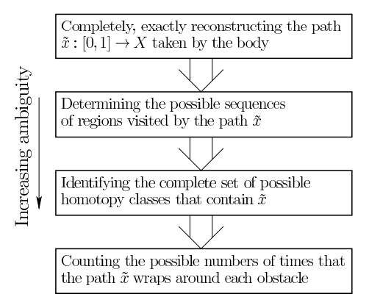
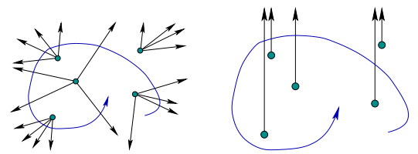
Sensor Lattices*
Steven M. LaValle and Max Katsev University of Illinois at Urbana-Champaign, USA {lavalle,katsev1}@uiuc.edu
Introduction
Sensor Lattices
Think about the devices we build that intermingle sensors, actuators, and computers. Whether they be robot systems, autonomous vehicles, sensor networks, or embedded systems, they are completely blind to the world until we equip them with sensors. All of their accomplishments rest on their ability to sift through sensor data and make appropriate decisions. Therefore, we take a completely sensor-centric view for designing these systems.
It is tempting to introduce the most complete and accurate sensors possible to eliminate uncertainties and learn a detailed, complex model of the surrounding world. We head in the opposite direction by starting with sensing first and then understanding what information is minimally needed to solve specific tasks. If we can accomplish our mission without knowing certain details about the world, then the overall system may be more simple and robust.
An in-depth discussion of these concepts can be found in [1].
The refinement relationship induces a partial order on the set of virtual sensors over a given state space. For example, if $X= ℝ^{2}×𝕊$, then several different forms of distance sensors are possible.
These sensors can be arranged into a lattice with a supremum of an omnidirectional depth sensor.
Suppose sensor $h_{1}:X→Y_{1}$ is a predecessor of a sensor $h_{2}→Y_{2}$. Because $Π\left(h_{1}\right)$ is a refinement of $Π\left(h_{2}\right)$, there exists a function $g:Y_{1}→Y_{2}$ such that $h_{2}\left(x\right)=g\left(h_{1}\left(x\right)\right)$. However, computation of $g$ can be infeasible or simply less practical than using $h_{2}$ from the start.
Omnidirectional Depth Sensor
Boundary Distance Sensor
Shifted Dir. Depth Sensor
K-directional Depth Sensor
Depth-Limited Depth Sensor
Simple Gap Sensor
Proximity Sensor
Boundary Sensor
Directional Depth Sensor
Depth-Limited Gap Sensor
$$h_{2}$$
$X$ $Y_{2}$
$$Y_{1}$$
$$h_{1}$$
$$g$$
Preimages
Beam sensors
Combinatorial filtering
A collection of beam sensors induces a decomposition of the free space X into connected cells. Beams may be directional, may intersect, and may be indistinguishable.
It is possible for the beams to be implemented indirectly, e.g., as lines passing through pairs of landmarks.
While any single beam sensor only provides a bit of information, a sequence of observations (sensor word) allows to recover certain information about the path taken by an agent [3].
We define models of instantaneous sensors, which use the physical state to immediately produce an observation. Let $X$ be any physical state space. Let $Y$ denote the observation space, which is the set of all possible sensor observations. A virtual sensor is defined by a sensor mapping,
$$h:X→Y$$
The interpretation is that when $x∈X$, the sensor instantaneously observes $y=h\left(x\right)∈Y$. To understand what an observation $y$ tells us about the state, we should think about all states $x∈X$ that could have produced the observation. For a given sensor mapping h this is defined as
$$h^{−1}\left(y\right)= \{ x∈X | y=h\left(x\right)\},$$
and is called the preimage of $y$. Because sensor models are usually many-to-one mappings, $h^{−1}\left(y\right)$ is a subset of $X$, which yields all $x$ that map to $y$.
Consider the collection of subsets of $X$ obtained by forming $h^{−1}(y)$ for every $y∈Y$. Since $h$ is a function on all of $X$, the collection of subsets forms a natural partition of $X$, For a given sensor mapping $h$, the corresponding partition is denoted as $Π\left(h\right)$.
Open Problems
What virtual sensor models/families are appropriate for nondeterministic and probabilistic disturbances? (Perhaps generalizing the approach in [2].)
What kind of sensor images can be explicitly computed? This sometimes trivial (distance from a fixed sensor tower), and sometimes very difficult (preimages for the directional depth sensor).
What is the cost of emulating one sensor with another? Even if a sensor can emulate a weaker sensor, it may not be able to do so efficiently. It is possible that there exist a pair of sensors where emulation of the weaker sensor by the stronger sensor is non-computable.
[1] S. M. LaValle. Sensing and filtering: A tutorial based on preimages and information spaces. Foundations and Trends in Robotics, 2011.
[2] R. He, S. Prentice, and N. Roy. Planning in information space for a quadrotor helicopter in a gps-denied environment. In Proc. IEEE International Conference on Robotics and Automation, 2008.
[3] B. Tovar, F. Cohen, L. Bobadilla, J. Czarnowski, and S. M. LaValle. Combinatorial ﬁlters: Sensor beams, obstacles, and possible paths. ACM Transactions on Sensor Networks, 2013. To appear.
* This research was supported in part by NSF grant 1035345 (Cyberphysical Systems).

