Slide 1
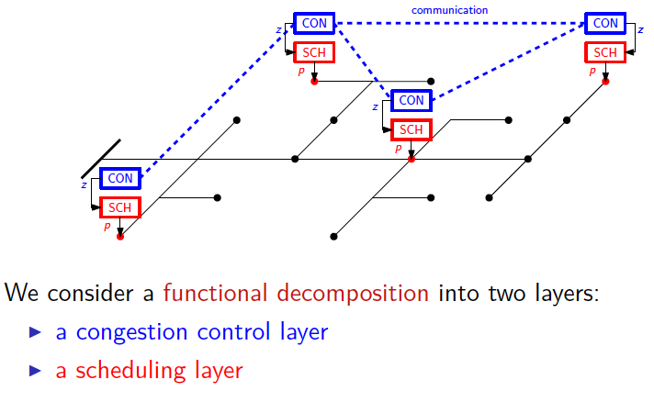
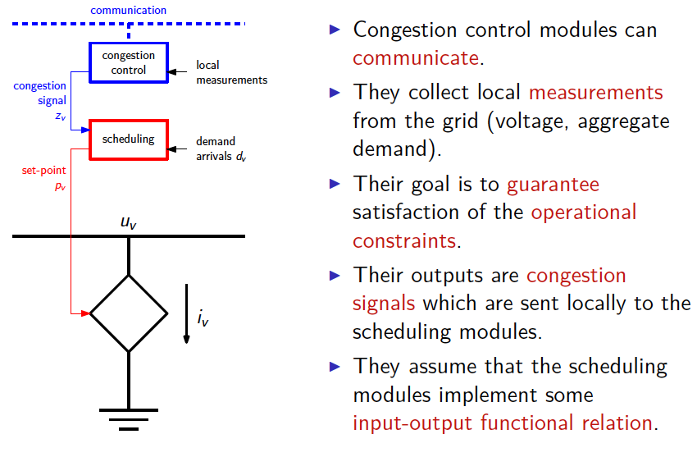
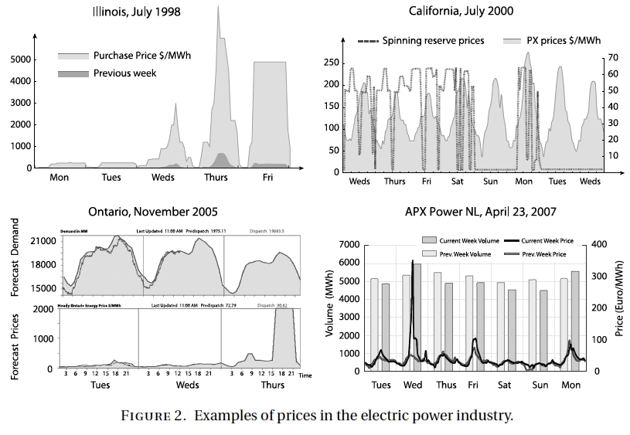
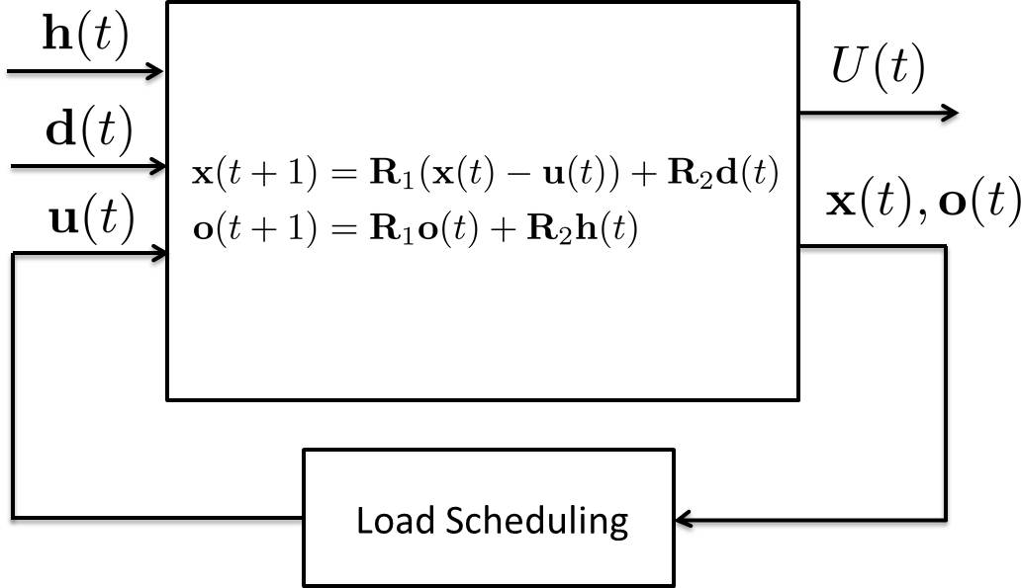
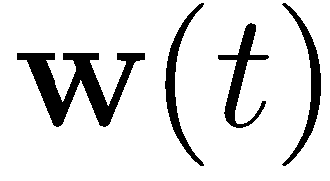

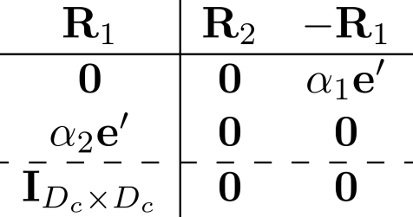

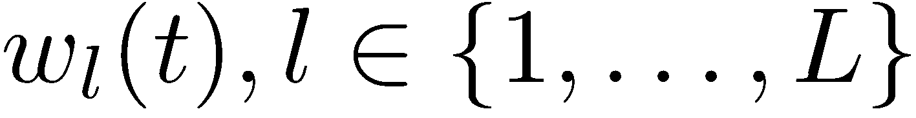



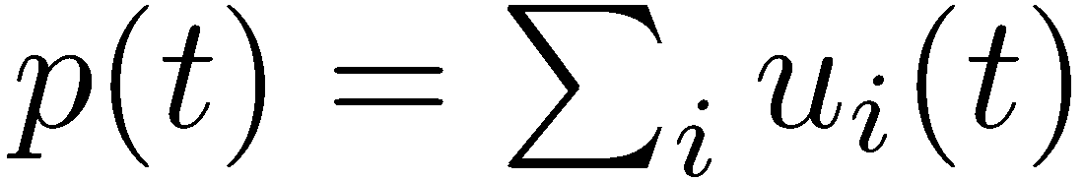



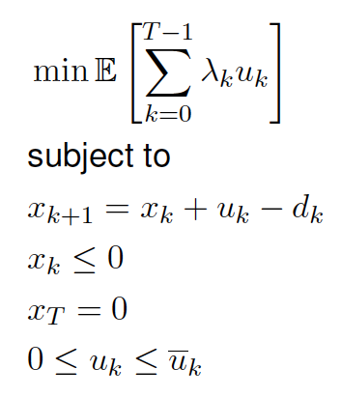

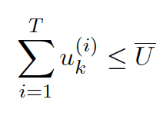

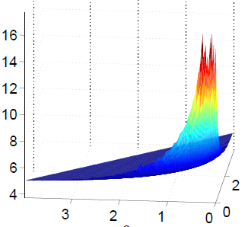


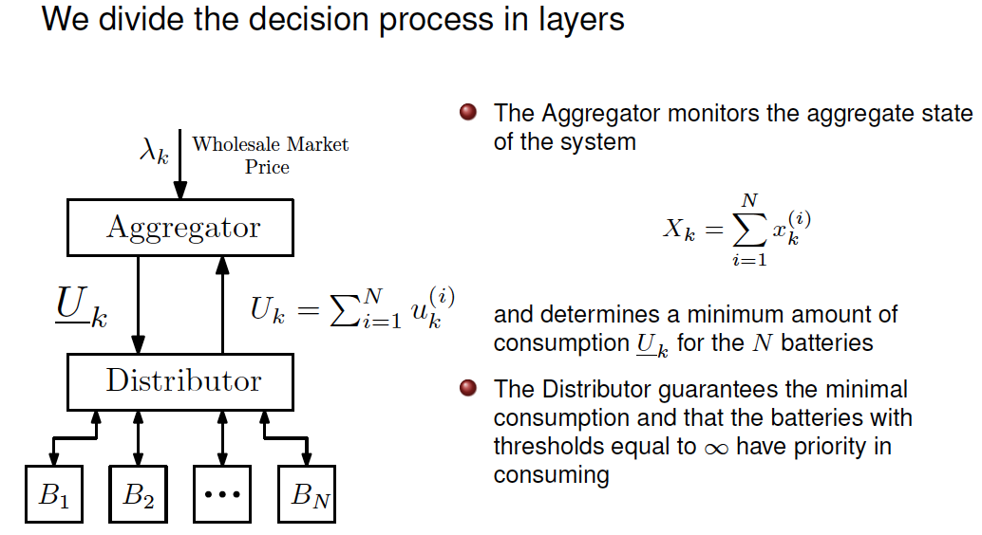
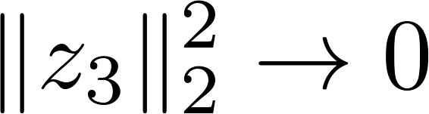

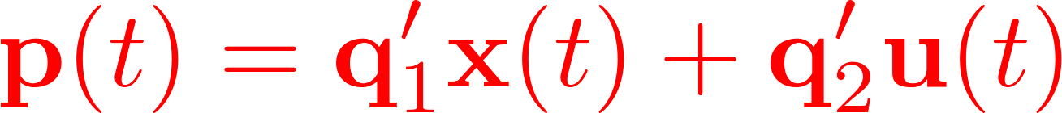

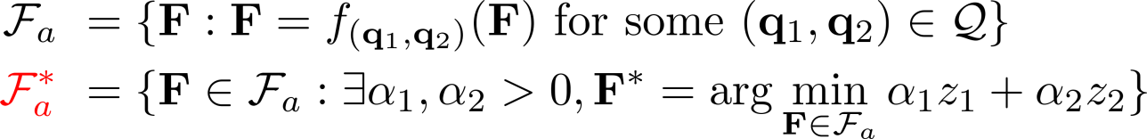
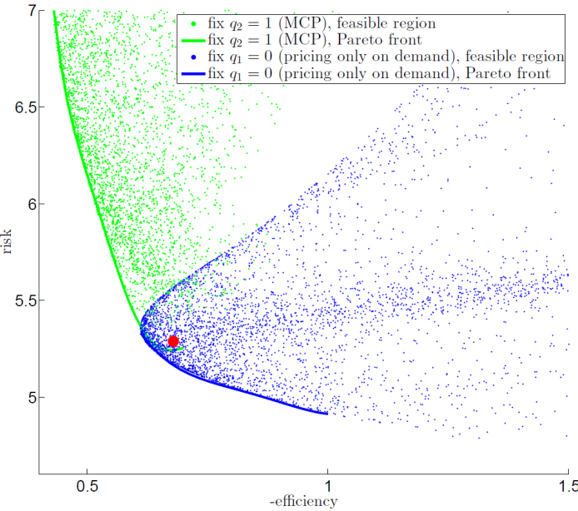
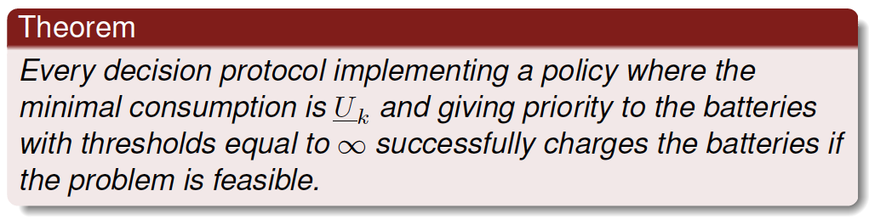


Smart Power Systems of the Future: Foundations for Understanding
Volatility and Improving Operational Reliability
Sean Meyn
University of Florida
Munther Dahleh, Mardavij Roozbehani, Sanjoy Mitter
Massachusetts Institute of Technology
Alejandro Dominguez Garcia
University of Illinois at Urbana-Champaign
Power Systems Are Large-Scale, Multi-Layer, Multi-Rate,
Cyber-Physical Networks
Model
Comparison of Two Architectures
Architectures for Congestion Control and Scheduling
System
architecture
Demand
response
Welfare
exogenous disturbances
Market
state: backlogged loads
of existing agents
supply schedule = aggregate demand
Consumer
Non-cooperative
More conservative
Less efficient
Low risk
state information
absorbing exogenous disturbances
u(t)
Dynamic
demand scheduling
Cooperative
More
aggressive
More efficient
High risk
Consumer
Complex intra-layer and cross-layer interactions pose challenges for analysis/design
Introduction of new feedback loops can help mitigate some disturbances but can also lead to new fragilities
Supply volatility will increase, leading to rapidly varying system configurations, undermining system reliability
Characteristics:
stringent deadlines, time-varying resource requirement, dynamics
System architectural properties
    Cooperative / non-cooperative
    Pricing method
    Risk sensitivity
    Information
Load-shifting Model Setup
Approximations:
  Study the limit case: arrival rate q = 1
  Use variance of aggregate backlog as a substitute measure of risk
  Normalization to mean zero processes
Agent arrival:
L types (deadline constraint)
Uncertainty
- Bernoulli arrival
- Workload distribution
1
t
3
1
t+1
Locational Marginal Prices at PJM/MISO 07-April-2011 13:45 EST
Marginal cost pricing with quadratic cost
2
t+2
1
t+3
Non-linear →
Linear time-invariant
Price volatility may increase or lead to demand volatility, undermining system reliability
This project addresses the impact of the integration of renewable intermittent generation and the integration of sophisticated sensing, communication, and actuation capabilities into the grid on the system’s reliability, volatility, and economic efficiency.
2
  Decision process and dynamics:
  Each agent participates in a finite window
  Agent schedules demand to minimize his expected total payment
Operator’s problem
Full Automation
Solutions
3-way tradeoff
  : closed loop norm of aggregate demand (-efficiency)
  : closed loop norm of aggregate backlog (risk)
  : closed loop norm of aggregate load mismatch upon deadline
How will increased volatility impact the grid? How should the architecture of the future grid be designed so as to accommodate renewables at large scale? What are the fundamental limits and the tradeoffs?
How do we systematically think about markets, incentives, policy, and their interactions with physical constraints in a new energy landscape?
Non-cooperative
Cooperative
Dynamic stochastic game
Markov perfect equilibrium
  Infinite horizon average cost MDP
The best Pareto front
Under any market architecture
Aggregate demand sample path
spikes
Cooperative
Non-cooperative
  when , the deadline constraints are enforced
Efficiency and Risk in Distributed Control with Strategic Complementarity
Decision making in multi-agent systems:
Well-known: strategic complementarity leads to efficiency loss
-- In an uncertain environment: efficiency ~ absorbing exogenous shocks
Multi agent collaboration can reduce externality,
-- but also create endogenous risks
-- System can become more vulnerable to severe exogenous shocks
  : closed loop norm of aggregate demand (-efficiency)
  : closed loop norm of aggregate backlog (risk)
  pricing policies class
  inducible agent response
  Pareto efficient agent response
  Pareto efficient pricing policies
small time scale
large time scale
Risk
Cooperative
Robust (low variance) yet fragile (fat tail)
In smart grid, real time electricity pricing and consumer side
load shifting may help absorb supply / demand uncertainties.
Consumer interaction may translate exogenous uncertainties to endogenous risk.
Price of
Coordination?
Non-cooperative
Inefficiency
L=3
Price of Anarchy

