Slide 1
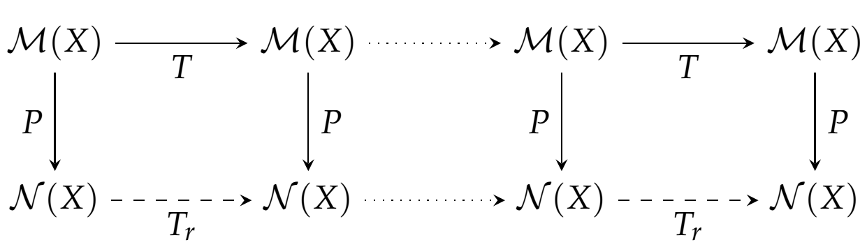
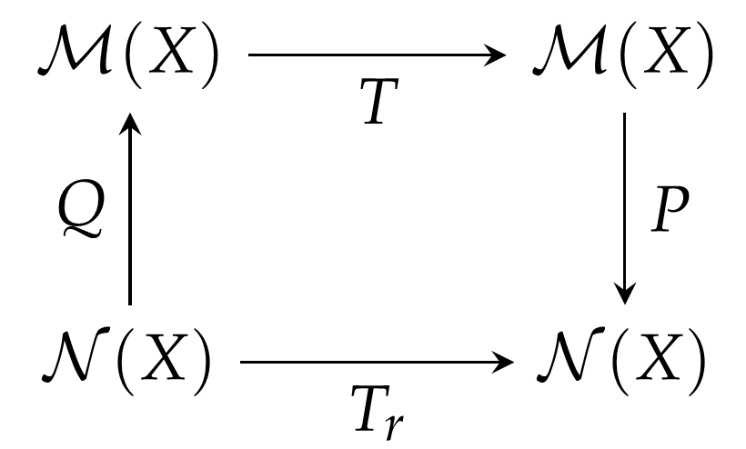


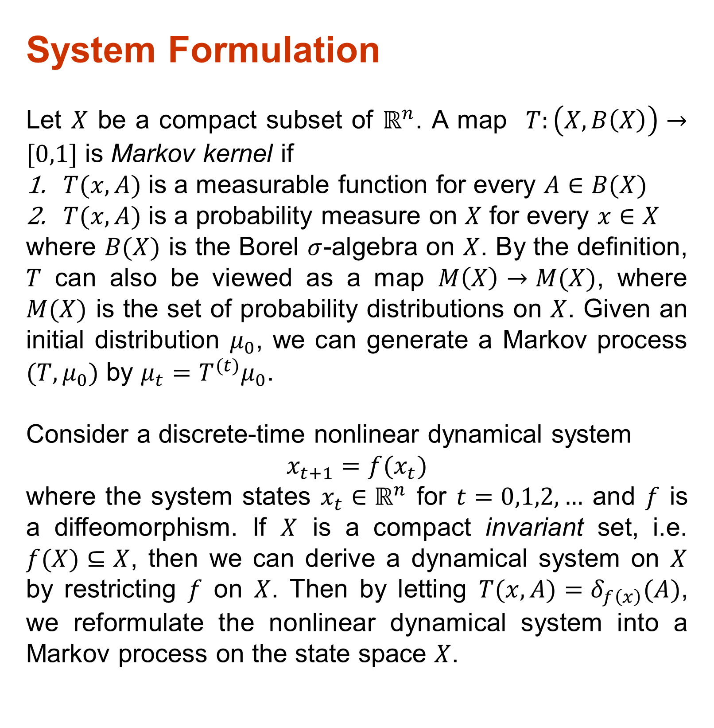
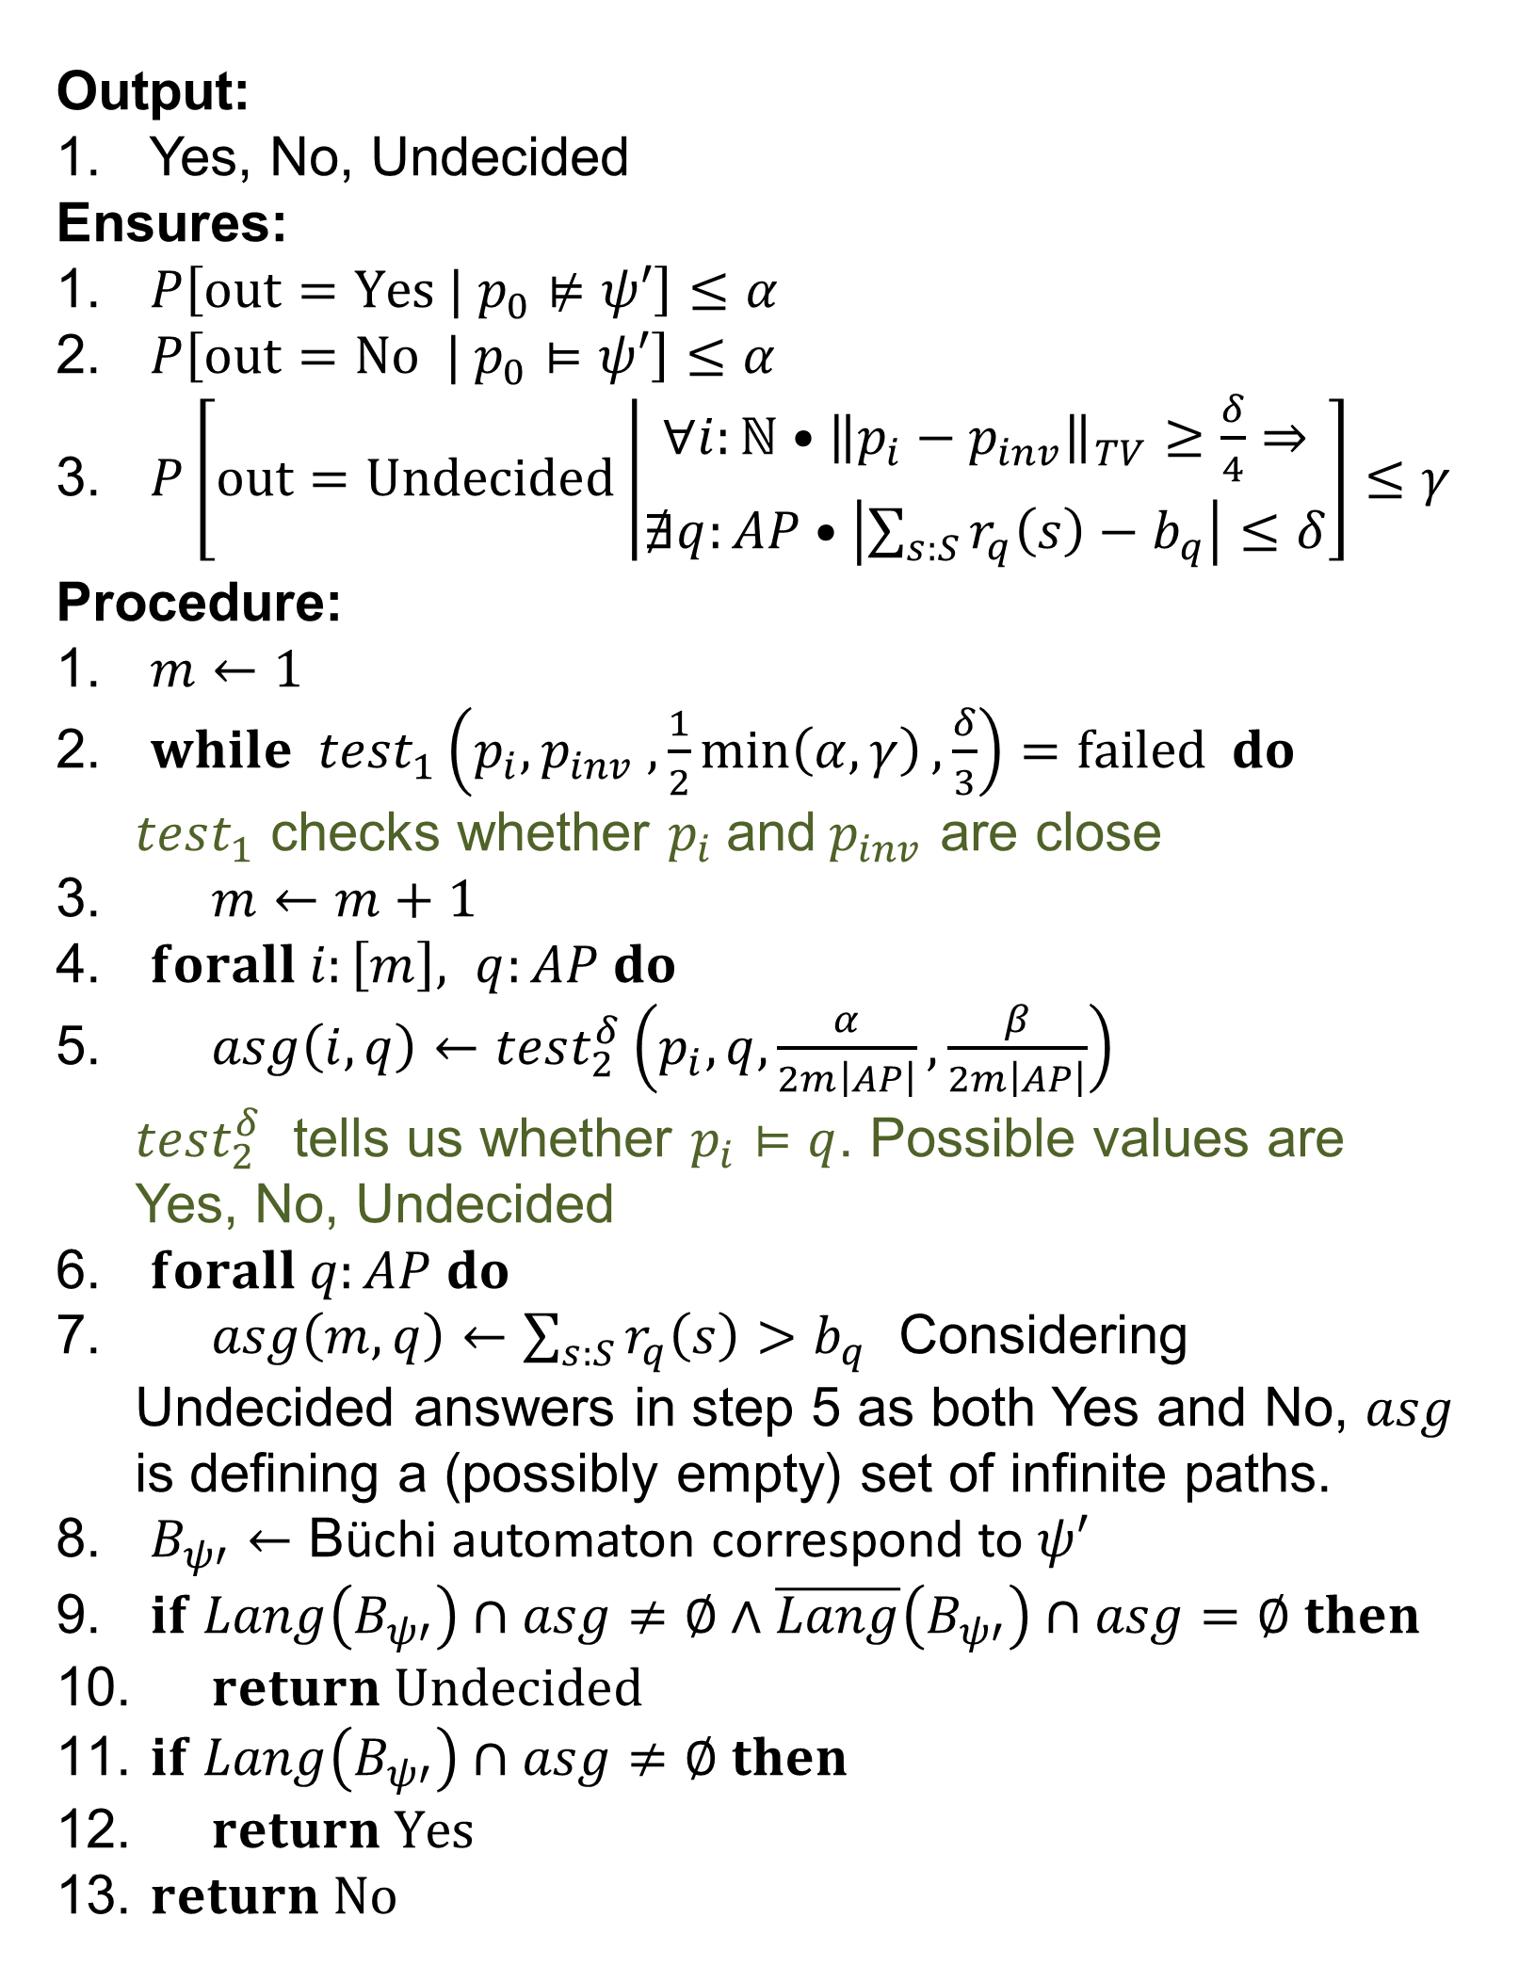
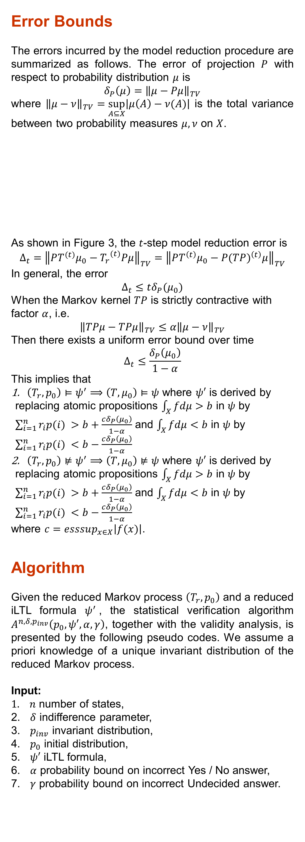
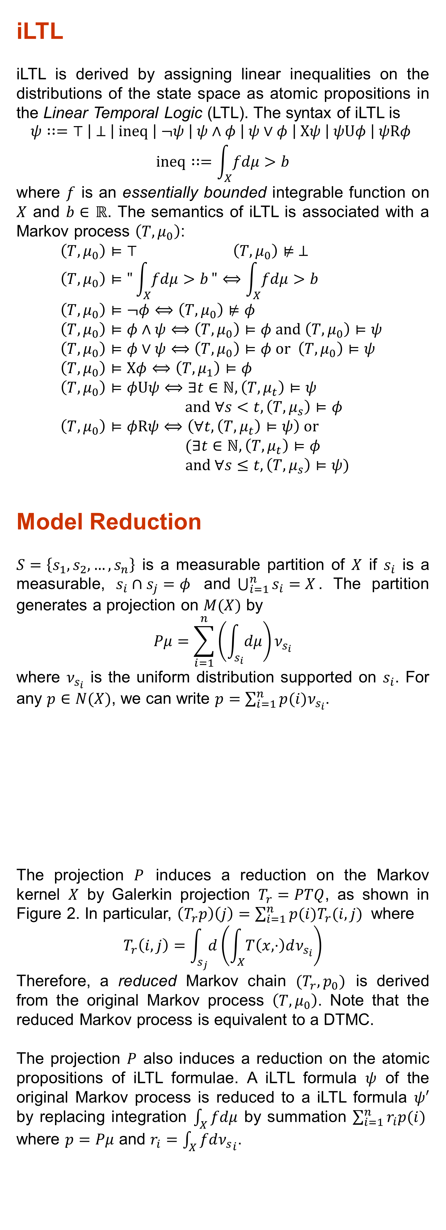
Statistical Verification of Dynamical Systems Using Set Oriented Methods
Yu Wang, Nima Roohi, Matthew West, Mahesh Viswanathan, Geir Dullerud
Coordinate Science Laboratory, Department of Computer Science, Department of Mechanical Science and Engineering, University of Illinois at Urbana-Champaign
Introduction
Modeling, analyzing and verifying real physical systems have long been a changeling task since the dynamics are usually nonlinear and the state spaces are always continuous. In this work, we use linear inequality LTL (iLTL), a temporal logic, to specify the behavior of nonlinear dynamical systems over time and propose a framework for statistical verification of temporal formulae on nonlinear systems using set oriented methods. As shown in Figure 1, a discrete-time nonlinear dynamical system is first transformed into a Markov process on the continuous state space. Then the Markov process is reduced to a new Markov process that is equivalent to a discrete time Markov chain (DTMC), using set oriented method. Furthermore, the iLTL formulae of the original Markov chain are also reduced to iLTL formulae of the new Markov chain. Finally, the reduced iLTL formulae are verified using a statistical model checker. The correctness of this framework is guaranteed by combining the errors introduced in every step. We point out that this framework have may also extend to the study of hybrid systems.
iLTL
iLTL is derived by assigning linear inequalities on the distributions of the state space as atomic propositions in the Linear Temporal Logic (LTL). The syntax of iLTL is
$$\begin{matrix}ψ∷=⊤ \left| ⊥ \right| ineq \left| ¬ψ \right| ψ∧φ \left| ψ∨φ \right| Xψ \left| ψUφ \right| ψRφ \\ ineq∷=\int_{X}{fdμ>b}\end{matrix}$$
where $f$ is an essentially bounded integrable function on $X$ and $b∈$ $ℝ$. The semantics of iLTL is associated with a Markov process $\left(T, μ_{0}\right)$:
  $$\left(T, μ_{0}\right)⊨⊤ \left(T, μ_{0}\right)⊭ ⊥$$
  $$\left(T, μ_{0}\right)⊨"\int_{X}{fdμ>b}"⟺\int_{X}{fdμ>b}$$
  $$\left(T, μ_{0}\right)⊨¬φ⟺\left(T, μ_{0}\right)⊭φ$$
  $$\left(T, μ_{0}\right)⊨φ∧ψ⟺\left(T, μ_{0}\right)⊨φ and \left(T, μ_{0}\right)⊨ψ$$
  $$\left(T, μ_{0}\right)⊨φ∨ψ⟺\left(T, μ_{0}\right)⊨φ or \left(T, μ_{0}\right)⊨ψ$$
  $$\left(T, μ_{0}\right)⊨Xφ⟺\left(T, μ_{1}\right)⊨φ$$
  $$\left(T, μ_{0}\right)⊨φUψ⟺∃t∈ℕ,\left(T, μ_{t}\right)⊨ψ$$
  $$and ∀s<t,\left(T, μ_{s}\right)⊨φ$$
  $$\left(T, μ_{0}\right)⊨φRψ⟺\left(∀t, \left(T, μ_{t}\right)⊨ψ\right) or$$
  $$(∃t∈ℕ,\left(T, μ_{t}\right)⊨φ$$
  $and ∀s≤t,\left(T, μ_{s}\right)⊨ψ)$
Model Reduction
$S=\left\{s_{1},s_{2},…,s_{n}\right\}$ is a measurable partition of $X$ if $s_{i}$ is a measurable, $s_{i}∩s_{j}=φ$ and$\bigcup_{i=1}^{n}{s_{i}}=X$. The partition generates a projection on $M(X)$ by
$$Pμ=\sum_{i=1}^{n}{\left(\int_{s_{i}}{dμ}\right)}ν_{s_{i}}$$
where $ν_{s_{i}}$ is the uniform distribution supported on $s_{i}$. For any $p∈N(X)$, we can write $p=\sum_{i=1}^{n}{p(i)ν_{s_{i}}}$.
The projection $P$ induces a reduction on the Markov kernel $X$ by Galerkin projection $T_{r}=PTQ$, as shown in Figure 2. In particular, $\left(T_{r}p\right)\left(j\right)=\sum_{i=1}^{n}{p(i)T_{r}(i,j) }$ where
$$T_{r}\left(i,j\right)=\int_{s_{j}}{d}\left(\int_{X}{T\left(x,⋅\right)dν_{s_{i}}}\right)$$
Therefore, a reduced Markov chain $(T_{r},p_{0})$ is derived from the original Markov process $\left(T, μ_{0}\right)$. Note that the reduced Markov process is equivalent to a DTMC.
The projection $P$ also induces a reduction on the atomic propositions of iLTL formulae. A iLTL formula $ψ$ of the original Markov process is reduced to a iLTL formula $ψ′$ by replacing integration $\int_{X}{fdμ}$ by summation $\sum_{i=1}^{n}{r_{i}p(i) }$ where $p=Pμ$ and $r_{i}=\int_{X}{fd{ν_{s}}_{i}}$.
Error Bounds
The errors incurred by the model reduction procedure are summarized as follows. The error of projection $P$ with respect to probability distribution $μ$ is
$$δ_{P}\left(μ\right)={\left\|μ−Pμ\right\|}_{TV}$$
where ${\left\|μ−ν\right\|}_{TV}=\sup_{A⊆X}\left|μ\left(A\right)−ν(A)\right|$ is the total variance between two probability measures $μ,ν$ on $X$.
As shown in Figure 3, the $t$-step model reduction error is
$$Δ_{t}={\left\|PT^{(t)}μ_{0}−{T_{r}^{}}^{(t)}Pμ\right\|}_{TV}={\left\|PT^{\left(t\right)}μ_{0}−P{(TP)}^{\left(t\right)}μ\right\|}_{TV}$$
In general, the error
$Δ_{t}≤tδ_{P}(μ_{0})$
When the Markov kernel $TP$ is strictly contractive with factor $α$, i.e.
$${\left\|TPμ−TPμ\right\|}_{TV}≤α{\left\|μ−ν\right\|}_{TV}$$
Then there exists a uniform error bound over time
$$Δ_{t}≤\frac{δ_{P}\left(μ_{0}\right)}{1−α}$$
This implies that
$\left(T_{r}, p_{0}\right)⊨ψ^{′}⟹\left(T, μ_{0}\right)⊨ψ$ where $ψ′$ is derived by replacing atomic propositions $\int_{X}{fdμ>b}$ in $ψ$ by $\sum_{i=1}^{n}{r_{i}p(i) }>b+\frac{cδ_{P}\left(μ_{0}\right)}{1−α}$ and $\int_{X}{fdμ<b}$ in $ψ$ by $\sum_{i=1}^{n}{r_{i}p(i) }<b−\frac{cδ_{P}\left(μ_{0}\right)}{1−α}$
$\left(T_{r}, p_{0}\right)⊭ψ^{′}⟹\left(T, μ_{0}\right)⊭ψ$ where $ψ′$ is derived by replacing atomic propositions $\int_{X}{fdμ>b}$ in $ψ$ by $\sum_{i=1}^{n}{r_{i}p(i) }>b+\frac{cδ_{P}\left(μ_{0}\right)}{1−α}$ and $\int_{X}{fdμ<b}$ in $ψ$ by $\sum_{i=1}^{n}{r_{i}p(i) }<b−\frac{cδ_{P}\left(μ_{0}\right)}{1−α}$
where $c=esssup_{x∈X}\left|f(x)\right|$.
Algorithm
Given the reduced Markov process $\left(T_{r}, p_{0}\right)$ and a reduced iLTL formula $ψ^{′}$, the statistical verification algorithm $A^{n,δ,p_{inv}}\left(p_{0},ψ′, α, γ\right)$, together with the validity analysis, is presented by the following pseudo codes. We assume a priori knowledge of a unique invariant distribution of the reduced Markov process.
Input:
$n$ number of states,
$δ$ indifference parameter,
$p_{inv}$ invariant distribution,
$p_{0}$ initial distribution,
$ψ′$ iLTL formula,
$α$ probability bound on incorrect Yes / No answer,
$γ$ probability bound on incorrect Undecided answer.
Output:
Yes, No, Undecided
Ensures:
$P\left[out=Yes | p_{0}⊭ψ′\right]≤α$
$P\left[out=No | p_{0}⊨ψ′\right]≤α$
$P\left[out=Undecided\left|\begin{matrix}∀i:ℕ•{\left\|p_{i}−p_{inv}\right\|}_{TV}≥\frac{δ}{4}⇒ \\ ∄q:AP•\left|\sum_{s:S}{r_{q}\left(s\right)}−b_{q}\right|≤δ\end{matrix}\right.\right]≤γ$
Procedure:
$m←1$
$while test_{1}\left(p_{i}, p_{inv} ,\frac{1}{2}\min\left(α, γ\right),\frac{δ}{3}\right)=failed do$
$test_{1}$ checks whether $p_{i}$and$p_{inv}$ are close
$m←m+1$
$forall i:\left[m\right], q:AP do$
$asg\left(i,q\right)←test_{2}^{δ}\left(p_{i},q,\frac{α}{2m\left|AP\right|},\frac{β}{2m\left|AP\right|}\right)$
$test_{2}^{δ}$ tells us whether $p_{i}⊨q$. Possible values are Yes, No, Undecided
$forall q:AP do$
$asg\left(m,q\right)←\sum_{s:S}{r_{q}\left(s\right)}>b_{q}$ Considering Undecided answers in step 5 as both Yes and No, $asg$ is defining a (possibly empty) set of infinite paths.
$B_{ψ′}←$ Büchi automaton correspond to $ψ′$
$if Lang\left(B_{ψ′}\right)∩asg≠∅∧\overline{Lang}\left(B_{ψ′}\right)∩asg=∅ then$
$return Undecided$
$if Lang\left(B_{ψ′}\right)∩asg≠∅ then$
$return Yes$
$return No$
Figure 3. Diagram for t-step Galerkin projection
Conclusions
In this work, we proposed a framework for statistical verification of temporal formulae on nonlinear systems using the set oriented model reduction methods. Using the uniform bound on the model reduction error, we rigorously linked model reduction and statistical verification together. In addition, we proposed a statistical verification algorithm for iLTL, and proved the validity of the algorithm.
Figure 1. Flow chart for this work
System Formulation
Let $X$ be a compact subset of $ℝ^{n}$. A map $T:\left(X,B\left(X\right)\right)→[0,1]$ is Markov kernel if
$T(x,A)$ is a measurable function for every $A∈B(X)$
$T(x,A)$ is a probability measure on $X$ for every $x∈X$
where $B(X)$ is the Borel $σ$-algebra on $X$. By the definition, $T$ can also be viewed as a map $M\left(X\right)→M(X)$, where $M(X)$ is the set of probability distributions on $X$. Given an initial distribution $μ_{0}$, we can generate a Markov process $(T,μ_{0})$ by $μ_{t}=T^{(t)}μ_{0}$.
Consider a discrete-time nonlinear dynamical system
$$x_{t+1}=f(x_{t})$$
where the system states $x_{t}∈ℝ^{n}$ for $t=0,1,2,…$ and $f$ is a diffeomorphism. If $X$ is a compact invariant set, i.e. $f(X)⊆X$, then we can derive a dynamical system on $X$ by restricting $f$ on $X$. Then by letting $T(x,A)=δ_{f\left(x\right)}(A)$, we reformulate the nonlinear dynamical system into a Markov process on the state space $X$.
Figure 2. Diagram for single-step Galerkin projection
Acknowledgments
The authors acknowledge support for this work from NSF CPS grant 1329991. Program Manager:
Dr. David Corman.

