Slide 2
Technologies for Cyber-Physical Systems
Dr. James Truchard
President, CEO and Cofounder
National Instruments

Slide 3
What are Cyber-Physical Systems?
CPS deeply integrate computation, communication, and control into physical systems
CPS exploit pervasive, networked computation, sensing, and control, i.e., “Internet of [controlled] things”
“CPS will transform how we interact with the physical world just like the Internet transformed how we interact with one another.” *
* CPS Summit Website:
http://varma.ece.cmu.edu/summit/index.html

Slide 4
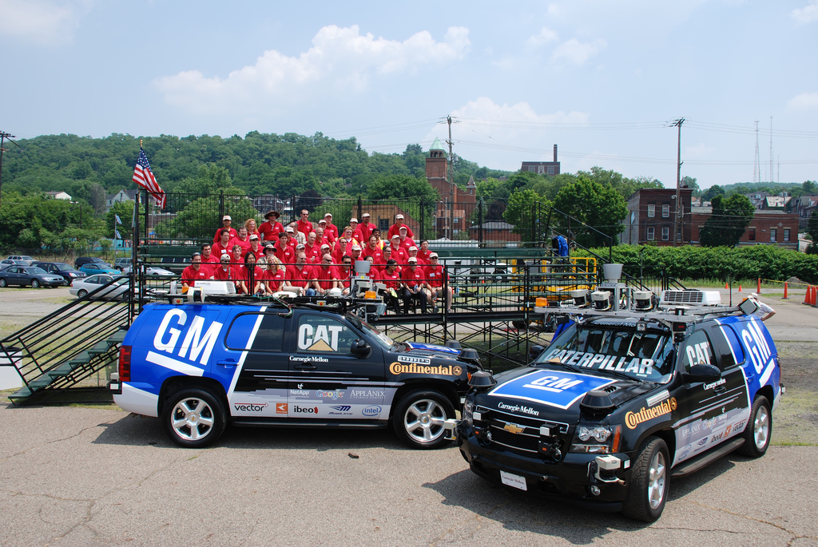
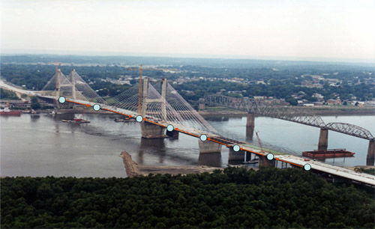
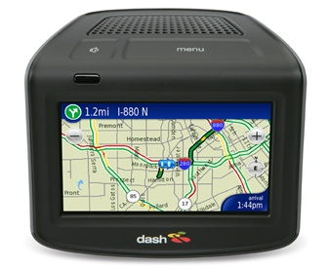
CPS: An Example at Multiple Scales
A BMW is “now actually a network of computers”
[R. Achatz, Seimens, The Economist, Oct. 11, 2007]
Autonomous Cars
Credit: PaulStamatiou.com
Smart Infrastructure
Credit: MO Dept. of Transportion.
Lampson’s Grand Challenge:
Reduce traffic deaths to zero
[B. Lampson, Getting Computers to Understand, Microsoft, J. ACM, 50:1, pp. 70-72, Jan., 2003]
Credit: Dash Navigation, Inc.
Cars as nodes in a network

Slide 5


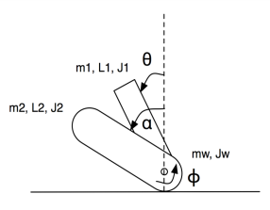
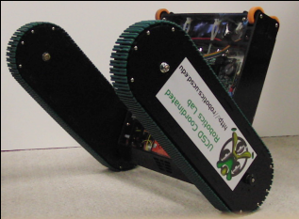
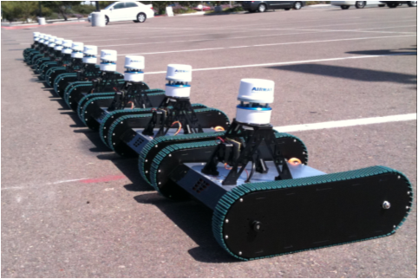
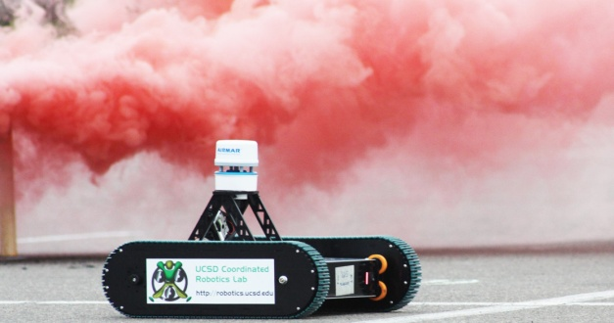
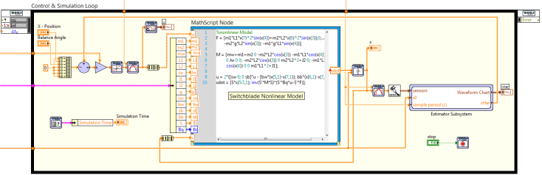
Multi-Modal Rover for Environmental Monitoring & Search and Rescue
Coordinated Robotics Lab
Coordinated control for monitoring & prediction

Slide 6
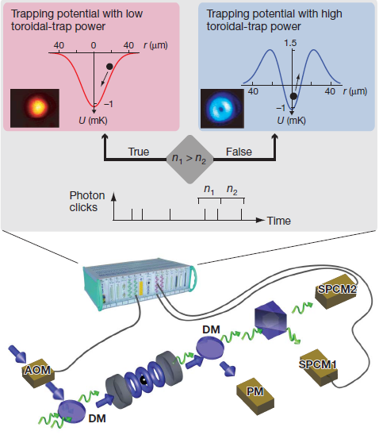
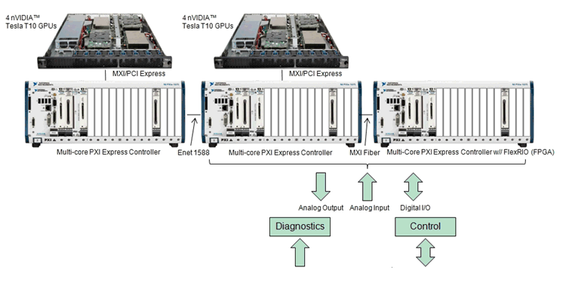
Quantum Optics Enabled by FPGA
Extremely demanding Quantum Optics simulation/HIL/control
Manipulation of trapped atoms & ions
12 European universities + industry
$5M funding (Curie)
10 MHz Closed-Loop Control

Slide 7
Graphical System Design Opportunity
Test and Measurement
Embedded
Virtual Instrumentation
Automated Test
Data Acquisition
Reconfigurable Instruments
Real-Time Measurements
Embedded Monitoring
Hardware-in-the-Loop
Industrial Control (PAC)
Machine Control
Electronic Devices
Software-Defined Radio
“To do for test and measurement
what the spreadsheet did for financial analysis.”
“To do for embedded what the PC did for the desktop.”

Slide 8
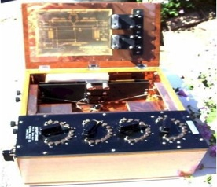
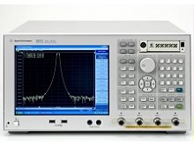
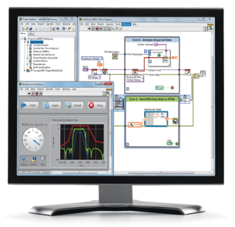
Evolution of Instrumentation
Vacuum Tube
Transistor
(Integrated Circuit)
Software
General Radio
Hewlett Packard
National Instruments
1920
1965
2010
Notes:
Tools for engineers and scientists have always leveraged the technology of the era. The era we live in today is all about software, the interface between human beings and the equipment, machines, and the devices we use. Graphical system design and this software-centric platform-based approach is the technology for measurement and control that gives you the best productivity for building systems today and scalability to meet future needs.

Slide 9
Expanding Measurement Capabilities
26
24
22
20
Accuracy (Bits)
18
16
14
12
10
8
6
4
1
10
100
1K
10K
100K
1M
10M
100M
1G
10G
100G
Sampling Rate (S/s)
NI Products, 1995
NI Products, 2004
NI Products, 2011
Traditional Instruments

Slide 10
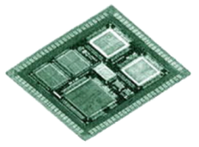
Concurrent Design and Test
System-Level Design
System-Level Test
Modeling & Analysis
Cyber-Physical
Shared IP & Data
Hardware-in-the-Loop
Model-in-the-Loop
Protocol-Aware
Component-Level Design
Component-Level Test
Stimulus/response
(test vectors)
Component design optimization
Component Prototyping
BIST
JTAG Boundary Scan
Implementation (SOC/SIP)

Slide 11
Parallel Architectures Drive Performance
5,000
5,000
6.737 TMACS
FPGA
Performance
(GMACs)
500
500
FPGAs
CPUs
CPU
Performance
(GFLOPs)
50
50
5
5
1997
1999
2001
2002
2004
2005
2006
2009
2010
2011

Slide 12
Number of Engineering Undergraduate Degrees Awarded Per Year
(estimated)
from National Science Foundation S&E degree data

Slide 13
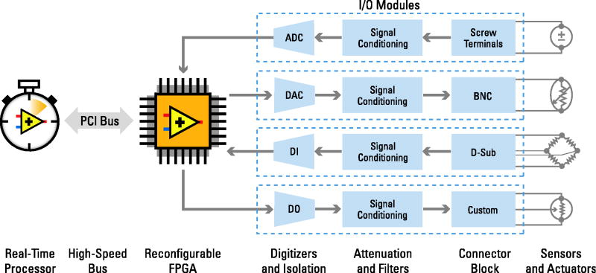


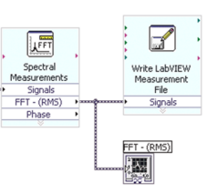
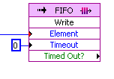

Heterogeneous Computing
Processor
Computing
Multicore programming
Sequential and
concurrent computation
High-level analysis,
control and communication
Existing C, textual math (.m) IP
FPGA
Computing
Inherently parallel
Predictable timing
Low-level, high-speed analysis, control, and communication
Existing VHDL IP
Memory
Memory
High-speed data transfer
Tight timing & synchronization of I/O
DAC
ADC
Processor
NI ASIC
FPGA
I/O

Slide 14
Traditional Design Process
Domain Experts
Packaging
designers
Software
designers
FPGA
designers
ASIC/SoC
designers
Custom IC
designers

Slide 15
Graphical System Design
Domain Experts
Domain
experts
Packaging
designers
Software
designers
FPGA
designers
ASIC/SoC
designers
System
designers
Custom IC
designers

Slide 16
Transitioning from Prototype to High-Volume
Domain Experts
Domain
experts
Domain
experts
Packaging
designers
Packaging
designers
System
designers
Software
designers
FPGA
designers
ASIC/SoC
designers
ASIC
designers
System
designers
Custom IC
designers
Platform
designers

Slide 17
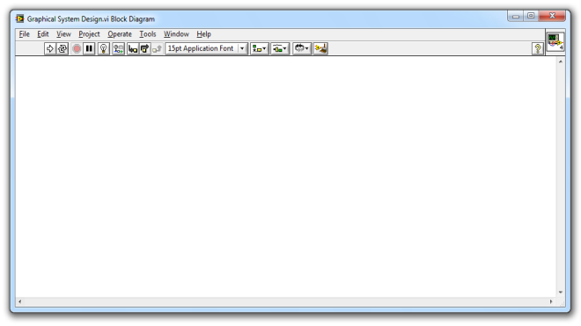
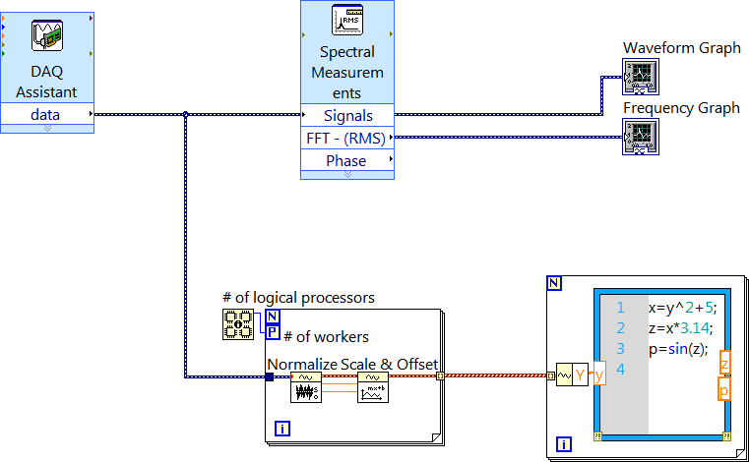
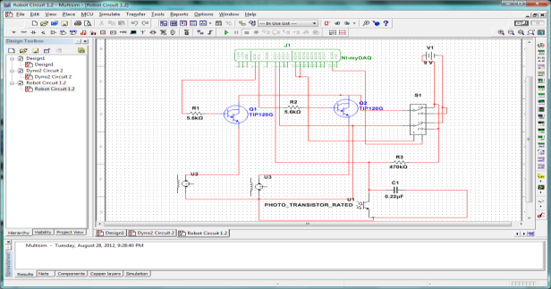
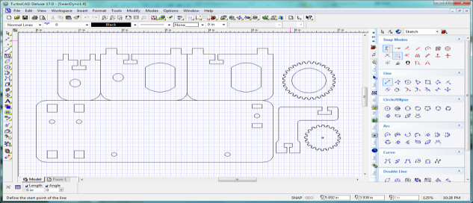
System Design
ADE
CAD
Graphical
EDA

Slide 18
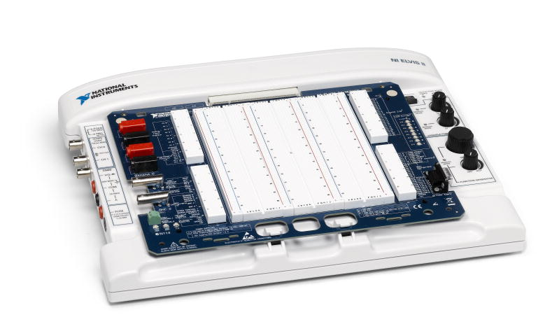
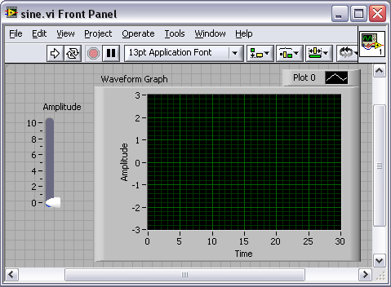
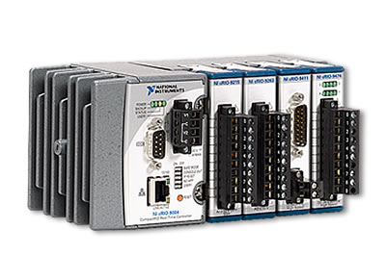
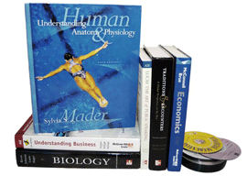
Graphical System Design
Community
K-8 High school College University Research
Graphical System Design
Theory
Design / Simulate
Prototype
Deploy
Curriculum
Integration
Real World
I/O
Integration
Industry
Relevant
Integration

Slide 19
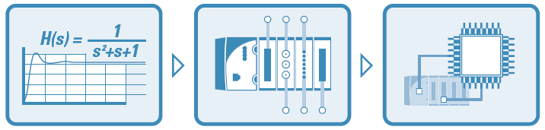
Graphical System Design
Design
Prototype
Deploy
Algorithm Design + Prototyping =
Algorithm Engineering
Notes:
We define the tasks associated with Algorithm Design and Prototyping as “Algorithm Engineering”.

Slide 20
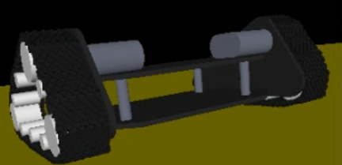
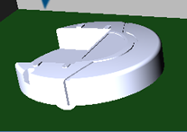
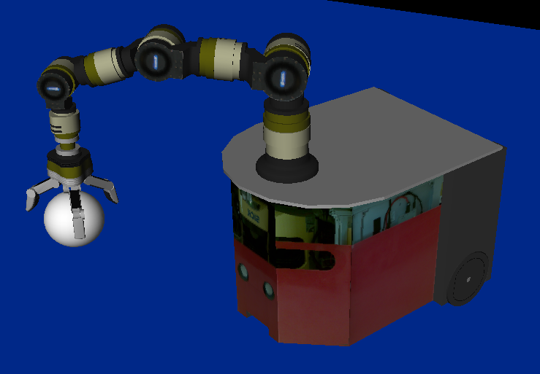
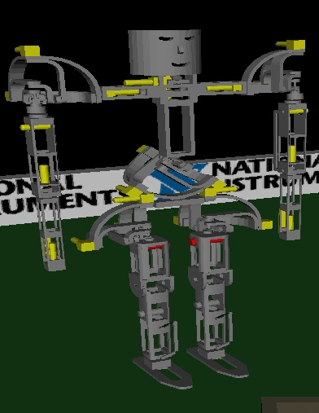
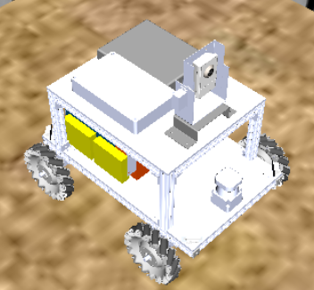
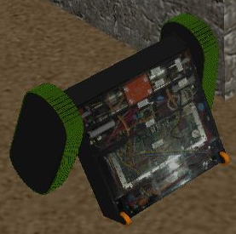
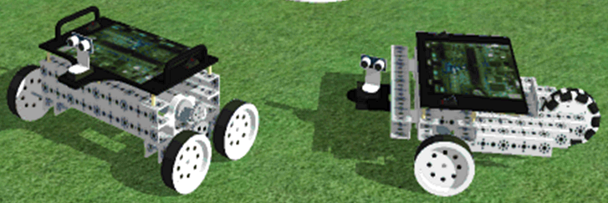
Notes:
Some released robots

Slide 21
Algorithm Engineering by Model-Based Design
Platform Dependent
Platform Independent
Platform Dependent
Simulated Sensors
Simulation
Environment
Simulated Actuators
Control Algorithm
Common Interface
Common Interface
Real
Sensors
Real
Actuators
Real-World
Environment

Slide 22
Scalable Software Abstraction
System Design Platform
C#
C++
Abstraction
C
Assembly Language
Machine Code
System Complexity
Notes:
The problems today need higher level tools. Gone are the days where we could simply throw more people at the problem, more resources. Tools not only need to keep pace with the latest high performance technologies available, but they need to make them accessible through higher levels of abstraction.
Imagine if you were all required to become thread experts in order to build a system that used a multicore processor. How much training would you need? How many experts would it take? This is not only the benefit of a tool like LabVIEW, but it also identifies the absolute necessity to be using a system level design tool to build real-world systems.

Slide 23
Academic Foundations to Strong Ecosystems
UC Berkeley
Berkeley SPICE1 (1973)
EDA Design Tools (1980s)
Synchronous Dataflow (1986)
Ptolemy I (1990)
Boolean Dataflow (1993)
Multidimensional SDF (1993)
Integer Dataflow (1994)
Bounded Dynamic Dataflow (1995)
Ptolemy II (1996)
Hetereochronous dataflow (1997)
Giotto (2001)
PRET (2009)
LabVIEW Platform
LabVIEW 1.0 (1986)
LabVIEW compiler (1990)
LabVIEW Multiprocessor (1997)
LabVIEW Real Time (1998)
LabVIEW FPGA (2003)
LabVIEW Control Design & Simulation (2004)
LEGO MINDSTORMS NXT G (2006)
LabVIEW Mathscript (2007)
LabVIEW Statechart (2008)
LabVIEW Scan Mode (2008)
LEGO WeDo (2008)
Notes:
LV Multiprocessor – 1997
Our Scan mode is Giotto for Ptolemy

Slide 24
Embedded Design Thesis
Embedded software is not just software on small computers.
Time and concurrency are essential in embedded software.
Platforms are essential in the design of embedded software.
Platforms need good modeling properties (model-based design).
Object-oriented design cannot provide these modeling properties.
Actor-oriented design offers better concurrency and time.
Behavioral types offer a truly practical form of verification.
Source: Edward A. Lee, “An Overview of the Ptolemy Project”

Slide 25
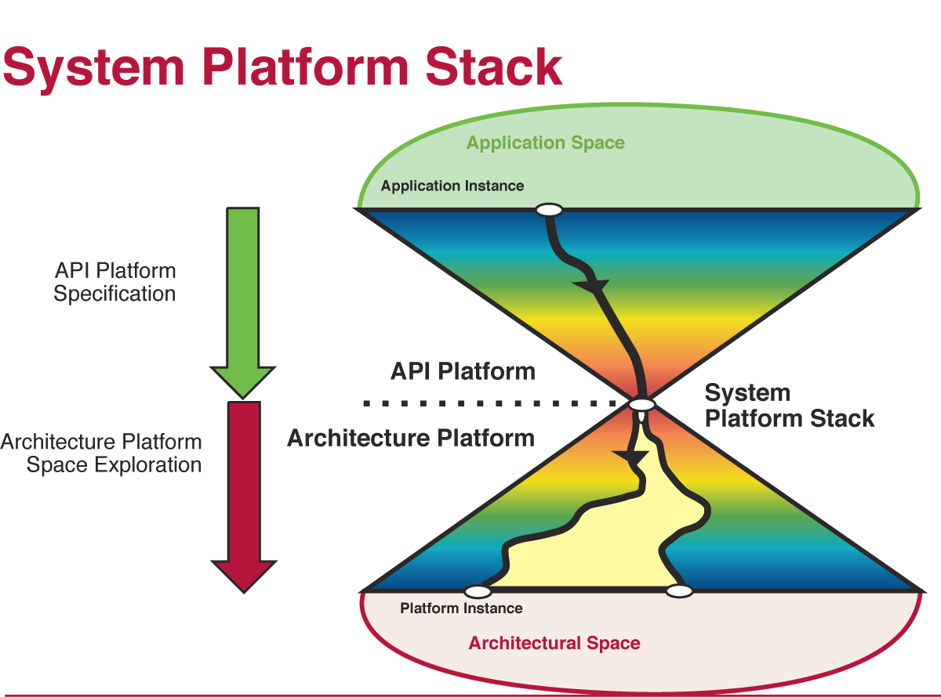
Platform-Based Design
Source: A. Sangiovanni-Vincentelli, UC Berkeley. Defining Platform Based Design. EEDesign, Feb 2002

Slide 26
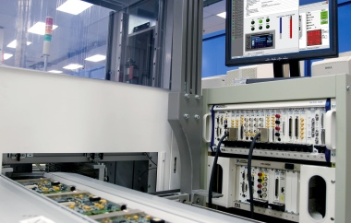
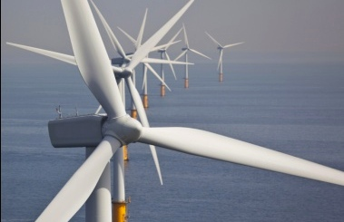
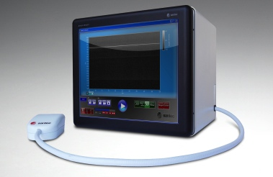
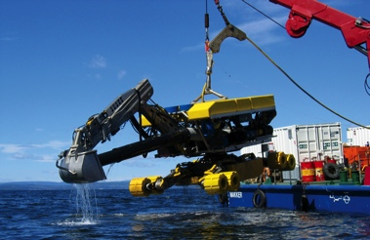
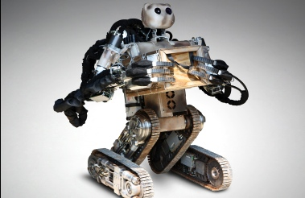
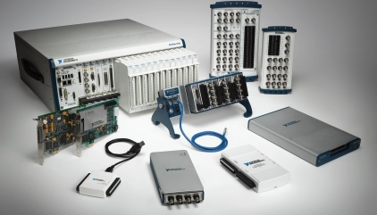
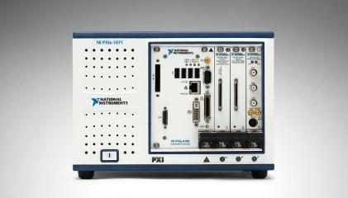
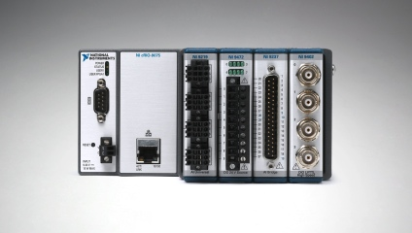
Platform-Based Approach to Graphical Design
Test
Monitor
Embedded
Control
Cyber Physical
Desktops and
PC-Based DAQ
PXI and Modular Instruments
RIO and Custom Designs
Open Connectivity With Third-Party I/O
Notes:
Graphical system design is a platform-based approach to accelerating the development of any system that needs measurement and control, in test, monitoring, embedded, control, or any combination of these applications.
With growing expectations of performance, footprint, reliability, and ease of use, you need a faster, high performance way to integrate new technologies to meet new challenges. This approach gives you reuse of a software centered platform targeting to multiple hardware footprints that share a reconfigurable architecture. Once you’ve applied the platform to a single problem, you can use it to scale to multiple problems, including future requirements and technologies to meet new challenges. LabVIEW is the key as the ultimate system design software to integrate the platforms and I/O you need to create your systems.

Slide 27
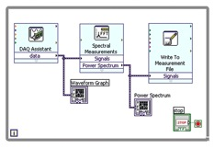
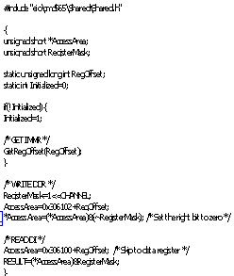
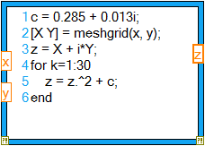
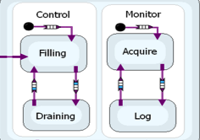


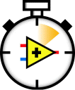


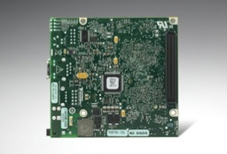

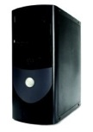
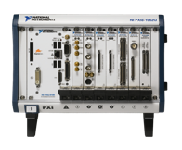


System Design to Deployment
Dataflow
C / HDL Code
Textual Math
Dynamic Systems
Statechart
LabVIEW
Desktop
LabVIEW
``
Real-Time
LabVIEW
FPGA
LabVIEW
MPU/MCU
Personal Computers
PXI Systems
CompactRIO
Single-Board RIO
Custom Design
Notes:
The integrated software and hardware nature of this platform makes it easier to visualize and implement all of the technology, I/O, math and models needed for a system. Within LabVIEW you can use different models of computation to describe the way the system works, and then compile to the best target to run your system. With graphical system design, you can close quickly on not just the visualization, but the implementation, of the systems you need.

Slide 28
MoC: Expressivity vs. Analyzability
Threads
KPN
Statecharts
SyncCharts
Expressive
Analyzable
Process
Networks
Lustre,
Esterel
Finite-State Machines
Allows Nondeterminism
Always Deterministic
Turing-Complete
Not Turing-Complete
Unclocked
Clocked
Difficult Analysis
Tractable Analysis
Concurrent
Sequential
Source: Edward A. Lee, “Concurrent Models of Computation for Heterogeneous Software”, EECS 290, 2011.

Slide 29
Technologies for Time and Concurrency
Time Scale
Backplane timing
Nanoseconds
IO synchronized with a global clock
Software programmed FPGAs
Microseconds
Timed loops
Software constructs: FIFOs | Queues
Software structured dataflow
Milliseconds
Flexibility

Slide 30



Dataflow Execution Fundamentals
Matrix – Vector Multiply
…
Run
Queue
Execution
Threads
Run
Time
Compilation
Multiple
Cores
Notes:
Matrix vector multiplication shown. Split matrix into 8 sub-matrices. Each does 1/8 of computation, recombined later to get to result.
Compiler clumps
Sequential code instructions and dependencies are grouped
Information about which pieces of code can run together are stored in a run queue
If block diagram contains enough parallelism, it will simultaneously execute in all system threads

Slide 31






Parallel Programming
Task Parallelism
Data Parallelism
Pipelining
Multicore
Processors
FPGAs
Notes:
Parallel Programming with LabVIEW

Slide 32



Tools for Signal Processing, Analysis, and Control
Advanced Signal Processing | Digital Filter Design | Control Design and Simulation Module
Wavelets Time-series analysis (independent component analysis, principal component analysis, model-based spectral analysis, … ) Time-frequency analysis (Gabor, STFT, … ) | FIR/IIR filter design/analysis, quantization Fixed-point modeling, fixed-point simulation, code generation (FPGA /ANSI C), … | Model construction, conversion, and reduction Time and frequency response Dynamic characteristics Classical control design root locus, PID, lead/lag ... State-space control/estimation LQR, LQG, pole placement, Kalman filter ...
Notes:
The Advanced Signal Processing Toolkit provides powerful tools for Joint Time-Frequency Analysis (JTFA), digital filter design, super-resolution spectral analysis, and wavelet/filter bank design. With JTFA, you can simultaneously examine the time and frequency domain representations of a signal. You also can quickly design lowpass, highpass, bandpass, bandstop FIR and IIR filters interactively, and output filter coefficients for use in LabVIEW and other applications. Super-resolution spectral analysis provides a model-based alternative to the FFT and delivers estimates of amplitude, phase, damping factor, and frequency of the damped sinusoidal components of a signal. The wavelet and filter bank design component decomposes a signal into multiple bands, representing the signal in terms of varying time and scales through a bank of filters. This decomposition facilitates extraction of signal features, noise reduction, and other operations.

Slide 33
A View of the Computational Map
RT-GPU
CPU
or
GPU
----------
Power
vs.
$$$
GPU
Problem Size
FPGA
CPU
10 μs
100 μs
1 ms
1 s
Cycle Time (Maximum Allowed)

Slide 34






Tokamak Shape Control
Soft X-Rays
Bolometric
Sensors
Tomography
Magnetic
Sensors
Grad-Shafranov
Solver
Shape Reconstruction
Controller
PID, MIMO
Target Shape
Notes:
34
This represents a standard process flow involved in plasma control – relevant to any design.
Soft X-ray tomography coupled with other sensor data feeds the Grad-Shafranov solver (i.e. a PDE-constrained optimization).
The boundary of the plasma is constructed from the solver solution and compared against the gold standard to determine how to adjust the magnetic field.

Slide 35
Power Electronics
Inverters
Motor Drives
Power Electronics Control
Power
Monitoring
Power Electronics Test
Renewable Energy
Electric Vehicles
Energy Storage
Distribution Switches
HIL Validation
PMU
Metering
Functional Test
Power Analyzer
Performance
Characterization
Fault Prediction
Notes:
Other
Welding machines, laser control, electromagnetic catapults, …
Power Electronics Test
Functional/Life Cycle Test (battery management systems, solar inverters, fuel cell controls, smart grid components), Performance Characterization (batteries, fuel cells, solar modules), Real-Time HIL Testing (Motor/generator control software, wind turbine control software)
Power Electronics Control
Motor/Generator Inverter/Converters (wind, solar, hydro generators, field oriented motor control), Smart Grid Power Distribution (smart reclosers, smart switches)
Power Monitoring
Field Monitoring/Analysis (Smart grid power analyzers, flicker meters, phasor measurement units (PMUs), substation automated power metering), Asset Monitoring & Predictive Maintenance (inverter fault prediction, motor current signature analysis, turbine sound & vibration analysis)

Slide 36




Advancing Power Electronics Education

Slide 37





General Purpose Inverter Controller
Notes:
…With the NI RIO off-the-shelf platform, we can do X, Y, Z.
NIWeek Keynote Video: http://zone.ni.com/wv/app/doc/p/id/wv-2860
NREL News Release: http://www.nrel.gov/news/features/feature_detail.cfm/feature_id=1570

Slide 38




Interoperable Software Enables Co-Simulation
LabVIEW
MultiSim
SolidWorks
SCADE
Modelica

Slide 39

Eliminating Artificial Complexity
Text-based Compiler
Graphical Compiler
Source String of Characters
Lexical Analyzer
Tokens
Parser
Source Dataflow Graph
Abstract Syntax Tree
Intermediate Code Generator & Semantic Analyzer
Intermediate Code Generator & Semantic Analyzer
Intermediate Code & Data Dependency Graph
Intermediate Code & Data Dependency Graph
Optimizer & Code Generator
Optimizer & Code Generator
Executable Code
Executable Code

Slide 40












Loops from Kindergarten to Rocket Science
FPGA
Single-Cycle Timed Loop
Dynamic Systems Loop
Real-Time
Timed Loop
While Loop
Lego® Mindstorms
NXT Loop
Lego® Education
WeDo Loop

Slide 41

LEGO MINDSTORMS Ecosystem
PDAs

Slide 42






Biomedical Devices and Instrumentation (Academia)
Radiographic Imaging w/ Robotic Manipulators
Real-Time 3D OCT Imaging w/ FPGA
Upper Limb Robotic Rehabilitation System
Ultrasonic Tumor Therapy
Mobile Fluoroscopy & CT System for Surgery
Haptic Device for Neurosurgery

Slide 43






Biomedical Devices and Instrumentation (Academia)
Radiographic Imaging w/ Robotic Manipulators
Real-Time 3D OCT Imaging w/ FPGA
Upper Limb Robotic Rehabilitation System
Ultrasonic Tumor Therapy
Mobile Fluoroscopy & CT System for Surgery
Haptic Device for Neurosurgery

Slide 44






Biomedical Devices and Instrumentation (Industry)
Femtosecond Laser Assisted Cataract Surgery
Real-Time 3D OCT Imaging w/ FPGA
DNA Sequencing
Tumor Treatment
Intelligent Infusion Pump
Flow Cytometry

Slide 45




Power and Power Distribution (Academia)
Developing a Functional Smart Grid Prototype
Online Switchgear Monitoring System
Real-Time Simulator for Power Quality Signals
Power Flicker Emulator and Measurement System

Slide 46




Power and Power Distribution (Academia)
Developing a Functional Smart Grid Prototype
Online Switchgear Monitoring System
Real-Time Simulator for Power Quality Signals
Power Flicker Emulator and Measurement System

Slide 47







Power and Power Distribution (Industry)
RT/FPGA General Purpose Inverter Controller
Advanced Smart Grid Distribution Switch
Ground Fault Detection in Electricity Distribution Network
High Speed Motor Simulation w/ FPGA’s
Airborne Wind Energy For Remote Villages
Grid Storage Battery Testing

Slide 48





Transportation (Academia)
RCP, HIL, & Deployment for EcoCAR Challenge
Multiple MoC for Optimal Fuel Cell Control
Electric vehicle driven 26,000 km on Pan-American highway
Robotic Sailboat for Sustainable Transportation
Human-Object Transporter

Slide 49





Transportation (Academia)
RCP, HIL, & Deployment for EcoCAR Challenge
Multiple MoC for Optimal Fuel Cell Control
Electric vehicle driven 26,000 km on Pan-American highway
Robotic Sailboat for Sustainable Transportation
Human-Object Transporter

Slide 50





Transportation (Industry)
Real-time embedded control for automotive fuel cell system
Virtual Test Trains for Railway Signaling Testing
Defect detection and localization for improved railway maintenance
Model-Based Dynamometer w/ Full Vehicle Simulation
Controlling the World’s Largest Fuel-Cell Hybrid Locomotive

Slide 51






Robotics (Academia)
Magnetic legged robot for steel bridge inspection
Control of Remotely Operated Pipeline Welding Robot
Bipedal robot control
Adaptive cruise control for fleet of robotic vehicles
Combined control and test of cheetah robot

Slide 52




Robotics (Academia)
Magnetic legged robot for steel bridge inspection
Control of Remotely Operated Pipeline Welding Robot
Bipedal robot control
Adaptive cruise control for fleet of robotic vehicles
Combined control and test of cheetah robot

Slide 53





Robotics (Industry)
Autonomous Mobile Robot for Home Monitoring and Service
Hydraulic Manipulator for Battlefield Extraction
Mobile Diagnostic Robot for Testing Washing Machines
Unmanned Platform for Patrolling Military & Civilian Environments
Autonomous Robot to Automatically Clean Solar Panels

Slide 54









RF/Comm (Academia)
Relay
Source
Destination
Physical Layer Prototyping w/ Continuous Monitoring of Multiple WiFi Channels
Cooperative MIMO Receiver
RF Position Localization w/ Large Aperture Array Testing
6x6 MIMO OFDM Testbed w/ Independent, Phase Coherent Tx & RX
Algorithm Research to Clean up “Dirty RF” w/ Live, Over-The-Air OFDM Link

Slide 55



RF/Comm (Academia)
Physical Layer Prototyping w/ Continuous Monitoring of Multiple WiFi Channels
Cooperative MIMO Receiver
RF Position Localization w/ Large Aperture Array Testing
6x6 MIMO OFDM Testbed w/ Independent, Phase Coherent Tx & RX
Algorithm Research to Clean up “Dirty RF” w/ Live, Over-The-Air OFDM Link

Slide 56




RF/Comm (Industry)
Improving WLAN Test Speed and Coverage Using Vector Signal Transceiver Technology
Digital Receiver System w/ Barker Code Matching For Pulse Compression
Managing Communication Protocols With FPGA RF Instrumentation
Channel Emulator to Simulate Real-World Atmospheric Impairment

Slide 57






Tough Real-Time Challenges
Large Telescope
Mirror Control
Tokomak
Plasma Control
Wind Turbine Sound Source
Characterization
CERN Hadron Collider
Early Cancer Detection
Structural Health Monitoring

Slide 58
Future Research Challenges
Tools
  System-level synthesis for heterogeneous platforms
  High-level Models of Computations
    Appropriate for productive application design
    Appropriate for efficient implementations
    Compilation time
  Interoperable software & IP exchange mechanisms
Platforms
  Reliability in heterogeneous systems
  Adaptability, resiliency and reconfiguration
  Human-machine interaction
  Redundant safety and security measures at multiple levels

Slide 59












Engineering Grand Challenges
Cancer Detection
Hadron Collider
Infant Brain Scans
Tokomak Plasma Control
Advance health informatics
Engineer the tools of
scientific discovery
Reverse-engineer the brain
Provide energy from fusion
IV Drift Pump
Advanced Purification
Haptics
Olympic Stadium Safety
Engineer better medicines
Provide access to clean water
Enhance virtual reality
Restore and improve
urban infrastructure
CO₂ Storage
Distance Learning
Cheap Solar Panels
Material Monitoring
Develop carbon sequestration methods
Advance personalized learning
Make solar energy economical
Prevent nuclear terror
Spectral Monitoring
Costa Rica Rain Forest
Secure cyberspace
Manage the nitrogen cycle

