Slide 1


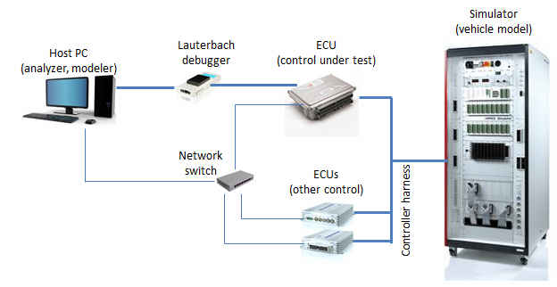
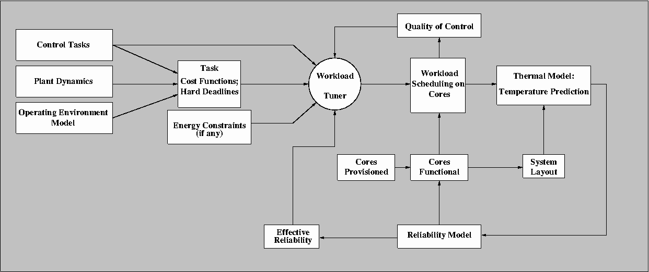
CPS: Synergy: Thermal-Aware Management of Cyber-Physical Systems
K.G. Shin; E.M. Atkins
University of Michigan
C.M. Krishna; I. Koren
University of Massachusetts
S. Wang
General Motors
Motivation
Online Thermal
Management
Validation
Cyber-physical processors work
in harsh environments and often suffer very high operating temperatures.
High temperature can accelerate processor aging and increase
failure rate.
Effective thermal-aware management is required to meet
the computational demands of
the application while reducing processor thermal stress.
Automobile Simulation
System-Wide Manager
Periodically samples core temps
Applies dynamic thermal mgmt. if any cores are likely to be overheated over the next sampling interval.
  Task migration
  Task substitution
Failure Sources
Electromigration
Dielectric breakdown
Negative bias temperature instability
Core-Level Manager
Unmanned Aerial Vehicles
Adjusts core speeds
Power gating
Architecture adaptation
All strongly dependent
on temperature
Our Approach
System Provisioning
Controlled Plant:
Current state
Dynamics
Desired trajectory
Safety envelope
Dynamic computational workload and core assignment
Core reconfiguration
Balance quality of control against
thermal stress

