Slide 1
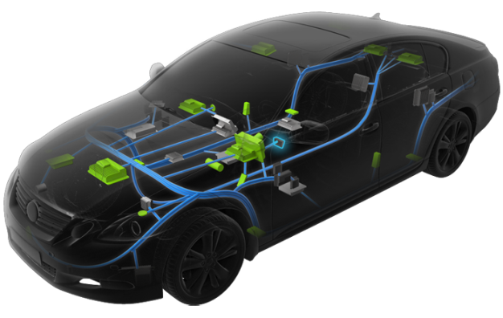
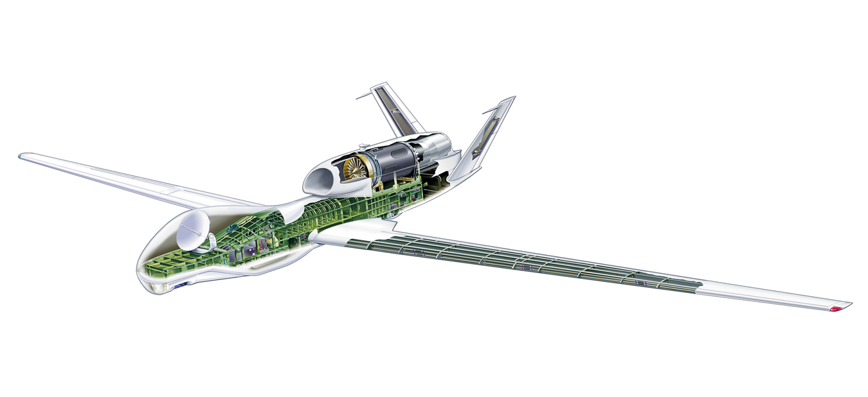
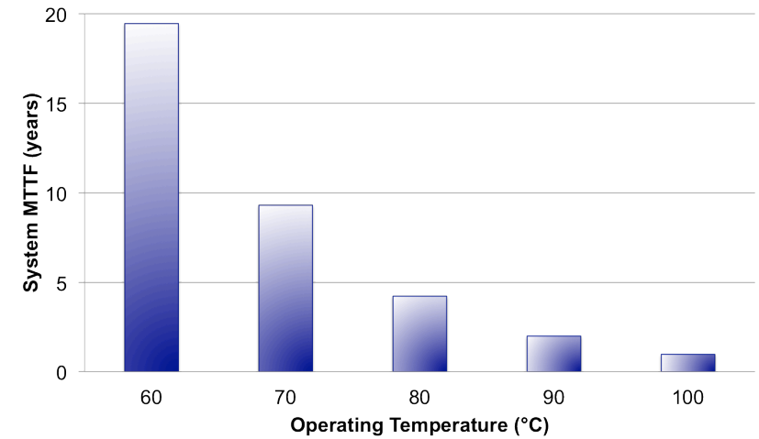
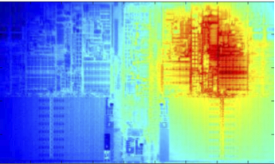
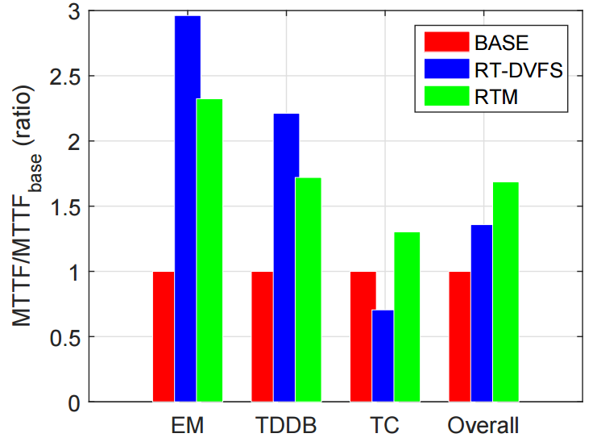
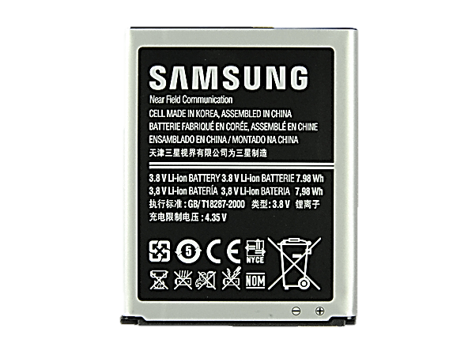
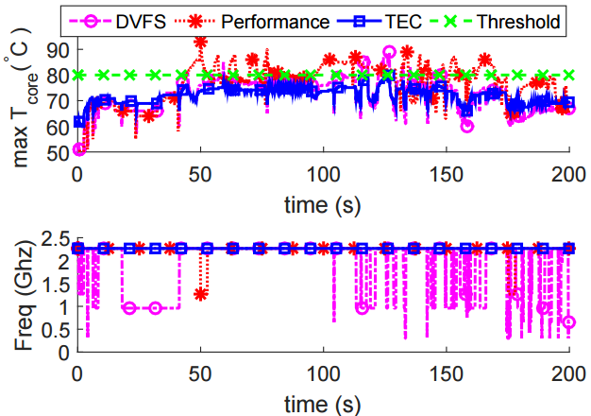
Thermal Management of Cyber Physical Systems
CNS-1329702
Kang G. Shin, Ella Atkins (UMich);
C.Krishina, Israel Koren (Umass); Shige Wang (GM)
Motivation
Physical system
High temperature and/or temporal/spatial gradient
→ System faults↑ Lifetime↓
Exponential
CPS 1: Vehicle ECUs
CPS2: Mobile system
CPS3: UAV system
Cyber space
Control Knobs
Task sched ($τ_{n}$)
Utilization($u_{n}$)
DVFS($V_{m},f_{m}$)
….
Thermal model
$$T(τ, V,f,u, …)$$
Exponentially decreasing lifetime
Temperature Prediction
Reliability Cost Function
Reliability model
$$MTTF(T,∆T, ∇T, …)$$
Mathematical Optimization
Thermal cycling
MTTF↓
Dynamic Thermal Management
Utilization
Reliability
Thermal hotspot
CPS 1: Vehicle ECUs
Task characterization
Thermal prediction
Maximizing utilization
Utilization 32% ↑ Lifetime 63% ↑
Temperature and utilization trace
CPS 2: Mobile System
Mean-time-to-failure reliability
CPU-battery thermal coupling
Minimizing power
Real-time deadline Thermal constraints
Performance/J ↑ 13%
Ambient
Battery
Total Power
Consumption
Battery thermal sensor
TEC Thermal sensor
Thermoelectric cooler
Cooling Current
Integrated heat spreader
Application Processor
On-chip Thermal sensor
DVFS
Ambient
Mobile System Thermal Interactions
CPS 3: Small Unmanned Aircraft System
Thermal reliability vs Performance
Optimize multi-objective mission performance
Minimize component thermal degradation
Model thermal dependency
energy
time
utilization
information
Thermal reliability
Multi-objective Optimization of UAV mission

