Slide 1




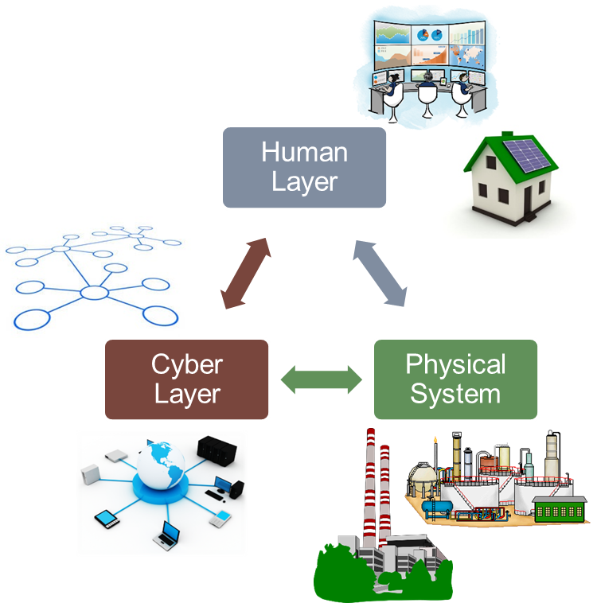
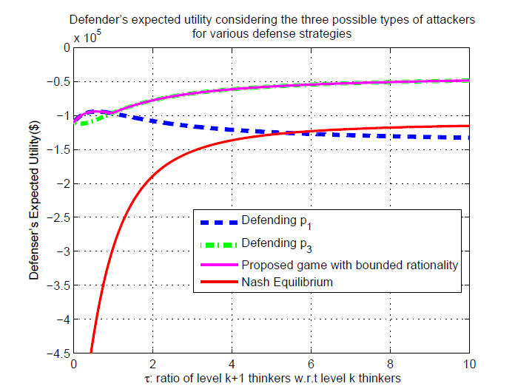

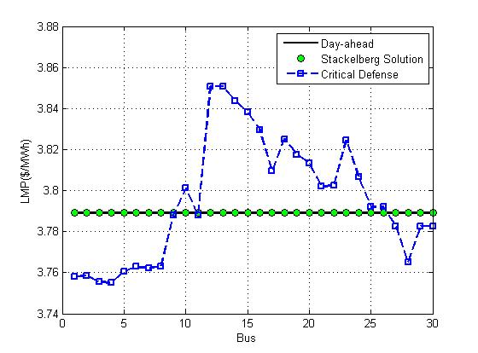
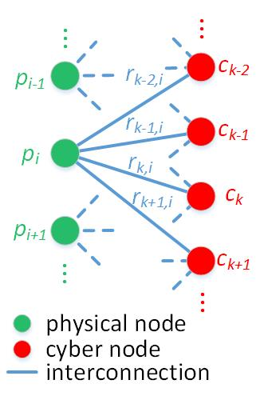

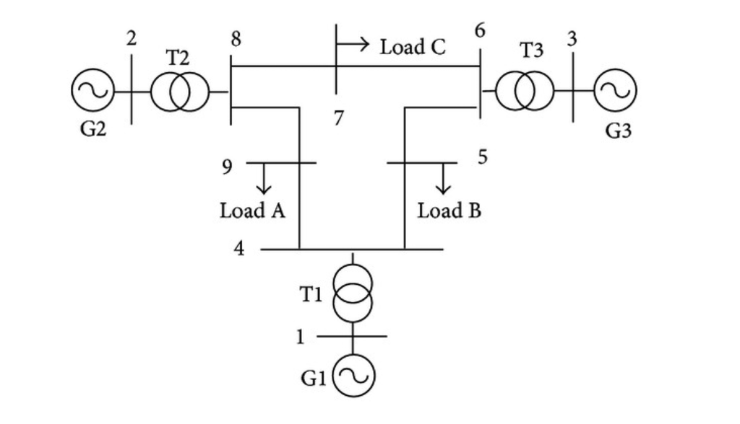

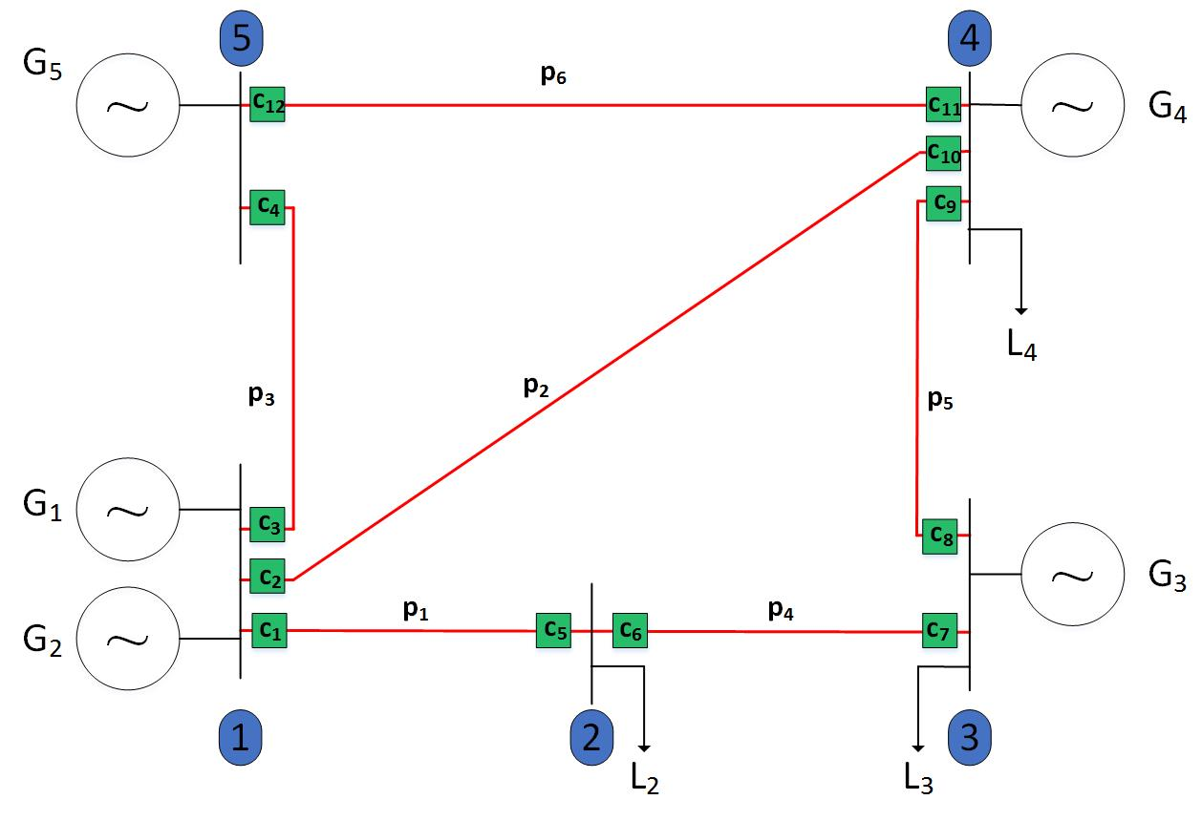
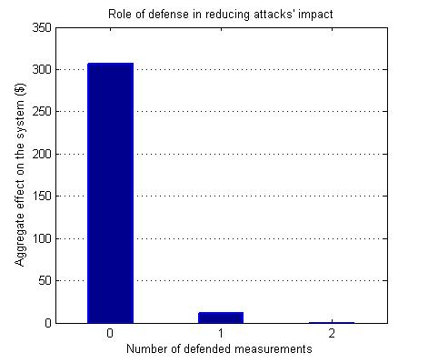

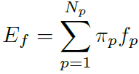

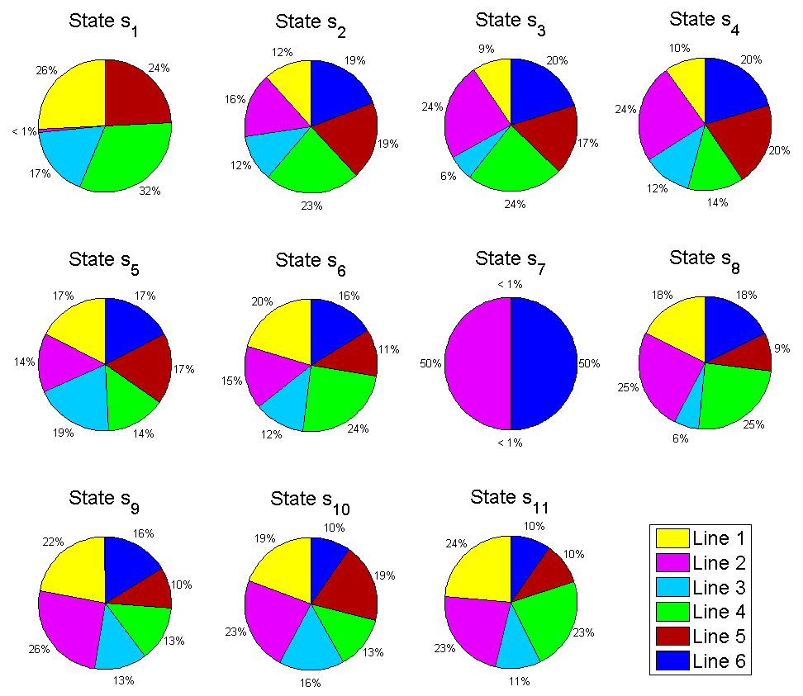
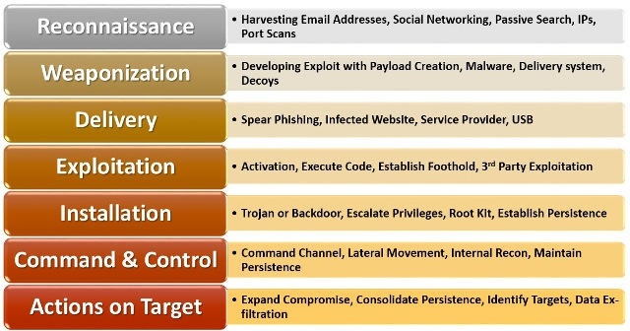
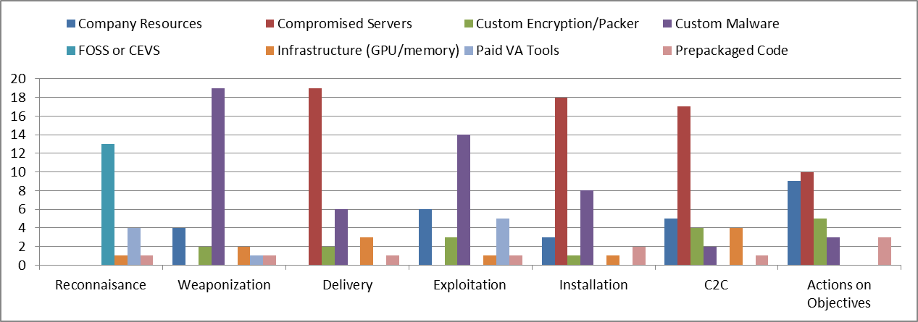
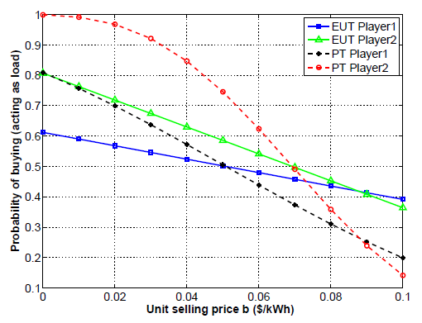
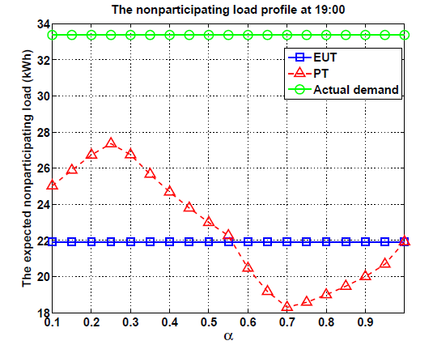
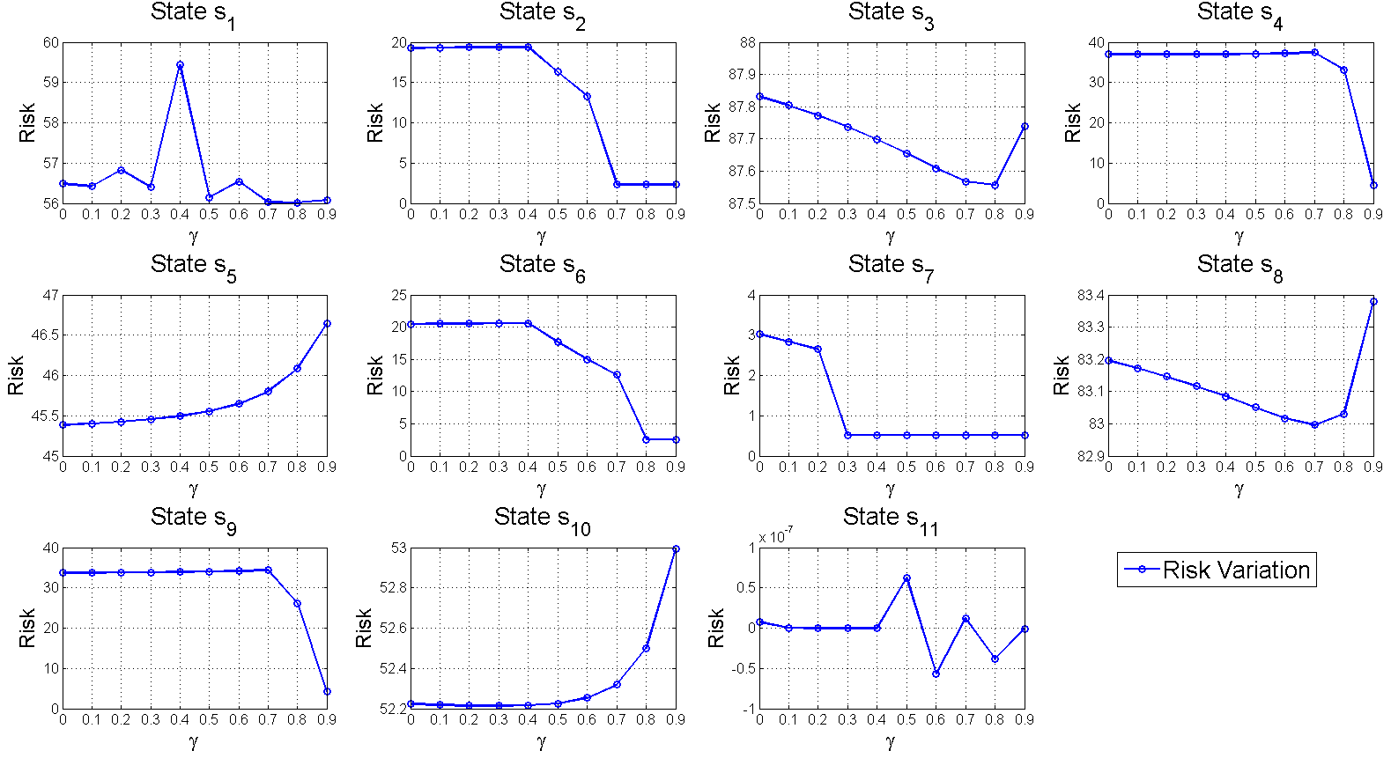
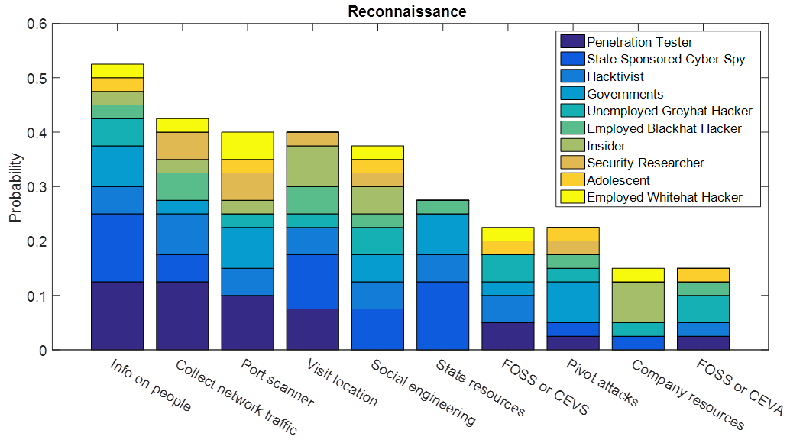
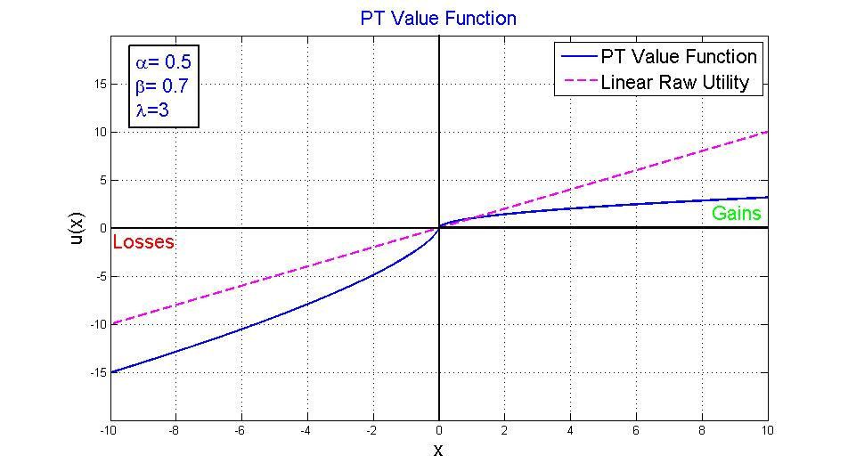
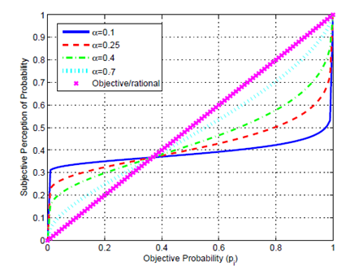
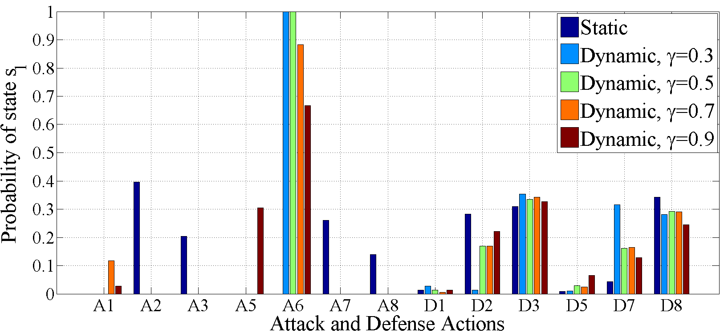
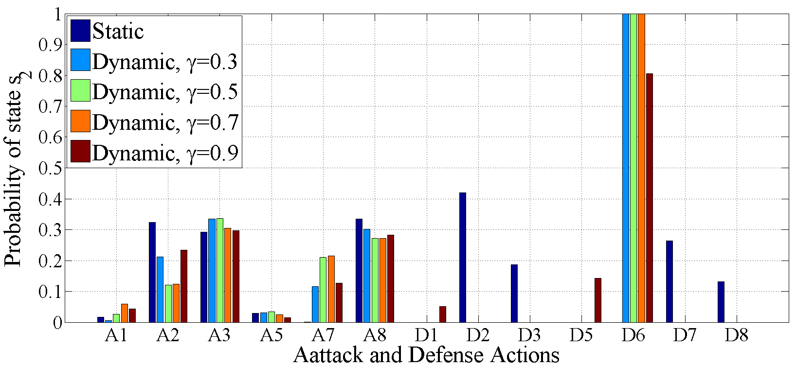



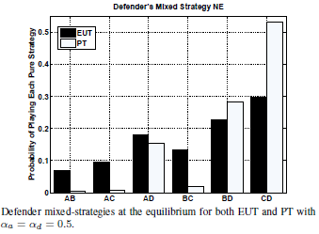
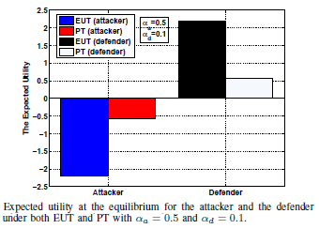
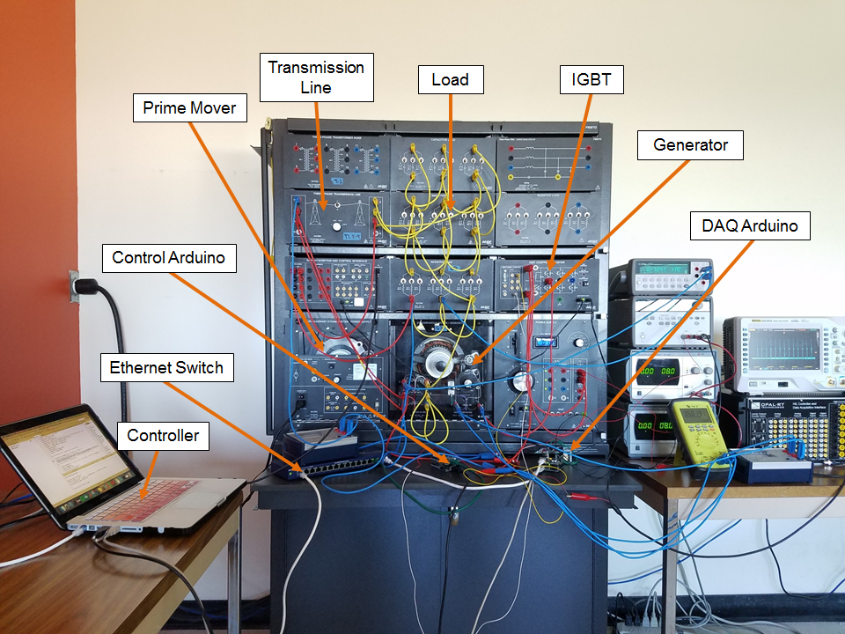
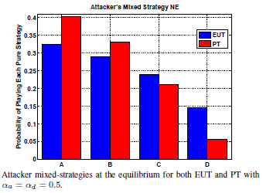
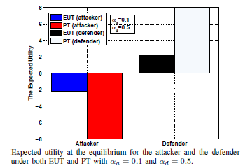
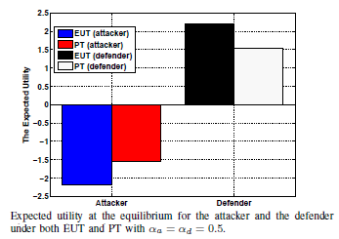
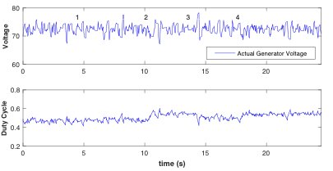










Towards Secure Networked Cyber-Physical Systems: A Theoretic Framework with Bounded Rationality
VT: Walid Saad (PI), FIU: Arif Sarwat (PI), Ismail Guvenc, Kemal Akkaya,
Temple: Saroj Biswas (PI), Aunshul Rege, Li Bai
Securing Cyber-Physical Systems Against Attack Diffusion
Data Injection Attack
Cyber-Physical Systems
CPS Attack Diffusion Model
Full rationality:
Full knowledge of $E_{f}=\sum_{p=1}^{N_{p}}{π_{p}f_{p}}$ is needed
  CPS are very complex
  $→$obtaining $f$ (vector of $f_{p}$’s) is complex
  $→$Solution: build own perception of $f$ $→ {\hat{f}}_{i∈\left(a,d\right)}$
  Level of thinking of $i∈\left(a,d\right)$: how close is ${\hat{f}}_{i}$ to $f$
  Higher level thinkers (cognitive hierarchy theory)
    Have better knowledge of the system
    Better computational capabilities
Optimal defense against: $α\left(0\right)l_{0}+α\left(1\right)l_{1}+α\left(2\right)l_{2}$
Data Injection Attacks:
Target: state estimator.
Objective: manipulate LMPs: financial gain
Multiple noncooperative attackers
Strategic model: Stackelberg game.
System operator: choose units to defend
Followers: choose measurement and level of manipulation
Cost/benefit of attacks and defense.
Bounded rationality: satisfaction equilibrium
New Equilibrium concept: Hybrid Hierarchical Equilibrium (HHE)
Day-ahead
Real-Time Operation
Stackelberg equilibrium with two defended measurements:
Optimal defense strategy better than intuitive critical strategy: defending the two measurements that can affect the system the most
At HHE: Defending two measurements enough to completely defend the system
$N_{p}$ physical nodes | $N_{C}$ cyber nodes
IEEE 9-bus system
$r_{c,p}$: interconnection weight
$r_{c,p}=\operatorname{Pr}\left(p fails \right|c has failed)$
Failure of $c$:
$→$ Implication: send corrupt data
$→$ Reason: cyber attack
$π=\left[π_{1},…,π_{N_{p}}\right]$: failure probability vector of physical nodes
$κ=\left[κ_{1},…,κ_{N_{c}}\right]$: failure probability vector of cyber nodes
Zero-sum game!
Financial Entities
Virtual Bids
Gen. Offers
Gen. Dispatch
State Estimator
Application: Wide Area Protection
Day-Ahead Market
    Energy markets implications:
    Optimal Power Flow (OPF)
    $V^{o}$: value function of the original OPF ($/h)
    $V^{p_{i}}$: value function of the OPF with loss of $p_{i}$ ($/h)
    $T^{p_{i}}$: time needed to bring $p_{i}$ back to operation (h)
    $CR^{p_{i}}:$ cost of repair of $p_{i}$
    $→$ $f_{p_{i}}=\left(V^{p_{i}}−V^{0}\right)T^{p_{i}}+CR^{p_{i}}$
Three types of attackers:
Level 0 $\left(l_{0}\right)$: chooses attack randomly
    Level 1 $\left(l_{1}\right)$: attacks line with highest power flow
Level 2 $\left(l_{2}\right)$: can solve OPF, attacks line with highest $f_{p_{i}}$
Facing type $k \sim$Poisson distribution $\left(τ\right)$:
Generation Owners
DA LMP
Role of defense: Defending a small fraction has a huge impact:
Defending 1 measurement (10% of vulnerable measurements): huge decrease in attacks’ effect.
Defending 2 measurements (20% of vulnerable measurements): eliminate attacks’ effect.
Load Bids
Attacker
$f_{p}$: cost of failure of $p$
Measurement Device
RT LMP Calculation
Communication Link
Load Serving Entities
Data Injection attack
Power System
A. Sanjab and W. Saad, "On Bounded Rationality in Cyber-Physical Systems Security: Game-Theoretic Analysis and Application to Smart Grid Protection" in Proc. of IEEE/ACM CPS Week, Workshop on Cyber-Physical Security and Resilience in Smart Grids, Vienna, Austria, April 2016.
A. Sanjab and W. Saad, "Data Injection Attacks on Smart Grids With Multiple Adversaries: A Game-Theoretic Perspective," in IEEE Transactions on Smart Grid, vol. 7, no. 4, pp. 2038-2049, July 2016.
A. Sanjab and W. Saad, "Smart grid data injection attacks: To defend or not?," 2015 IEEE International Conference on Smart Grid Communications (SmartGridComm), Miami, FL, 2015, pp. 380-385.
Prospect Theory (PT): Alternative Theory of Choice
Dynamic Game Theory
Human Decision-Making on Tactics Across Cyberattacks
“Theory of how people make choices in between gambles with monetary outcomes and specified probabilities” – Daniel Kahneman
Application: Coordinated Cyber-Physical Attacks
Markov perfect equilibrium:
A state of the game such that no player can increase its reward by unilaterally deviating from this equilibrium state.
The optimal defense resource allocation strategy is shown in the left figure.
Adversarial Intrusion Chain Stages
Findings Summary: Top Tactics for Across Stages (Independent of Adversaries)
Prospect Theory (1979)
Nobel prize in economic sciences (2002)
Decision making under risk:
Empirical violations of expected utility theory (EUT)
EUT: $U\left(x_{1},p_{1};…;x_{n},p_{n}\right)=p_{1}u\left(x_{1}\right)+…+p_{n}u(x_{n})$
PT: $V\left(x_{1},p_{1};…;x_{n},p_{n}\right)={w(p}_{1})v\left(x_{1}\right)+…+w_{n}\left(p_{n}\right)v\left(x_{n}\right)$
Basic observations:
Outcomes perceived as gain and losses w.r.t ref. point
Individuals are risk seeking in losses an risk averse in gains
Individuals exaggerate losses (losses loom larger than gains)
High probabilities are underweighted, low probabilities are overweighed
Application: Smart Grid Energy Management
Coordinated Cyber-Physical Attacks:
Target: physical and cyber components of the smart grid.
Objective: disrupt the system operation: maximize the physical impact towards the system.
Strategic Model: Stochastic Game:
System operator vs. Potential attacker.
Protection/repair cost of defense actions.
Physical impact/cost of attack actions.
Power system state space.
Bounded rationality: Markov perfect equilibrium.
Distributed energy storage: charging strategy
Active customers own storage units
Decision: store vs sell energy (selling price, $b$ $/KWh)
Example: two active customers
Demand Side Management:
Active customers
Decision: Participate or not in DSM( when to start participating)
Participate $=$ shift loads to off peak
Case Study: IEEE 9-bus Transmission Line Protection
The risk in each of eleven states
Adversarial Tactics Choices
Target: cyber components of the smart grid
Objective: identify tactics used across intrusion chain
Methodology
Online survey of ethical hackers; N=33
Findings: Most Common Tactics for Each Stage (Independent of Adversaries)
Attack actions: physical attacks and DoS attacks.
Defense mechanisms: building barriers and implementing filters to reinforce normal lines and repair broken lines.
PT weighting function
Adversarial Types:
Penetration tester; Stated sponsored; Hacktivists; Governments; Hackers; Insiders; Adolescents
W. Saad, A. L. Glass, N. B. Mandayam and H. V. Poor, "Toward a Consumer-Centric Grid: A Behavioral Perspective," in Proceedings of the IEEE, vol. 104, no. 4, pp. 865-882, April 2016.
Markov perfect equilibrium
L. Wei; A. Sarwat; W. Saad; S. Biswas, "Stochastic Games for Power Grid Protection Against Coordinated Cyber-Physical Attacks," in IEEE Transactions on Smart Grid, 2016.
Hardware Trojan Detection: Prospect-Theoretic Analysis
Stability of Generator Control Loop under DoS attack
Experimentation with CPS Attacks on Smart Grid Testbed
Hardware Trojan (HwT): malicious design
introduced in hardware
Source of threat:
Unsupervised electronics’ manufacturing
Use of Commercial-of-the-shelf
Testing for HwT: Resource limitation
Defense: choose types of HwT for which to test
Attacker: Choose certain HwT type to insert
Decision making under risk: PT
Cyberattack in Generator Control System
  Two control loops: excitation control and prime mover control
  DoS attack at sensor interface and actuator interface
  Attacker’s objective: Set generators into transients and instability
Identify packet drop threshold for stability
  Objective: Determine threshold of packet drop at sensor and actuator interfaces for stability
Approach: Stochastic stability analysis
  Model: packet drop is an i.i.d. Bernoulli process
  Mean square stability analysis for closed loop system
  Determine region of stability for various control options
Main result
  System is stable if packet drop probability is within a certain threshold
  Holding the last received data in the event of packet loss improves stability
  Packet drop at actuator interface is more detrimental to closed loop stability
  High gain fast acting controller does not necessarily improve stability under DoS attack
9-Bus IEEE Testbed
Objective:
The developed testbed is used to experiment with multiple types of individual and coordinated attacks in physical and cyber parts of the system.
Cascading Failure:
Event 1: DoS attack on G1
Event 2: Transmission line 3 is over loaded
Event 3: Intentional physical attack on line 5
Event 1: Jamming and packet drop attack on T1
Dynamic Islanding Mode:
Load B is supported by synchronous generator 3
Protection controller connects relays when attack is gone.
$𝒯=\left\{A,B,C,D\right\},$
$$V_{t}=\left\{1,2,4,12\right\},$$
$$K=2$$
Time sequence of CPS attacks to smart grid
Number of supported load
9-Bus IEEE with Different events

