Slide 1
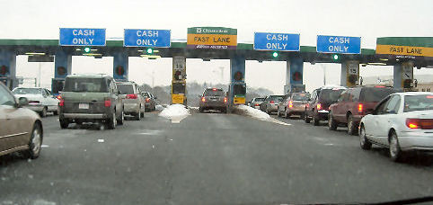
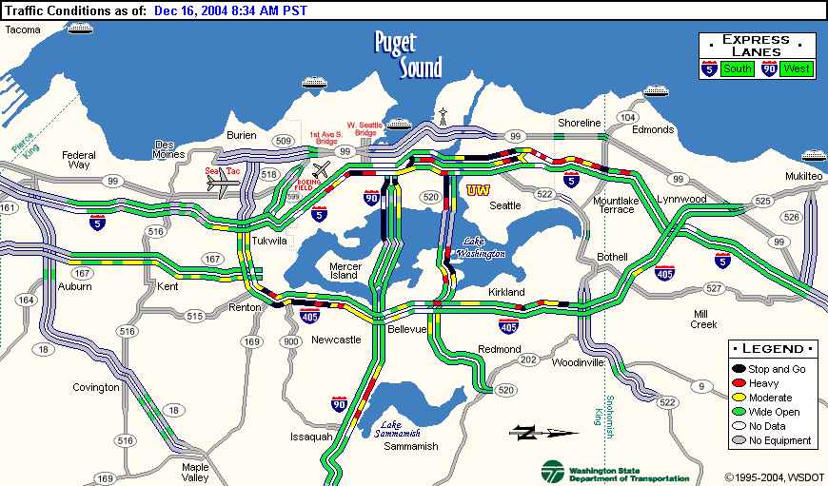


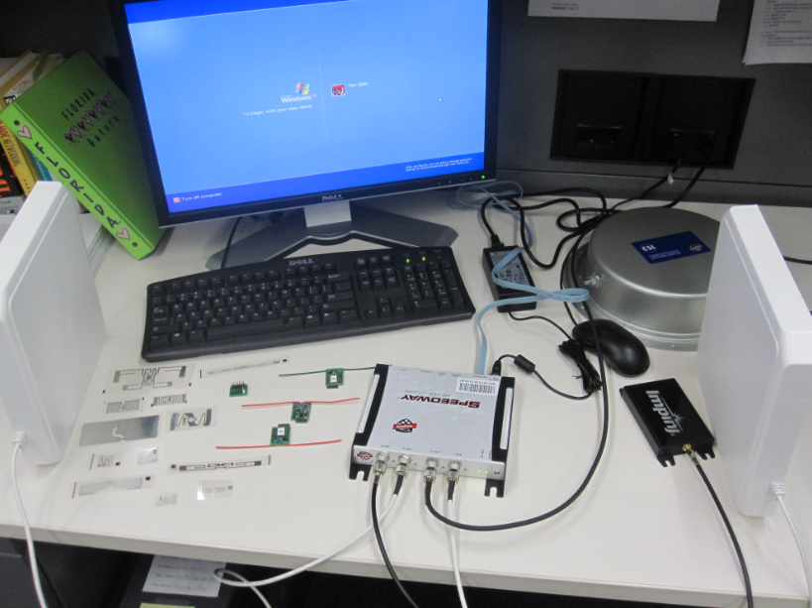
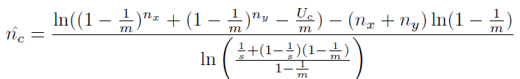


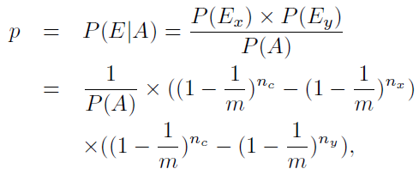

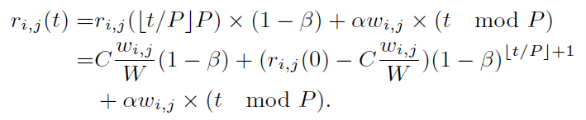
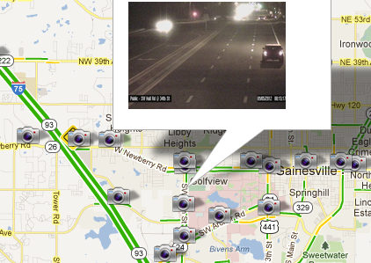







Transforming a City’s Transportation Infrastructure through an Embedded Pervasive Communication Network
PI: Dr. Shigang Chen, Computer Science, Co-PI: Dr. Yafeng Yin, Civil and Coastal Engineering
Students: Ming Zhang, Wen Luo, Mohammed Mamun,Yan Qiao
University of Florida
Intelligent Road System
Anonymous Authentication and City-traffic Measurement
An Engineering Framework for Intelligent Transportation Systems
Objective: Investigating new technologies that transform the streets of a city into a hybrid transportation/communication system, called the Intelligent Road (iRoad), based on which novel transportation applications can be developed.
Objective: A robust self-learning framework for transportation engineering, which leverages the iRoad’s capacity for real-time data collection to enable advanced traffic operations for better efficiency, safety and reliability
Components
  System identification: delivering a complete image of traffic conditions and transportation system performance based on limited traffic information of varying quality
  Robust decision-making: ensuring stable application performance without severely compromising optimality, even during disruptive events
Data Center
Transportation Applications
Research
Bi-objective optimization model for determining traffic signal timings to minimize traffic delay and risk associated with human exposure to traffic emissions
‘Select zone analysis' procedure in traffic impact studies, using iRoad to identify flow distributions
Sensor location problem in traffic impact studies: how to deploy a minimal number of sensors across an urban road network to fully capture the origin-destination distribution of the vehicular flows on the network
How will iRoad improve transportation system design?
  Traffic signal timing
  Select zone analsis
  Sensor placement
What are the technical requirements of iRoad?
  Soft throughput/real-time assurance
  Multiple service classes
  Quantitative bandwidth distribution
Security and Privacy
  Privacy-preserving authentication (toll payment)
  Privacy-preserving transportation traffic measurement
Wireless Resource Management
PISD: Proportional Increase Synchronized Multiplicative Decrease
Repository
r(t)
AIMD queue
802.11 DCF
MAC
Wireless Channel
Technical Challenges
Wireless Challenges
  Wireless contention and bandwidth sharing
  Multi-rate anomaly and location-dependent interference
  Dynamic link capacity and unknown contending traffic
  Multi-service classes and differentiated traffic engineering
Security Challenges
  Open nature of wireless communication
  Anonymous requirement
Transportation Application Challenges
Collaboration
Dynamic weight adaptation and prioritized rate assurance in vehicular and RSU networks
For a MAC flow f_{i,j}^{k} ,
  Ceiling:
  Floor:
Prioritized Rate Assurance
Differentiated Bandwidth Allocation
No Starvation and Maximum Utilization
Weight Adaptation:

