Slide 1
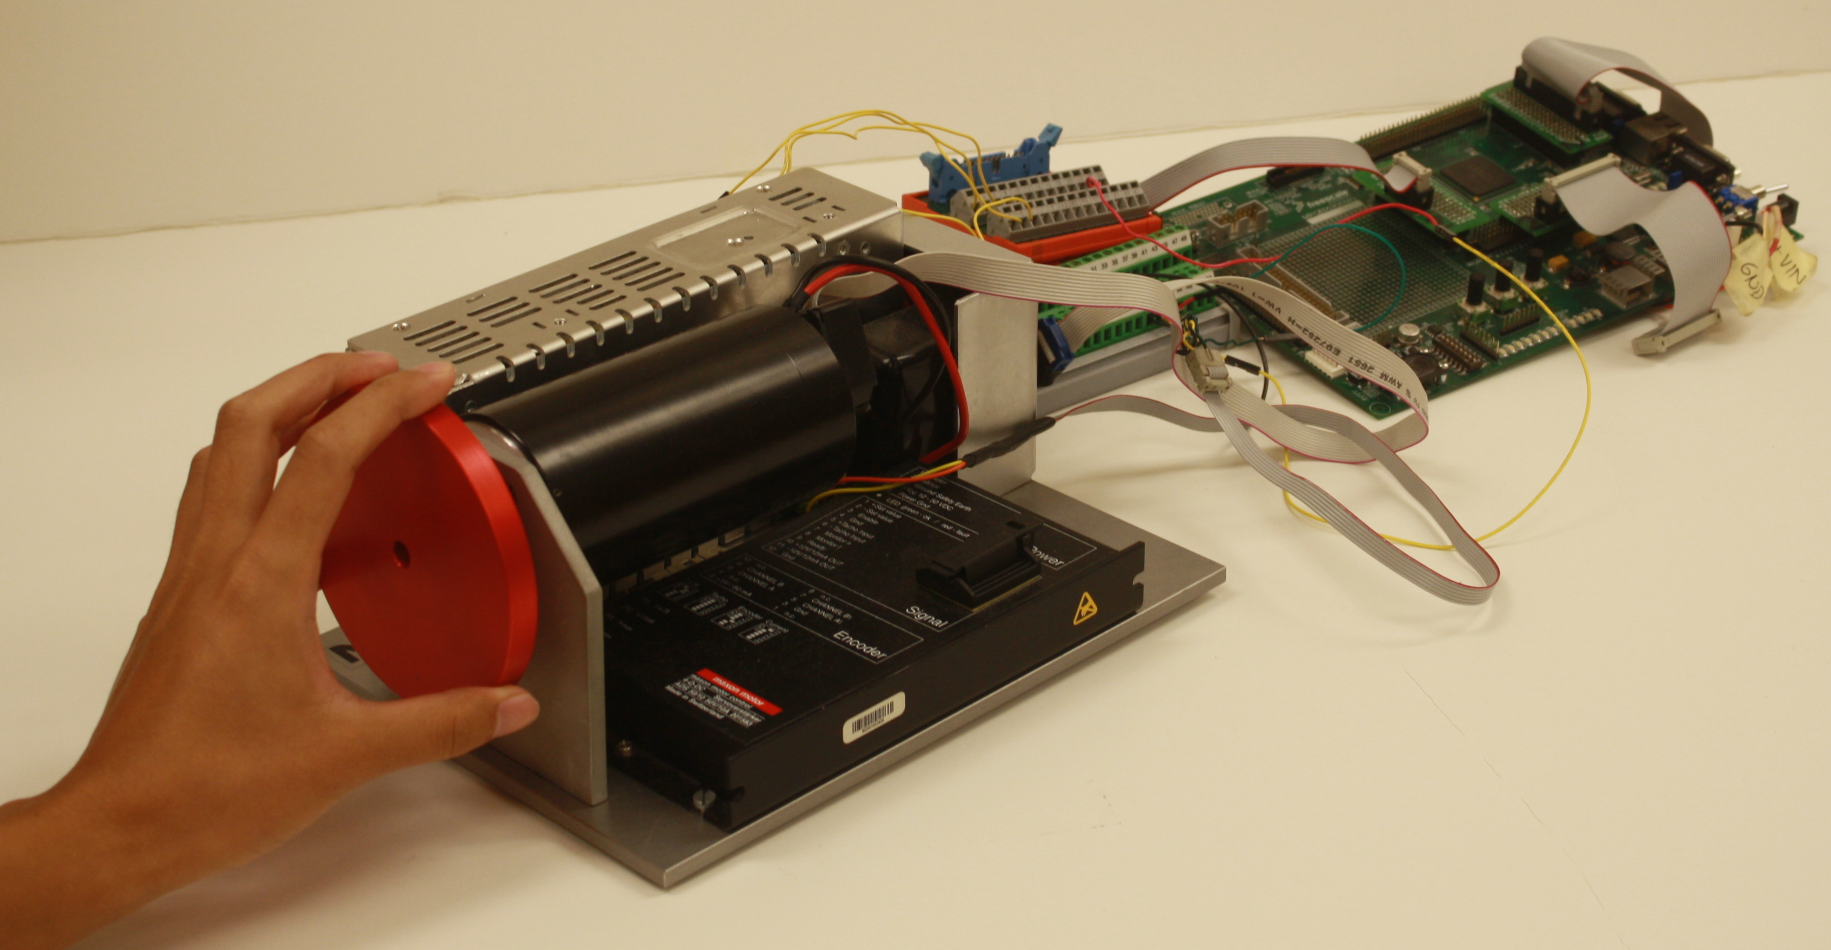
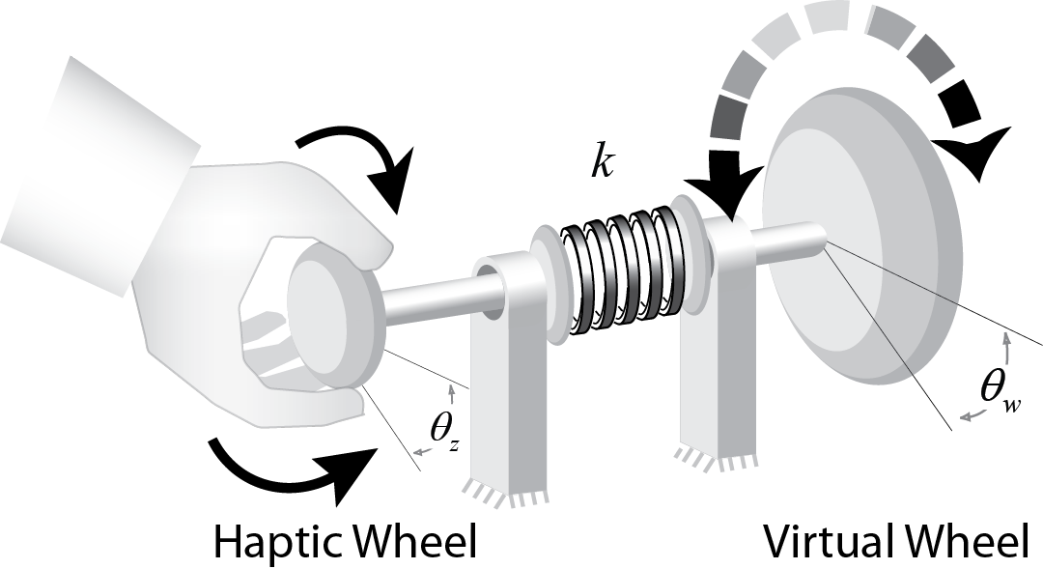
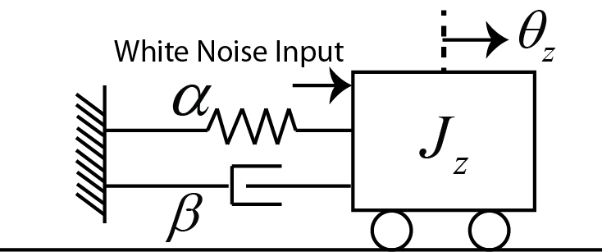
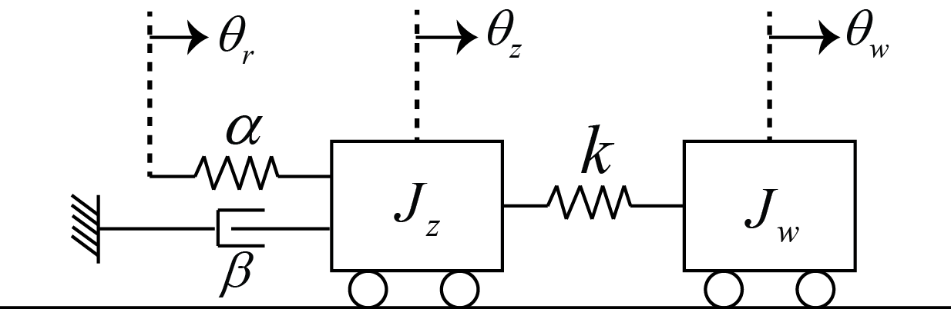
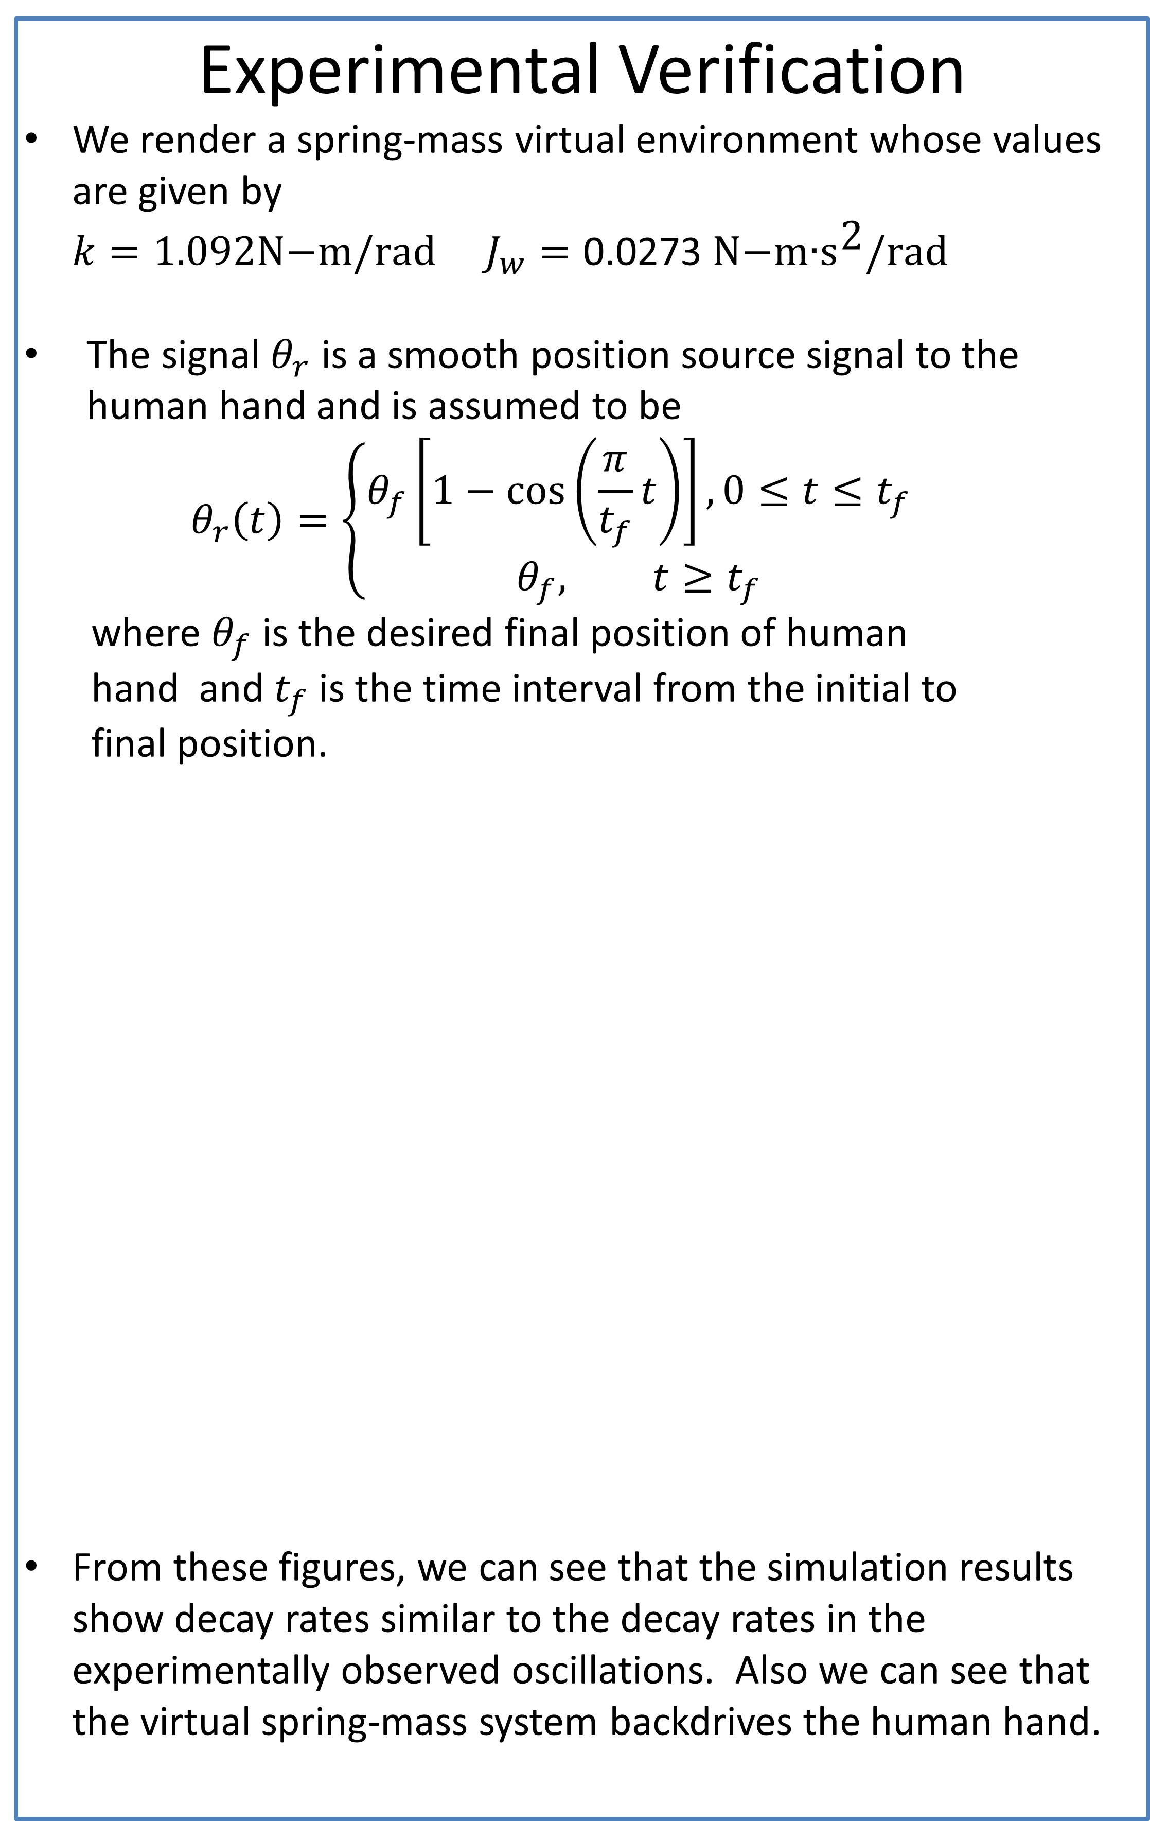

When the Cyber Backdrives the Physical: Information Flow vs. Power Flow
James Freudenberg (PI), Brent Gillespie (Co-PI), and Bo Yu
University of Michigan, Ann Arbor
Introduction
In the Michigan Embedded Control lab, students interact with virtual environments through a custom built single-axis haptic interface. Students program the Freescale MPC5553 microprocessor to render virtual (cyber) environments such as virtual walls, spring-mass systems, and a networked multi-vehicle driving simulator through the haptic interface.
In one laboratory exercise, students implement a virtual spring-mass system, and apply a “step input” by rapidly turning the haptic wheel, holding it in its new position, and monitoring the reaction torque by feel. Students expect the cyber spring-mass system to oscillate without decay, however, oscillations quickly die out.
Evidently dissipativity arises from the inability of users to hold the haptic wheel motionless as the cyber system backdrives the physical system. Then damping effects enter that involve damping in the haptic device and the biomechanics of the human user. Empirical models of the driving point impedance of the hand and arm exist, but these are insufficient when volitional control is also involved (as in the step input experiment).
Significant gaps remain in the determination of a coupled model that captures the user’s neuromotor intent, the biomechanics of the hand/arm interacting with the haptic wheel, and the cyber spring-mass system. We aim to develop such a model to describe the observed phenomena.
Haptic feedback, unlike visual or audio feedback, carries significant power as well as information and introduces mechanical coupling between the physical and cyber worlds.
Experimental Verification
We render a spring-mass virtual environment whose values are given by
$k=1.092\text{N}\text{−}\text{m}\text{/}\text{rad}$ $J_{w}=\text{0.0}\text{273 }\text{N}\text{−}\text{m}\text{∙}{\text{s}}^{\text{2}}\text{/}\text{rad}$
The signal $θ_{r}$ is a smooth position source signal to the human hand and is assumed to be
$θ_{r}\left(t\right)=\left\{\begin{aligned}θ_{f}\left[1−\cos\left(\frac{π}{t_{f}}t\right)\right], 0≤t≤t_{f} \\ θ_{f}, t≥t_{f}\end{aligned}\right.$
where $θ_{f}$ is the desired final position of human
hand and $t_{f}$ is the time interval from the initial to
final position.
From these figures, we can see that the simulation results show decay rates similar to the decay rates in the experimentally observed oscillations. Also we can see that the virtual spring-mass system backdrives the human hand.
Methods
We model the human hand as a simple second order system, e.g. a spring-mass-damper system (a mechanical impedance)
$\frac{θ_{z}(s)}{T(s)}=\frac{1}{J_{z}s^{2}+βs+α}$
We use a frequency-domain system-identification method to estimate the spring-damper-mass model
  Input is white noise signal programed in C++ used to drive the motor connected to the haptic wheel
  Output${ θ}_{z}$is measured at 850 Hz over a 15-minute trial using the optical encoder with a resolution of 1000 cycles per revolution
  Data were processed in MATLAB using the tfestimate function to produce a transfer function estimate
$J_{z}=\text{0.00068} \text{N}\text{−}\text{m}\text{∙}{\text{s}}^{\text{2}}\text{/}\text{rad} α=\text{2.10 }\text{N}\text{−}\text{m}\text{/}\text{rad}$
$β=\text{0.0}\text{272 }\text{N}\text{−}\text{m}\text{∙}s\text{/}\text{rad}$
We propose a control-oriented model of the coupled system that includes the identified human hand model and the cyber (virtual) environment.
$k$ is the virtual spring
$J_{w}$ is the virtual mass
4. We will perform additional system identification experiments to estimate $θ_{r},$ that represents
the user’s neuromotor output with volitional control.
Natural freq. of cyber system:
1Hz
Natural freq. of cyber system:
3.1Hz
Future Work
We will investigate reasons for the differences between the simulation results and experimental data.
We will model and identify the neuromuscular systems
We will develop teaching materials of this cyber-physical system and deliver them to students
Notes:
We are going beyond characterization of the driving point impedance (alpha/beta/Jz), adding additional experiments and features to our model that capture volitional control (user intent). Theta_r is a simple motion source (doesn’t really exist) that enables a particularly simple (hopefully still competent) model of the user with intent.
Previous work in modeling the coupled dyanmics of human and haptic device has only contributed (driving point) impedance models. Missing is the simplest competent model that captures *volitional control*.

