Slide 1



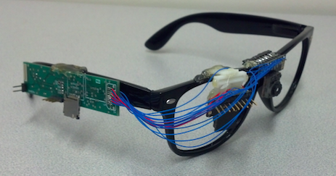
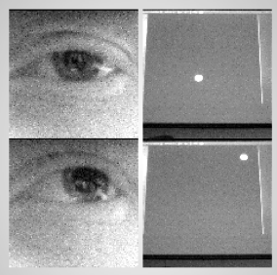
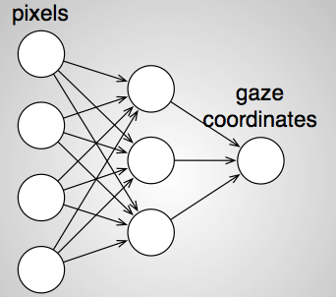
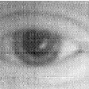
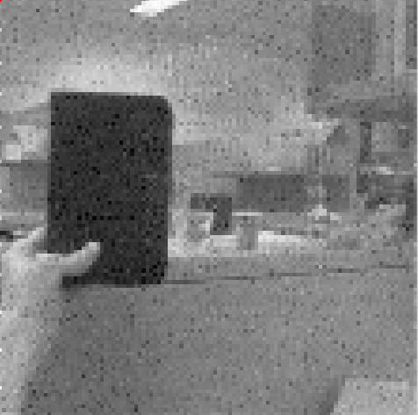
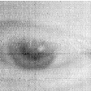
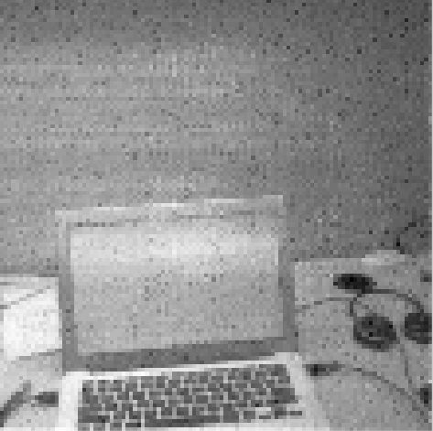
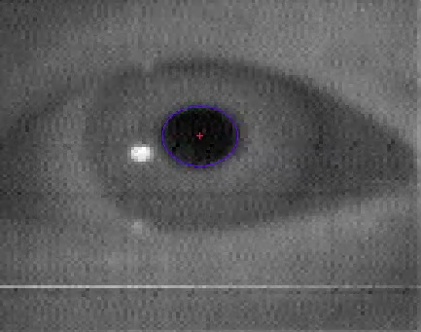
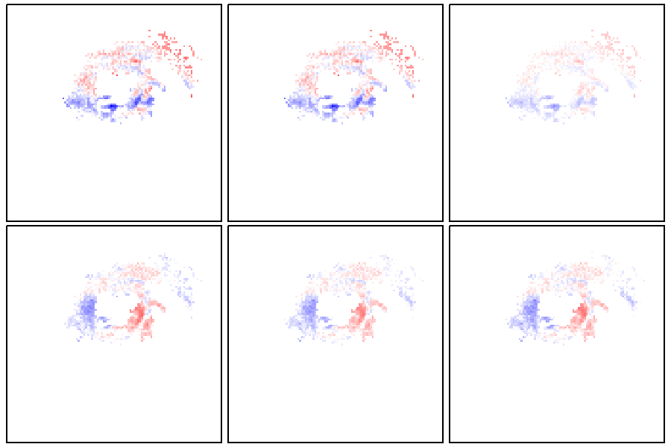
iShadow: The Computational Eyeglass
Addison Mayberry, Pan Hu, Christopher Salthouse, Benjamin Marlin, Deepak Ganesan
Introduction
iShadow Platform Prototype
The iShadow project aims to develop an end-to-end system that includes novel ultra-low power computational eyeglasses capable of detecting eye movement and features of the external environment. It will provide real-time sensing, processing, and inference capability. Using this system, we will be able to provide the fundamental knowledge base necessary to discover patterns of human behavior and to leverage such patterns to improve transportation and healthcare.
SD Storage
Eye-Facing Camera
Microprocessor (Hidden)
Environment Camera
Gaze Tracking System Pipeline
1. We collect training data of a subject’s eye following a dot on a monitor
2. We use image pixels as features to train a neural network model
3. The model parameters are loaded to the platform for live gaze prediction
Results
Pupil Dilation
By adding regularization to the neural network, we can control the number of pixels selected:
The regularization emphasizes pixels around the iris:
We can drastically reduce the number of pixels with low impact on accuracy, due to redundancy in the eye image:
Our camera provides a random-access pixel interface, allowing us to sample only the regularized pixels and thus conserve system power:
A person’s pupil can dilate in response to a number of factors, including level of cognition (e.g. problem solving) and substance use.
Using near-infrared light, which is invisible to the human eye, illuminates the pupil very clearly. This facilitates simple methods for tracking pupil position and dilation:
We are currently working towards integrating a pupil detection algorithm with the existing gaze tracking model.
Acknowledgements
Partial funding for the project came from the National Science Foundation, NSF Grants: 1239341, 1217606, and 1218586.
For further info on the Sensors Lab:
For information on current work in the Sensors Lab, visit
http://sensors.cs.umass.edu

