Slide 1
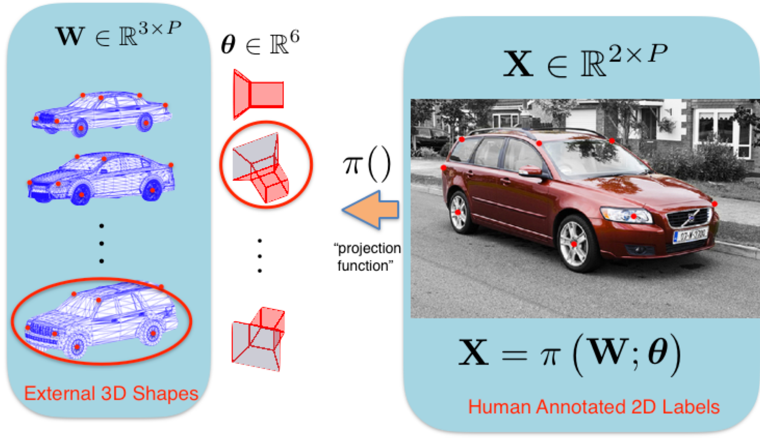
NRI: A New Paradigm for Geometric Reasoning through Structure from Category
PI: Laszlo A. Jeni, Carnegie Mellon University
Challenge
2D labels are cheap and easy to obtain, however, 3D labels are onerous; as they require association with an external 3D shape.
Broader Impact
Simplifying how 3D labels can be obtained will dramatically improve how robots and AIs can geometrically reason about the world.
Outputs to be integrated into a new course graduate level course on Geometry in Deep Learning for Robotics.
2022 NRI & FRR Principal Investigators' Meeting
April 19-21, 2022
Award ID#: 1925281

Slide 2
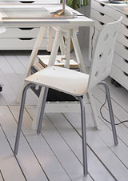
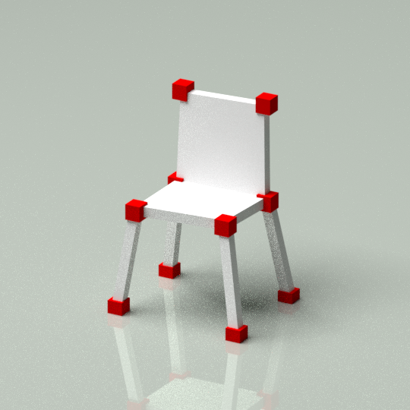
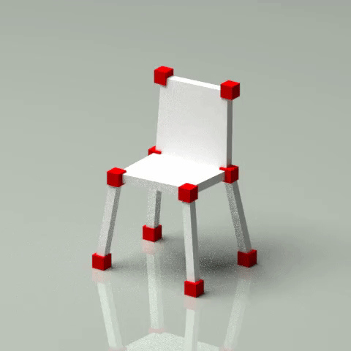
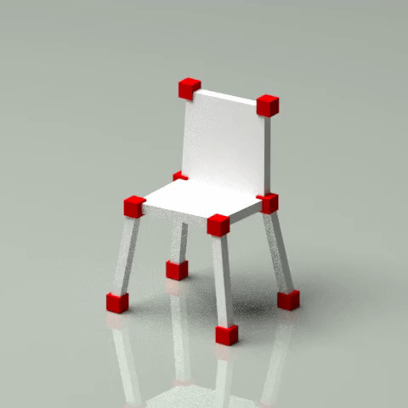
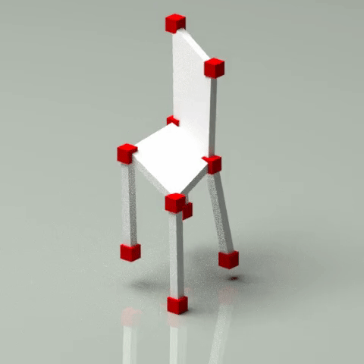
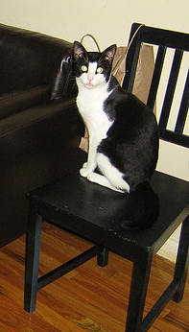
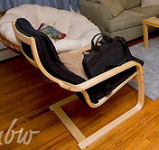
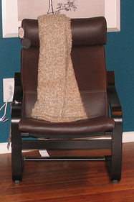
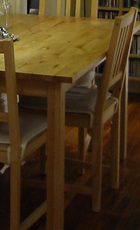
NRI: A New Paradigm for Geometric Reasoning through Structure from Category
PI: Laszlo A. Jeni, Carnegie Mellon University
Solution
To recover 3D labels solely from an ensemble of 2D landmarks stemming from the same object category (e.g. “chair”).
We propose to use something called “structure from category”; leveraging recent theoretical insights connecting deep learning to compressed sensing.
Ground-truth.
State-of-the-art
Our result.
Scientific Impact
Critical for innovations in autonomous transport, disaster relief, endangered species preservation, and space exploration.
2022 NRI & FRR Principal Investigators' Meeting
April 19-21, 2022
Award ID#: 1925281

