Slide 1
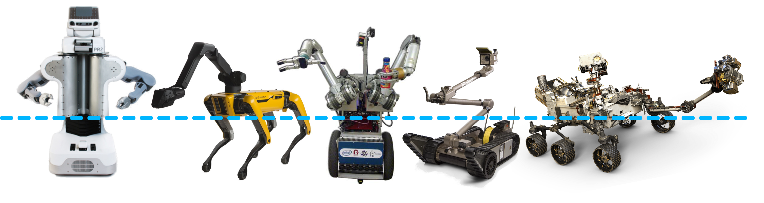




NRI: FND: COLLAB: Design of Dynamic Multibehavioral Robots new tools to consider design tradeoff and enable more capable robotic systems
Challenge:
How do we design a robot that is good at multiple behaviors?
Scientific Impact
The analytical and computational techniques we create will contribute toward establishing a systematic paradigm for robot design.
Most mobile manipulation systems are built by combining independent manipulation and locomotion system.
Solution
Lift reduced-order model performances to a common design parameter tradespace, then use techniques from Pareto optimization to navigate that tradespace.
Broader Impact
Design for multibehaviorality will help produce e.g. home assistance robots that must move and interact in human environments.
Integrated into teaching and outreach.
This project will study the relationship between design spaces and develop methods for navigating the tradeoffs between behaviors.
Prof Sam Burden, UW PI
University of Washington, Seattle
NSF Award #1924303, Sep 19 – Aug 22
Prof Aaron Johnson, CMU PI
Carnegie Mellon University
NSF Award #1924726, Sep 19 – Aug 22

Slide 2
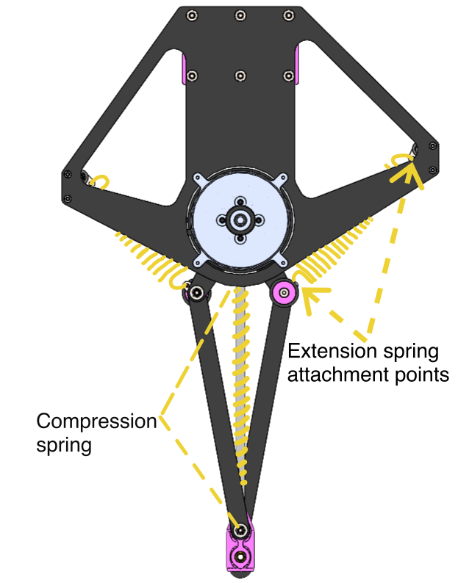
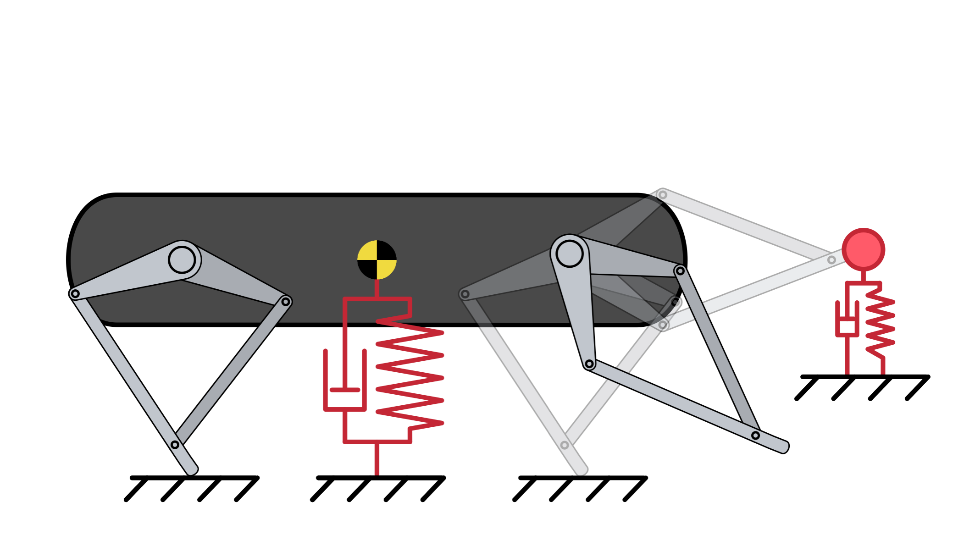
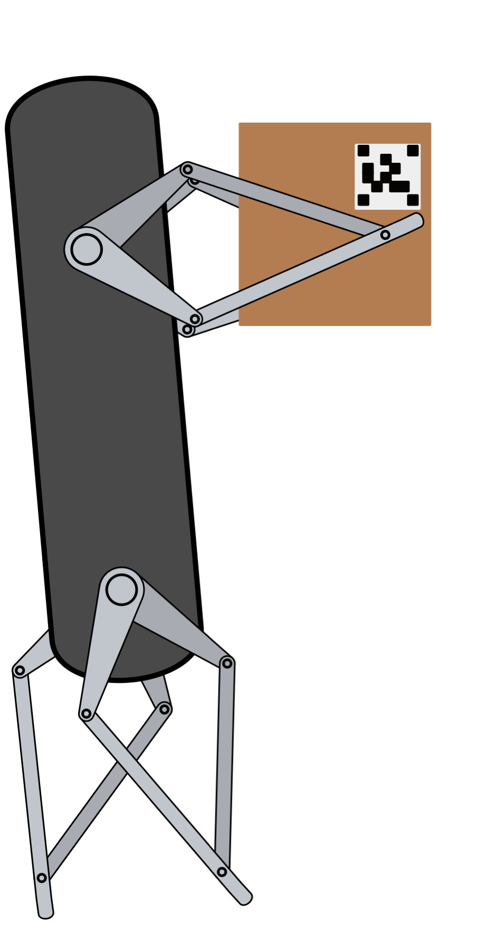
NRI: FND: COLLAB: Design of Dynamic Multibehavioral Robots new tools to consider design tradeoff and enable more capable robotic systems
Challenge:
How to design one robot for both locomotion and manipulation?
Solution:
Formulate dynamic behaviors as objective functions, solve multi-objective optimization problem involving design parameters, e.g. spring stiffness and geometry.
locomotion
manipulation
Prof Sam Burden, UW PI
University of Washington, Seattle
NSF Award #1924303, Sep 19 – Aug 22
Prof Aaron Johnson, CMU PI
Carnegie Mellon University
NSF Award #1924726, Sep 19 – Aug 22

Slide 3
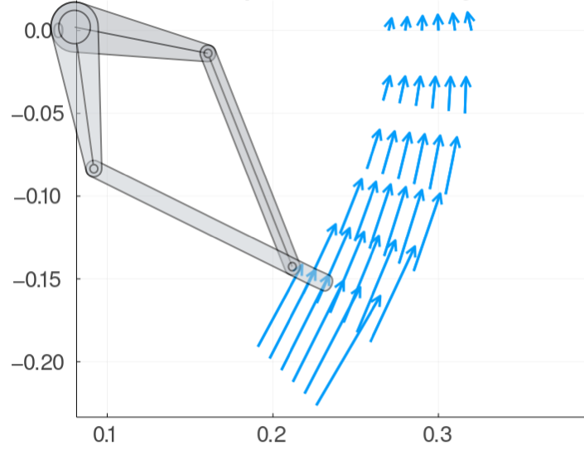
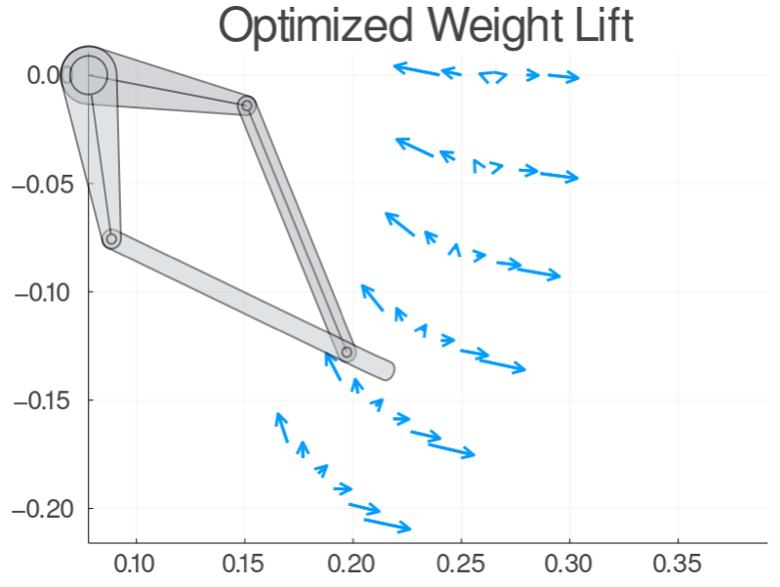
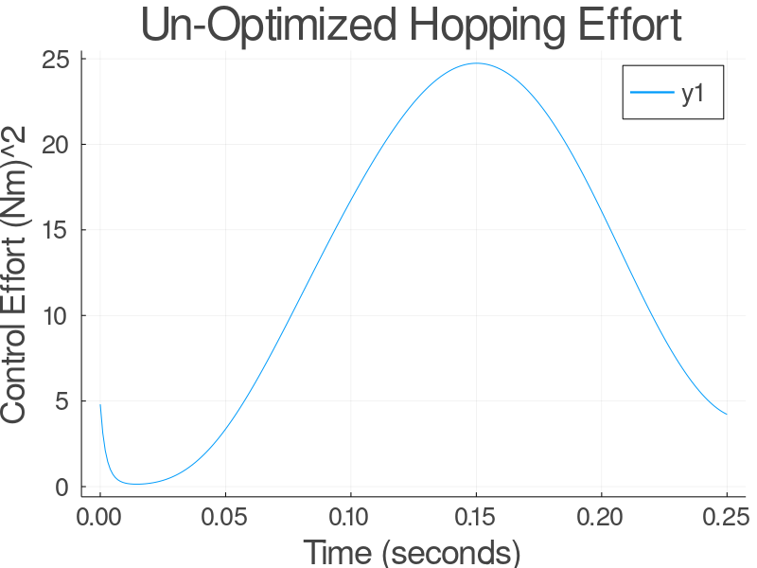
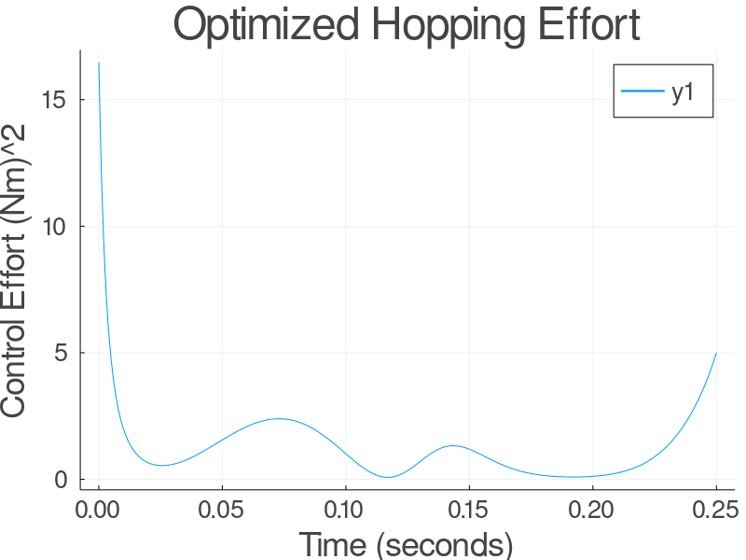
NRI: FND: COLLAB: Design of Dynamic Multibehavioral Robots new tools to consider design tradeoff and enable more capable robotic systems
Challenge:
How to design one robot for both locomotion and manipulation?
Results:
optimized design requires less effort for both locomotion and manipulation …
locomotion
manipulation
… and strictly (Pareto-)dominates optimal no-spring design for both behaviors
Prof Sam Burden, UW PI
University of Washington, Seattle
NSF Award #1924303, Sep 19 – Aug 22
Prof Aaron Johnson, CMU PI
Carnegie Mellon University
NSF Award #1924726, Sep 19 – Aug 22

