Slide 1


Jim Kurose, Assistant Director, Computer and Information Science and Engineering
Linda Blevins, Deputy Assistant Director, Engineering

Slide 2

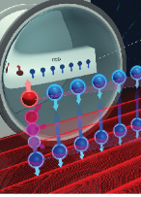



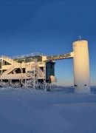
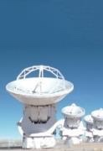

NSF “Big Research Ideas”
Work at the
Human-Technology
Frontier
Windows on the Universe
“ … bold questions that will drive NSF's long-term research agenda -- questions that will ensure future generations continue to reap the benefits of fundamental S&E research. ” F. Córdova, NSF Director
Quantum Leap
Harnessing the Data Revolution
Rules
of
Life
Navigating the New Arctic
new in FY19, with foundation set in FY 17, 18
convergence research
$30M/year per Idea, 5-year planning cycle, centrally and collaboratively managed
process research ideas: NSF INCLUDES, midscale research infrastructure, NSF 2026, growing convergence research

Slide 3


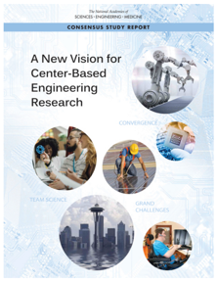
Convergence Accelerators
Accelerating Discovery through Convergence Research
time-limited entities: accelerating impactful convergence research in areas of national importance
separate from directorates in leadership, budget, and programmatics (but relying on, and building on foundational disciplinary research)
emphasis on translational research, partnerships
projects with clear goals, milestones, directed deliverables (e.g., 6-months)
more intentional, more directed management
mission-driven evaluation
HDR Convergence Accelerator
FW-HTF Convergence Accelerator
Future accelerator(s)
BIO
CISE
EHR
ENG
GEO
MPS
SBE

Slide 4
ENG builds and catalyzes partnerships
Basic research
Emerging Frontiers in Research and Innovation
Research infra-structure
Natural Hazards Engineering Research Infrastructure
Centers
Engineering Research Centers
Industry-University Cooperative Research Centers
Tech trans-lation
Partnerships for Innovation
Work-force prep
I-Corps™
INTERN
Notes:
Fundamental research by individuals and teams
Emerging Frontiers in Research and Innovation, with AFOSR
Research infrastructure
Natural Hazards Engineering Research Infrastructure, in support of National Earthquake Hazards Reduction Program (NEHRP)
Centers
Engineering Research Centers
Industry-University Cooperative Research Centers
Technology translation research
Partnerships for Innovation
Education and workforce preparation
Innovation Corps (I-Corps™), with the state of Ohio
INTERN

Slide 5



CISE Partnerships: Many dimensions
Partnerships build capacity, leverage resources, increase the speed of translation from discovery to innovation
Joint NSF/industry research solicitations: Intel (5), SRC (8), VMware (2), PAI(1)
Research infrastructure: PAWR: Platforms for Advanced Wireless Research, cloud credit for BIGDATA, (AWS, Google, Microsoft, IBM)
Individual project-based: I/UCRC, Intrans, GOALI
industry
universities
international
CISE
local gov’t
Federal
agencies
societal org’s
Prescription 3: Establishing a More Robust National Government-University-Industry Research Partnership

Slide 6
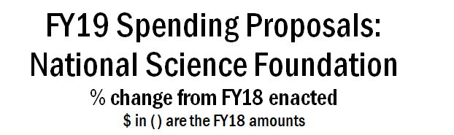
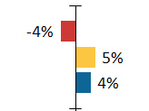
2019 Budget Process: underway
    NSF currently operating under a Continuing Resolution (CR) until Dec. 7, 2018
      NASA, NOAA, NIST also on CR
      DOD, DOE, NIH have FY19 budgets
Source: https://www.aip.org/fyi/

Slide 7

…. to our CISE and ENG CPS teams
…. to our AAAS Fellows
…. to our agency partners
…. to the Program Committee
…. to the CPS VO

