Slide 1
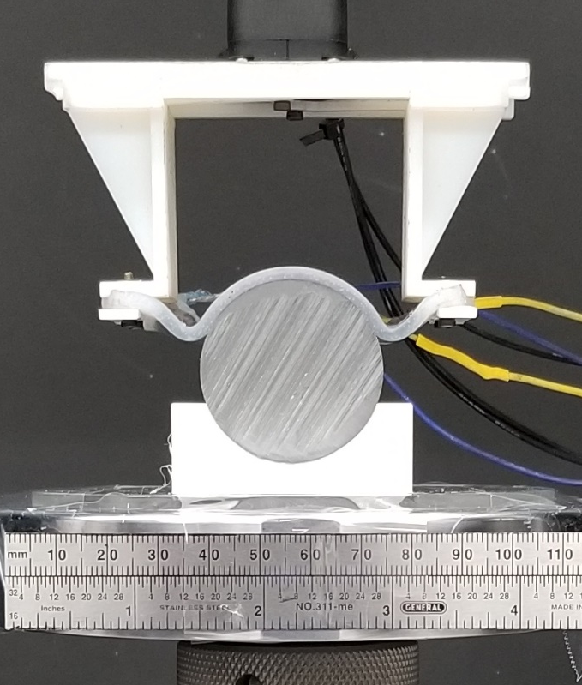
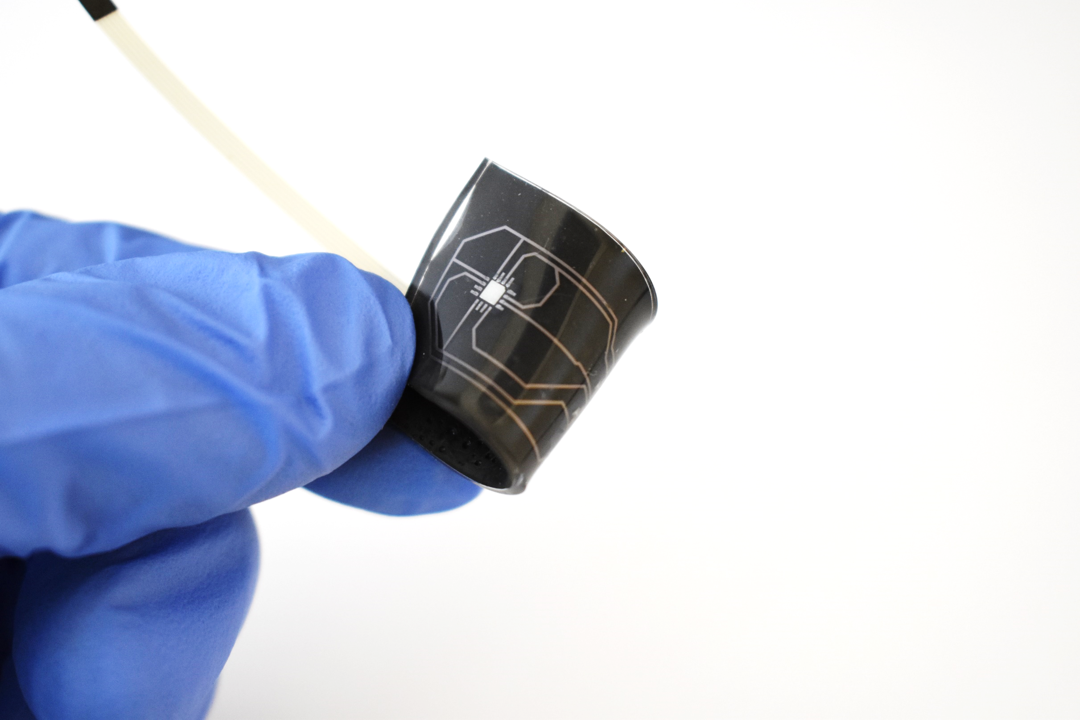
NRI:INT:COLLAB: Soft Active Contact Pads with Tunable Stiffness and Adhesion for Customizable Robotic Grasping
CMMI 1830362 • Carmel Majidi (CMU) • Kevin Turner (Penn) • Wanliang Shan (Syracuse)
CHALLENGE
Universal & Customizable Robot Grasping
Match the versatility of natural grippers in handling a wide variety of objects.
SOLUTIONS
Polymer composites that dynamically change modulus and adhesion in response to electrical stimulation
Soft robotic end effectors for grasping and manipulation
Sensing stickers for measuring interfacial forces

Slide 2
NRI:INT:COLLAB: Soft Active Contact Pads with Tunable Stiffness and Adhesion for Customizable Robotic Grasping
SCIENTIFIC IMPACT
Discovery of novel stiffness & adhesion tuning materials
Nasab, A.M., Sharifi, S., Chen, S., Jiao, Y. and Shan, W., Advanced Intelligent Systems, 2000166 (2020).
Computational Modeling of Soft Gripper Mechanics
Zhao, C., Chen, X., Shan, W. and Wan, K.T., International Journal of Solids and Structures, 236, p.111351 (2022).
Stabile, C.J., Levine, D.J., Iyer, G.M., Majidi, C., and Turner, K.T., IEEE RA-L (2022).

Slide 3
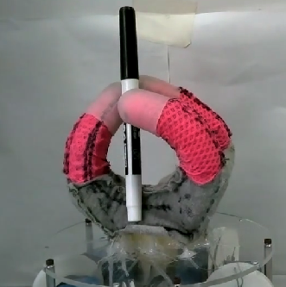
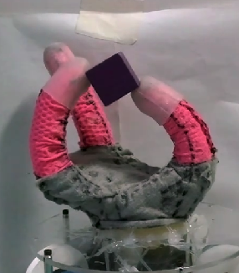
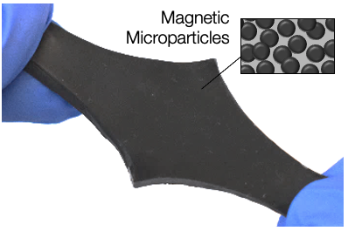
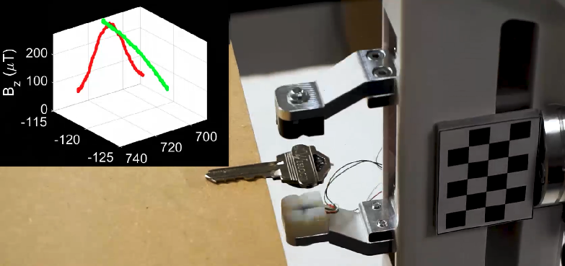
NRI:INT:COLLAB: Soft Active Contact Pads with Tunable Stiffness and Adhesion for Customizable Robotic Grasping
Soft Robot Gripper Implementations with Novel Material Architectures
Coulson, R., Stabile, C.J., Turner, K.T. and Majidi, C., Soft Robotics in press (2021).
Coulson, R., Li, C., Majidi, C. and Pollard, N. IEEE-RAS Humanoids (2021).
Luo, A., Pande, S.S., and Turner, K.T. Soft Robotics in press (2022).
Soft Magnetic Skin for Tactile Sensing and Grasp Detection
Hellebrekers, T., Zhang, K., Veloso, M., Kroemer, O. and Majidi, C., IEEE/RSJ IROS (2020).
Hellebrekers, T., Chang, N., Chin, K., Ford, M.J., Kroemer, O. and Majidi, C., IEEE RA-L, 5(3), 3892-3898 (2020).
Bhirangi, R., Hellebrekers, T., Majidi, C. and Gupta, A., Conference on Robot Learning (CoRL) (2021).

Slide 4
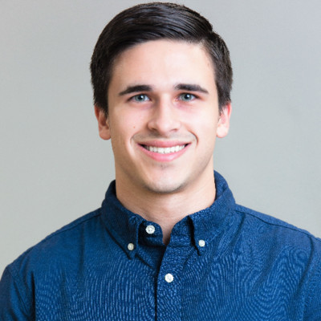
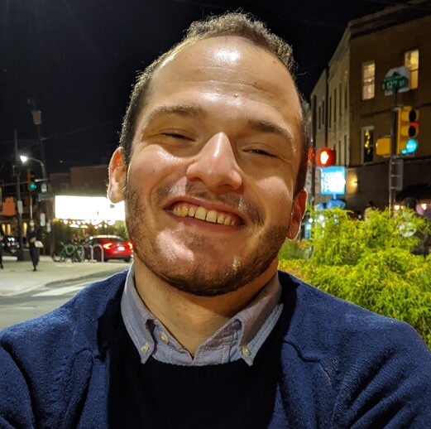
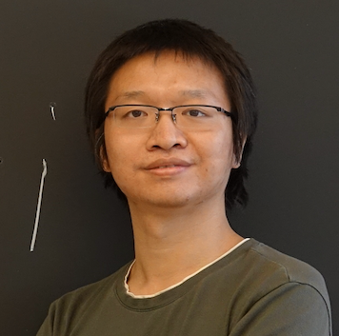
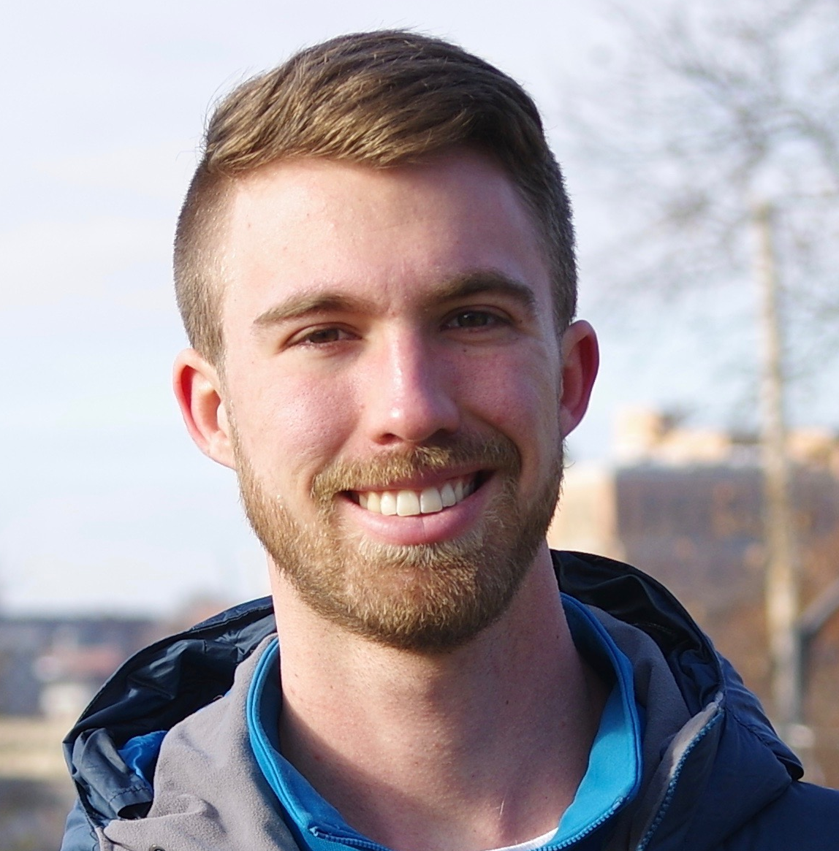
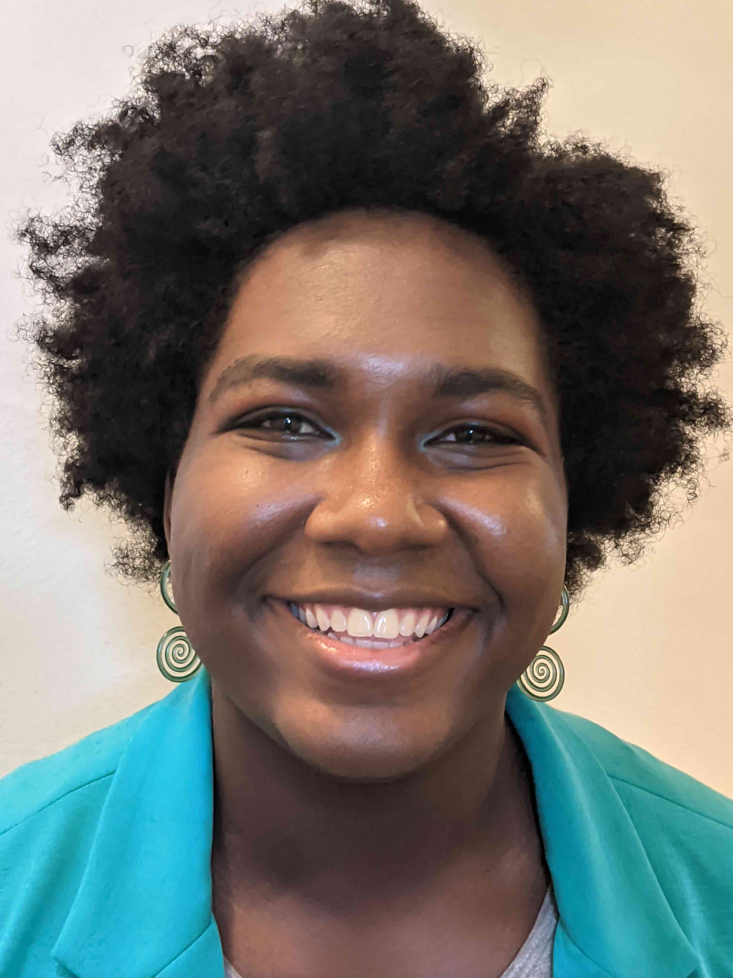
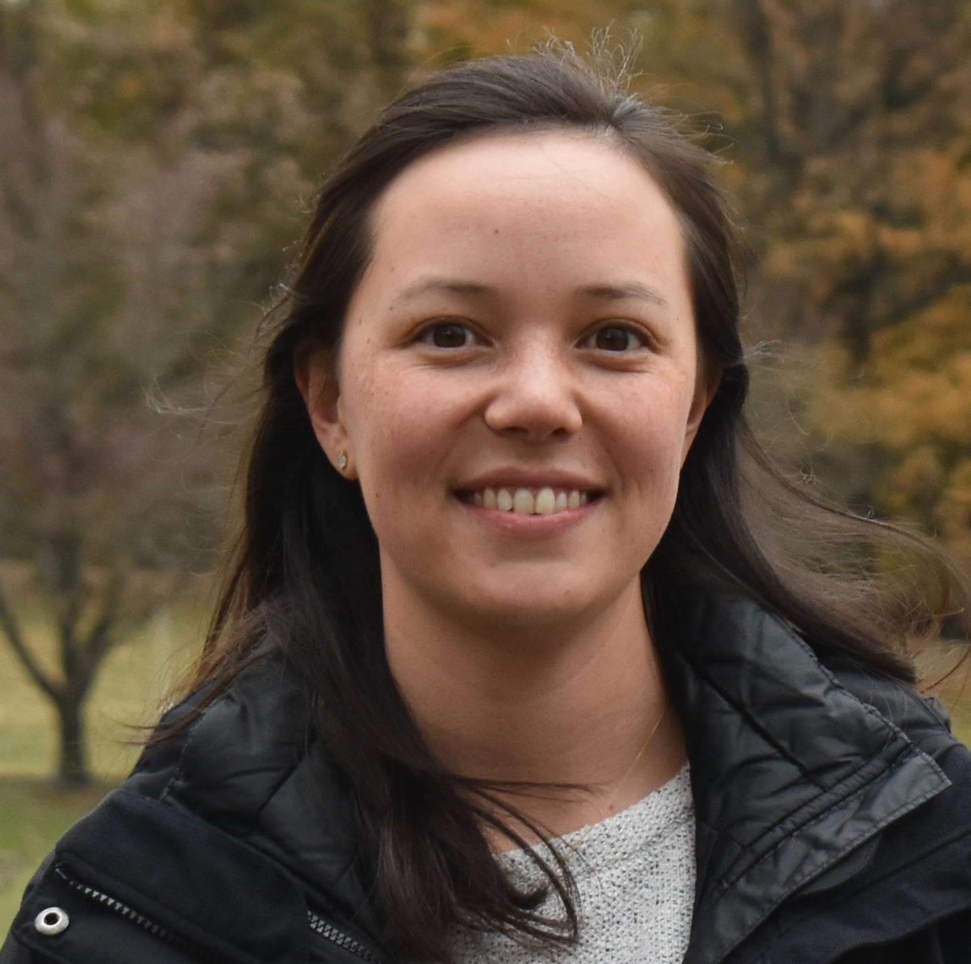
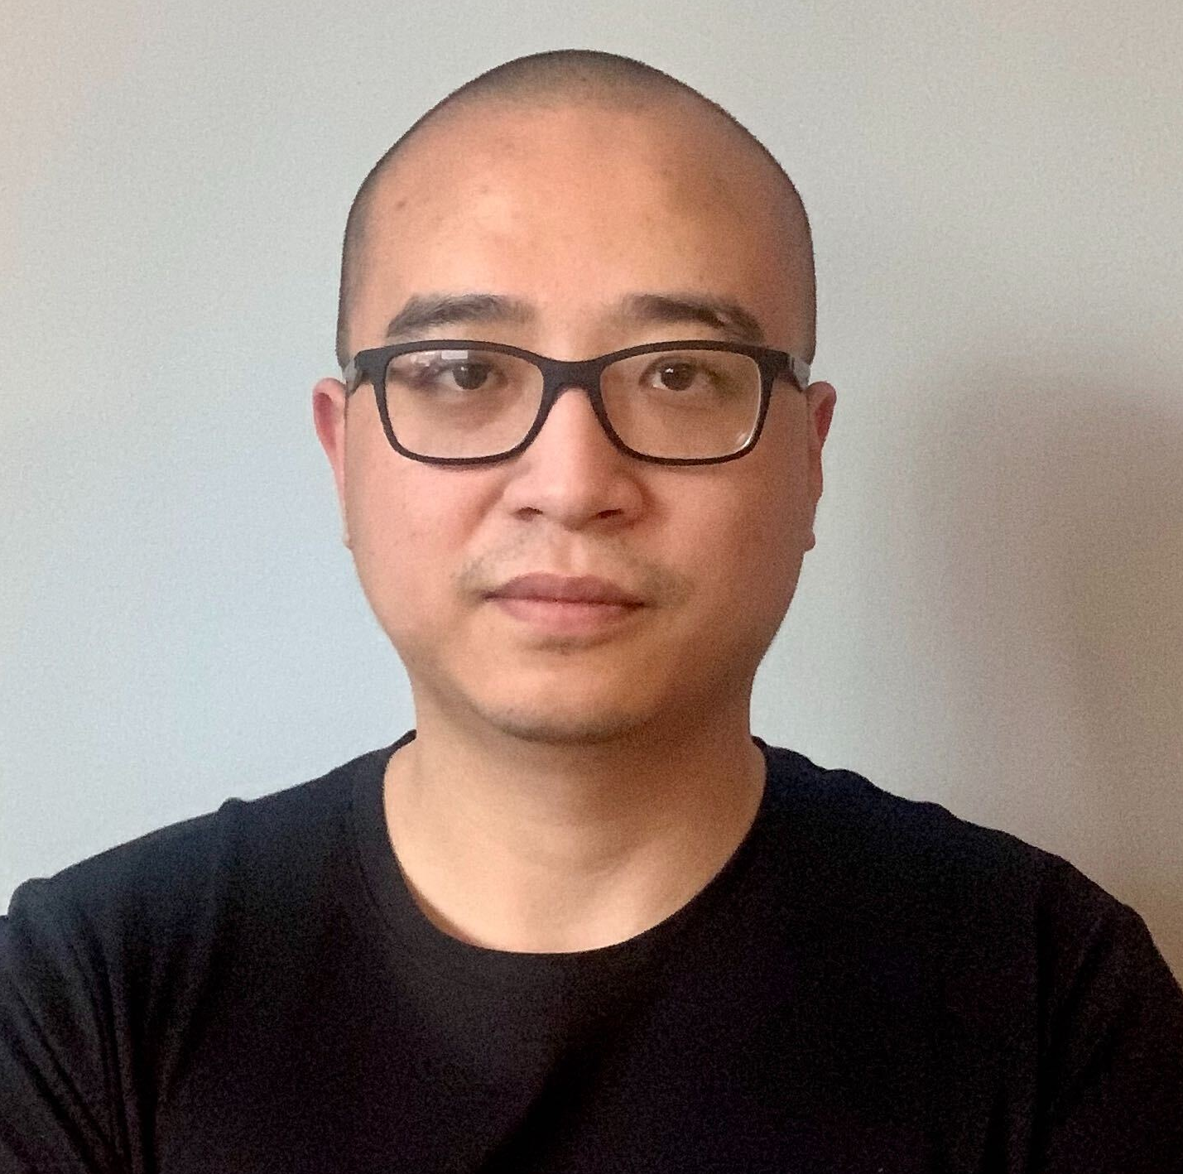
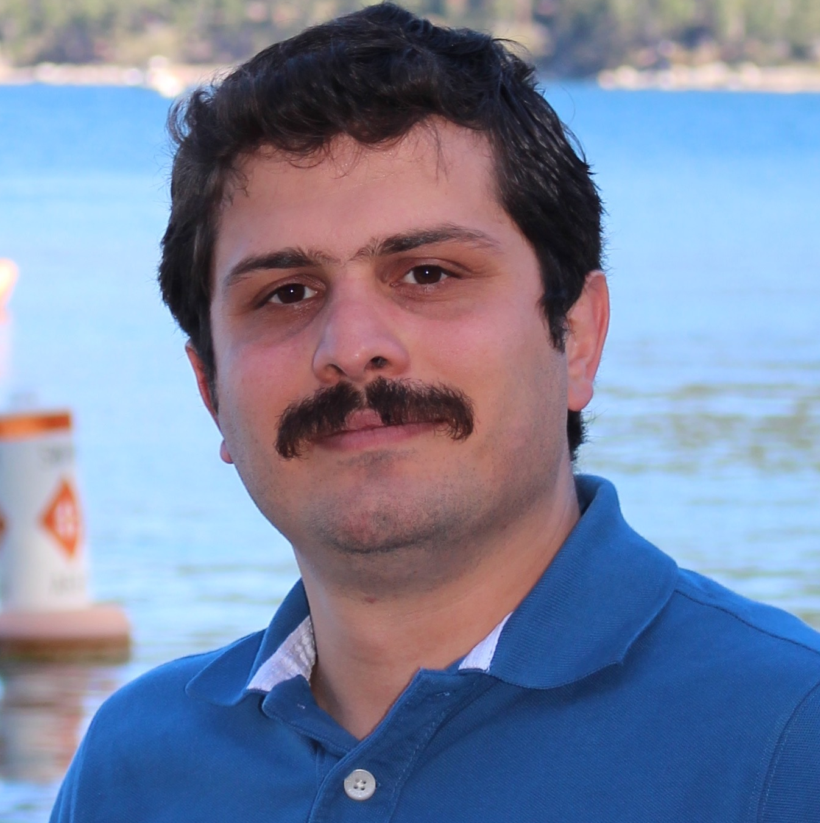
NRI:INT:COLLAB: Soft Active Contact Pads with Tunable Stiffness and Adhesion for Customizable Robotic Grasping
BROADER IMPACT
STEM educational outreach at CMU/Penn/SU
Graduate research training for PhDs and MS researchers
Current exploration of IP licensing and commercial translation of materials technologies with companies in robotics, healthcare, and prosthetics
Chris Stabile
David Levine
Aoyi Luo
Ryan Coulson
Kiyn Chin
Tess Hellebrekers
Chenxu Zhao
Amir Nasab

