Slide 1
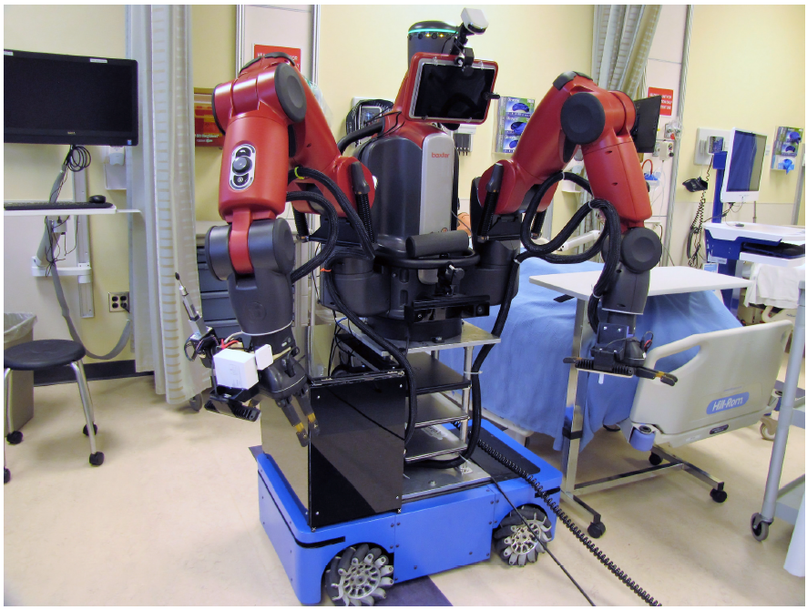
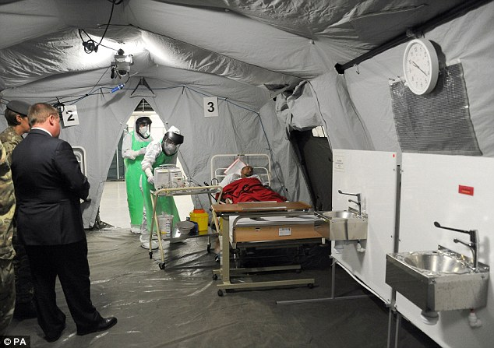
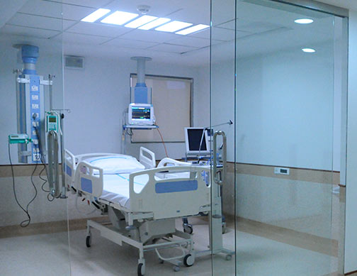
Customizing Semi-Autonomous Nursing Robots using Human Expertise
NRI #1830366 / #2025782
Kris Hauser (PI) Department of Computer Science Department of Electrical and Computer Engineering University of Illinois at Urbana-Champaign
Ryan Shaw (Co-PI) Department of Nursing Duke University

Slide 2
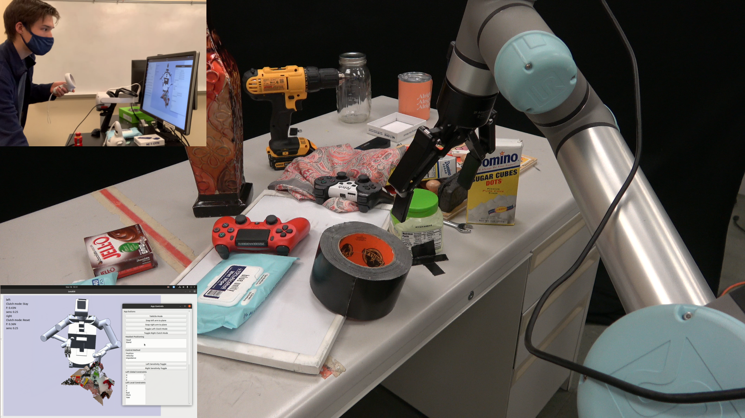
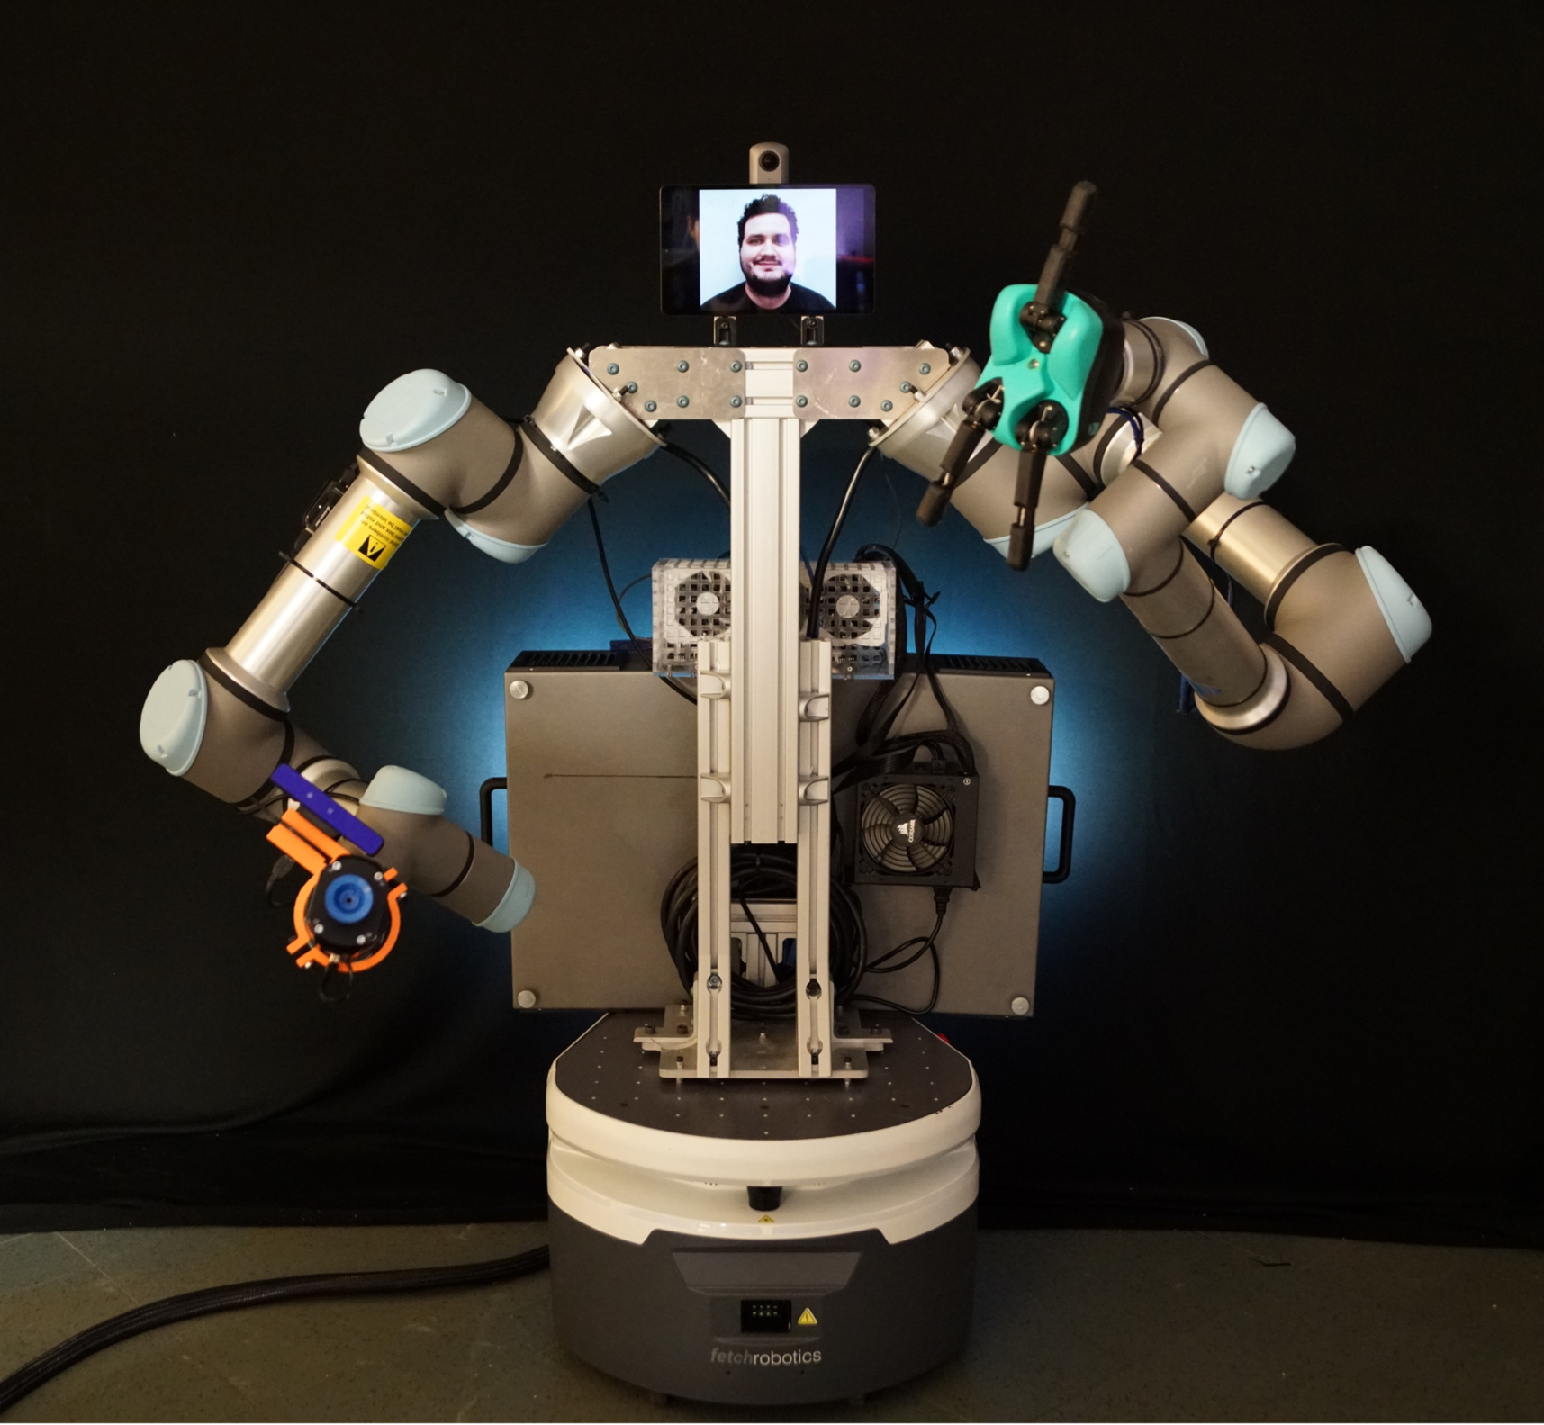
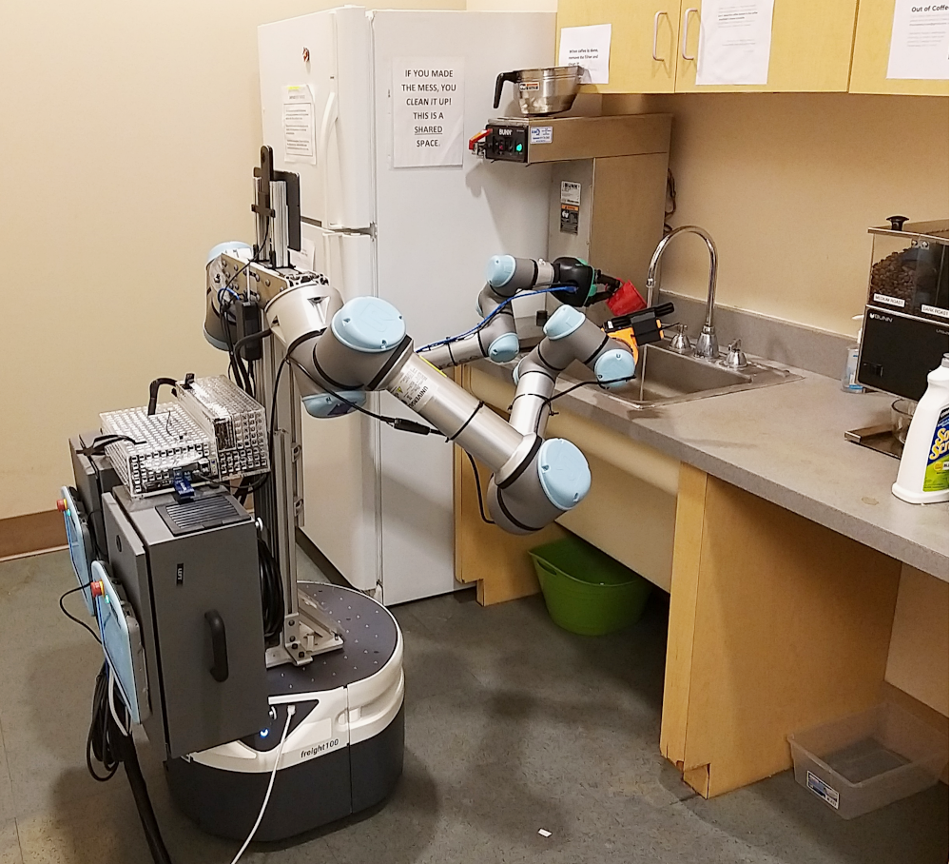
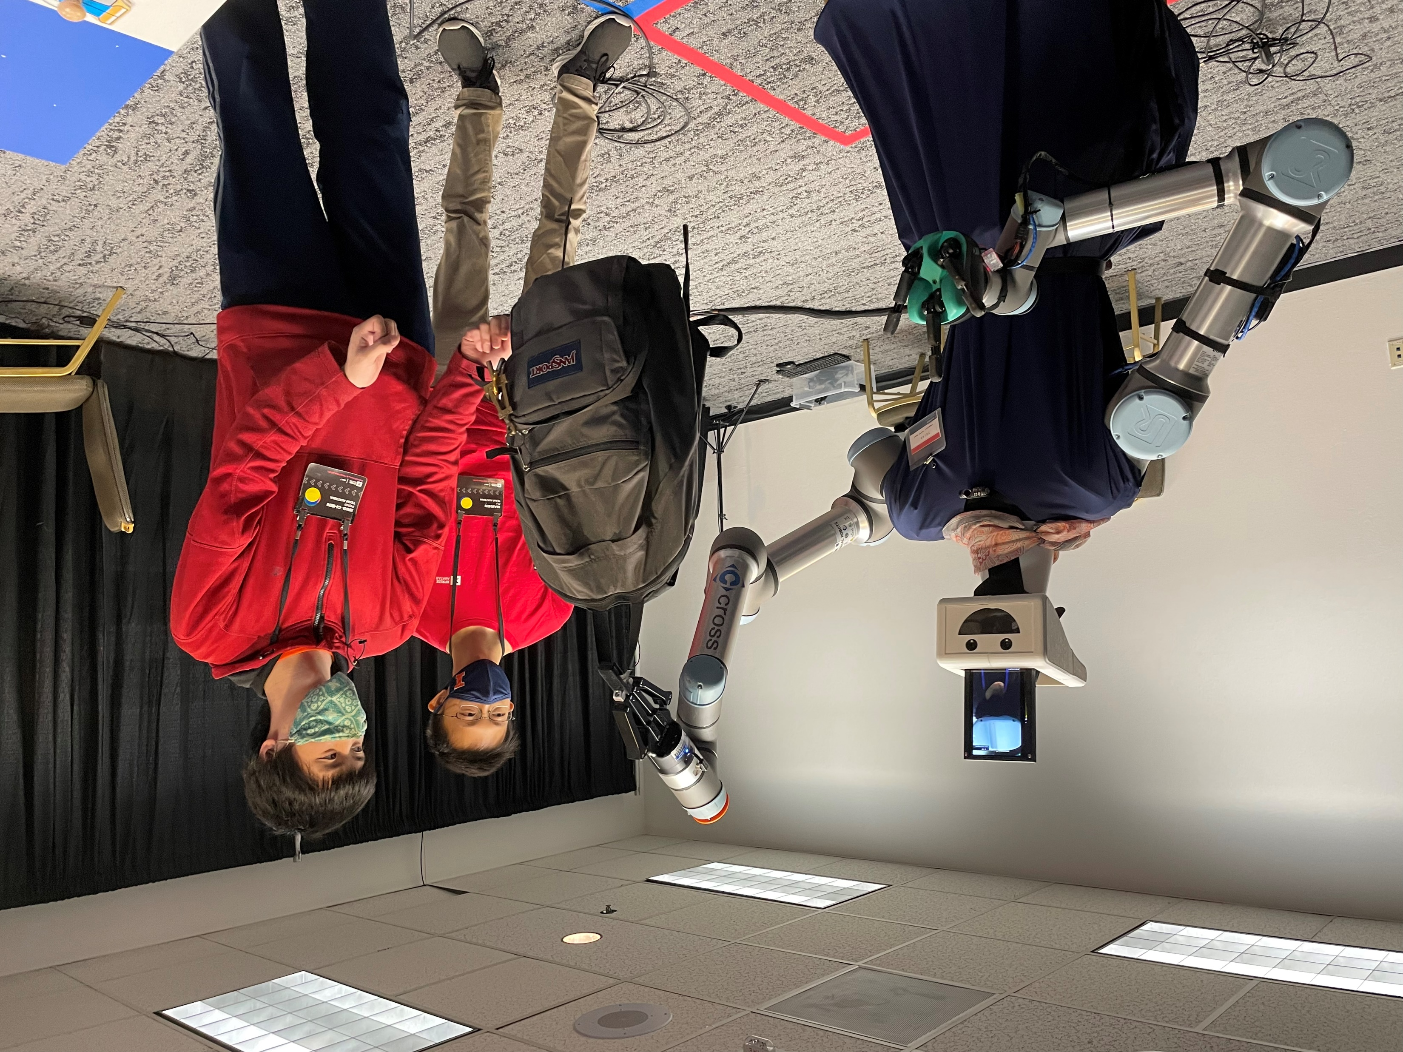
Current Progress
Intelligent User Interfaces with open-world perception
TRINA 2.0 hardware
Telepresence screen
360⁰ camera
Swappable end effectors
Stereo camera
Point-and-click teleoperation
Teleoperator assistance
Automating medical examinations
UR5 6DOF arms
Eye-in-hand RGBD cameras
Fetch Freight mobile base
Engaging undergraduates in research

Slide 3
Medical Consultation Scenario
Patient consultation with remote doctor
TRINA capabilities demonstrated
Operator/recipient communication
Navigation
Fine manipulation with motion scaling
Bimanual manipulation
Handover
Visual inspection
Stereo vision
Head movement tracking

Slide 4
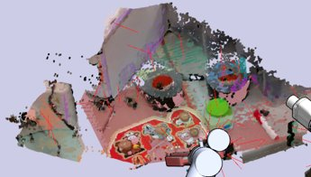
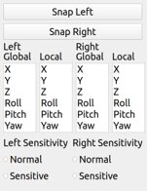
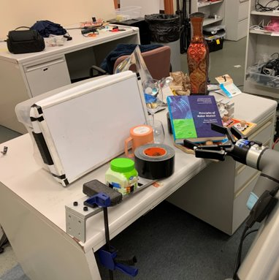
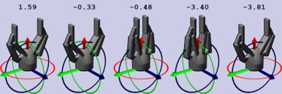
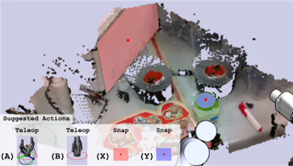
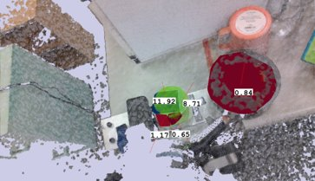
Teleoperator Assistance in Open Worlds
[P. Naughton and K. Hauser, Structured Action Prediction for Teleoperation in Open Worlds, IEEE Robotics and Automation Letters, 2022]
Classical menu-based UI
Perception: Label-free segmentation + attribute prediction
Prediction of k-most-likely actions from perception + history features using expert operator data
>90% accuracy in top-5 prediction across tasks
Teleop w/ cartesian constraint scores (max 1.6)
Expert Action Recommender
Intelligent UI
Snap-to plane scores (max 11.9)

Slide 5
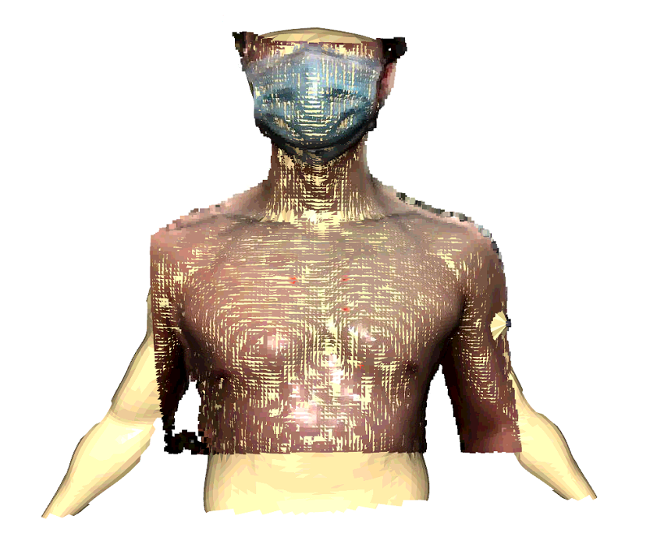
First Automated Auscultation
[Y. Zhu, A. Smith and K. Hauser, Automated Heart and Lung Auscultation in Robotic Physical Examinations, IEEE Robotics and Automation Letters, 2022]
Auscultation: using stethoscope to listen to heart and lung sounds
Use 3D vision to estimate reference anatomical landmarks
Probe at landmarks using digital stethoscope
Adjust locations if sound quality is poor (nonparametric Bayesian inference + informative path planning)
Send audio to doctor for interpretation
Anatomical model / auscultation locations registered to patient scan
Experiments on N=4 male subjects
Our approach has higher quality than registration only
Similar quality and faster than robot teleoperated by med student

Slide 6
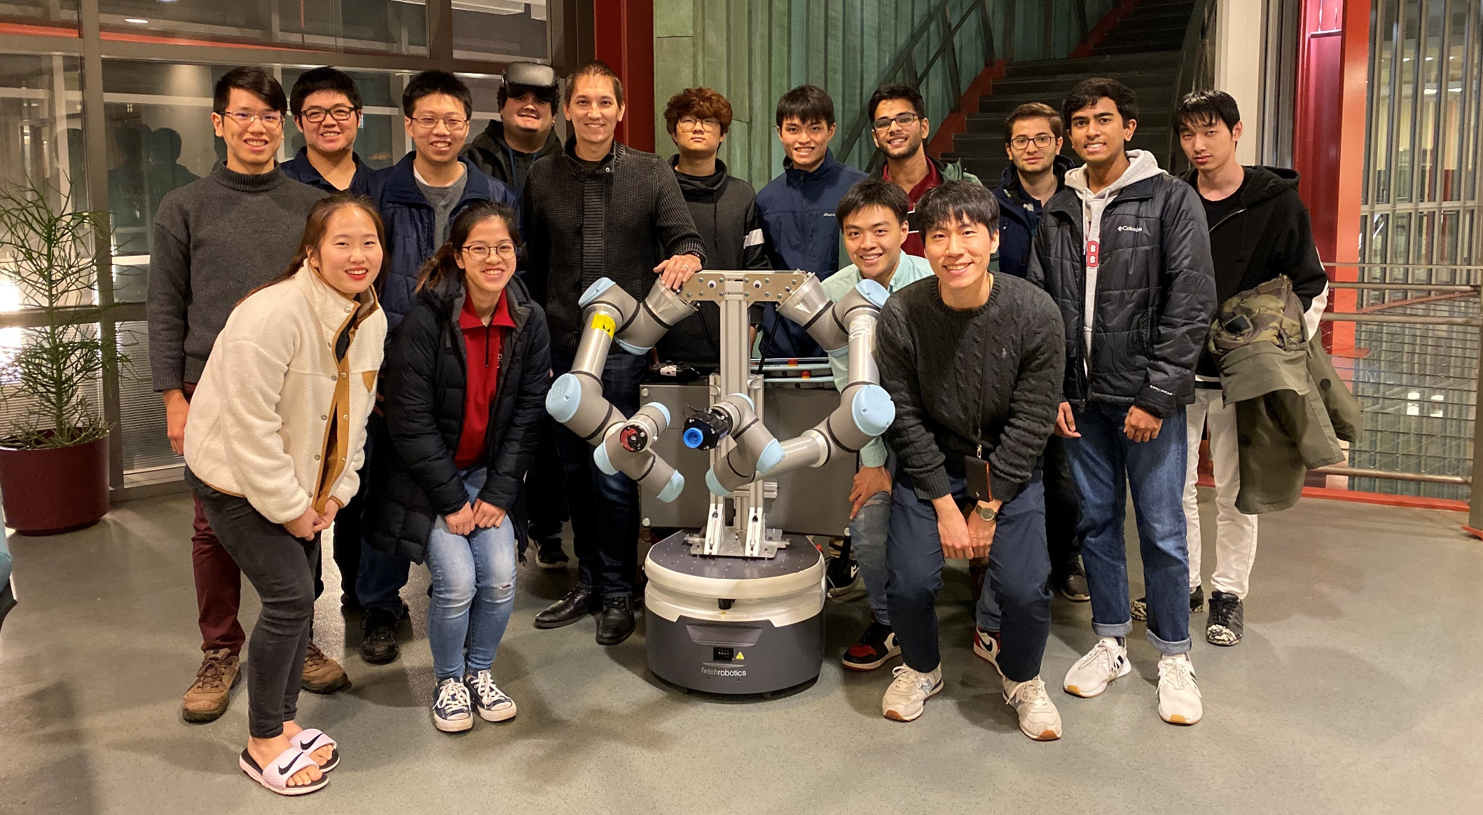
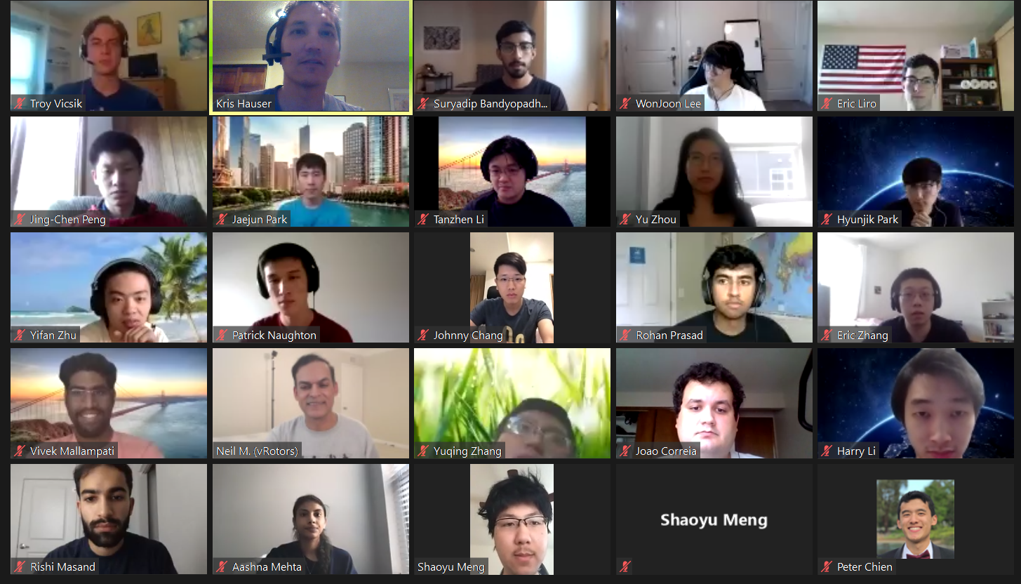
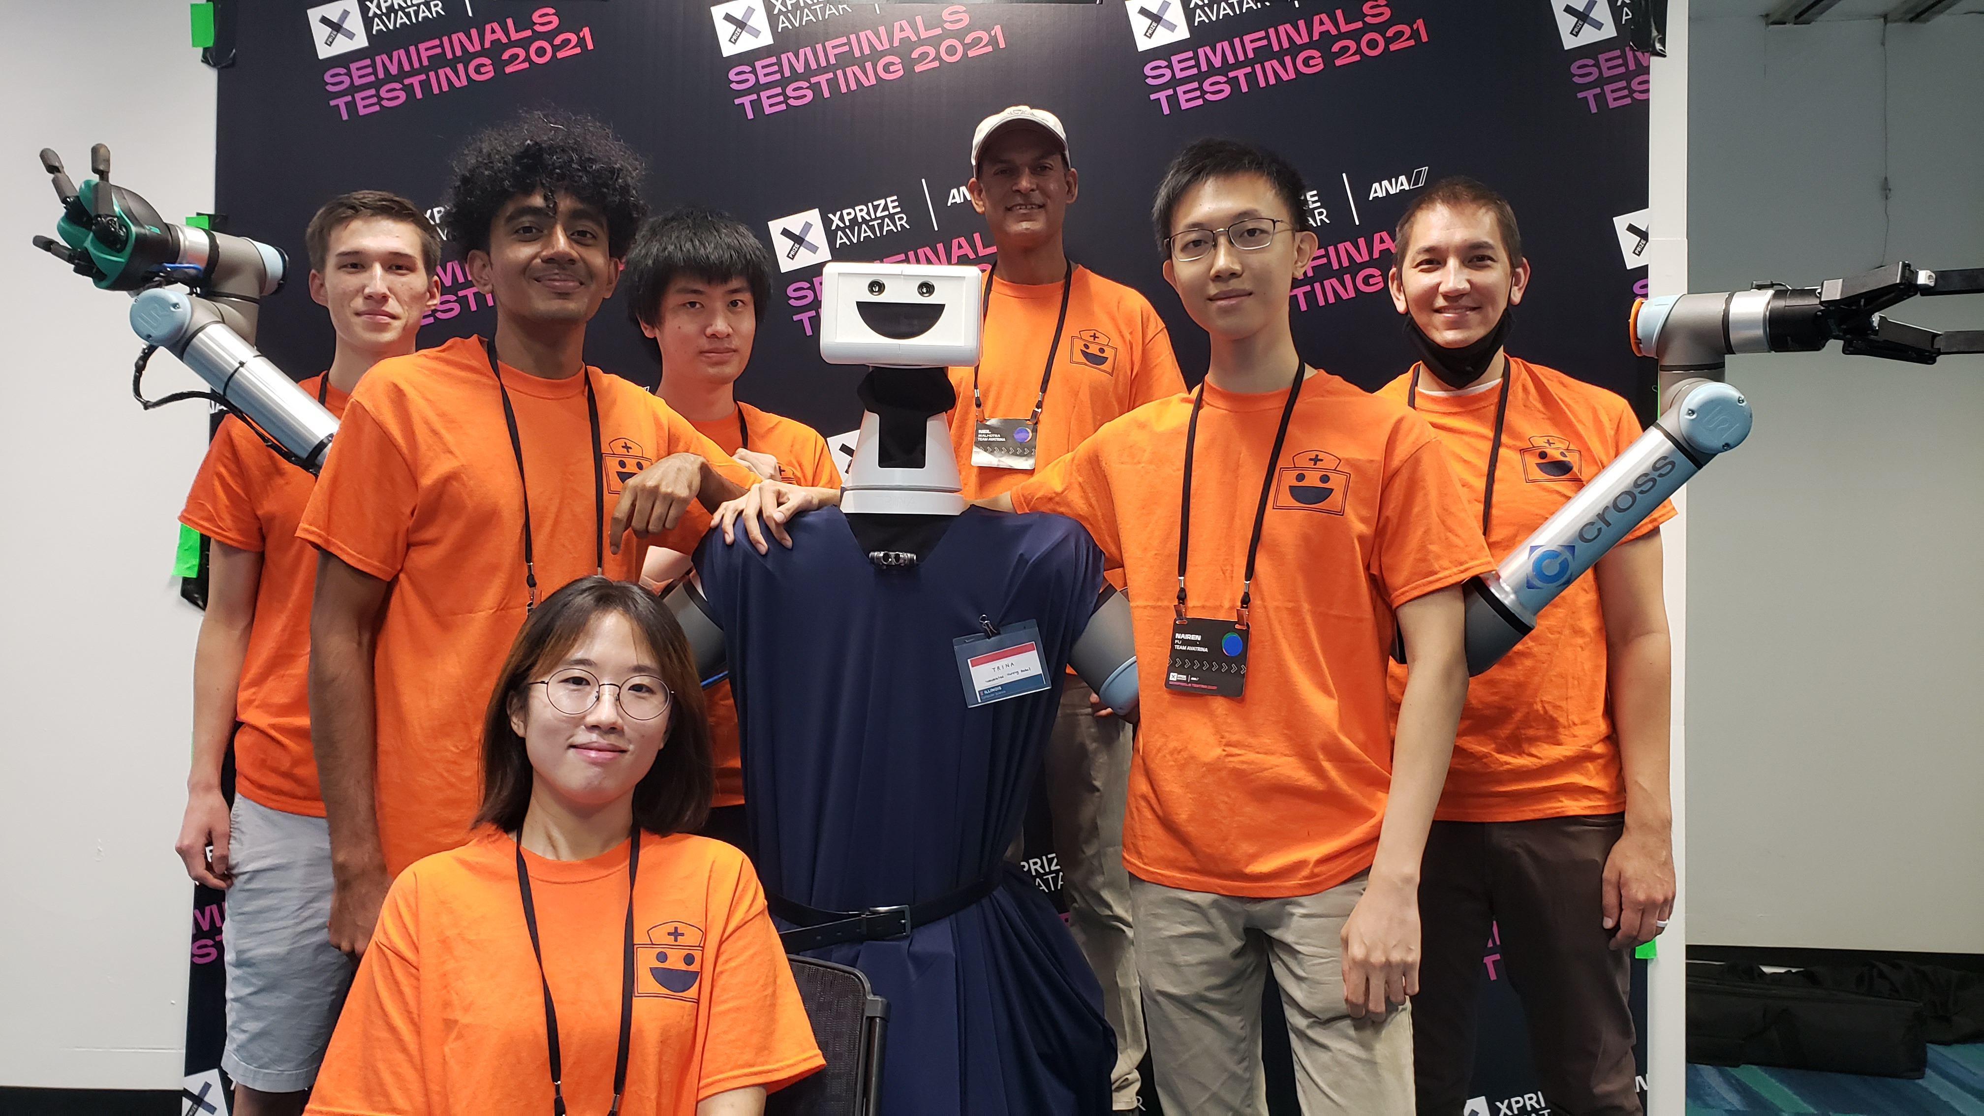
Next up
Scaling up Intelligent UI to dozens of actions
User studies with Registered Nurses @ Duke
ANA Avatar XPRIZE Finals

